Slide 1
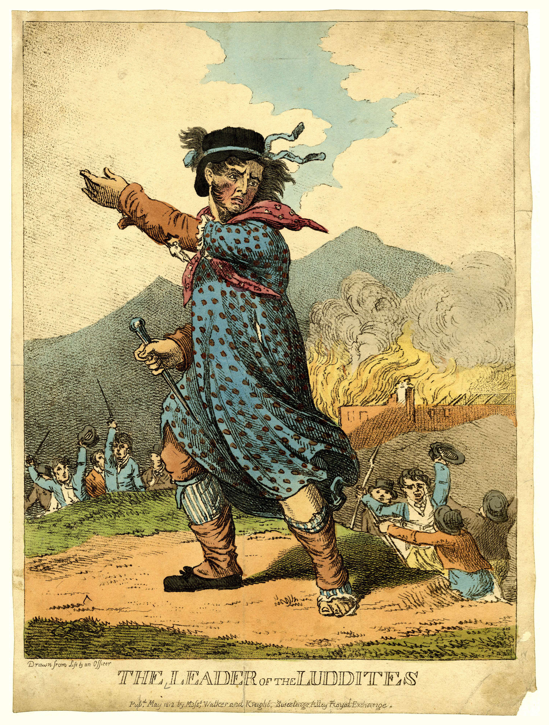
SG2 : ‘Building the case against the pressure for continuous online language learning.’
NATO BILC Conference
Loreto, Italy
26 May 22

Slide 2
Standing on the shoulders of giants:
Scott Manuel (Sweden)
Dugald Sturges (Germany)
Ana Carina Lagares Overgaa (Spain)
Dr Chris Loreck (Germany)
Stefan Geneva (Bulgaria)
Order Bostanci (Turkey)
Tadeja Hafner (Slovenia)
Gilberto Petrine (Italy)
Robbie Breen (Italy)
Angela Logue (Italy)
Matt Sharp (UK)

Slide 3
Context
Topical and contentious question (‘pressure’) in context of:
Emerging from the ‘forcing function’ of Covid 19 but also set in wider sociological context of the Information Age.
Widespread organisational investment to increase remote access & some associated increase in skills (example UK MoD saw 2000% increase in access to a personal laptop and VPN network access)
Unsurprisingly, questions emerge of efficiency/ effectiveness. Has ‘Sweat the metal’ become ‘sweat the silicon chip’ ?
SG2 members reflecting on earlier presentations particularly thoughts from Troy (BYU) & Kryzysztof Wolak ( Poland)
SG2 members recognised that this should not be a binary position - language learning professionals are able to position themselves to offer advice in support of evidence-based decision making.
SG2 members reflections on pre, during & post pandemic experiences.

Slide 4
Pros and Cons
Manifold and considered in relation to the degree of benefit/shortfall against elements that language learning professionals know either aid or hinder learning outcomes sought. These also span learner centric, tutor centric and capability centric pros and cons including but not limited to:
Degree of Interaction (Tutor)
Degree of Interaction (Other learners and learner agents)
Degree of learning support
Degree of technical ability
Degree of flexibility and customisation
Degree of suitability at scale
Degree of learner convenience & accessibility
Degree of organisational assurance and standardisation
Degree of motivation, stimulation
Degree of immersion
Degree of transferability
Degree and extent of resource availability
Degree of augmentation
ADD YOUR OWN REFLECTION & EXPERIENCE HERE AND KEEP ABREAST OF SYSTEMATIC RESEARCH

Slide 5
Ideas to shape optimum outcomes:
Aim for objectivity in reflection - When considering pre-pandemic status weigh whether there were ever ‘perfect’ students/teachers/requirements/courses/assessments?
Speak truth to power ….but consider if describing the problems is like taking a picture of all the piles of detritus at a mountain’s base camp, then perhaps specifying the optimum outcomes is like looking at a picture from the summit.
Use management tools – Review change management models and revisit desired outcomes. Revisit methods and media analysis noting that C19 reactivity offers opportunity for proactive planning.
Seek out stakeholder views - Establish if there are any change to the end user risk appetite when weighing any faster/cheaper/better dynamics.
Switch on longer range radar – A matter of appropriate professional interest would be to reflect with colleagues on the state an use of language learning technology in 2012 and project to language learning technology in 2032.
Look after the team – run student and staff technical skills audit and support plan – room to be sensitive, as a culture of inclusivity includes supporting technical skill. Of Generation X teachers and learners who may be teaching and learning alongside Generation Z
Seek a clear linkage to any national and departmental language capability strategy. Take the opportunity to capture a systematic and wholistic approach that appear as ends with associated ways and means.

Slide 6
How not to handle it…..
Between 1811-1816, during the period of the UK’s Industrial Revolution, a group led by a weaver named Ned Ludd (pictured left) formed, grew and named itself the Luddites.
Luddites believed their very way of life was under threat from industrialisation and that their hard earned knowledge and skills were being undermined. They resorted to sabotaging industrial equipment and as a result faced charges of criminal damage.
At one point there were more British soldiers fighting Luddites than there were deployed to Spain and Portugal in the war with Napoleonic France.
Whilst punishments varied, in a significant number of convicted Luddites were subject to ‘Transportation’ – forced and permanent re-location to then colonies ….. Both Australia and North America.

