Slide 1
Basic Course Assessment Needs Analysis
Dr. Robert Savukinas
Detlev Kesten

Slide 2
Required knowledge and skills
Curriculum design
Assessment

Slide 3
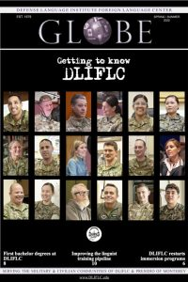
Background & Goal
DLIFLC Command Guidance for FY 2023: “Standardize course tests across language programs (36, 48, 64 weeks programs).”
Evaluate the current status of in-course assessment in seven major BC programs (AD, CM, KP, PF, RU, FR, QB) and identify the areas that require standardization.

Slide 4
Procedure
Conducted a two-step needs analysis
Identified commonalities and differences in course assessment of the seven programs, focusing on unit tests (a collection of test information from UCAT, a review of each program’s syllabus, verification with each program)
Conducted the BC faculty and student survey to gauge their perception and opinion of current unit tests

Slide 5
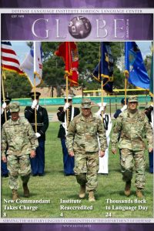
Major differences
Availability of proficiency tests
Frequency of unit tests
The number of grading scales
Grade weights
GPA components
GPA interpretation

Slide 6
Unit Test Design
Commonalties
differences
A separate assessment of each modality (LC, RC, SP)
An increasing portion of items that ask students to identify essential elements of information throughout the program (a smaller portion of grammar and vocabulary items)
Inclusion of grammar/vocab items
Use of various response formats
Inclusion of authentic materials
The number of total items and points

Slide 7
Overall Survey Findings
Respondents: 210 faculty members and 230 students
Faculty: neutral opinion of unit tests (M = 3.43)
Students: positive opinion of unit tests (M = 3.72)
Varying degree of satisfaction with unit tests across the programs
- AD/RU faculty and students are the least satisfied overall
- AD faculty (M = 3.38) and students (M = 3.60)
- RU faculty (M = 3.28) and students (M = 3.65)

Slide 8
Consistent issues across the programs
Correspondence in difficulty between class and test materials
Fairness of grading scales
Availability of grading information across the programs
Usefulness of test results in identifying students’ learning gaps
Washback effect on class instruction and learning
Test item quality

Slide 9
Next steps for standardization
Design the universal test master plan for BC programs (36, 48, and 64 weeks)
Develop the test framework and test blueprints for unit test design and implementation
Write a test development manual
Develop targeted training

Slide 10
Q & A www.dliflc.edu

