Slide 2
The mystery of level 4
Testing native speakers?
Considerations on Level 4 testing in ACO and implications on recruitment policy
Michael Adubato
Besa Hashani
Language Evaluators
SLTC (SHAPE Language Testing Center)
NATO

Slide 3
Why open Pandora’s box?
How do we build our case?
The need to bring NATO-relevant evidence

Slide 4
Why open Pandora’s box?
How do we build our case?
The need to bring NATO-relevant evidence

Slide 5
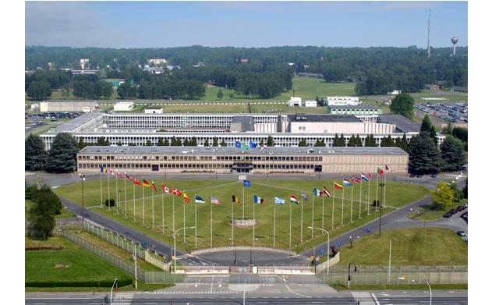
Context of testing at SHAPE
Mostly level 3
Mostly level 3
And sometimes level 4
➔ 900% increase in posts

Slide 6
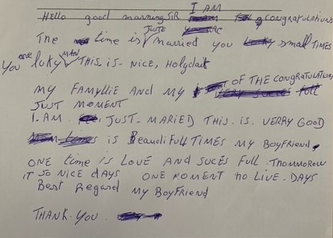
We should
definitely test
NNSs…

Slide 7
ACO civilian recruitment policy:
NSs exempted
Notes:
Anecdote of the Belgian historian whose first language is French, but who has taught in British unis and written academic books in English…

Slide 8
Frustration of NNSs
As regards the language proficiency, I was 4443 before my appointment in SHAPE (see ‘language proficiency 2015’) and I am 4444 since 2018 (see ‘language proficiency’). Also, I ranked first with SHL assessment (6 hours of evaluation in English + 3 hours of online testing, also in English) among the three short-listed for an A5 position within NCI Agency (see the debrief assessment report). Also, I am native speaker in one of the 2 official languages in NATO. Anyway, if these guarantees are not deemed sufficient, I am absolutely willing to undertake a test, but again on a reasonable notice. Thank you very much for your understanding.
Notes:
High-stakes test:
disqualification from the recruitment process
native speakers have an advantage from the start
Frustration of NNSs that feel discriminated against → that’s what triggered our thought process

Slide 9
Should all candidates be tested when it comes to L4?

Slide 10
Opinions from the BILC community…
“Hm, makes you wonder. My uncle Bill was an engineer, senior project manager at NASA. Very smart guy but a quadruple 4 he was not. Anecdotally speaking, of course.”
“This is clearly a high-stakes job, for which there is a standard of English required. Therefore, in my view, all applicants, irrespective of their linguistic heritage, should be tested, with no waiver for NSs.”
NS ≠ level 4
Notes:
Being NS does not entail level 4 proficiency. First quote: education does not automatically lead to level 4 proficiency.

Slide 11
“Native speakers are not exempt in Germany – I have often tested English/German bilinguals. Including a few where English was the first language. They still required a STANAG rating for NATO postings.”
Some nations already do it

Slide 12
“I’ve heard it said that at 3+ levels, STANAG language testing is more of an intelligence test than a language test. With that in mind, then I’d say test them all, but then that would be abusing the test. […] Perhaps a separate, shorter communicative competency test should be developed for native speakers.”
Is level 4 still a proficiency level?

Slide 13
“Over many years, I met many Brits who would struggle to achieve SLP 4 level, especially in writing! But then again, I’m impressed that you can test to SLP 4 level! Only a handful of jobs really require SLP 4. If you start testing all candidates in the interests of fairness and Brits fail, it would highlight the problem of demanding SLP 4 for posts.”
Test native speakers and see how (well) they perform
Notes:
Difficulty changing language levels in job descriptions. However, we could still try to influence policy regarding language testing for recruitment. → short study to see how NS and NNS perform

Slide 14
“All good points which convince me even more that moving away from (or getting rid of) the native speaker construct, is fundamental to achieving language proficiency fairness.”
“Can of worms that gets opened occasionally but then resealed. Where to begin when we say ‘native speaker?’ To rephrase, test them all and let HR sort them out.”
What is a ‘native speaker’?
Notes:
Level 4 testing leads to plenty of questions which remain difficult to answer for the most part
Yet, we need answers to influence policy

Slide 15
Yes,
we should!
NS ≠ level 4
What is a ‘native speaker’?
Is level 4 still a proficiency level?
Some nations already do it
Notes:
To sum up… YES!

Slide 16
Why open Pandora’s box?
How do we build our case?
The need to bring NATO-relevant evidence
Definitions of
“native speaker”
STANAG 6001 level 4 (writing)

Slide 17
2.1 What is a ‘native speaker’?
Dictionary definitions
“[…] someone who has spoken a particular language since they were a baby, rather than having learned it as a child or adult”
(Cambridge)
“A native speaker of a language is someone who speaks that language as their first language rather than having learned it as a foreign language.”
(Collins)
“[…] a person who learned to speak the language of the place where he or she was born as a child rather than learning it as a foreign language”
(Merriam-Webster)
Native speaker // age of language acquisition
Our emphasis
Notes:
What the opinions have foregrounded is that the commonly accepted definition of a ‘native speaker’ is that of a person born in or from a certain country and de facto having assimilated its language at a very young age. This definition is the one that is found in dictionaries…

Slide 18
2.1 What is a ‘native speaker’?
Academia
Early research
Bloomfield (1927)
- theoretical linguistics
- NS = idealized bearer of L1 competence
Chomsky (1965)
- L1 instinct
- NS = feeling when a structure is ill-formed (and sometimes inability to say why)
Lenneberg (1967)
- Age in SLA
- Critical Period Hypothesis
FLA: highest levels of proficiency reached by almost all learners
Not the case in SLA
Notes:
Yet…
As your opinions showed, it is very easy to find counter-examples to the idealized L1 use
- How does one prove one is a native speaker of a language?
Users of a language born in a country that does not use the language (e.g. children of our soldiers posted across ACO)
Migration
Social and regional differences
External and internal factors influencing proficiency among NSs
Language attrition
A long debate that shows us one thing: there is individual variation

Slide 19
2.1 What is a ‘native speaker’?
Mulder and Hulstijn (2011)
variation in lexical and production skills among adult native speakers (of Dutch)
age, level of education and profession
Street and Dabrowska (2010)
education as a factor for variation among NS (of English)
Individual variation
“Using a NS model as the basis for a scale is thus like using
a piece of elastic to measure something.” (Christiansen, 2022, p. 498)
Academia
Current trends
Notes:
Does it make sense to use the NS model to conceptualise L2 language proficiency?
Too flexible a category to be used in a procedure which should ensure as much objectivity and fairness as possible

Slide 20
2.1 What is a ‘native speaker’?
NSs in the NATO context
ELF to ensure interoperability through standardization
More NNSs than NSs
Most communication happens between NNSs than between NSs
English for instrumental purposes:
→ Relevance of the NS/NNS dichotomy is less than that found in languages where most interaction is between NSs
Notes:
Does it make sense to use the NS model to conceptualise L2 language proficiency?
Too flexible a category to be used in a procedure which should ensure as much objectivity and fairness as possible

Slide 21
2.2 What does L4 (W) consist in?
Speaking of pieces of elastic…
STANAG 6001 level 4 (writing)
Can write the language precisely and accurately for all professional purposes including the representation of an official policy or point of view. Can prepare highly effective written communication in a variety of prose styles, even in unfamiliar general or professional-specialist areas. Demonstrates strong competence in formulating private letters, job-related texts, reports, position papers, and the final draft of a variety of other papers. Shows the ability to use the written language to persuade others and to elaborate on abstract concepts. Topics may come from such areas as economics, culture, science, and technology as well as from the writer’s own professional field. Organizes extended texts well, conveys meaning effectively, and uses stylistically appropriate prose. Shows a firm grasp of various levels of style and can express nuances and shades of meaning.
Our emphasis

Slide 22
2.2 What does L4 (W) consist in?
No NS mentioned…
The NS model comes back in L5 (“Highly-articulate native”)
Wide array of tasks and contents to test
How does one design an effective L4 writing test?
Accuracy
Can a native speaker automatically produce a “final draft”?

Slide 23
Should all candidates be tested when it comes to L4?

Slide 24
Research
Language variation
ELF
STANAG 6001 descriptors for L4
➔ YES
Does education necessarily mean that one has, for instance, “a firm grasp of various levels of style” or that one can “elaborate on abstract concepts”?
Yet…
Positions requiring L4: higher education as an essential requirement
Highly educated NSs typically achieve the highest levels of proficiency
➔ NO
Notes:
Research seems to say: yes, please do
Language variation among native speakers
ELF: importance of tailoring one’s communication to NNSs in this specific context
Descriptors at L4 do not use the native speaker construct

Slide 25
Why open Pandora’s box?
How do we build our case?
The need to bring NATO-relevant evidence

Slide 26
Initiation of a study at SHAPE
Level 4 writing test
NSs
NNSs
Blind rating of the samples (4 raters) + justification
Metadata:
Age
Education
Gender
Knowledge of other languages (L1, other languages)
Profession (type of use of English)
Corpus
 | NS | NNS
BA/MA/PhD | 2 | 8
No higher education |  | 1
Unknown | 3

Slide 27
Hypothesis
“When we piloted our L4 reading and writing tests, we could see that these tests no longer discriminated between NSs and NNSs, that is, NSs had no advantage over NN readers and writers. I agree with you that every participant in a competition should be tested.”

Slide 28
Serial # | NS/NNS | L1 | Age | Education | Rated Level | Comments
1 | NN | French | 52 | PhD – history/politics | 4 | Flawless
2 | NN | Spanish | 39 | Masters – Mil Sci | 3+ | Well written but does not say a lot
3 | NN | Greek | 29 | PhD – history | 3+ | Not saying much, repetitive, inaccuracies, structure
4 | N | English | 57 | Associates Degree (2yr) | 3(+) | Points out problems/solutions but not discussing issue
5 | NN | Spanish | 23 | High School Diploma | 3 | Solid level 3 (went to USA school as a child for 3 years)
6 | N | English | 60 | Bachelors Degree | 4(-) | Needs editing to be considered a final draft
7 | NN | Spanish | 47 | Masters Degree | 3 | A solid level 3 only
8 | NN | Spanish | 45 | Masters Degree | 3 | Well written but at 3
9 | NN | Spanish | 48 | Bachelors degree | 3(+) | Did not complete the task; wrote a speech though there are hints of L4
10 | NN | French | 55(!) | Unknown (FR Colonel) | 4 | Tested as part of civilian recruitment so no data
11 | NN | Spanish | 55(!) | Unknown (SP Colonel) | 4 | Taught at USMA, West Point for 3 years
12* | N | English | Unknown | Unknown | 3(+) | Inaccuracies and repetitions
13* | N | English | Unknown | Unknown | 4 | Very well written!
14* | N | english | Unknown | Unknown | 3+ | Obscure at times; unnecessary complicated sentences, syntax

Slide 29
More data needed
Observations so far
3/9 NNSs: SLP 4
3/9 NNSs: SLP 3+
3/9 NNSs: SLP 3 (incl. 1 NNSs without higher education)
2/5 NSs: SLP 4
3/5 NSs: SLP 3+
NSs are not automatically SLP 4
Education and age play an important role amongst NNSs SLP 4

Slide 30
Food for thought
Do we really elicit level 4 language when we ask them to provide an academic discussion of abstract concepts?
Should we test NSs for military posts too?
Is L4 a proficiency level?
Mike: “Is L4 really necessary at NATO?”
Notes:
Positive discrimination of academic people → the example of the Belgian university professor

