Slide 1
BILC Standardization Efforts & BAT, Round 2
Peggy Garza
and
Roxane Harrison

Slide 2
Be wise –STANDARDIZE
Why standardize?
Testing is a national responsibility.
Linguistic interoperability cannot occur without standardization.
NATO and Partner nations must have a common interpretation of the STANAG 6001 descriptors and how to accurately assess the language skills of their armed forces IAW STANAG 6001.
From NATO Standardization Office emails
Is the STANAG 6001 document enough to ensure standardization of language assessment across the alliance?

Slide 3
BILC Standardization Efforts
Language Testing Seminars
BILC Assistance to Nations
Annual STANAG 6001 Testing Workshops
Best Practices in STANAG 6001 Testing
A Toolbox for Language Testers
Working Group on Level 4
Benchmark Advisory Test (BAT)

Slide 4
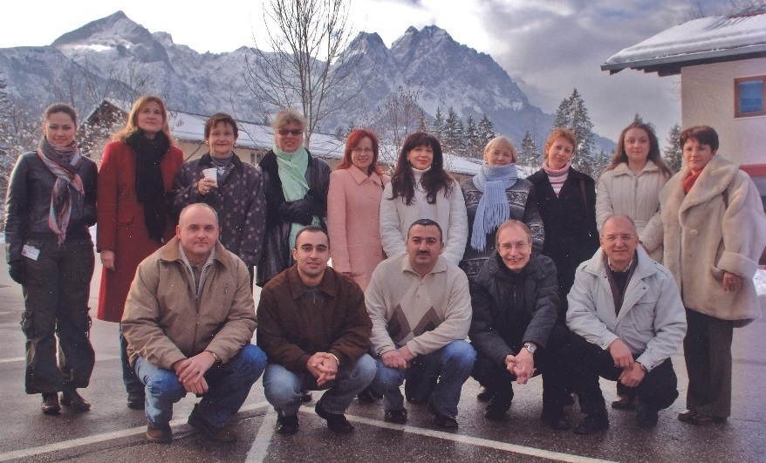
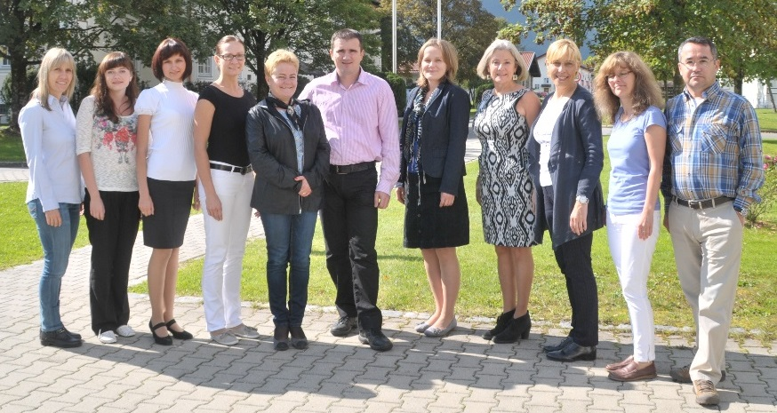
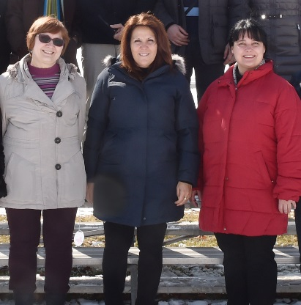
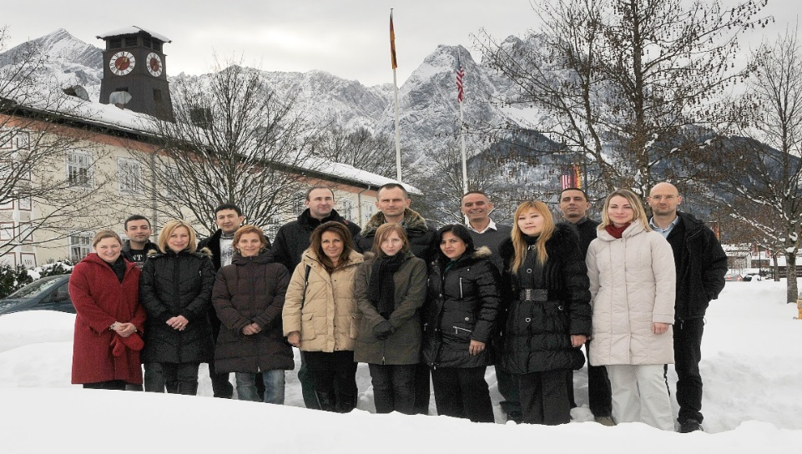
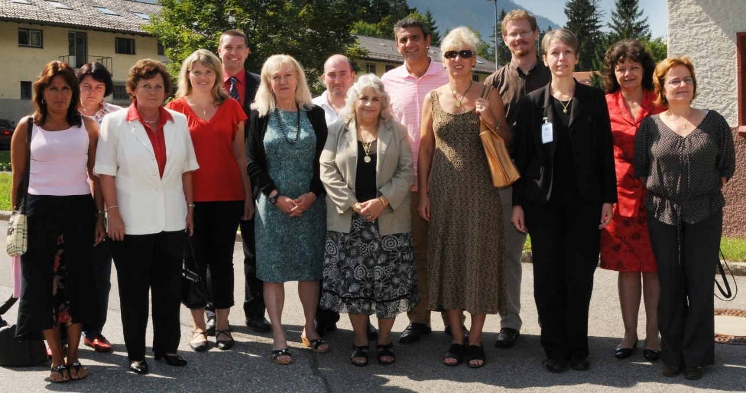
Language Testing Seminars
Language Testing Seminar (LTS)
2-week foundational course offered twice a year.
Since 2000, 540 participants from 53 nations/NATO offices. 40 facilitators from 20 nations.
Advanced Language Testing Seminar (ALTS)
3-week highly technical course for experienced language testers offered once a year.
Since 2009, 105 participants from 31 nations/NATO offices.
14 facilitators from 9 nations.

Slide 5
LTS
Introduction to the scale: STANAG 6001
Familiarization with L1- L3
ALTS
Standardization exercises: STANAG 6001
BAT protocol for testing writing
Test production process
Introduction to Validity Roadmap
Introduction to criterion-referenced testing
Focus on L3
BAT protocols for testing speaking and writing
Validity Roadmap
Collect evidence/ documentation
Practical activities in statistical analysis for criterion-referenced tests

Slide 6
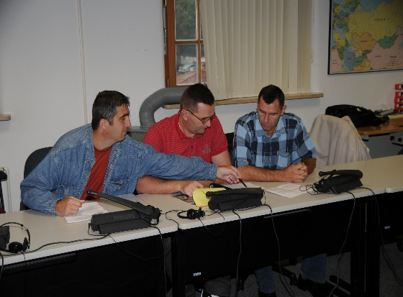
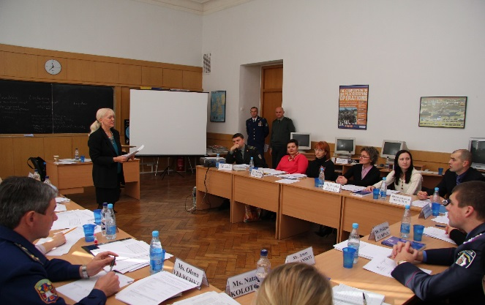
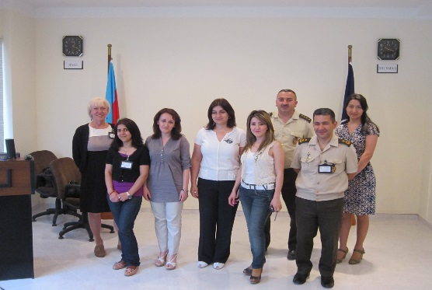
Assistance to national testing organizations
Azerbaijan
Bosnia-Herzegovina
Georgia
Macedonia
Moldova
Ukraine

Slide 7
STANAG 6001 Testing Workshops
Who attends?
LTS graduates who are current STANAG 6001 testers
Goals:
To promote standardization of STANAG 6001 testing by providing a forum for the exchange of information, best practices and new approaches in the field of language testing
Workshop findings are used to update the testing seminars and can lead to new projects and collaboration

Slide 8
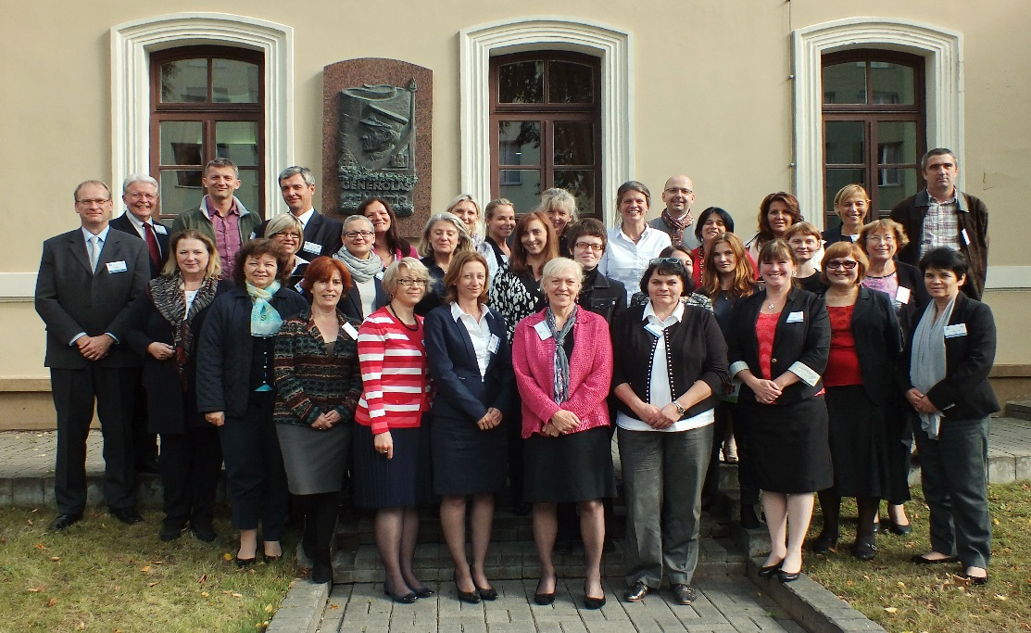
2010 Sarajevo, Bosnia and Herzegovina
2011 Stockholm, Sweden
2012 Copenhagen, Denmark
Testing speaking
Testing writing
2013 SHAPE Mons, Belgium
Integrating test development stages
Testing listening
2014 Reichenau, Austria
Item development workshop
2015 Vilnius, Lithuania
Challenges in testing (text editing, authenticity & Level 4)
2016 Brno, Czech Republic
Testing the test – How valid is our validity argument?
2017 Skopje, Macedonia
Tester success
STANAG 6001 Testing Workshops

Slide 9
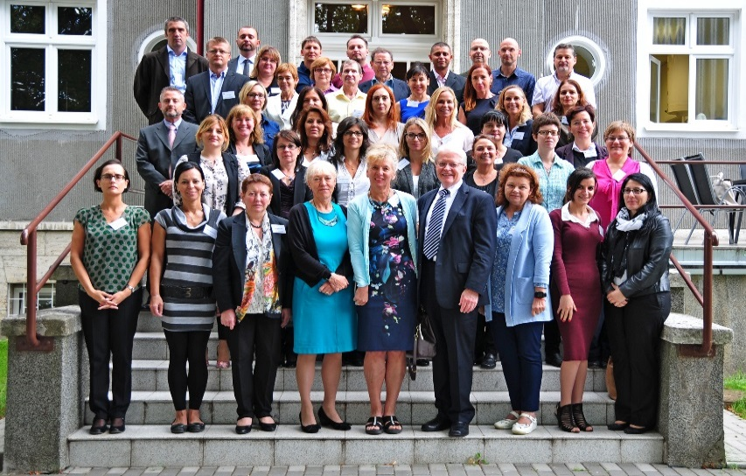
Findings from Brno
Validity Roadmap
Criterion-referenced testing
Alignment activities
Angoffing
Statistical analysis
jMetrik
Item Response Theory (IRT)

Slide 10
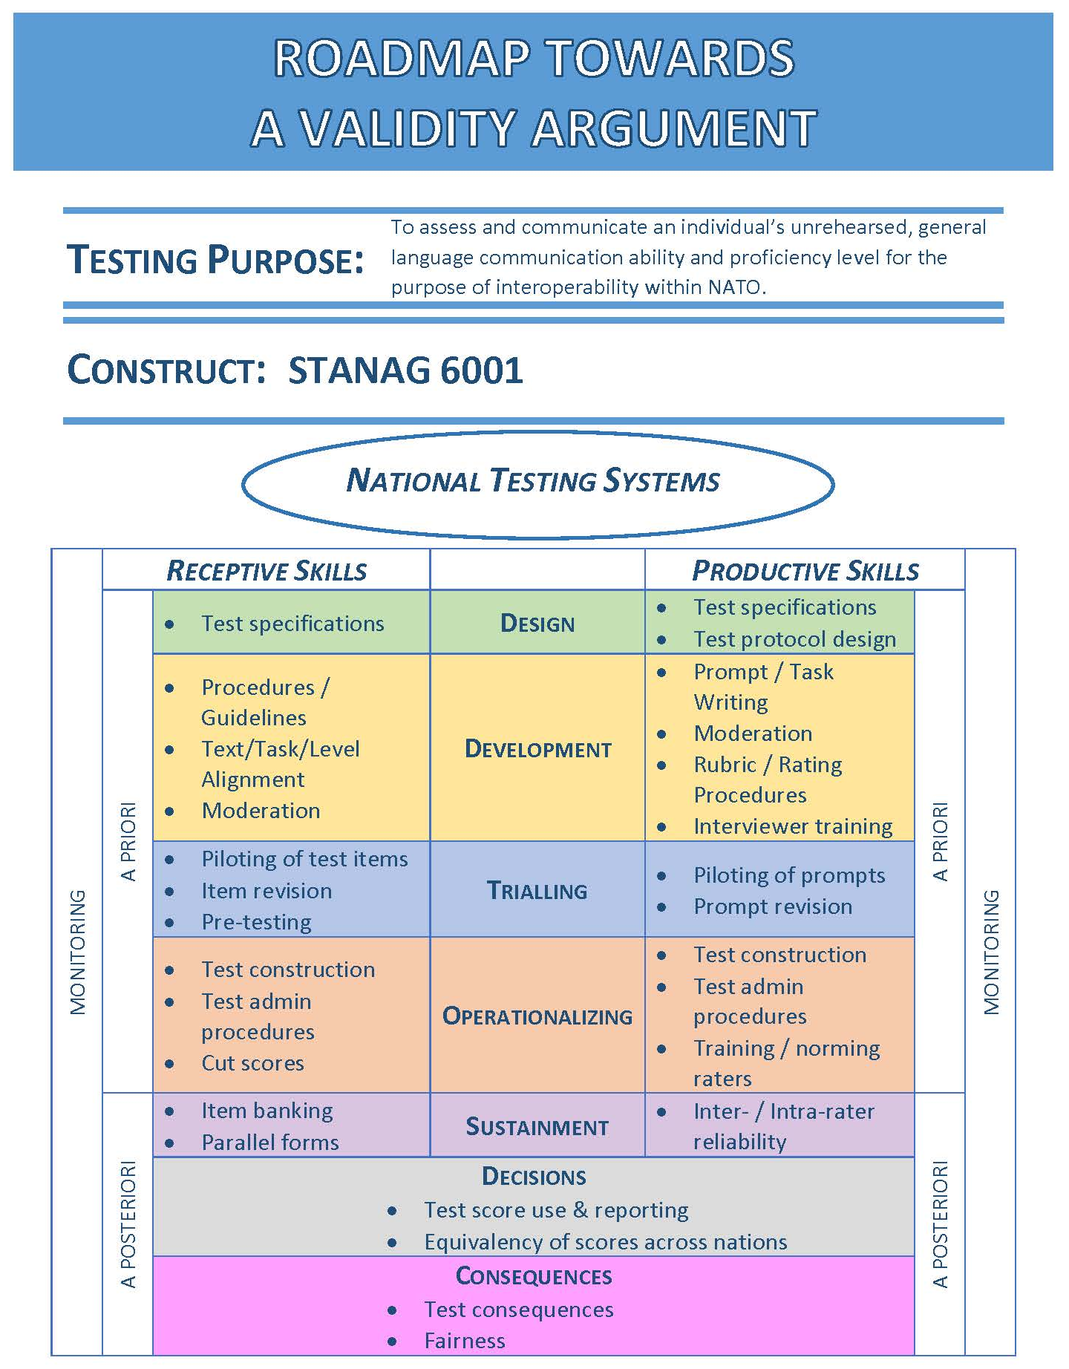
Findings from Brno
Building the argument
Evidence
Documentation

Slide 11
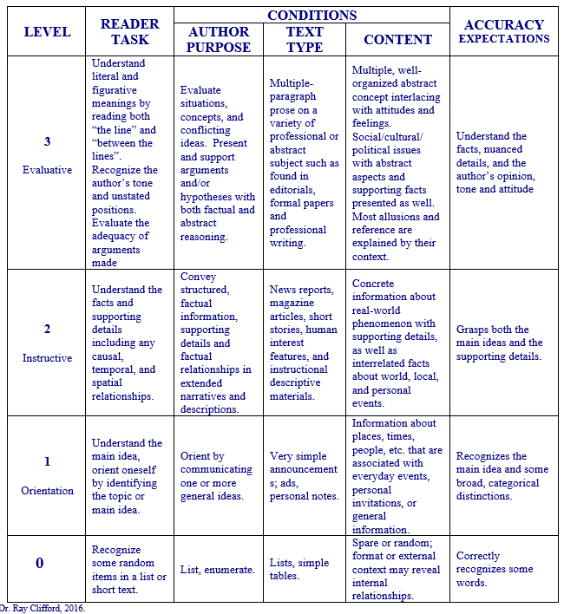
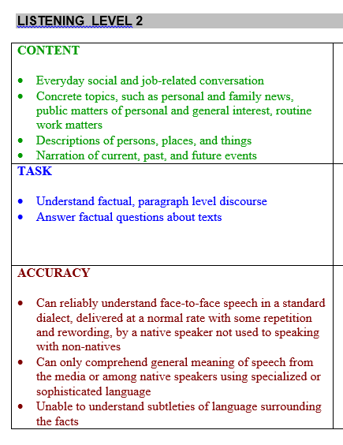
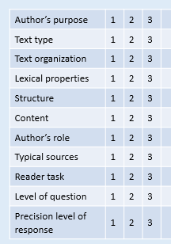
Tools and techniques to check test item quality & alignment
Findings from Brno
Content-Tasks-Accuracy (CTA) statements
Alignment worksheets
Angoffing procedures

Slide 12
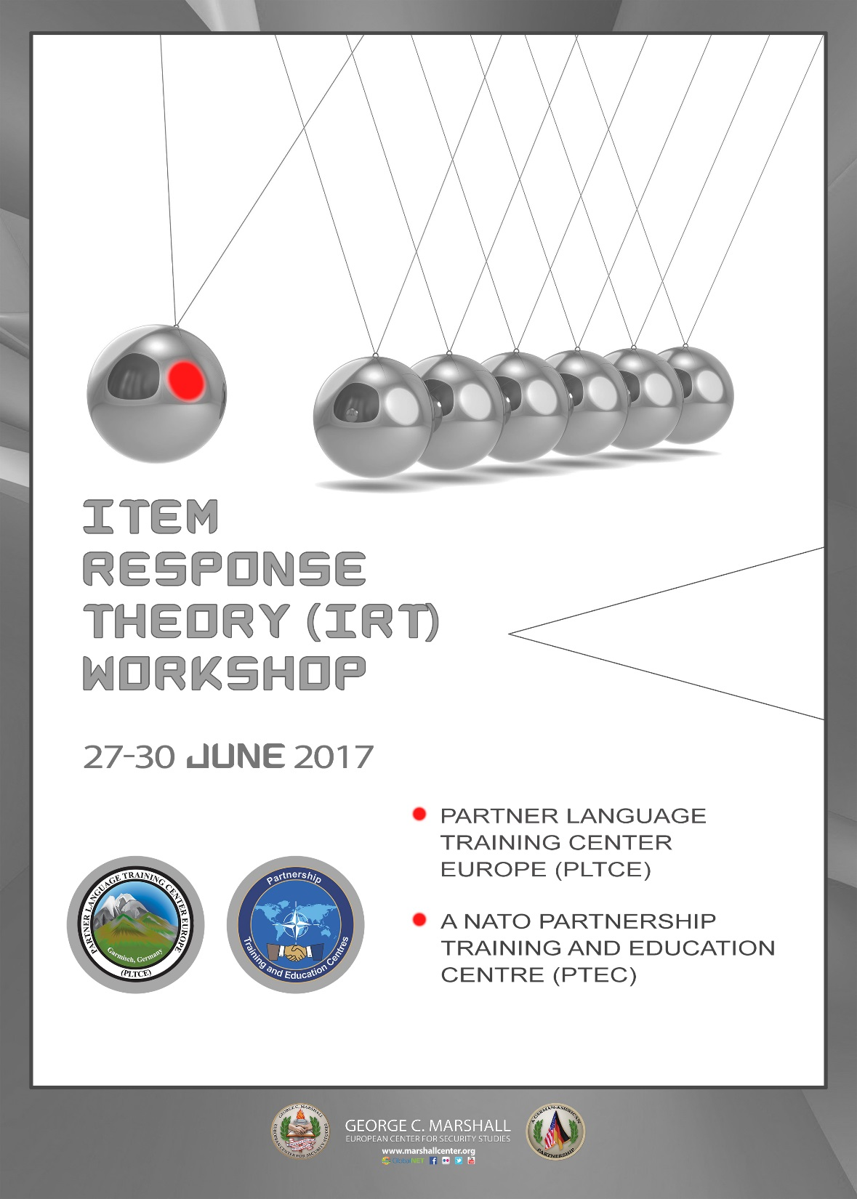
IRT Workshop
Findings from Brno
11 nations attended
Objectives
Introduction to IRT concepts and the advantages of using Rasch IRT analysis
Using jMetrik for Rasch IRT analysis
Interpretation of the data for informed decisions about tests and items
Individualized consultation on national test datasets
IRT is the industry standard for computer-delivered and computer-adaptive testing

Slide 13
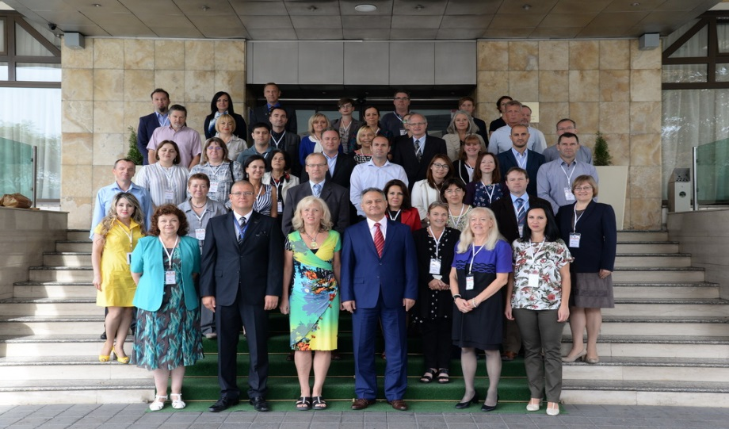
Findings from Skopje
Best Practices
Norming raters of speaking and writing tests
Tools for tester success

Slide 14
Findings from Skopje
Best Practices in STANAG 6001 Testing
Purpose of STANAG 6001 language proficiency tests
Test design
Test development
Test administration
Hiring, training and norming testers
Stakeholders’ rights and responsibilities
A method or technique that has consistently shown results superior to those achieved with other means, and that is used as a benchmark.

Slide 15
Norming Raters of Speaking &Writing Tests
Findings from Skopje
Nations submitted speaking and writing test samples for possible use in norming sessions
BILC STANAG 6001 testing experts reviewed the tests and provided feedback
Observations/Findings
Elicitation techniques affect a rater’s ability to rate
Non-alignment of tasks with elicited level affect rating and test-takers’ performance
Failure to establish floor and test at the level of probes affect rating – lack of “can do” evidence versus overwhelming “can’t do” evidence
Challenges with distinguishing between a 2+ and threshold 3 and between 0+ and 1
Under-representation of tasks and topics affect rating reliability
Rigid testing protocols (not adapted/tailored to the test-taker) exert stress on the test-taker

Slide 16
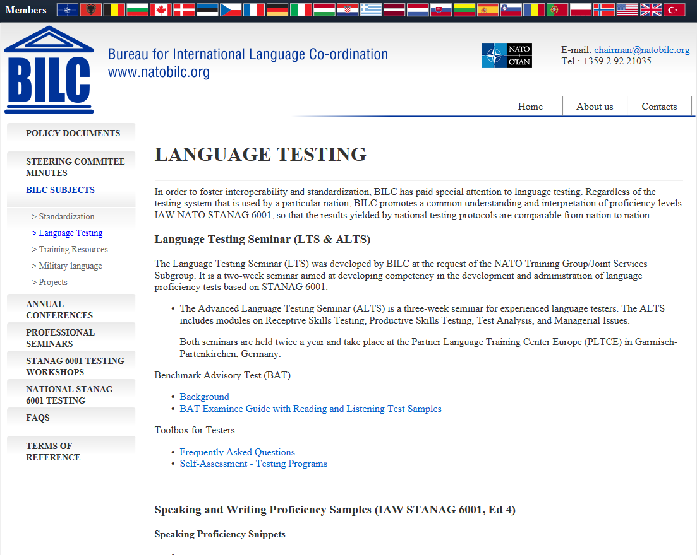
BILC Website - www.natobilc.org
Findings from Skopje
BILC Policy Recommendations
Toolbox for Testers
Self- assessment of testing organizations
Speaking and writing samples at different levels
Paper on Level 4: A Conceptual Model and Implications for Testing
Soon to be added:
Template for job descriptions
Content-task-accuracy alignment worksheets
Test item moderation guidelines and checklists
Evidence for building a validity argument

Slide 17
Level 4: Introduction and Background
Formation of BILC Working Group on Level 4 Proficiency
Istanbul 2010
Aims:
to assist nations feeling ill-equipped for testing at Level 4
to amplify STANAG 6001 Level 4 descriptors
to discuss testing related implications

Slide 18
Level 4 Construct
Level 4 - Expert
typically only achieved by individuals who use the foreign language extensively on a daily basis as part of their profession or specialization
usually more characteristic of individual ability than of job requirements
evaluative comprehension – reading/listening “beyond the lines”
prerequisite: higher order thinking skills (e.g., deductive and inductive reasoning, analyzing, and synthesizing)

Slide 19
Level 4 Language Use
Language use is highly precise, nuanced and effective
Readily adapt and tailor language to suit the purpose and situation
Firm grasp of various levels of style and register
Ability to hypothesize and persuade
In very demanding academic and professional settings:
challenging and high-stakes situations
negotiate and persuade effectively in international environments
Examples of military-related tasks at Level 4:
serve as spokesperson responsible for press releases and press conferences requiring nuanced, culturally appropriate communications
act as an arbiter between warring factions during a sensitive peace-keeping assignment
analyze the hidden communicative intent of diplomatic pronouncements

Slide 20
Level 4 WG Products
Paper: “NATO STANAG 6001 Level 4 Language Proficiency – A Conceptual Model and Implications for Testing” (April 2013)
Article “Defining and Assessing STANAG 6001 Level 4 Language Proficiency”
(Chapter 10, Language in Uniform, Cambridge Scholars, 2015)
Level 4 Reading Test Specifications
Tutorial (principles of text rating, differences btw Level 3 and Level 4 texts, sample texts, sample test development procedure, etc.)
Level 4 Test Prototype (Tester and Examinee Booklets for speaking/writing modality; administration and rating procedure)
Test Familiarization Guide
Feedback Questionnaire

Slide 21
Familiarization Workshop on
L4 Reading Proficiency
The workshop will cover
the interpretation of the L4 reading descriptor,
the differences between L3 and L4 reading texts and skills,
testing techniques, rating criteria and scoring procedures
23-27 October 2017
Where: Partner Language Training Center Europe (PLTCE) Garmisch-Partenkirchen, Germany
POC: Jana Vasilj-Begovic

Slide 22
Benchmark Advisory Test (BAT)
Then & Now
Round 1: 2009
Round 2: 2018
Advisory measure for nations
Evidence of standardization

Slide 23
BAT Purpose
To provide an external measure against which nations can compare their national STANAG 6001 test results
To promote relative parity of scale interpretation and application across national testing programs
To standardize what is tested and how it is tested in the Alliance

Slide 24
BAT History
Launched as a volunteer, collaborative project
The BILC Test Working Group
13 members from 8 nations
Contributions received from many other nations
The original goal was to develop a reading test for Levels 1-3

Slide 25
BAT History (continued)
Later awarded a competitive contract by ACT
ACTFL working with BILC Working Group
To develop tests in 4 skill modalities
Reading and Listening tests piloted and validated
Speaking and Writing tests developed
Testers and raters trained and certified
Test administration and reporting protocols developed
200 BAT 4-skills tests allocated under the contract
Tests administered and rated
Scores reported to nations

Slide 26
BAT Reading and Listening Tests
Internet-delivered and computer scored
Criterion-referenced tests
Each proficiency level is tested separately
Test takers take all items for Levels 1, 2, 3
20 texts at each level; one item with multiple choice responses per text
The proficiency rating is based on
“Floor” – sustained ability across a range of tasks and contexts specific to one level
“Ceiling” – non-sustained ability at the next higher proficiency level

Slide 27
BAT Speaking Test
Telephonic Oral Proficiency Interview
Goal is to a produce a speech sample that best demonstrates the speaker’s highest level of spoken language ability across the tasks and contexts for the level
Interview consists of
Standardized structure of “level checks” and “probes”
NATO- specific role-play situation
Conducted and rated by one certified BAT-S Tester
Independently second rated by a separate certified tester or rater
Ratings must agree exactly
Level and plus level scores are assigned
Discrepancies are arbitrated

Slide 28
BAT Writing Test
Internet-delivered
Open constructed response
Four, multi-level, prompts
Prompts target tasks and contexts of STANAG levels 1,2,3
NATO- specific prompt
Rated by a minimum of two certified BAT-W Raters
Ratings must agree exactly
Level and plus level scores are assigned
Discrepancies are arbitrated

Slide 29
2009 BAT Administration
Allocation to 11 nations
All nations completed testing
Testing began in May, 2009
Tests administered by LTI, the ACTFL Testing Office

Slide 30
Overview of all 2009 tests
BAT Scores by Level
Skill | BAT
Listening | 177
Speaking | 157
Reading | 176
Writing | 178

Slide 31
Comparing Scores by Level
Listening - 2009
 | BAT-L | National Test
Level 0 | 2 | -
Level 1 | 35 | 20
Level 2 | 47 | 46
Level 3 | 67 | 74
Level 4 | - | 11
Notes:
Observations – Listening Scores
Exact agreement of BAT and National Scores is 59%
When there is disagreement
In 52 cases, disagreement is across one contiguous level
In 10 cases, disagreement is across two levels (1/3 and 2/4)
National score is HIGHER in 81% of the cases

Slide 32
Comparing Scores by Level
Speaking - 2009
 | BAT-S | National Test
Level 1 | 41 | 21
Level 2 | 76 | 50
Level 3 | 20 | 60
Level 4 | - | 6
Notes:
Observations – Speaking Scores
Exact agreement of BAT and National Scores is 50%
When there is disagreement
In 62 cases, disagreement is across one contiguous level
In 8 cases, disagreement is across two levels (1/3 and 2/4)
National score is HIGHER in 97% of the cases

Slide 33
Comparing Scores by Level
Reading - 2009
 | BAT-R | National Test
Level 1 | 32 | 13
Level 2 | 42 | 56
Level 3 | 76 | 70
Level 4 | - | 11
Notes:
Observations – Reading Scores
Exact agreement of BAT and National Scores is 65%
When there is disagreement
In 49 cases, disagreement is across one contiguous level
In 3 cases, disagreement is across two levels (1/3 and 2/4)
National score is HIGHER in 81% of the cases

Slide 34
Comparing Scores by Level
Writing - 2009
 | BAT-W | National Test
Level 1 | 56 | 21
Level 2 | 93 | 80
Level 3 | 4 | 41
Level 4 | - | 11
Notes:
Observations – Writing Scores
Exact agreement of BAT and National Scores is 47%
When there is disagreement
In 66 cases, disagreement is across one contiguous level
In 15 cases, disagreement is across two levels (1/3 and 2/4)
National score is HIGHER in 98% of the cases

Slide 35
Accounting for Divergence
For receptive skills
Compensatory cut score setting
Lack of alignment of author purpose, text type, and task in some test items
For productive skills
Inadequate tester/rater norming
Inconsistencies in interpretation of STANAG 6001
Inadequate item response alternatives

Slide 36
Benchmark Advisory Test (BAT)
Round 2
Aim: Provide evidence of standardization of STANAG 6001 testing across the nations
21 nations interested in participating
10 tests per nation
Will take place in 2018
First steps
Application process
BAT Speaking & Writing norming sessions

Slide 37
2018 BAT Application Process
Nations complete questionnaire describing national STANAG 6001 tests
Test design
Administration procedures
To minimize technical problems in test administration
To provide insights into possible reasons for misalignment, if any
Why?

Slide 38
2018 BAT Speaking & Writing Norming Sessions
What
Norming sessions - maximum 10 participants
Who
Experienced STANAG 6001 testers
When
January 2018 & July 2018
Where
Partner Language Training Center Europe

Slide 39
BAT
BILC Assistance
to Nations
A Toolbox for
Language Testers
Language Testing
Seminars
Standardization
Norming speaking
and writing raters
Annual STANAG 6001
Testing Workshops
Best Practices in
STANAG 6001 Testing

Slide 40
Thank you.

