Slide 1
A mixed methods approach to validating a test
BILC Testing Workshop
Bonn, September 2022
Mária Vargová
Language Institute
Testing Team
Liptovský Mikuláš, Slovakia

Slide 2
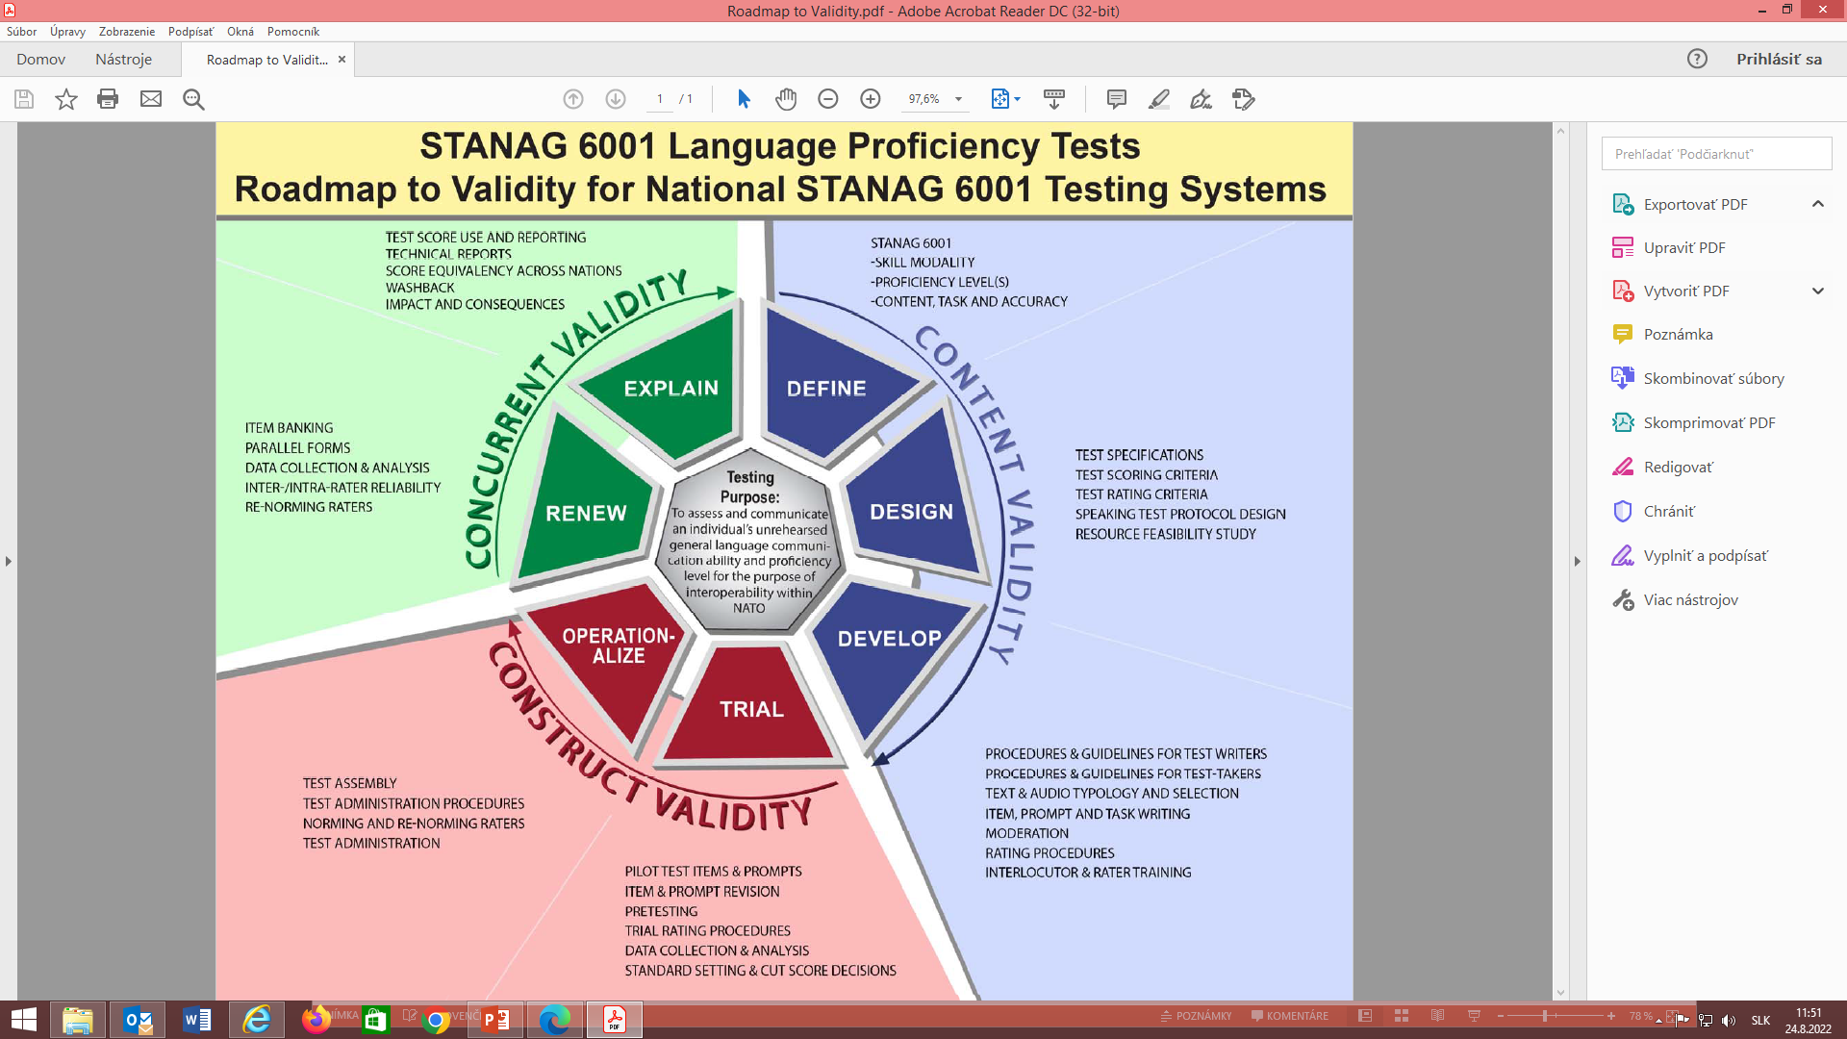
https://www.natobilc.org/documents/LanguageTesting/Roadmap%20to%20Validity.pdf

Slide 3
The data are primarily numerical. We analyse the collected data by statistical methods
1. What kind of data do you collect during pretesting?
2. How do you analyse the collected data?
„A scientific research is the organized, systematic search for answers to the questions we ask.“
(Hatch&Lazarton, 1991, p. 1)

Slide 4
Quantitative research
„QUAN proponents usually emphasize that at its best the quantitative inquiry is systematic, rigorous, focused, and tightly controlled, involving precise measurement and producing reliable and replicable data...“
(Dörneyi, Z., 2007, p. 34)
Source: ALTS HB, Version 14,

Slide 5
Quantitative analysis methods- limitations
“… not very sensitive in uncovering the reasons for particular observations… . That is, the general exploratory capacity of quantitative research is rather limited.” (Dőrmeyi, 2007, p. 35)
„qualitative researchers view quantitative research as overly simplistic, decontextualized, reductionist in terms of its generalizations…“
(Brennen, J. 2005, p. 7)
“A more critical limitation to correlational and experimental approaches to construct validation is that these examine only the products of the test taking process – the test scores – and provide no means for investigating the processes of test taking.” (Bachman, 1990, p. 269)

Slide 6
Qualitative research
“...qualitative research is ideal for providing insights into […] contextual conditions and influences.“
(Dörneyi, 2007, p. 36)
„… by using qualitative methods we can uncover subtle meanings that are inevitably lost in quantitative reaseach, … .“
(Dörneyi, 2007, p. 28)
… it is test-taker perceptions that Messick (1989) considers a crucial source of evidence for construct validity.

Slide 7
Qualitative research methods
- Discourse/Conversation Analysis
- Questionnaires
- Observations
- Verbal Protocol Analysis
- Software Programmes
- Interviews
(Lazaraton, 2007, p. 198)

Slide 8
Verbal protocols
”… data collected from test takers and/or examiners in which they talk about their thought processes while they take a test or assess a test performance.” (Banerjee, p. 3, 2004)
a) Think aloud: immediate verbalization
b) Introspection: 10-20 second time delay
c) Immediate retrospection: time delay of about 1 minute
d) Delayed retrospection: time delay of an hour or more
(Cohen, 1984)

Slide 9
Think-aloud reporting
1. Task identification
2. Task analysis
3. Selecting an appropriate procedure
4. Selecting subjects
5. Training subjects (for concurrent methods only)
6. Collecting verbal reports
7. Collecting supplementary data (optional)
8. Transcribing verbal reports
9. Developing an encoding scheme
10. Segmenting protocols
11. Encoding protocols
12. Calculating encoder reliability
13. Analyzing the data (Green, 1998)

Slide 10
The potential of verbal reports
Verbal reports offer insights into:
1. the match between test-designers´ predictions and the actual skills and processes test-takers use during the test.
2. the role of test-taking strategies in the successful completion of certain task types.
3. the distribution of micro-skills across a test (in order to establish test coverage)
(Banerjee, 2004, p. 8)

Slide 11
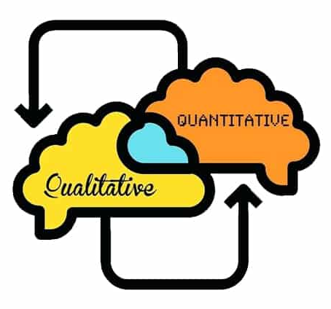
Mixed methods approach
“...QUAL and QUAN are not extremes but rather form a continuum” (Dőrneyi, 2007, p. 25)
“
“...what we are advocating is a true interplay between the two.”
(Strauss and Corbin, 198, p. 34)
“Quantitative and qualitative inquiry can support each other.” (Miles and Huberman, 1994, p. 310)

Slide 12
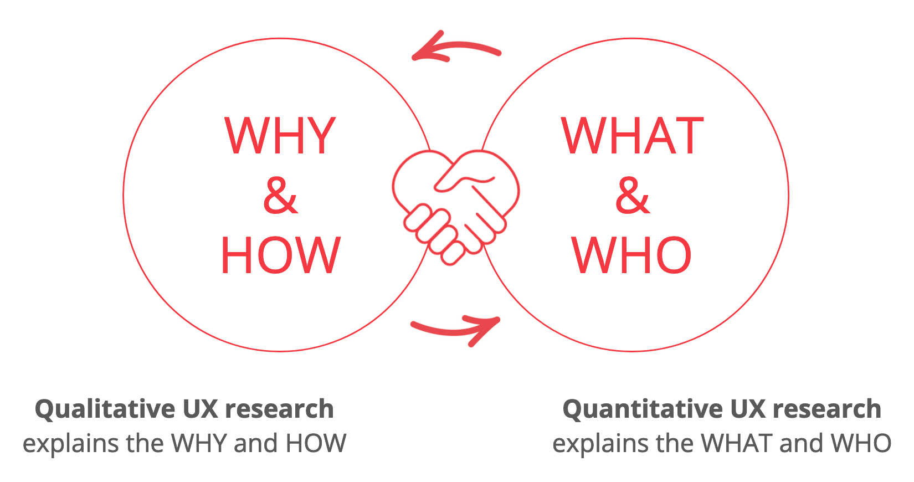
Source:ferpection.com
Thank you for your attention!

Slide 13
References:
Bachman, L. F. (1990). Fundamental Considerations in Language Testing. Oxford: Oxford University Press.
Banerjee, J. (2004). Qualitative Analysis Methods. Section D of The Reference Supplement to the Preliminary Pilot Version of the Manual for Relating Language Examinations to the Common European Framework of Reference for Languages: learning, teaching, assessment. Language Policy Division. Council of Europe. Strasbourg.
Brannen, J. (2005). Mixed Methods Research: A Discussion Paper. Retrieved from http://eprints.ncrm.ac.uk/89/1/MethodsReviewPaperNCRM-005.pdf
Cohen, A. (1984). On taking language tests: What do students report, Language Testing, 1/1, 70-81. Hatch, L. & Lazarton, A. (1991) The Research Manual: Design and Statistics for Applied Linguistics. New York: Newbury house

Slide 14
References:
Dörneyi, Z. (2007). Research Methods in Applied Linguistics. Oxford, UK: OUP.
Green, A. (1998). Verbal protocol analysis in language testing research: A handbook (Vol.5). Cambridge, UK:Cambridge University Press
Lazaraton, A. (2008). Utilizing Qualitative Methods for Assessment, In Encyclopedia of Language and Education. Part 7, Part 24, pp. 2336 – 2348.
Messick, S. (1989). Validity. In Educational measurement. 3rd edition. New York: American Council of Education / Macmillan.
Miles, M. B. & Huberman, A. M. (1994). Qualitative Data Analysis, 2nd Edition. Thousand Oaks, Calif.: Sage.
Strauss, A. L. & Corbin, J. (1998). Basics of Qualitative Research: Techniques and Procedures for Developing Grounded Theory, 2nd Edition. Thousand Oaks, Calif.: Sage.

