Slide 1
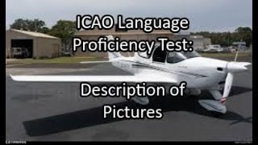
1: Problem identified; 3332
4: We do NOT want to become driving instructors
2: LNA based on JTAC STANAG, exercises, interviews w SMEs
5: The surprise party-crasher
3: Retaining isolated skills or going for integration?
JTAC practitioners vs NATO/US decision-makers….

Slide 2
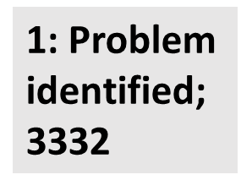
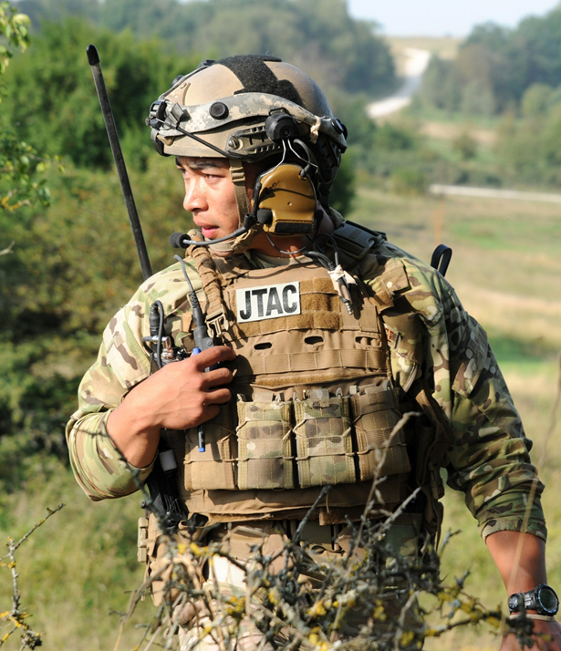
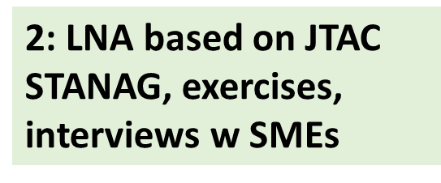
Picture # 1: The orginal 2021 request from the US JFO to BILC to look into whether the current 3332 SLP
requirement for JTACs (joint terminal attack controllers) was a fair reflection of JTAC tasks, and whether
there might be a better way to test JTAC language skills, was triggered by multiple NATO test centers
testing and failing an increasing number of otherwise well-performing JTACs.
Picture # 2: The JTAC WG was established and conducted an in-depth LNA based on US and NATO JTAC
job descriptions and training requirements, observations during JTAC field exercises, as well as
interviews and surveys involving JTACs, JTAC trainers, and JTAC program managers.
Picture # 3: The WG concluded that the current JTAC SLP and the STANAG-test format used are NOT aligned with the language skills actually required for JTACs. Those skills are essentially at level 2, but they are not general-English level 2; thus the need for a different test format and test construct. The WG decided to be creative and discard the isolation of skills; instead we are now trying to draft a test format that builds on an unfolding JTAC scenario, with spiralling tasks and integrated skills.
Picture # 4: However, that approach comes with the risk that the test may drift into becoming a JTAC-competence test, rather than a test of JTAC-relevant language skills. We need to be aware of this danger.
Picture # 5: In our progress report submitted to BILC and JTAC decision-makers, we mention that ICAO has a language test used for aviation personnel that might have elements we can utilize. This has apparently prompted some JTAC decision-makers to conclude that the ICAO test can do the job on its own, despite that test only assessing listening and speaking. It would therefore NOT comply with the current JTAC training requirements. The WG is standing by for further developments…..

