Slide 1
A Case for STANAG 6001 Rater Training & Norming
David Oglesby
Defense Language Institute English Language Center

Slide 2
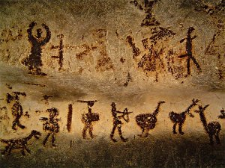
The Way I See It…
“Two individuals can witness the same external event, but interpret and perceive it totally differently, depending on how they think about or cognitively process it.” Stephen Diamond
Magura

Slide 3
Testing the Productive Skills
We want to set tasks that form a representative sample of the population of oral tasks that we expect candidates to be able to perform
The tasks should elicit behavior which truly represents the candidate’s ability
The samples of behavior can and will be scored validly and reliably
From Hughes’ Testing for Language Teachers

Slide 4
Reliability in Testing
A reliable test should be a consistent measure of performance.
Immune to Boredom
Grin & Bear It Bored
Can’t Read My Stoic Face
OMG! I’m Bored
Miserable Fog of Ennui
Bored to Tears
Levels of Boredom

Slide 5
Fair & Balanced Testing?
TEST
1.
2
3.
I object to your
subjectivity
I won’t be subjected
to your objectivity
Rating Productive Skills

Slide 6
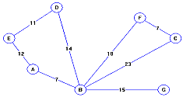
Objective vs Subjective Scoring
Given this undirected graph, what would be the result of a depth first iterative traversal starting at node E?
a. EABCFDG b. EDBFCG c. EDBGFCA d. EADBCFG e. EGDCFBA
Write a fictional account of this young woman’s life up to the moment reflected in the picture.

Slide 7
Training STANAG Raters
Background & Overview: Introduce scale, testing protocol & scoring conventions
Initial Norming: Review & discuss benchmark language samples
Guided practice: Rate samples using rating scale & rubric
Mock Interviews: For speaking assessment, complete practice interviews
Certification: Select raters who provide reliable and efficient ratings

Slide 8
Background & Overview
Discuss the STANAG testing mission and purpose
Introduce the modality-specific specifications and testing protocol
Demonstrate/preview a model interview
Issue training materials (handbook) and discuss contents

Slide 9
Business of Testing Protocols
1. General: Unwritten rules or guidelines that are peculiar to every culture or organization, and are supposed to be observed by all parties in the conduct of business, entertaining, negotiating, politics, etc.
2. Product development: Statement of attributes (features and benefits) that a new product must be designed to have. A product protocol is prepared by consulting all parties to the project.
3. Technology: Set of agreed upon, and openly published and distributed, standards that enables different firms to manufacture compatible devices to the same specifications. All devices made under the same protocol work with one another without any adjustment or modification.

Slide 10
Initial Norming
Present calibrated (benchmark) performances at each base/plus level
As a group, analyze the performance considering content, task & accuracy
Participants identify parts of performance that constitute a ratable sample
Discuss the rating with respect to rubric

Slide 11
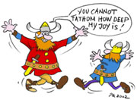
Benchmarks Reduce the Likelihood of Rater Drift
Level 1
Level 2
Level 3

Slide 12
Guided Practice
Present speaking/writing performances for individual practice rating
Participants report scores and criteria applied
Group discussion leads to consensus (or not)
Compare group rating with expert rating

Slide 13
Evaluating at the Microlevel
Purpose of evaluating
= Select level
Collecting information
= Elicit sample
Interpreting information
= Apply criteria
Decision making
= Determine rating

Slide 14
Mock Interviews for Speaking Assessment
Pairs of trainees conduct mock interviews
Other trainees observe & take notes
After the interview, all trainees assign rating
Group discusses conduct of interview, effectiveness of elicitation, ratings
Trainees paired anew and repeat process
Certify reliable & efficient raters

Slide 15
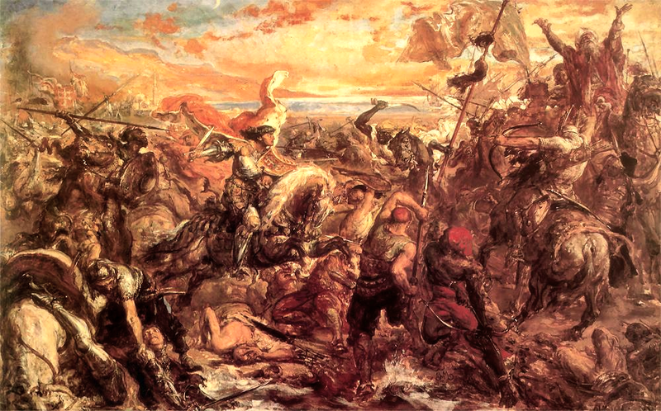
The Norming Conquest
Construct-irrelevant variance can cause rater drift over time
Moral dimension (severe – lenient)
Halo effect
Central tendency
Analyze inter-rater/intra-rater reliability
Renorm raters using benchmarks

Slide 16
People are Dying for Change
“A new scientific truth does not triumph by convincing its opponents and making them see the light, but rather because its opponents eventually die, and a new generation grows up that is familiar with it.” Max Plank

Slide 17
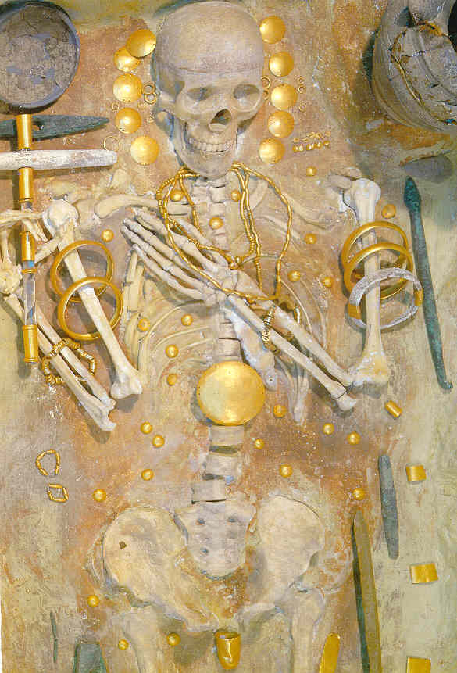
Questions?

