Slide 1
Lessons Learned
A hierarchy of needs for successful blended learning

Slide 2
Summary and contents
Need for a blend
Hierarchy of needs for a blended curriculum
Matrix for choices in blended design
Typical week quadrant
Mistakes and wins
Takeaway
Vanessa Chapman – van Drunen

Slide 3
Warm up: Discuss the following with your neighbor
Where did you really learn English?
School?
Family?
Radio?
Vacation?
Television?
Reading?
Vanessa Chapman – van Drunen
Notes:
We cannot escape the reality of Covid, and online learning offers a solution to the problems of quarantines, but we also need the f2f time, like these responses show.

Slide 4
Powerful blend of social interaction and motivation
Importance of social interaction in language acquisition and learning
Non-interactive platforms like TV and YouTube
Peppa Pig
Minecraft
If a learner is motivated to learn content, despite a language barrier, they will end up learning the language through their search for more content (CLIL).
Vanessa Chapman – van Drunen
Notes:
The Linguistic Genius of Babies TedTalk

Slide 5
Tools for creating a powerful blend
Hierarchy for of needs blended curriculum
Matrix for choices in blended design
Typical week quadrant
Vanessa Chapman – van Drunen

Slide 6
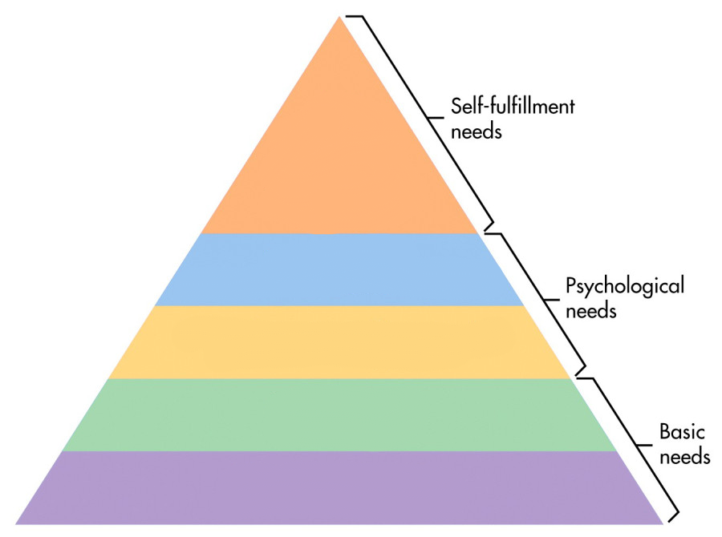
Three levels of needs (AKA Maslow)
Motivation for learning itself. Part of the course needs to tap into whatever it is that intrinsically motivates the students to learn in general.
This is where the YouTube video learning comes in.
Motivation
Independent or collaborative
F2F, online, synchronous, asynchronous
Type
Location
The online lessons need to be broken into small chunks.
A place to be able to focus and interact online
Mental space
Timing
Physical space
Desk, chair
Laptops, accounts, passwords, course material, internet
Infrastructure
Vanessa Chapman – van Drunen
Notes:
Remember: Not everything has to have a right or wrong answer. Changing the goal to something as simple as “Give your opinion on the following statement.” motivates many students who would otherwise shy away from tackling new aspects of the learning. These kinds of assignments need to be incorporated into the course to boost motivation in distance learning situations. Ex. Weekly memo, personal vocab book.
Once an activity “hooks” the students, they’re much more motivated to ask questions and seek out information on their own. Here is where the Youtube phenomenon comes in, I believe. If you want to know more about an ICEX, finding videos about subs in the Arctic is interesting, and listening to the sailors talk about what it’s like to take part in an ICEX teaching you more (vocational) English as a result. If a student is in the “self-fulfillment” tier of language learning, then YouTube isn’t a chore or a lesson anymore. It’s a source of information for something the student is already interested in.

Slide 7
Matrix for choice of design and working methods
Offline
Training
Conventions
Peer coaching
Progress meetings
Case studies
Clinical lessons
Team activities
Observation activities
Workplace learning
Books/magazines
Coaching
Reading articles
Exams
Workplace/practical activities
Writing reflections
Webinars
Virtual classrooms
Forum
Serious gaming
Mind maps
Creating videos
Skype meetings
Peer feedback
Social networking
E-learning modules
Internet searches
Using informative apps
Serious gaming
Formative exams/quizzes
Watching/creating videos
Polls
Reading/writing blogs
E-books
Mind maps
Role plays
Pronunciation activities
Provide clarification on answers and/or assignments
Conducting interviews for speaking practice
Preparing presentations
Group projects
Extensive reading
Synchronous
Asynchronous
Breakout rooms for students to discuss previous assignments
Brainstorming activities for intro to new topic
Delivering presentations to group
Online grammar drills
Listening practice
Replying to weekly prompts
Online
Vanessa Chapman – van Drunen
Notes:
Translated from Dutch and adapted for language learning

Slide 8
Notes:
The author has a link on her Twitter account to download it for free. https://twitter.com/jenniferwathall/status/1225994161528066049

Slide 9
Mistakes and Wins
Based on my lessons learned this past year, here some concrete examples of mistakes and wins per hierarchy level.
Vanessa Chapman – van Drunen

Slide 10
Basic – Infrastructure and Physical Space
Mistakes: Students did not have Team accounts set up (with passwords), no word processing software on their own computers.
Wins: Students were instructed to find free software (Google docs) and be prepared by the next class, increasing learner autonomy. They started asking each other about infrastructure problems instead of the instructors.
Vanessa Chapman – van Drunen

Slide 11
Psychological Needs – Mental Space, Timing, Type & Location
Mistakes: Wrong type of activity for type of location. Distinguishing minimal pairs with a speaking partner is not nearly as successful outside of the classroom.
Wins:
Online Asynchronous – The video-watching activities done at home allowed for less down time in class for the faster students.
Online Synchronous – Grammar online (timed into small chunks with breakout rooms to check answers) led to a fast-paced lively online dynamic. Students could contact me separately for more help without being embarrassed for not “getting it”.
Vanessa Chapman – van Drunen

Slide 12
Self-fulfillment - Motivation
Mistakes: Assuming that a fun activity in class would translate to a motivating activity outside of class.
Wins:
Changing the assignment to have no right or wrong answer allowed students to be much more creative, and they showed us language use we hadn’t seen before in class.
Keeping a vocabulary journal as a challenge to see who could stump the class with their word each day was highly motivating.
Vanessa Chapman – van Drunen
Notes:
As with everything, context is key. In a new learning environment, the context changes, and the activities need to be adapted. I can only imagine the reason that it failed is that the motivation to ask me new words, was through hearing others ask me. Alone, there was nobody to spark the curiosity.
For our chapter on OPSEC and social media use, I thought that the brainstorming activity would work well online asynchronously. The students put almost zero effort into it. In class, though, the students are really engaged and spend a lot of time making mind maps about what OPSEC is.

Slide 13
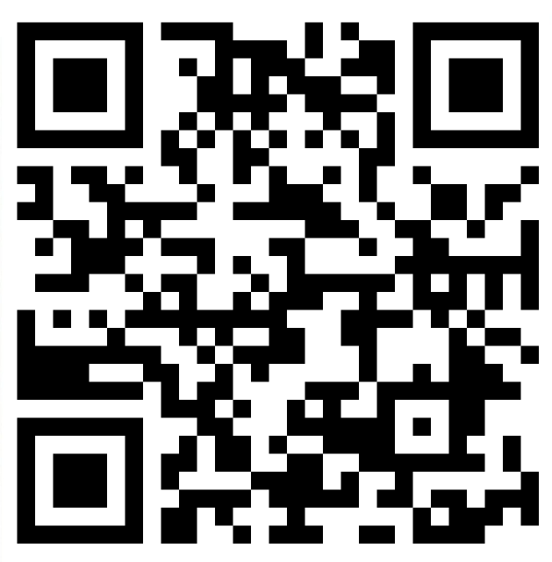
Takeaway - Padlet
What will you take away from this presentation, now that we have looked at the pyramid and the quadrants?
What changes or ideas do you have for an activity or a course you currently use?
https://padlet.com/vvdrunen/8cveij19m9kb815g
Vanessa Chapman – van Drunen
Notes:
Thinking back on your answer to how you learned English, and now with this framework of quadrants and pyramids:

Slide 14
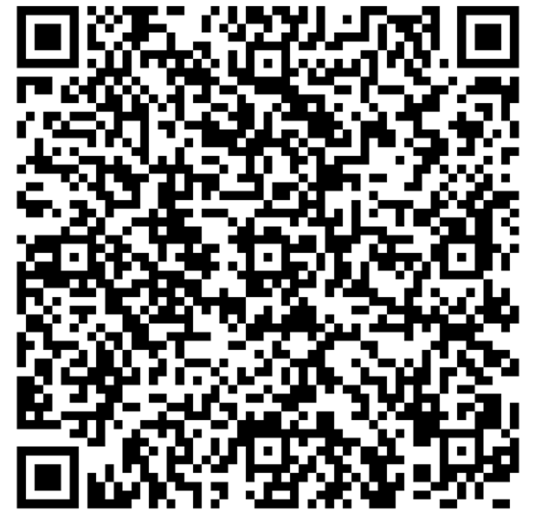
Thank you!
Vanessa Chapman – van Drunen
Senior Language Instructor
Dutch Defense Language Institute
VD.Chapman.v.Drunen@mindef.nl
T +31 6 82266954
Vanessa Chapman – van Drunen

