Slide 1
Interpretation: From the classroom to what field(s)?
BILC Copenhagen 20191010 Carina Gossas PHD & Jérôme Josserand PHD
Swedish Armed Forces Languages School

Slide 2
What we produce

Slide 3
Recruitment of a military interpreter
Language (quick learner, precise, good code switcher)
Good Soldier (not a burden for the rest of the unit)
Leadership (becoming an officer as well as an interpreter)
Social competence (open-minded, capacity of integration, flexible)

Slide 4
Program
3 x 12 = 36 weeks
Ca 70 hours/week (2520 hours)
Ca 12000 words (333 words a week)
4 skills + interpretation technique + communicative competence
Listening
Exam every week
Final exam: a week’s military exercise

Slide 5
Proficiencies
General proficiency
From level 0 to a strong 2+/3
Specific proficiency
Military terminology
Military tasks at tactical level
Interpreting skills

Slide 6
Culture
Competence (integration within the program)
Experience (immersion)
Responsibility as a cultural advisor

Slide 7
Feedback from the Field

Slide 8
But there is always more…
Mingling…
Whispered interpreting
Simultaneous interpreting
Presentations
Speeches
Staff work
Bad use of the interpreter (major issue even in the civilian world)

Slide 9
so…
Where was the needs analysis?

Slide 10
Developing vocabulary in quantity and depth
General proficiency over specific purpose
Developing automaticity
Teaching methods proven (not?) to work

Slide 11
Quantity
300-500 words a week = ca 12000
Flashcards
Word/lexical item
What does it mean to know a word?

Slide 12
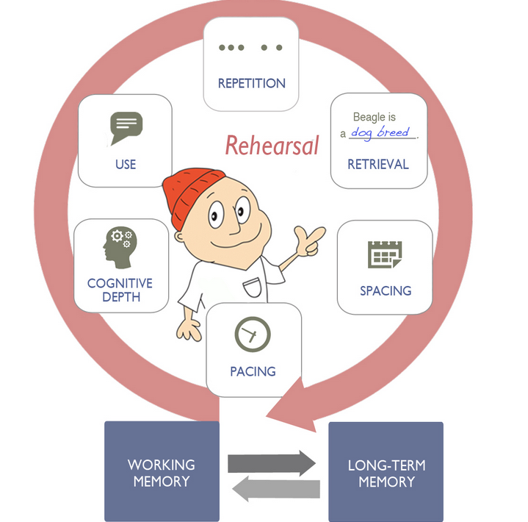

Slide 13
Problems
Flashcard obsession / not enough language study
Lack of accuracy
Wrong register
Gaps between grammar and vocabulary
Pronunciation

Slide 14
Course development
Phonetic introduction week
Learning vocabulary strategies
Enhancing automaticity
Creative thinking, critical thinking

Slide 15
Raising the level of abstraction
Academics (literature, movies, etc…)
Writing Process (red-blue-yellow-green)
Presentations, speeches
Debates
General knowledge

Slide 16
References
Nation, I.S.P (2012), Learning Vocabulary in Another Language. Cambridge University Press.
Thornbury, S. (2002). How to teach vocabulary. Harlow: Longman.
Lazarević, N., T. Paunović, L. Marković, (eds) Teaching Languages and Cultures: Developing Competencies, Re-thinking Practices. Cambridge scholars Publishing 2018.
Kersten, Saskia (2010). The Mental Lexicon and Vocabulary Learning: Implications for the Foreign Language Classroom. Tübingen: Narr.

Slide 17
THANK YOU!

