Slide 1
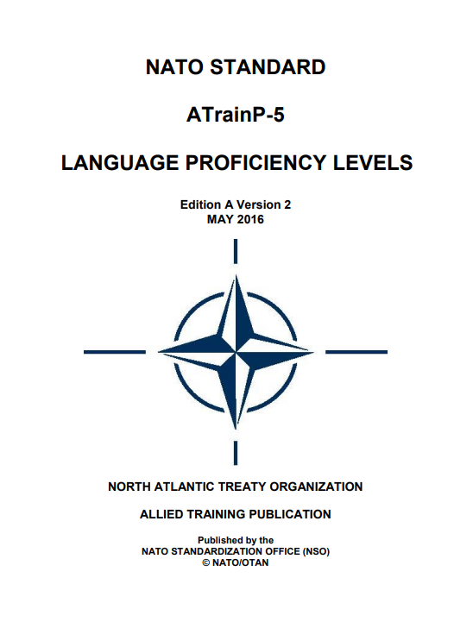
Comparing Test Designs: STANAG 6001 Tests vs ESP Assessment
STANAG 6001 Tests
ESP Assessment
Course-related assessment
Job-related assessment
Skills tested separately
Learning origin is irrelevant
Assess general language proficiency
Testers must be trained
Common scale recognized across the Alliance
Test content is connected to a course or job (English for occupational purposes testing)
Good face validity
Can test technical vocabulary and jargon
Integrated skills testing possible
May be task-based to assess domain-specific communication skills
Variety of testing options: performance tests, selected response tests, role plays, scenarios & military exercises, virtual reality
Range of scoring options (pass/fail, rubrics, etc.)
May be formative or summative, high stakes or low stakes
Considerations: technical content vs language
No discrete
point testing,
e.g., for grammar or vocabulary

