Slide 1
Considerations for computer-based STANAG 6001 reading tests
Troy Cox, PhD
Brigham Young University

Slide 2
Who is Troy Cox?
Associate Professor, Linguistics
TESOL MA Graduate Coordinator
Associate Director Research and Assessment Center for Language Studies (2013-present)
Technology and Assessment Coordinator at the English Language Center (1996-2013)
Brigham Young University

Slide 3
Technology
The dreaded
Letter “Aye”
Letter “Dee”
Number “Ten”
Letter “Tee”
Error

Slide 4
Technology
Aye-I
Dee-D
Ten-10
Tee-T
ID10T

Slide 5
2019 Technology Use Survey Results

Slide 6
Respondents
N = 31
Representing 20 nations and NATO
Austria
Belgium
Bulgaria
Croatia
Czech Republic
DNK
France
Germany
Italy
Latvia
Mongolia
NATO
North Macedonia
Norway
Poland
Portugal
Romania
Slovakia
Slovenia
Spain
Ukraine

Slide 7
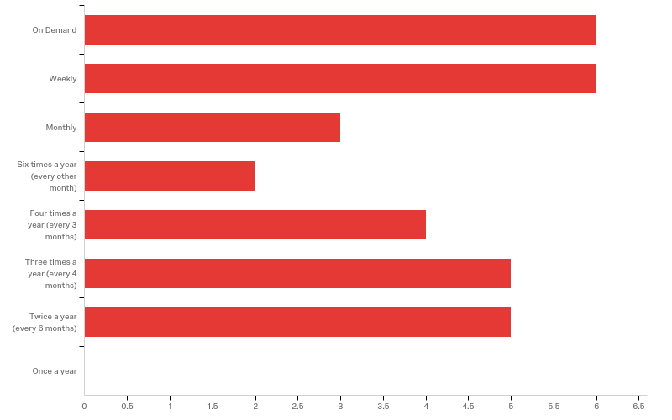
Q2 - How frequently do you administer language tests in a year?
On Demand
Weekly
Monthly
6 Times a Year
4 Times a Year
3 Times a Year
2 Times a Year
Once a Year

Slide 8
Q3 - Approximately how many people do you test in a year?
Mean | 823.69
Std Deviation | 2709.02
Minimum | 1
Maximum | 15000
Count | 29

Slide 9
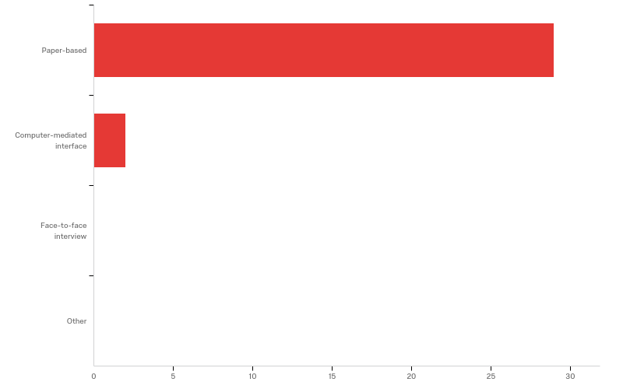
Q7 - How do you test reading?
Paper-based
Computer-mediated interface
Face-to-face interview
Other

Slide 10
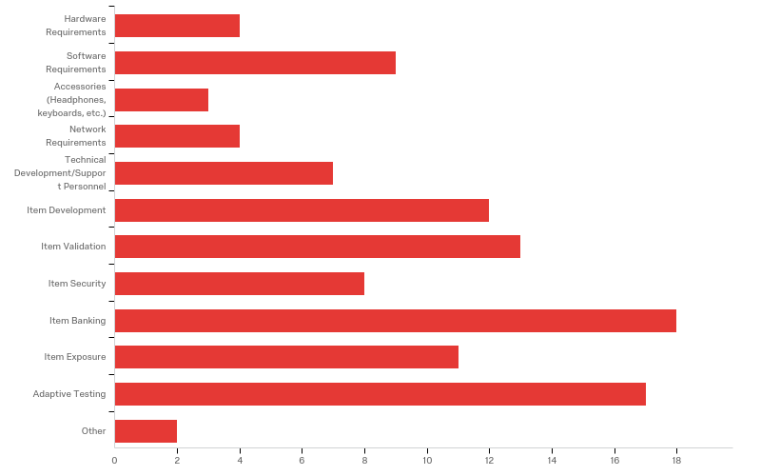
Q8 - What topic areas would you like us to address?
Hardware Requirements
Software Requirements
Accessories
Network Requirements
Technical Development/Support Personnel
Item Development
Item Validation
Item Security
Item Banking
Item Exposure
Adaptive Testing
Other

Slide 11
Questions To Answer Before Administering High Stakes Tests via Computers
BILC Testing Workshop
September 2020

Slide 12
Trusting Technology: A Cautionary Tale

Slide 14
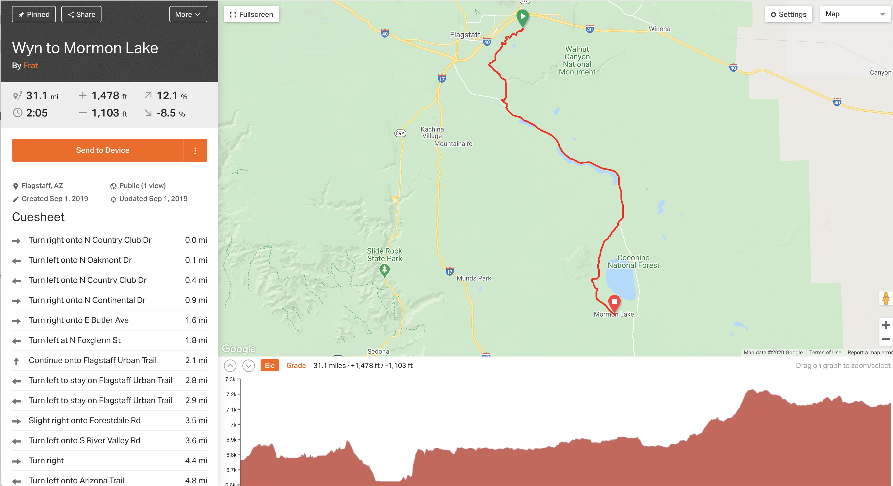

Slide 21
Introduction
Most classroom tests are low stakes, and thus instructors can experiment with computer-based testing relatively easily.
Once the tests become high stakes, however, a number of issues need to be addressed to “avoid the dirt roads” and ensure the tests are valid, reliable and secure.

Slide 22
Self-Assessment Dunning-Kruger Effect
If you or your colleagues are very confident about your ability to start implementing testing on computers, you might be summiting the peak referenced above.

Slide 23
Things to Consider
Computer-based Testing
Physical Set-up
Test Creation
Test Security
Test Administration
Test Scoring
Test Reporting
Items
Development
Validation
Banking
Exposure
Local Independence
Timing
Adaptive Testing
In 3 minutes, look at the topics above and write down everything you think is important to consider.

Slide 24
Physical Set-up
What resources are needed to start testing with computers?

Slide 25
Physical Set-up
Do you have the funds for computers?
Do you have a network with access to servers?
If not, are you prepared to distribute and gather results one at a time?
Do you have (or have access to) the technical expertise to set up the computers?
Do you have (or have access to) the technical expertise to install the software?
Do you have a way to restrict the IP addresses of the computers (client and server) to improve test security and reduce the likelihood of external, unauthorized access?

Slide 26
Test Creation
What resources are needed to create computerized tests?

Slide 27
Test Creation
Do you have the funds for the software to create the tests?
Is there existing software?
How will you support it?
If hiring a programmer, what steps need to be taken to ensure continuity of the product?

Slide 28
Test Security
What you do need to do to ensure your tests are secure?

Slide 29
Test Security
Do you have a plan on how your items will be secure and less likely to be compromised when stored and accessed digitally?
Do you have a Non-Disclosure Agreement (NDA) for anyone that will have access to the items?
Do you have end user and proctor agreements in place to safeguard item integrity?
Do you have a system in place to check-in students and ensure the identity of the test-taker?

Slide 30
Test Administration
What resources are needed to administer computer-based tests?

Slide 31
Test Administration
Do you have adequate staffing (proctors, tech support) to ensure smooth test delivery?
Do you have adequate numbers of devices (including accessories like headphones) to serve your testing circumstances?
Do you have any back-ups for equipment failure?
Do you have system in place to log problem or irregularities that occurred?

Slide 32
Test Scoring
How will responses will be scored/graded?

Slide 33
Test Scoring
Do you have a system in place to store results in a central location such as a server?
If not, do you have staffing to move from machine to machine to copy results to a portable drive?
Do you have software to score the tests automatically?
Do you have software to assign raters to judge open-ended assessments such as speaking or writing?
Do you have a system to ensure the raters are assigned in a manner to minimize rater drift?
Do you have method to account for rater disagreement established?

Slide 34
Test Reporting
What decisions need to be made about reporting the results?

Slide 35
Test Reporting
Will the examinees receive their scores at the time they take the assessment?
If so, do you have a way to ensure answers aren’t exposed via brain dumps?
Will the examinees have an electronically secure method to receive their scores?

Slide 36
Item Development for Computer-based Testing

Slide 37
Item Development
Test Specification (Blue Print)
Item Specification (Spec sheets-electrical, plumbing, etc.)

Slide 38
Item Specifications should …
Be detailed enough that someone else can write an item based on the description
Contain
General Description
Instructions
Prompt Attributes
L1 or L2
Timing constraints
Response Attributes
Sample Item
Timing parameters
Instructions to maximize local independence

Slide 39
Timing Parameters
Xi, 2016

Slide 40
Local Independence
Each item needs to act independently of all the other items.

Slide 41
To validate items
Use Item Specifications
Have experts judge the items (reverse engineer)
Have examinee focus groups do a sensitivity check
Have an editor proofread the items
Administer items to ensure they are functioning as intended
Keep an incident log to note any anomalies during trialing
Use item statistics to investigate anamolies

Slide 42
Items vs testlets
Items
Testlets
Single response to some stimulus
Multiple responses to ONE stimulus
Series of questions on same passage
NOT RECOMMENDED
Context dependent item sets in which the questions can be constant but the input can vary
Purposefully assembled items that are administered in a group

Slide 43
Items in item banks should have
Naming conventions
Version control
Fields for
History
Usage/Exposure
Meta-data (content, level, etc.)
Difficulty parameters (IRT)
Security protocols (ie “plants” to detect cheating, etc.)

Slide 44
What you need to do IRT

Slide 45
Computer Adaptive Tests
Advantages
Disadvantages
Test is tailored to each examinee
Cheating by looking at neighbors is diminished
Test CAN be shorter
Item exposure can be reduced
Examinees can’t go back and change answers (local independence)
Development is MUCH more expensive
All items need to be calibrated prior to being included
Item exposure needs to be carefully monitored-some items might be overexposed due to ability of examinees
Examinees can’t go back and change answers (face validity)

Slide 46
Computer adaptive tests need
Starting criteria for initial estimation of person ability
Algorithms for choosing items/testlets from item bank
Stopping criteria

