Slide 1
A decade of Standardization Efforts & BAT2 History
Peggy Garza
and
Corina Ispas

Slide 2
BILC Community’s Standardization Efforts
Language Testing Seminar (LTS) Advanced Language Testing Seminar (ALTS) | STANAG 6001 Testing Best Practices
Annual STANAG 6001 testing workshop and products | Roadmap to Validity concept a and collection of evidence
BILC website: Testing Resources page | Presentations and research by national STANAG 6001 testers, MA degrees from Lancaster
Bilateral/regional cooperation | BILC assistance visits
Networking with colleagues & international testing experts | Speaking and writing norming forums BAT2 tester/rater certification

Slide 3
Original Goals of BAT2
To confirm our hypothesis that the STANAG 6001 testing community has made progress over the past 10 years in “what they test” and “how they test”, specifically
the quality of their tests
better alignment with STANAG 6001
more standardization of test results across the nations
To improve/update what we offer to the STANAG 6001 testing community
Notes:
Although not a stated goal, results of norming and testing as a community included: team building and network building professionalization of testers – BAT2 part of professional synergy of BILC testing community – that continues.

Slide 4
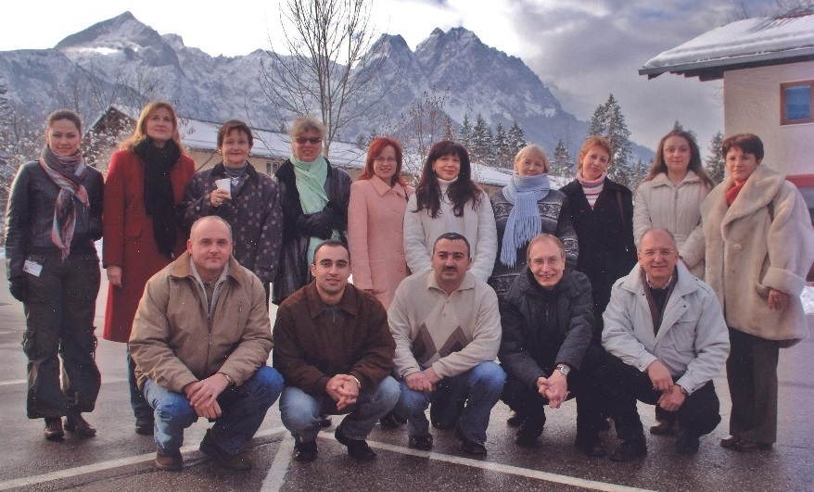
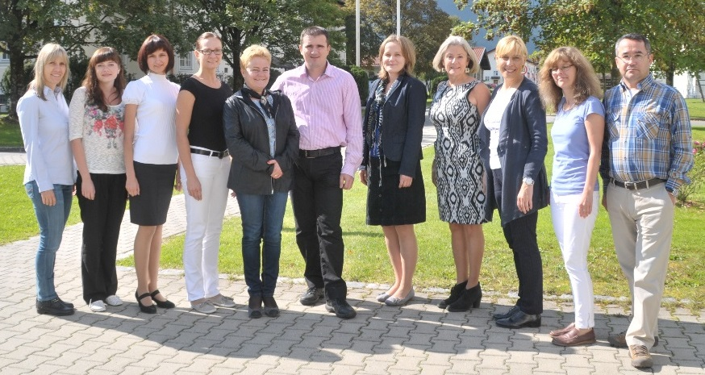
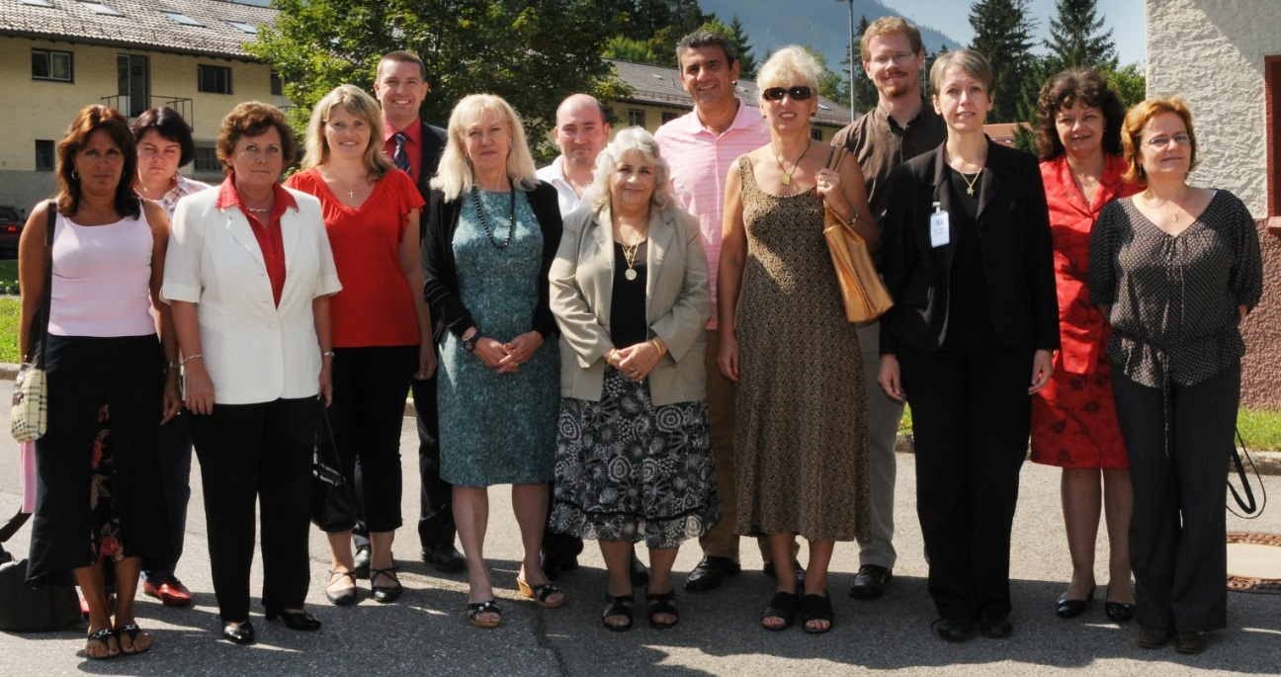
NATO-accredited
Language Testing Seminars
Language Testing Seminar (LTS)
2-week foundational course offered twice a year.
Since 2000, 620 participants from 55 nations/NATO offices. 40 facilitators from 20 nations.
Advanced Language Testing Seminar (ALTS)
3-week highly technical course for experienced language testers offered once a year.
Since 2009, 130 participants from 32 nations/NATO offices.
14 facilitators from 9 nations.

Slide 5
LTS
Introduction to the scale: STANAG 6001
Familiarization with L1- L3
ALTS
Standardization exercises: STANAG 6001
BAT protocol for testing writing
Test production process
Introduction to Validity Roadmap
Introduction to criterion-referenced (CR) testing
Focus on L3
BAT protocols for testing speaking and writing
Validity Roadmap
Collect evidence/ documentation
Practical activities in statistical analysis for criterion-referenced (CR) tests

Slide 6
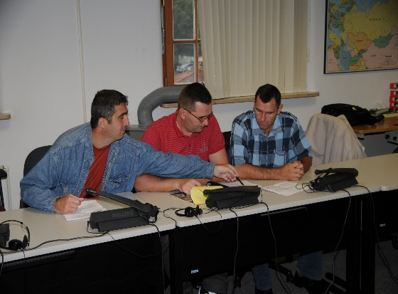
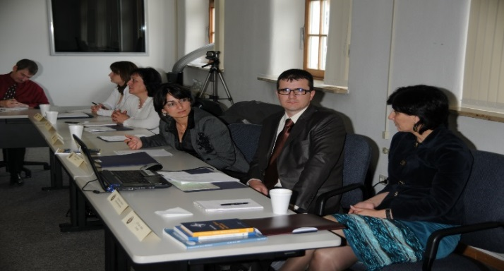
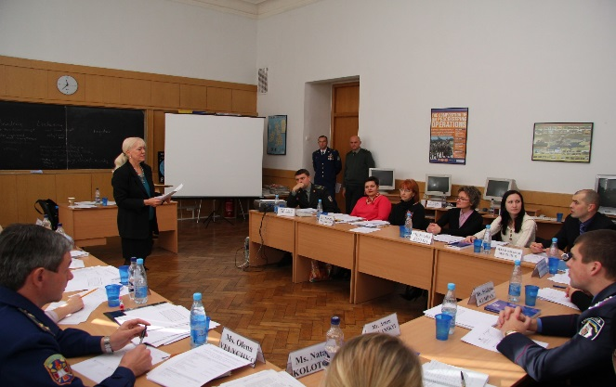
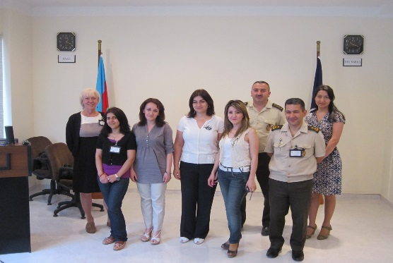
Assistance to national testing organizations
Azerbaijan
Bosnia-Herzegovina
Georgia
North Macedonia
Moldova
Ukraine
Jordan
Mongolia

Slide 7
STANAG 6001 Testing Workshops
Who attends?
LTS graduates who are current STANAG 6001 testers
Goals:
To promote standardization of STANAG 6001 testing by providing a forum for the exchange of information, best practices and new approaches in the field of language testing
Workshop findings are used to update the testing seminars and can lead to new projects and collaboration

Slide 8
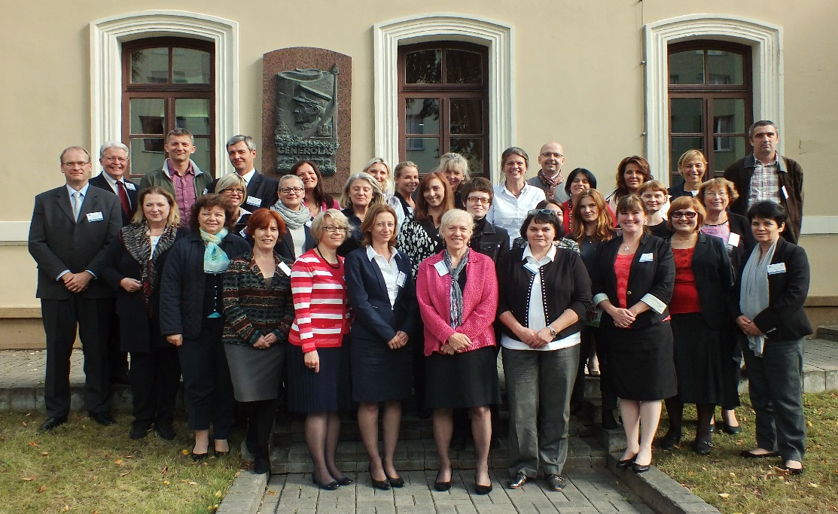
2010 Sarajevo, Bosnia and Herzegovina
2011 Stockholm, Sweden
2012 Copenhagen, Denmark
Testing speaking
Testing writing
2013 SHAPE Mons, Belgium
Integrating test development stages
Testing listening
2014 Reichenau, Austria
Item development workshop
2015 Vilnius, Lithuania
Challenges in testing (text editing, authenticity & Level 4)
2016 Brno, Czech Republic
Testing the test – How valid is our validity argument?
2017 Skopje, North Macedonia
Tester success (hiring and training testers)
2018 Kranjska Gora, Slovenia
Successful Trialling (quantitative & qualitative analysis)
STANAG 6001 Testing Workshops

Slide 9
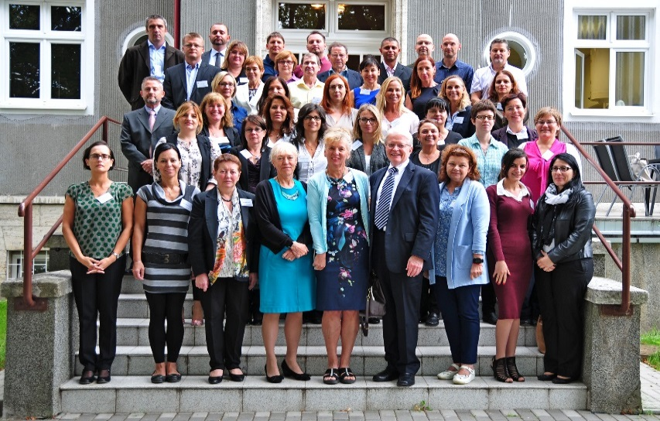
Findings from Brno
Validity Roadmap
Criterion-referenced testing
Alignment activities
Angoffing
Statistical analysis
jMetrik

Slide 10
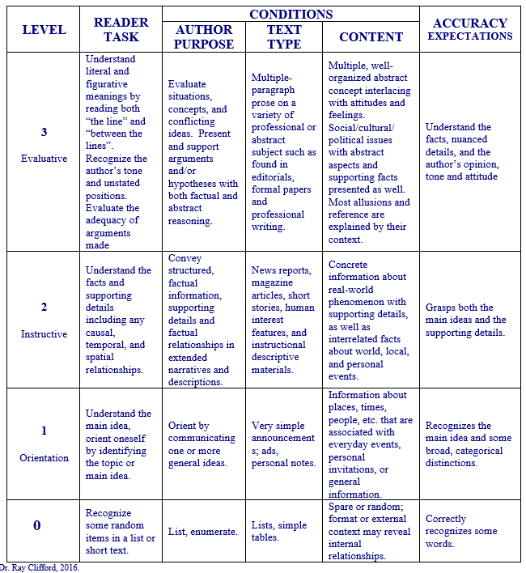
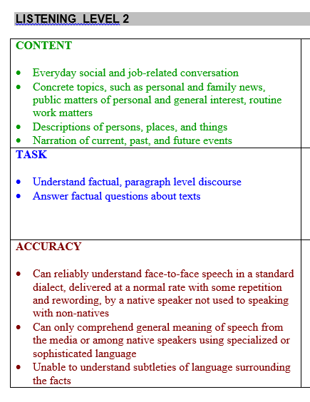
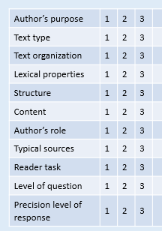
Tools and techniques to check test item quality & alignment
Findings from Brno
Content-Tasks-Accuracy (CTA) statements
Alignment worksheets
Angoffing procedures

Slide 11
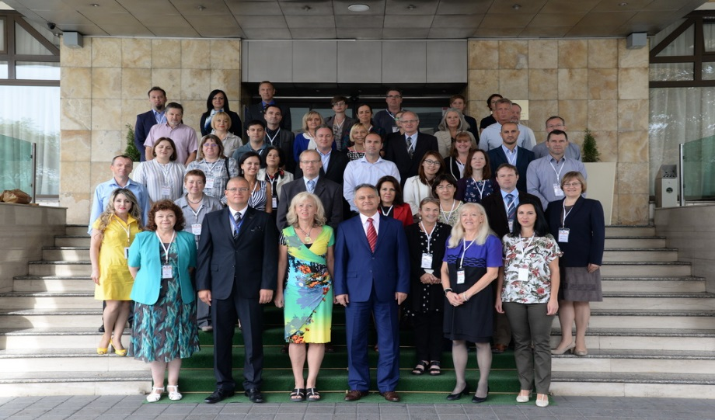
Findings from Skopje
Best Practices
Norming raters of speaking and writing tests
Tools for tester success

Slide 12
Findings from Skopje
Best Practices in STANAG 6001 Testing
Purpose of STANAG 6001 language proficiency tests
Test design
Test development
Test administration
Hiring, training and norming testers
Stakeholders’ rights and responsibilities
A method or technique that has consistently shown results superior to those achieved with other means, and that is used as a benchmark.

Slide 13
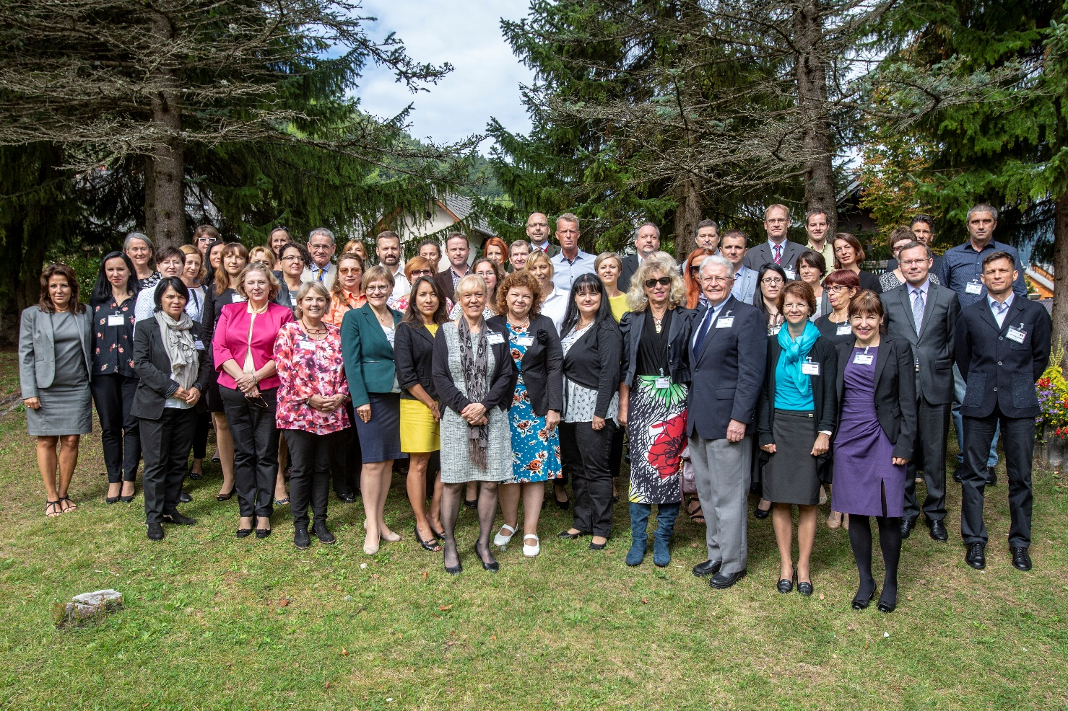
Findings from Kranjska Gora
Trialling Best Practices
Quantitative and qualitative analysis
Statistical analysis for CRT
Excel and jMetrik
Questionnaire design

Slide 14
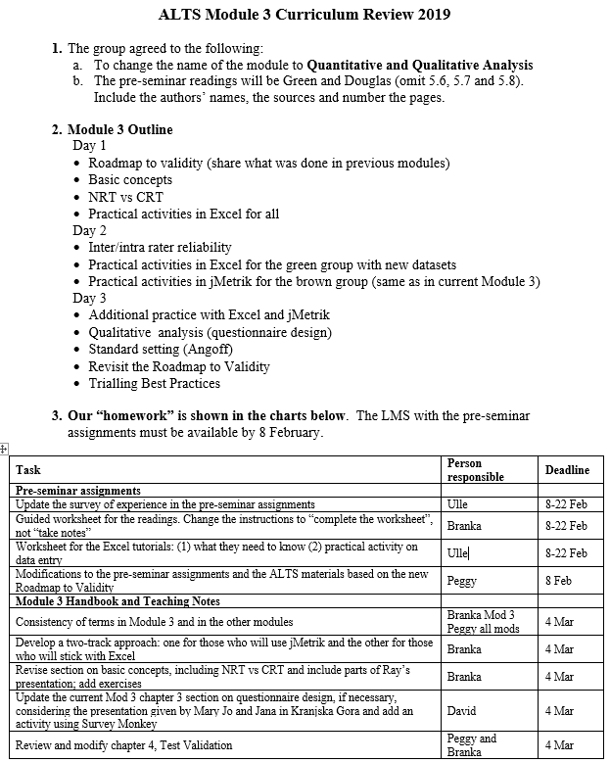
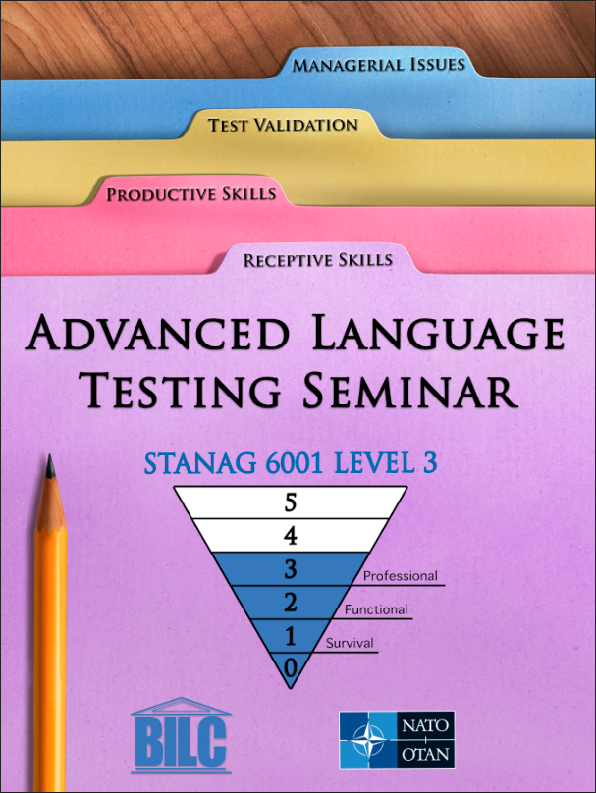
Findings from Kranjska Gora
Updates to ALTS Module 3
Module renamed
“Quantitative & Qualitative Analysis”
Two-track approach for participants
Practical activities with Excel OR jMetrik
Disambiguation of terms
Trial / Pilot / Pre-test

Slide 15
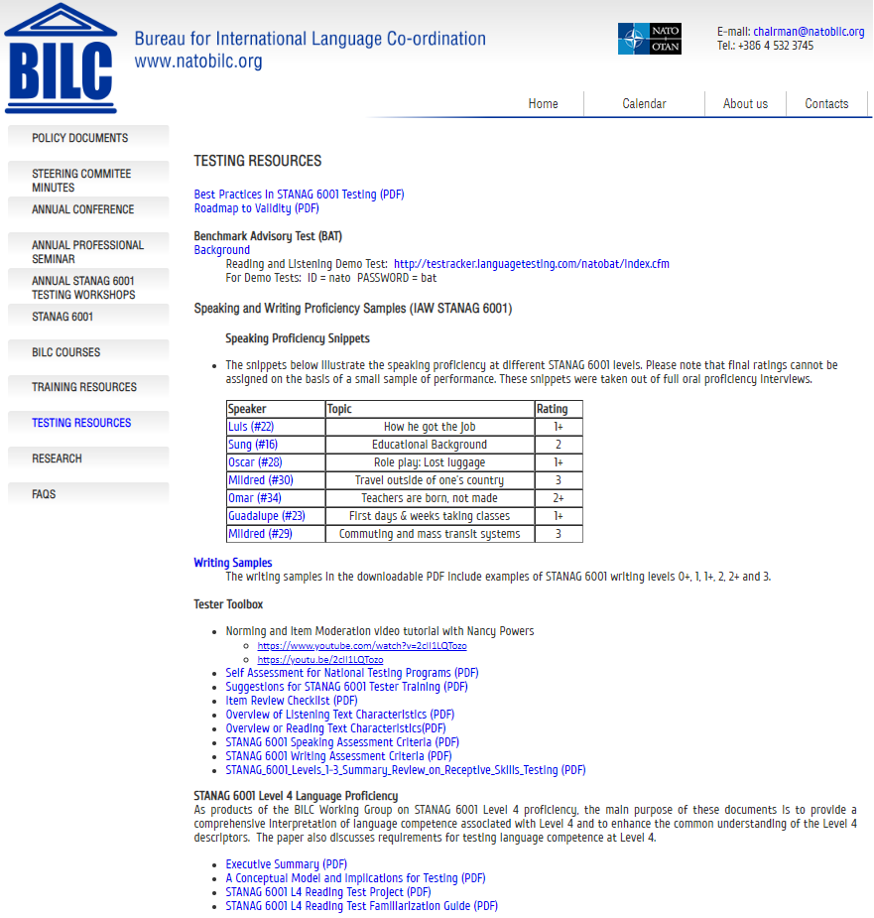
BILC Website - www.natobilc.org
BILC Policy Recommendations
Language Testing Resources
Best Practices in STANAG 6001 testing
Roadmap to Validity
BAT
BAT demo
Speaking and writing samples at different levels
Toolbox for Testers
Norming and item moderation video tutorial
Self- assessment of testing organizations
Suggestions for tester training
Item review checklist
Listening and reading overviews
Levels 1-3 summary reviews
Level 4
A Conceptual Model and Implications for Testing
Level 4 reading test project and Familiarization Guide

Slide 16
Benchmark Advisory Test (BAT)
Then & Now
Round 1: 2007-2009
Round 2: 2018- 2019
Advisory measure for nations
Evidence of standardization

Slide 17
BAT History
Launched as a volunteer, collaborative project
The BILC Test Working Group
13 members from 8 nations
Contributions received from many other nations
The original goal was to develop a reading test for Levels 1-3

Slide 18
BAT History (continued)
Later awarded a competitive contract by ACT
ACTFL working with BILC Working Group
To develop tests in 4 skill modalities
Reading and Listening tests piloted and validated
Speaking and Writing tests developed
Testers and raters trained and certified
Test administration and reporting protocols developed
200 BAT 4-skills tests allocated under the contract
Tests administered and rated
Scores reported to nations

Slide 19
BAT Reading and Listening Tests
Internet-delivered and computer scored
Criterion-referenced tests
Each proficiency level is tested separately
Test takers take all items for Levels 1, 2, 3
20 texts at each level; one item with multiple choice responses per text
The proficiency rating is based on
“Floor” – sustained ability across a range of tasks and contexts specific to one level
“Ceiling” – non-sustained ability at the next higher proficiency level

Slide 20
2009 BAT Administration
Allocation to 11 nations
All nations completed testing
Testing began in May, 2009
Tests administered by LTI, the ACTFL Testing Office

Slide 21
Benchmark Advisory Test (BAT)
Round 2
Aim: Provide evidence of standardization of STANAG 6001 testing across the nations
21 nations interested in participating
10 tests per nation
First steps in 2018
Application process
BAT Speaking & Writing norming sessions

Slide 22
2018 BAT Application Process
Nations complete questionnaire describing national STANAG 6001 tests
Test design
Administration procedures
To minimize technical problems in test administration
To provide insights into possible reasons for misalignment, if any
Why?

Slide 23
2018 BAT2 Speaking & Writing Norming Forums
What
Blended program of web-based and in-person norming
Development of writing prompts for BAT2
Who
Experienced STANAG 6001 testers
When
July & August 2018

Slide 24
BAT2 Speaking & Writing Follow-Up
What
BAT2 tester and rater certification
Who
Graduates of the BAT S&W norming forums
What else
Trialling of the writing prompts
Where
Defense Language Institute English Language Center (DLIELC)

Slide 25
BAT2 Administration
Schedule
One nation in November 2018
17 nations from January -June 2019
Description
Reading and listening, Levels 1-3
Computer-delivered multi-stage adaptive
Multiple choice-4 options plus “I don’t know” option
Writing
Computer-based, 3 tasks; Levels 1 &2, Level 2& 3, Level 3
Rated by 2 certified BAT2 raters
Speaking
Telephonic, Levels 1-3
Conducted by one BAT2 certified tester/rater
Second rating by another BAT2 certified rater

Slide 26
BAT2 Administration: Proctor
Proctors
Training
Sign agreement
Confirm computers and network systems met the technical requirements
Identify 10 test takers
National scores within 6 months of BAT2 administration
Ideally 2+/3 in speaking
Administer the computer-delivered reading, listening and writing tests
Proctor the telephonic speaking tests
Provide feedback via online questionnaire

Slide 27
BAT2 Administration: Test Taker
Test takers
Read Examinee Guide and take BAT2 demo test
Sign agreement
Take BAT2 listening, speaking, reading and writing tests
Provide feedback via online questionnaire

Slide 28
What did the participating nations receive?
BAT2 and national score comparisons
Compilation of proctor and test taker responses
BAT2 certificates

Slide 29
BAT Analysis Meeting 24-28 June
BAT2 Analysis Team
Dr. Ray Clifford, Brigham Young University
Dr. Troy Cox, Brigham Young University
Mary Jo Dibiase Lubrano, Yale University
Peggy Garza, PLTCE
Roxane Harrison, PLTCE
David Oglesby, PLTCE
Dr. Elvira Swender, past Director ACTFL Professional Programs

Slide 30
BAT Analysis Meeting : Productive Skills
Discussion on data analysis
BAT1 vs BAT2
National vs BAT2
Ways to measure the “no stakes” effect on results
Test taker feedback
Proctor feedback
Tester/rater comments
Effectiveness of BAT Examinee Guide
Speaking
IRR/Rater agreement stats
Lessons learned
Writing
IRR/Rater agreement stats
Analysis of the effectiveness of the prompts
Lessons learned
Positive effect of norming forums and recommendations for the future
Selection of speaking and writing sample for A(LTS) and norming sessions

Slide 31
BAT Analysis Meeting : Receptive Skills
General topics on testing the receptive skills
Applying CR-scoring to multi-stage adaptive testing
Effectiveness of the BAT2 demo test
Reading
Quantitative and qualitative analysis
Distractor analysis including the “I don’t know” option
Lessons learned
Listening
Quantitative and qualitative analysis
Distractor analysis including the “I don’t know” option
Lessons learned
New sample items for the (A)LTS
Model reading and listening test specs for the A(LTS)
Considerations for computer delivered/adaptive testing

Slide 32
Updates to (A)LTS
Selection of BAT2 speaking and writing tests for training
Classic benchmark samples
Borderline samples
Sample reading and listening items
Sample test specifications
How to calculate tester/rater agreement
How to perform distractor analysis

Slide 33
Future Projects
Add new resources to the BILC website
Possibilities
Annual norming sessions for testers and raters of the productive skills
Advice and consultation: “Is your nation ready for computer-based testing?”
One -week workshop on converting from paper-based to computer-based testing
What else?

