Slide 1
Face Validity as an Important Factor in the Military as a Social System
LTC Dr. Karl TESTOR @ BILC Testing Workshop RIGA

Slide 2
Good prompt?
Task: Referring to the following prompt, state your opinion and explain in detail.
Studies have linked social media to depression, body image concerns, self-esteem issues, social anxiety and other problems. Therefore, some would argue that social media is everything but social.

Slide 3
BILC mission¹
To promote and foster interoperability among NATO and Partner nations by
furthering standardization of language training and testing,
and harmonizing language policy.
BILC supports the Alliance through the exchange of knowledge and best practices, in accordance with established procedures and agreements.
¹ Cf. BILC Terms of Reference (2016). Edition 1. Mission.

Slide 4
Stakeholders in Military
MoD
HR-Division
Academies and Schools
Mission(s)
Soldier(s) themselves
…
Each with different “purpose“ → Influence policy
“Politics plays an important role in many aspects of life, and language testing is no exception.”¹
¹ Green, R & Wall, D. (2005): Language testing in the military: problems, politics and progress. p.390

Slide 5
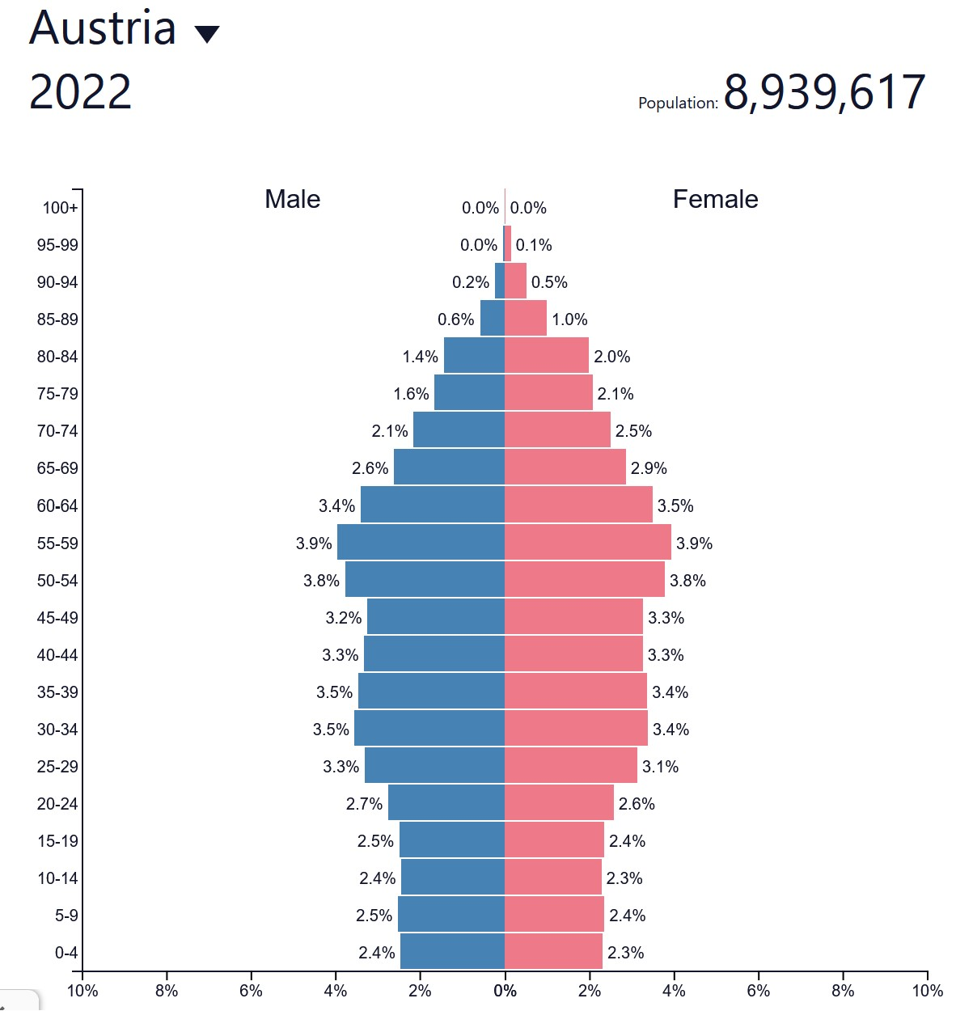
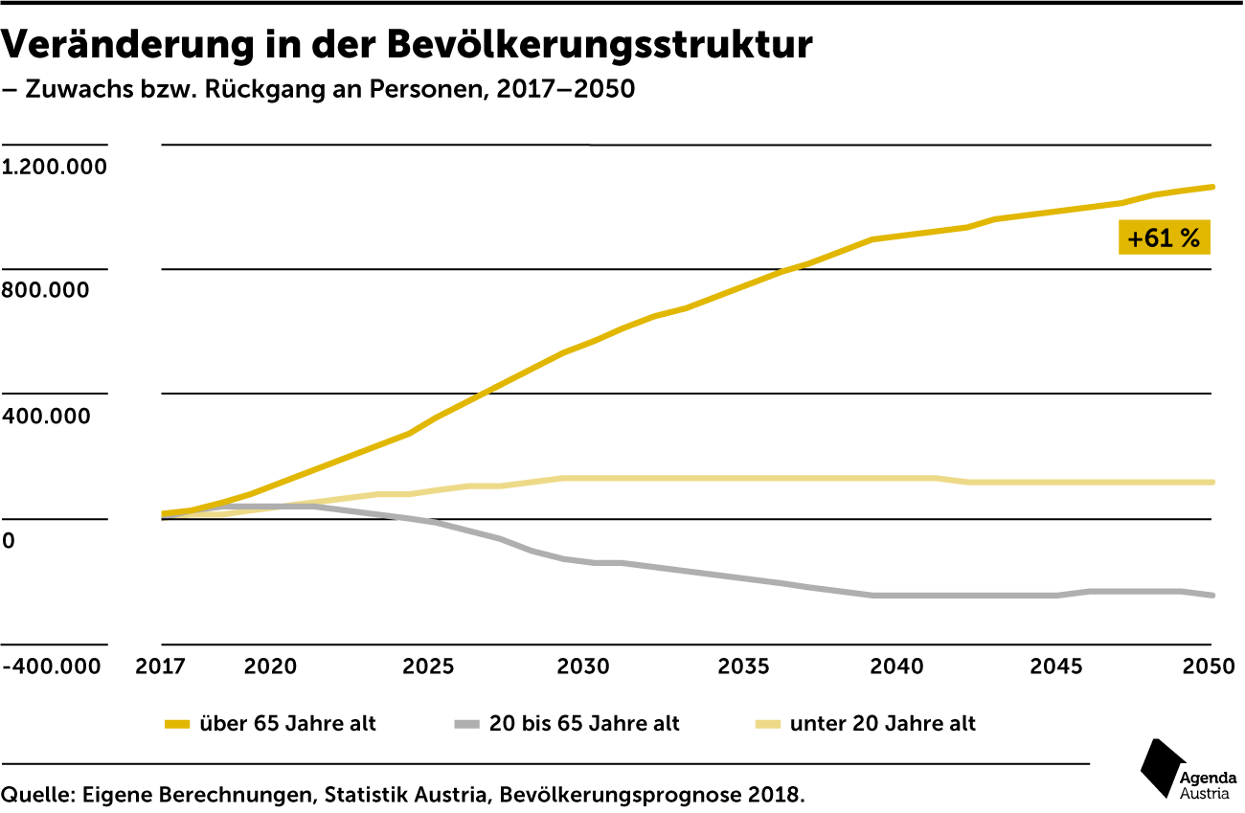
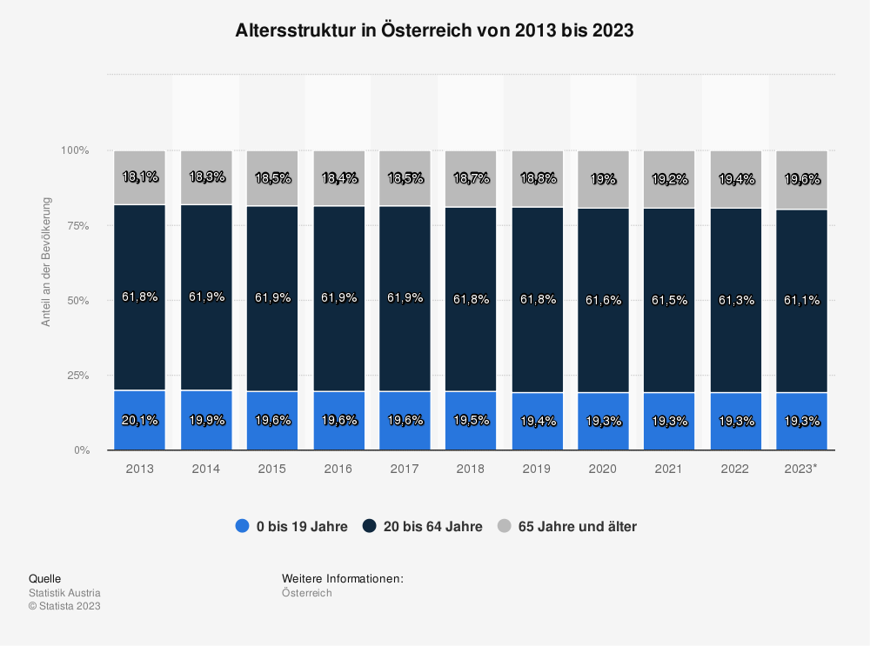
Demographics

Slide 6
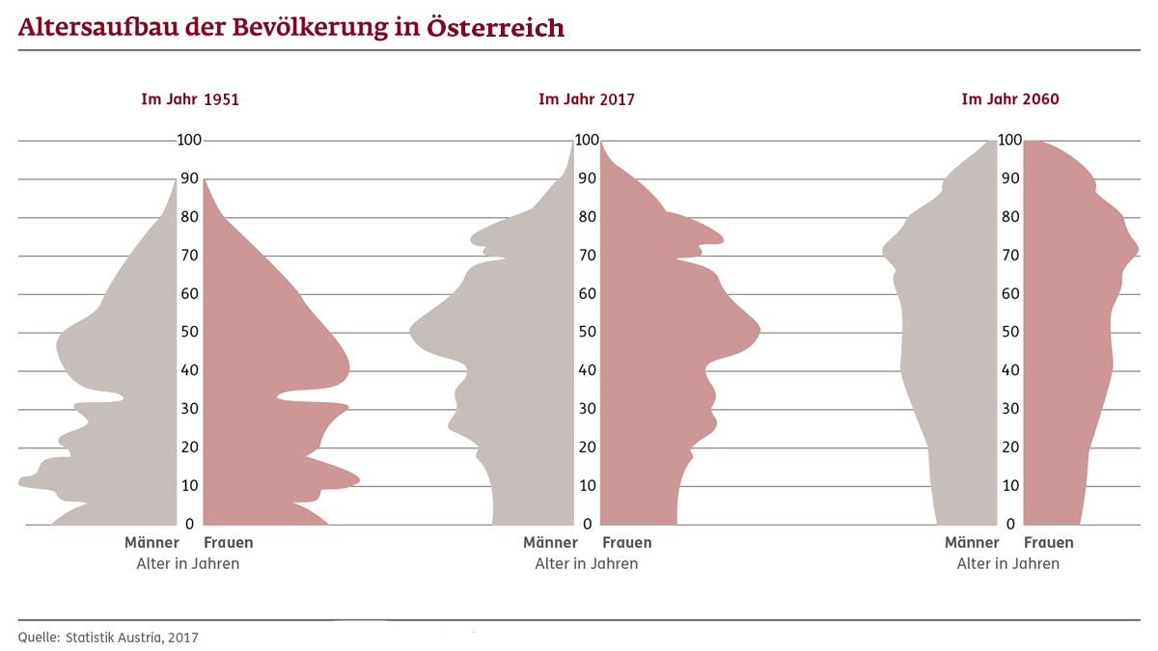
Demographics
On Average: 12% fewer people in the “work force“

Slide 7
Demographics influence
Fewer children
Longer life-expectancy
Fewer people in “work force“
Future AI-development → fewer educated people have higher unemployment rates
→ more budget spending on social security (health, unemployment etc.)
Therefore, Mil will have to fight for budgets and have less potential to recruit personnel.

Slide 8
Face validity
”A test is said to have face validity, if looks as if it, measures what it is supposed to measure”.²
”A test which does not have face validity may not be accepted by candidates, teachers, education authorities or employers. It may simply not be used;”³
It is all about acceptance of the test.
² Siddiek, A.G. (2010): The Impact of Test Content Validity on Language Teaching and Learning. p.137.
³ Hughes, A. (2003): Testing for Language Teachers. p.33.

Slide 9
Writing Level 3
“Can write about special fields of competence with considerable ease. Can use the written language for essay-length argumentation, analysis, hypothesis, and extensive explanation, narration, and description. Can convey abstract concepts when writing about complex topics (which may include economics, culture, science, and technology) as well as his/her professional field.”⁴
⁴ ATrainP-5 (2016): Language Proficiency Levels. p.A8

Slide 10
Lack of understanding testing⁵
“Survey also indicated that there are teams charged with creating fair testing procedures who are then expected to change their standards if circumstances require it.”
“[Language] teams often have no say in matters of policy or high-level implementation”
⁵ Green, R. & Wall, D. (2005): Language testing in the military: problems, politics and progress. p.390

Slide 11
Complaints
The topics are not good. Why should I be able to talk about ZZZ. I do not know anything about it.
In an international mission, we do not need to know these things.
My level of English works for other nations. I had no problems in any mission ever…
Did you ever see XXX‘s (random nation) soldiers? They are…
Who complains? The ones who failed to achieve their level expected.
The problem with cognitive skills as oposed to physical skills: we ourselves are not able to “see“ our limitations!

Slide 12
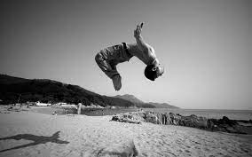
Physical skills difference

Slide 13
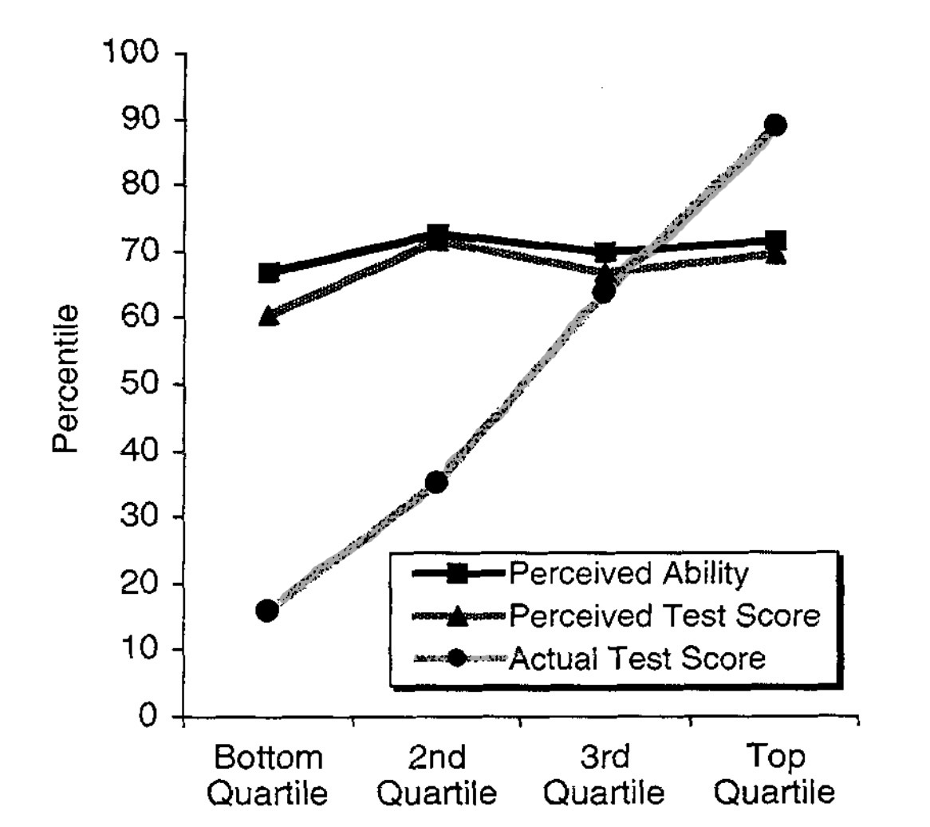
Dunning-Kruger-Effect⁶
“Figure 3. Perceived grammar ability and test performance as a function of actual test performance”
⁶ Kruger, J. & Dunning, D. (1999): Unskilled and Unaware of It: How Difficulties in Recognizing One’s Own Incompetence Lead to Inflate Self-Assessments. p.1126

Slide 14
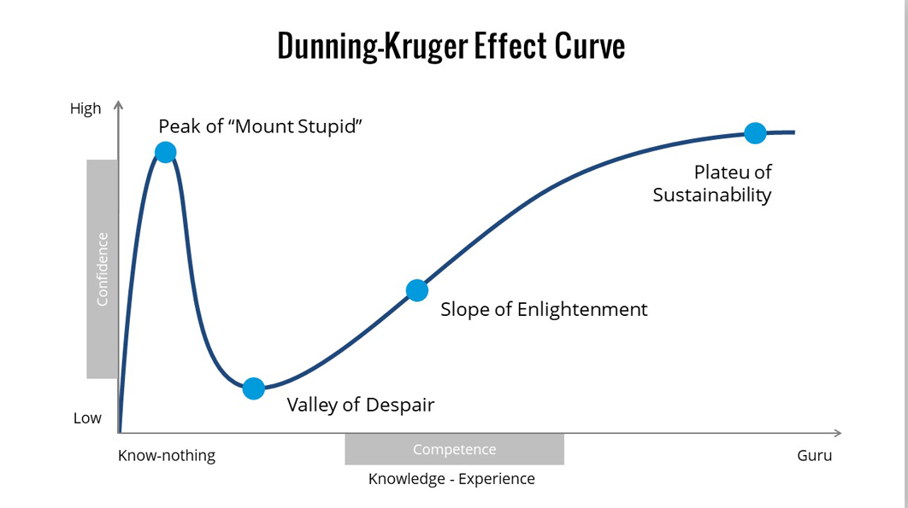
Dunning-Kruger-Effect
Figure: https://slidemodel.com/dunning-kruger-effect/ [accessed 05th September 2023]

Slide 15
Stakeholders‘ purposes for testing
MoD -> interoperability and mission readiness
HR-Division -> quality assurance vs. recruiting
Academies and Schools -> learning development
Mission(s) -> functioning soldiers
Soldier(s) -> career/development/mission/benefits ?
… -> ….
Each with different “purpose“.

Slide 16
Consequences for testing
Raise awareness in advance: Policy-making has to be done in time to ensure stakeholders‘ support
Provide strong support for the validity argument
“Subject knowledge is needed by test developers […] to produce appropriate […] tasks based on military scenarios. […] testers have to […] develop authentic tasks”⁷
Tests only SHOW the STATUS QUO, consequences for the system have to be solved somewhere else.
⁷ Green, R. & Wall, D. (2005): Language testing in the military: problems, politics and progress. p.396

Slide 17
Good prompt?!
Task: Referring to the following prompt, state your opinion and explain in detail.
Studies have linked social media to depression, body image concerns, self-esteem issues, social anxiety, and other problems. Therefore, some would argue that social media is everything but social.

Slide 18
Good prompt?!
Task: Referring to the following prompt, state your opinion and explain in detail.
Studies have linked social media to depression, body image concerns, self-esteem issues, social anxiety, and other problems. Therefore, some would argue that social media is everything but social. However, social media is commonly used by soldiers in missions abroad giving them a slight feeling of home.

Slide 19
Thank you for your attention!
More languages - More security!

Slide 20
Literature
ATrainP-5 (2016): Language Proficiency Levels. Allied Training Publication. NATO Standardization Office.
Green, R & Wall, D. (2005): Language testing in the military: problems, politics and progress. Language Testing Vol.22, Issue 3, p. 379-398.
Hughes, A. (2003): Testing for Language Teachers. Second Edition. Cambridge University Press.
Lepak, D./Snell, S. (1999): The Human Resource Architecture: Toward a Theory of Human Capital Allocation and Development. The Academy of Management Review, Vol. 24, No.1, p. 31-48.
Kruger, J. & Dunning, D. (1999): Unskilled and Unaware of It: How Difficulties in Recognizing One’s Own Incompetence Lead to Inflate Self-Assessments. Journal of Personality and Social Psychology. Vol. 77, No.6, p.1121-1134
Siddiek, A. G. (2010). The impact of test content validity on language teaching and learning. Asian Social Science. Vol.6, No.12, p.133-143.

