Slide 1
BILC JTAC Working Group (WG) Update

Slide 2
What do joint terminal attack controllers do?

Slide 3
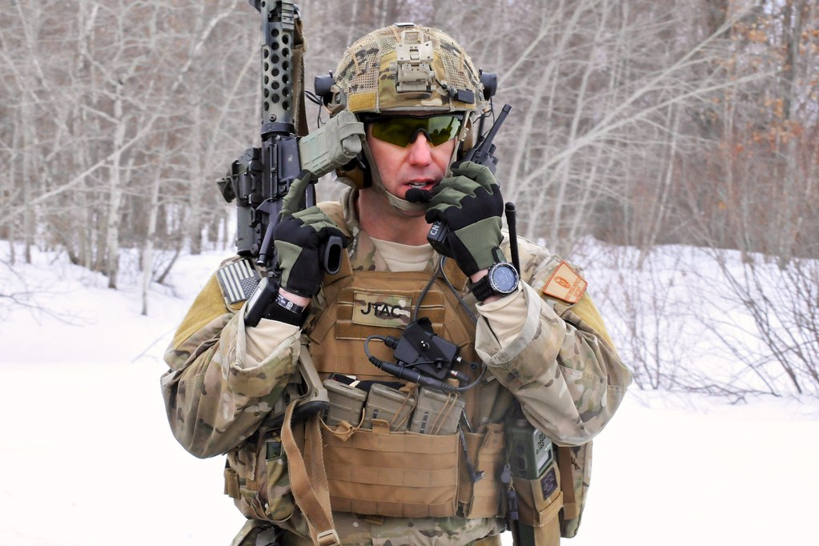
How is BILC involved?
JTACs have a language requirement as per ATP-3.3.2.2
STANAG 6001 SLP 3332
Many qualified and competent JTACs across NATO fail their STANAG tests
JTAC stakeholders asked BILC to conduct a language needs analysis
Analyze the unique JTAC language tasks
Include a mix of nationalities in the research
Consider a “more focused test” taking the JTAC environment and range of tasks into account
This Photo by Unknown Author is licensed under CC BY-ND

Slide 4
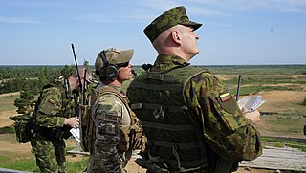
Update on recent activities
25 May: Briefed 75 JTAC program managers at a CAS conference at Ramstein AFB
28 May-3 June: Adriatic Strike exercise in Slovenia
Briefed 300 JTACs on the project
Observed exercise activities
Designed questionnaires for three different audiences;
largely confirming the WG conclusions of misalignment
JTACs (experienced and novice)
JTAC trainers and evaluators
English-language NS JTACs
5 Sept: ICAO meeting and steps toward a JTAC prototype test
This Photo by Unknown Author is licensed under CC BY-SA

Slide 5
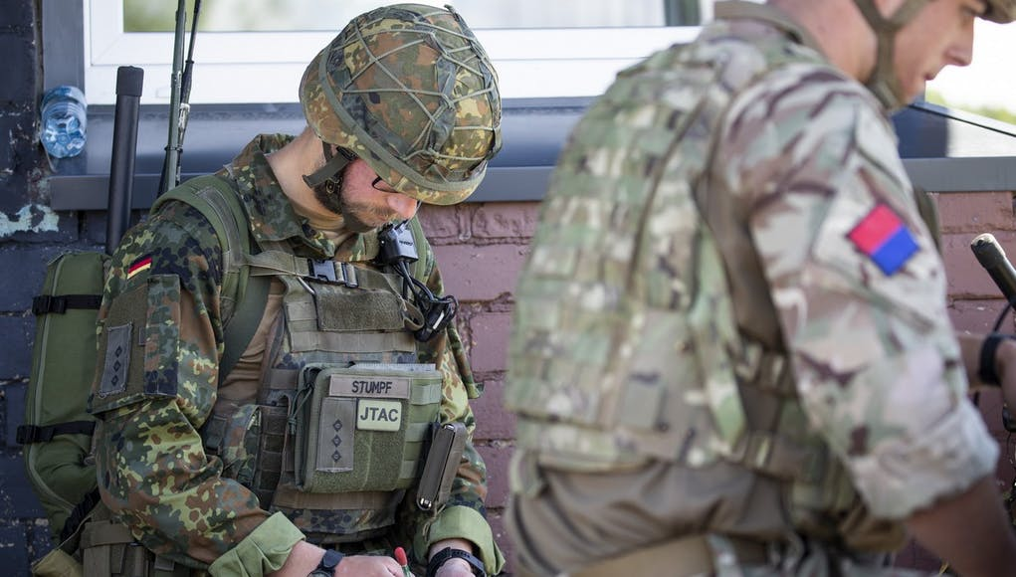
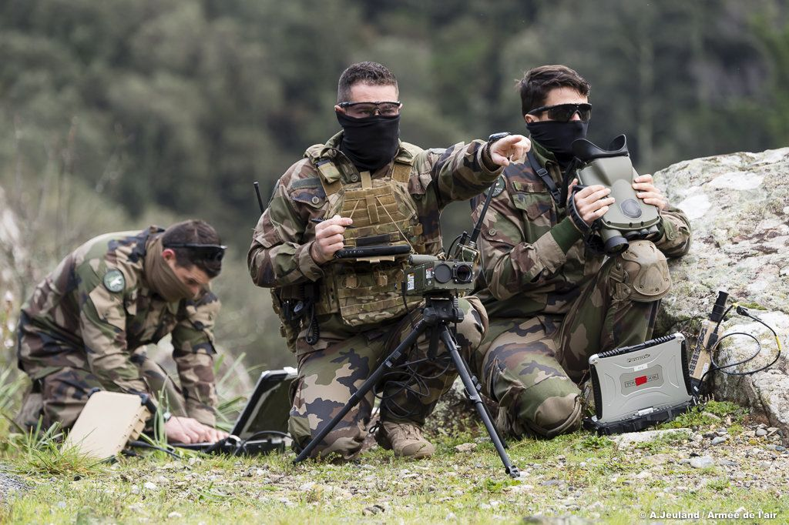
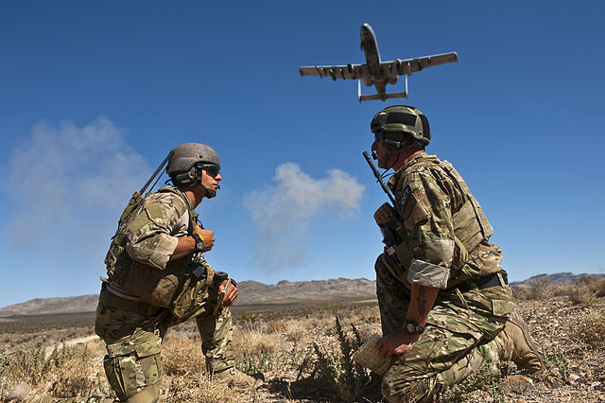
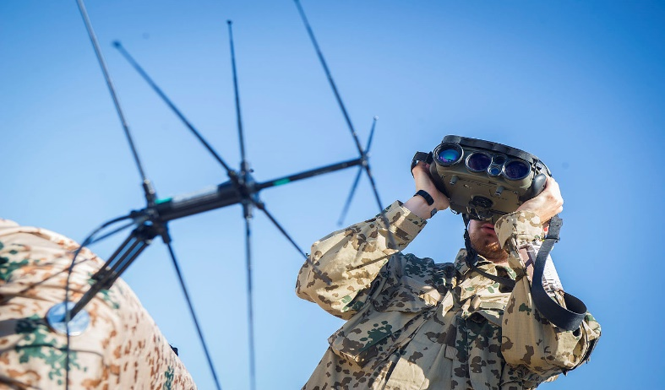
We appreciate the BILC member nations that have offered their input and assistance.
BILC@marshallcenter.org
This Photo by Unknown Author is licensed under CC BY-SA
This Photo by Unknown Author is licensed under CC BY-SA

