Slide 1
Willing Suspension of Disbelief

Slide 2
Work hard play hard

Slide 3
This is not Martina

Slide 4
Lukaaaaah!!!

Slide 5
Details
Name: Karishma Chafekar
Email: k.chafekar@mindef.nl
Phone: 003176 5274114
Name: Harry Kirkels
Email:hfmh.kirkels.01@mindef.nl
Phone: 003176 5274264

Slide 7
Officer-Cadets and Midshipmen

Slide 8
The Netherlands

Slide 9
Royal Netherlands Naval Institute

Slide 10
Royal Netherlands Military Academy

Slide 11
Grammar? Oh no, not again!

Slide 12
Shock

Slide 13
Soldier-Diplomat

Slide 15
“ …it was agreed, that my endeavours should be directed to persons and characters supernatural, or at least romantic, yet so as to transfer from our inward nature a human interest and a semblance of truth sufficient to procure for these shadows of imagination that willing suspension of disbelief for the moment, which constitutes poetic faith”.

Slide 16
Trident Juncture 2018

Slide 17
Rod Ellis

Slide 18
TBLT
Situational authenticity: real world task.
E.g. borrowing a library book, painting a fence
Interactional authenticity: communicative behaviour arising from performing real world tasks: in order for the task to be successfully completed, interaction must take place!
E.g. picture drawing task (asking questions and clarifying meanings)

Slide 19
10 Commandments
Teacher's Version Learner's Version
1 Lower inhibitions Fear not!
2 Encourage risk-taking Dive in
3 Build self-confidence Believe in yourself
4 Develop intrinsic motivation Seize the day
5 Engage in cooperative learning Love thy neighbour
6 Use right-brain processes Get the BIG picture
7 Promote ambiguity tolerance Cope with the chaos
8 Practice intuition Go with your hunches
9 Process error feedback Make mistakes work for you
10 Set personal goals Set your own goals
Brown, 2014 (135)

Slide 20
Officer Training

Slide 21
Short-term Commissioning Officers’ Course
60 contact hours
30 study hours
Audience: approx. level 2
16 pax

Slide 22
STANAG 6001 Speaking Level 3 Professional
Speaking
Writing
“answering objections, clarifying points, justifying decisions, responding to challenges, supporting opinion, stating and defending policy…conducting meetings, delivering briefings or other extended and elaborate monologues, hypothesising, and dealing with unfamiliar subjects and situations.”
“…essay-length argumentation, analysis, hypothesis, and extensive explanation, narration, and description. ….abstract concepts when writing about complex topics”

Slide 23
Military Tasks: Formal Meeting

Slide 24
Military tasks: Defence Attache

Slide 25
Military tasks: Conduct Briefings

Slide 27
Course Design UN Mission
Orientation
Preparation
Deployment
Wind-down
Familiarisation conflict
Pre-deployment training
Boots on the ground
Ops Update
Process, disseminate information
Compare, contrast, clarify points, support opinion
Thinking and talking on your feet
Briefing

Slide 28
Phase 1 Orientation
Geo-political situation
Actors
UN
Article 100

Slide 29
Geo-political situation
Territorial claims
Refugees
Repression
Oil
Religious strife

Slide 30
Actors
3 or 4 states and
2 or 3 non-state actors

Slide 31
UN
UNSC
Charter
Chapter 6 & 7
PSO

Slide 32
Preamble UN
WE THE PEOPLES OF THE UNITED NATIONS DETERMINED
to save succeeding generations from the scourge of war, which twice in our lifetime has brought untold sorrow to mankind, and to reaffirm faith in fundamental human rights, in the dignity and worth of the human person, in the equal rights of men and women and of nations large and small, and to establish conditions under which justice and respect for the obligations arising from treaties and other sources of international law can be maintained, and to promote social progress and better standards of life in larger freedom…

Slide 33
Article 100 Process

Slide 34
Phase 1 Orientation
Geo-political situation
Actors
UN
Article 100
Debate

Slide 35
Phase 2 Preparation
PDT-programme
Law of Armed Conflict: Breaches
Geneva Conventions
Rules of Engagement
Press
Meetings
Discussions
Dilemmas
Press interviews

Slide 36
Press Conference

Slide 37
Phase 3 Deployment
Terrain
People
Events
Radio
Map
Social Graces (VIPs)
Reports
Briefings
Messages
Field exercises

Slide 38
Map Orientation Ypres

Slide 39
Phase 4 Wind-down
Briefing
Writing
Assessment

Slide 40
Final Briefing: Audience

Slide 41
Trick or treat

Slide 42
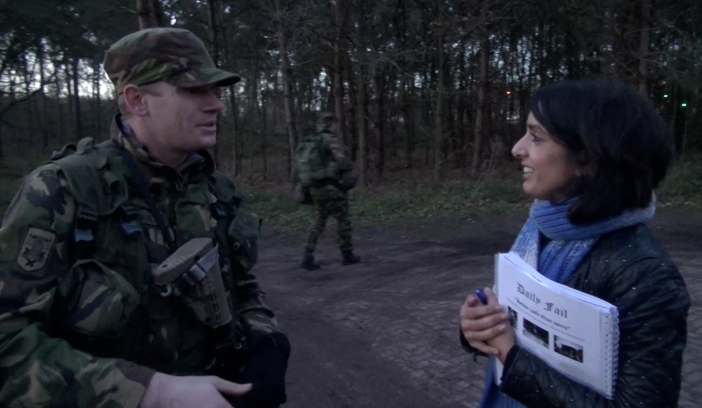
In action on exercise

Slide 43
Feedback on exercise

Slide 45
Hvala!

Slide 46
TBLT Extra
6/7 engineers
Organise conference engineering
Invite a real audience
Invite a guest speaker
Give a number of presentations
Organise venue
Evaluate conference
Period: two weeks

