Slide 1
A Corpus-Based Approach to Adapting Authentic Military Material
Ms. Andrea Gjorevski
Defense language institute English language center (DLIELC)

Slide 2
Presentation objectives:
To share an online resource “Word and Phrase”
To demonstrate how we used this tool to assist in developing a new level
To inspire you to become familiar with the site to help with your needs

Slide 3
Activity: What is a corpus?
I’ve never used a corpus before!
I’ve heard of this and sometimes use one
I use a corpus all the time!

Slide 4
What is a Corpus?
A collection of written OR spoken language
SOURCES: books, newspapers, magazines, journals, news reports, etc.
Word and Phrase https://www.wordandphrase.info/
The Corpus of Contemporary American English https://corpus.byu.edu/coca/

Slide 5
COCA & Word And Phrase
Developed by Dr. Mark Davies, professor of Linguistics at Brigham Young University
The Corpus of Contemporary American English (COCA) is the largest freely-available corpus of English, released 2008
560 million words of text (1990-2017)
Word and Phrase.info uses COCA data, released 2012
User-friendly
Student-friendly

Slide 6
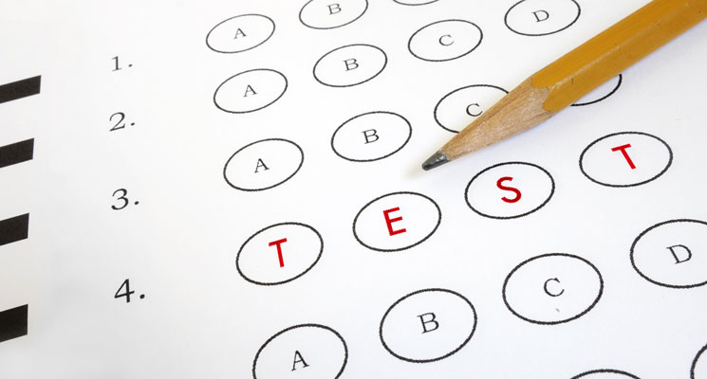
How do we use COCA data at DLI?
TESTING: Test writers use COCA to…
find descriptors of similar frequency/difficulty
ensure appropriate context for the objective being assessed
level items and present a variety of terms
CURRICULUM: Course writers use COCA data to…
write high-frequency definitions
present authentic collocations
present authentic context (newspaper, spoken, fiction, etc.)
Notes:
find descriptors of similar frequency/difficulty (unusual/strange VICE bizarre)
ensure appropriate context for the objective being assessed (spoken/dialogue vs. written context)
for level 3 (high-frequency abstract) and 4 (low-frequency abstract)

Slide 7
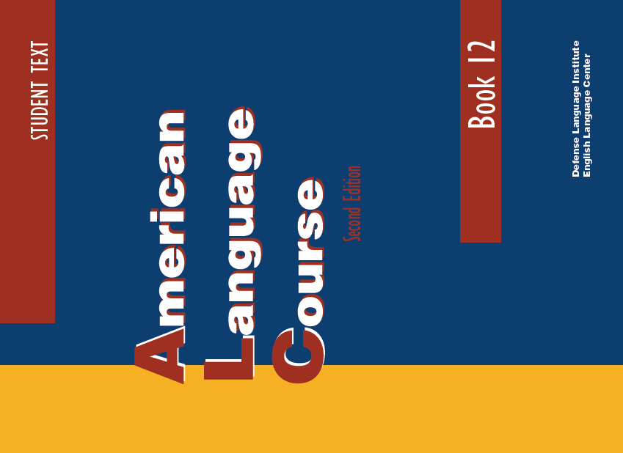
Our task: Develop a new level
Authentic material
New Vocabulary!
More military context
Integrated skills focus

Slide 8
Problems with authentic texts
Texts (for both listening and reading) were often too long or too difficult
Identifying vocabulary items was overwhelming
Adapt & use excerpts, cut out text that required technical knowledge
Use Word and Phrase to identify target vocabulary
SOLUTIONS

Slide 9
Identify the text

Slide 10
Copy text into WAP (Analyze Text)

Slide 11
Frequency Range:
Blue: high frequency (rank 1-500 on word list) “the” “and” “be”
green: medium frequency (501-3000 on word list) “international” to “athletic”
Yellow: lower frequency
(3001-60,000) “slight” to “self-pollination”
Gray: Proper Nouns
Definitions: top 5 frequency-based

Slide 12
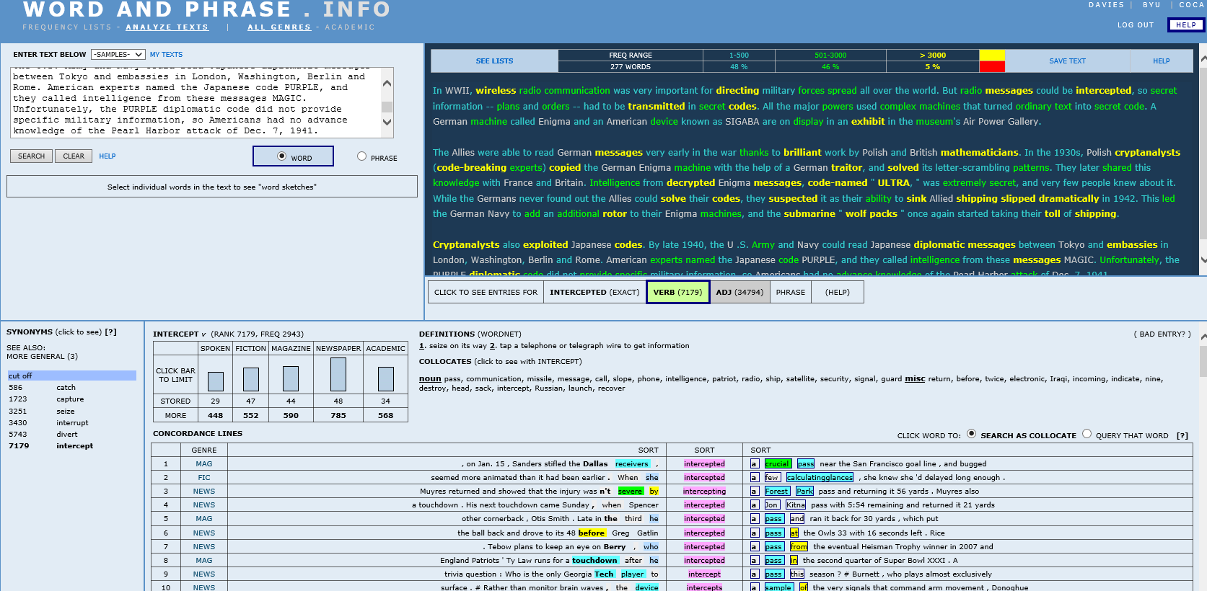
Collocates: frequency-based; grouped by part of speech
Definitions: top 5 frequency-based

Slide 13
Context/Genre:
Spoken
Fiction
Magazine
Newspaper
Academic
Synonyms: sorted by rank
Concordance lines: spoken/written texts from magazines, news, movies, TV shows, academic texts, etc.

Slide 14
All of that data helped us…
Adult learners tackle a difficult text with confidence
Practice vocabulary they would need
Spend time on skills development
Use class time wisely!
Make informed choices!
Adapt texts, scaffold material
Present activities in context
Focus on useful vocabulary
Match most appropriate objective to the text
Create efficient lessons…
Notes:
We’re providing relevant vocabulary/definitions
Higher frequency words = likelihood of encountering terms more often
Less time spent on low-frequency items of little relevance
Students have a clearer focus in the text
It’s still authentic… and scaffolded so students can tackle texts without support
Military context with support

Slide 15
Classroom applications
The case of “ceremony” versus “ritual”
Ritual | Ceremony
religious | religious
daily | annual
ancient | traditional
sacred | civil
public | private
family | ribbon-cutting
belief | closing
myth | opening
bedtime | graduation
mating | wedding
church | award
Matching Activity using Concordance lines
I watched as she conducted her daily __________ of pouring tea.
As the _______ and sacrifice begins, more offerings are made.
The formal ________ are preceded by a large planning session the evening prior.
They tied the knot officially on New Year’s Eve during a private ________ in the Grand Hotel.
Archeologists found the bronze Roman coins, probably used in a dedication _______ meant to ensure good fortune of the home owners.

Slide 16
A Corpus is a tool…

Slide 17
Thank you! Hvala!

