Slide 1
2024 NATO BILC MILITARY TERMINOLOGY CONFERENCE

Slide 2
BILC INFORMATION BRIEFING
Irena Prpic Djuric BILC Chair

Slide 3
Outline of presentation
BILC Background & Mandate
NATO Language Training Context
Programme of Work & Standardization Efforts
Military Terminology Conference
Notes:
3

Slide 4
Bureau for International
Language Co-ordination
NATO’s consultative and advisory body for language training and testing issues.
Main responsibility: custodian of STANAG 6001
Community of language teaching/testing professionals from MoDs and defense-sponsored organizations.
Purpose: To foster cooperative professional support among BILC member nations and to extend support to NATO within the field of language training and education and language assessment.

Slide 5
Bureau for International
Language Co-ordination
1966 – DEU, FRA, GBR, ITA, USA
1967: Belgium, Canada, Netherlands 1975: SHAPE and IMS/NATO (non-voting members) 1978: Portugal 1983: Turkey 1984: Denmark and Greece 1985: Spain 1993: Norway 1999: Czech Republic, Hungary, Poland 2004: Bulgaria, Estonia, Latvia, Lithuania, Romania, Slovakia, Slovenia
2009: Albania, Croatia
2017: Montenegro
2020: North Macedonia
2023: Finland
2024: Sweden
PfP, MD & ICI countries, ‘partners across the globe’ – welcome to attend and/or observe

Slide 6
BILC Steering Committee
GBR (1966-1981)
DEU (1982-1996)
USA (1997-2008)
CAN (2008-2014)
USA (2014-2016)
BGR (2016-2019)
SVN (2019-2022)
HRV (2022-2025)
Chair
Irena Prpić Đurić
Senior Advisor
Dr. Ray Clifford
Secretaries
Suzana Horvat
Borjana Soldo
Associate Secretaries
Peggy Garza
Julie Dubeau
Jana Vasilj-Begovic

Slide 7
Bureau for International
Language Co-ordination
1978 – 2011 – the Joint Services Sub-Group within NATO Training Group (NTG)
2011 – 2023 – under the auspices of the Supreme Allied Commander Transformation (HQ SACT); the HQ SACT Joint Force Development, Human Capital Enhancement & Individual Training Branch (HCEIT Branch) → MEMORANDUM OF COOPERATION between SACT and BILC (2019)
2024???

Slide 8
Bureau for International
Language Co-ordination
Mission:
To promote and foster interoperability among NATO and Partner nations by furthering standardization of language training and testing.
To support the Alliance's operations through the exchange of knowledge and best practices, IAW established procedures and agreements.
Vision:
To achieve levels of excellence where progress made by one is shared by all.
28 active NATO nations and about 18 partner nations including NATO bodies (i.e. NMI, ACO/SHAPE and IMS)

Slide 9
STANAG 6001 (A TrainP-5) ed. 5, ver. 2 Key to Interoperability
Language proficiency descriptions developed by BILC
Standardization Agreement = STANAG
Adopted by NATO in 1976
SLP (Standardized Language Profile) SLP 3232
Four numbers for Listening, Speaking, Reading, and Writing
0-5 scale (0: No Ability; L1: Survival: L2: Functional; L3: Professional; L4: Expert; L5: equivalent to a highly-articulate, well–educated native speaker)
SLPs in job descriptions, prerequisites for training, Language Capability Goals, Partnership Goals, etc.
BILC is responsible for periodically updating STANAG 6001

Slide 10
NATO Language Training Context
Each nation is responsible for own training & testing program.
Training durations vary greatly from nation to nation..
No common tests, only a common standard - STANAG 6001..
Nations certify their military with SLPs based on own STANAG - based tests…
Some nations have no tests…
Notes:
10

Slide 11
Major BILC Events
1) NATO BILC Conference
May 2023 was CANCELLED (Istanbul, Turkey)
SC Meeting – held virtually
May 13 – 16, 2024, to be hosted by Vienna, Austria
Theme: “ZEITENWENDE”: Adapting Language Policy and Training Strategies to Meet New Requirements”
2) NATO BILC Professional Development Seminar
October 16 – 19, 2023, hosted by Baku, Azerbaijan
Theme: ″Language Teaching Theory and the Teaching Practice: Are They Always in Synch?”
October 14 – 17,2024, to be hosted by Prague, Czech Republic

Slide 12
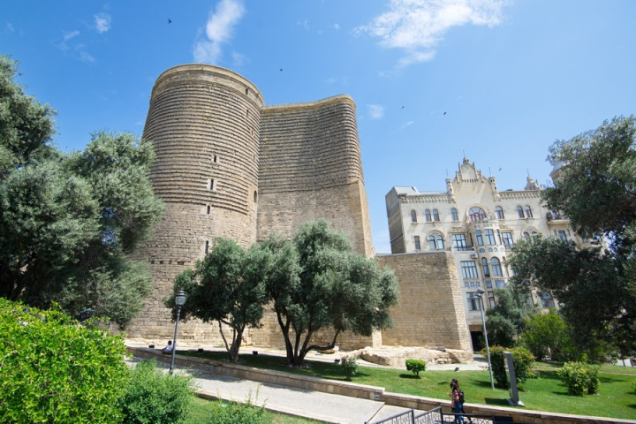
2023 NATO BILC Professional Development Seminar (October 16 – 19, 2023)
Language Teaching Theory and the Teaching Practice: Are They Always in Synch?
What does it take to design a good LSP/ESP course: the importance of needs analysis in LSP/ESP course design
Principles of successful integration of general and LSP/ESP content and its assessment
Frameworks for evaluating the success of language programmes
Authenticity in curricula and test design
Interlinks between language, culture and training
Student perceptions of effective teaching practices
Language teaching theory
Enhancing teacher competence and performance through professional development
Native versus non-native teachers
Using technology tools to enhance instruction

Slide 13
3) NATO BILC STANAG 6001 Testing Workshop
September 5 – 7, 2023, hosted by Riga, Latvia
Theme: “Furthering the Validity Argument by Keeping Pace with Technological Developments”
September 3 – 5, 2024, to be hosted by Bergen, Norway
4) NATO BILC Military Terminology Conference
biennial event, April 8 – 12, 2024, to be hosted by Stockholm, Sweden
Theme: “Terminology Management in the 21st Century”

Slide 14
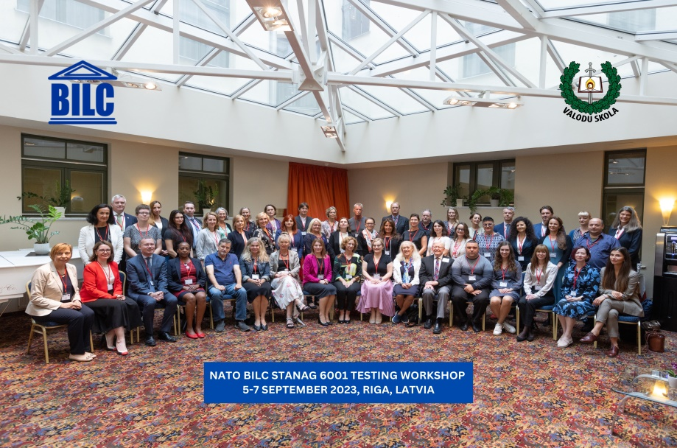
2023 NATO BILC STANAG 6001 Testing Workshop
Riga, LATVIA
5 – 7 September, 2023
Theme: Furthering the Validity Argument by Keeping Pace with Technological Developments
Norming
Shared Item Bank accomplishments and practices
Utilizing AI and ChatGPT for test development
Neoclassical Statistical Analysis and IRT Models
Test development and administration in the digital age
(testing writing, authenticity)

Slide 15
Who Attends BILC Conferences and Seminars?
Ministry level policy people
Commandants
School Directors
Department Chairs
Testing experts
Curriculum developers
Classroom teachers in many languages
Terminologists, translators/interpreters
= Blend of civ & mil

Slide 16
BILC Professional Development Programme in Partnership Cooperation Menu (PCM. i. e. ACT-sponsored BILC courses)
1. Language Testing Seminars (conducted at PLTCE):
Language Testing Seminar, ACT.647, 2 weeks;
Advanced Language Testing Seminar, ACT.658, 3 weeks;
Language Standards and Assessment Seminar, ACT.648, 2 weeks.
2. BILC Methodology Workshops
English Teaching Faculty Development Workshop “Teaching Speaking and Writing for Military Purposes”, ACT.659, 2 weeks. Conducted at 3 PTECs PLTCE, Bulgaria and Slovenia.
Facilitators: BILC teaching & testing experts from 24 nations.

Slide 17
SUPPORT TO PARTNER NATIONS
DEEP – Defence Education Enhancement Programme
(https://www.nato.int/cps/en/natohq/topics_139182.htm)
English is NATO’s operational language
Many DEEP military educational institutions have language programs
BILC is ready to continue to support DEEP
BILC
DEEP
Notes:
17

Slide 18
BILC support to DEEP March 2023 – March 2024
ARMENIA
Development of language training and testing capacity
AZERBAIJAN
Support for STANAG 6001 testers and teachers on test development
Developing and designing ESP courses
BOSNIA AND HERZEGOVINA
Pre-service training for newly-hired instructors
Military terminology & translation
Leadership discussions
Norming & continuous professional development for STANAG 6001 testers

Slide 19
BILC support to DEEP March 2023 – March 2024
COLOMBIA
Professional Development of English language instructors
Development of STANAG 6001 testing capacity
GEORGIA
Professional development for teachers of English
Support for STANAG 6001 testers on test development
IRAQ
Professional development of IDLI teachers
(Initial) training of STANAG 6001 testers
JORDAN
Development of STANAG 6001 testing capacity

Slide 20
BILC support to DEEP March 2023 – March 2024
MAURITANIA
Support to Higher Institute of English (HIE) instructors
UKRAINE
Professional development for instructors of English
STANAG 6001 familiarization for language instructors and program managers
Support for STANAG 6001 testers on test development and statistical analysis
Language program management

Slide 21
BILC WGs & Projects
Shared Item Bank Project
JTAC Working Group
STANAG 6001 Update – Focus Group

Slide 22
Shared Item Bank Project
WG members from:
Canada, Croatia, Estonia, Latvia, Romania, Slovakia, and Slovenia
Project goal:
To create a bank of reading and listening anchor items for
Levels 1, 2 and 3
Designed 47 items (L1 – 12 items, L2 – 17 items, L3 – 18 items) & pre-tested in 16 countries

Slide 23
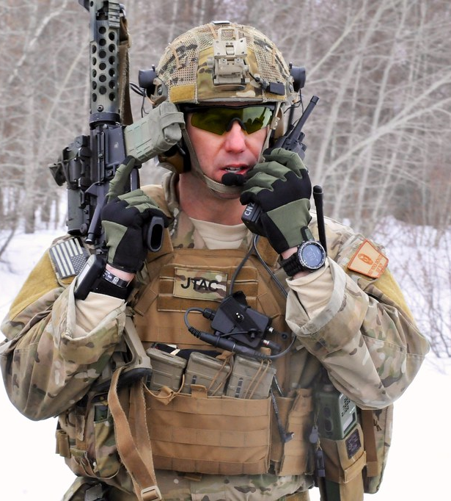
BILC JTAC Working Group (WG) Update
JTACs have a language requirement
STANAG 6001 SLP 3332
US Joint Fires Integration Division JTAC stakeholders asked BILC to conduct a language needs analysis
Analyze the unique JTAC language tasks
Consider a “more focused test” taking the JTAC environment into account
This Photo by Unknown Author is licensed under CC BY-ND

Slide 24
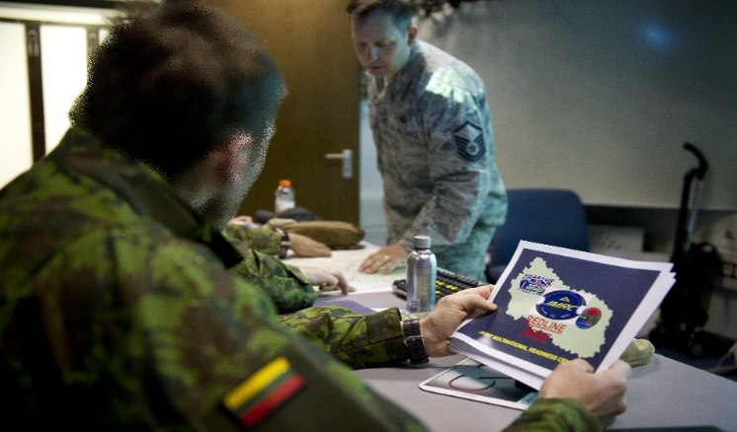
Findings
Two research questions:
#1: Is SLP 3332 needed for successful performance of JTAC tasks?
No, but ………..
#2: Is there a more suitable test format for evaluating JTACs’ target language use (TLU?)
Yes!
Report published 10 May 2023

Slide 25
STANAG 6001 Focus Group
Periodic reviews of STANAG are expected by NATO NSO
Noted inconsistencies and inadequacies in French led to opportunity to revisit overall standard
Ongoing discussion on the native speaker as reference point, in Standards in general, and in STANAG 6001.
Benefits of adding some military contexts and linguistic tasks linked to these content/context domains to set the STANAG scale apart from others.

Slide 26
BILC site – www.natobilc.org

Slide 27
Language training is costly so planning is essential
Learning a language takes time
Training teachers in STANAG 6001 interpretation & application is important
Investing in lifelong language learning of military personnel is ‘pragmatic’..
Language is the most complex of human behaviors.
Language is key to interoperability!
Notes:
27

Slide 28
MILITARY TERMINOLOGY CONFERENCE
- genesis -

Slide 29
TERMINOLOGY → TEACHING & INTERPRETING/TRANSLATION
1972 – the Training of Translators
1997 – Apmplification of STANAG 6001, including the role of interpreting and translation
2002 – Teaching Operational Language , NATO terminology and Acronyms
2003/2004 – the BILC Secretariat posts the Tri-service Word List on the BILC website
2007 – Language Teaching/Interpretation for NATO missions
2011 – SG: Military Terminology and Interpretation
2012 – the 2011 SG becomes a WG
2014 – Teaching Translation and Interpretation as Specific Language Skills
2017 – SG: Teaching Military and Security-related Terminology (best practices and challenges)
2018 – SG: Revision of the Tri-Service Word and Terminology Lists
2022 – Military Terminolgy Conference

Slide 30
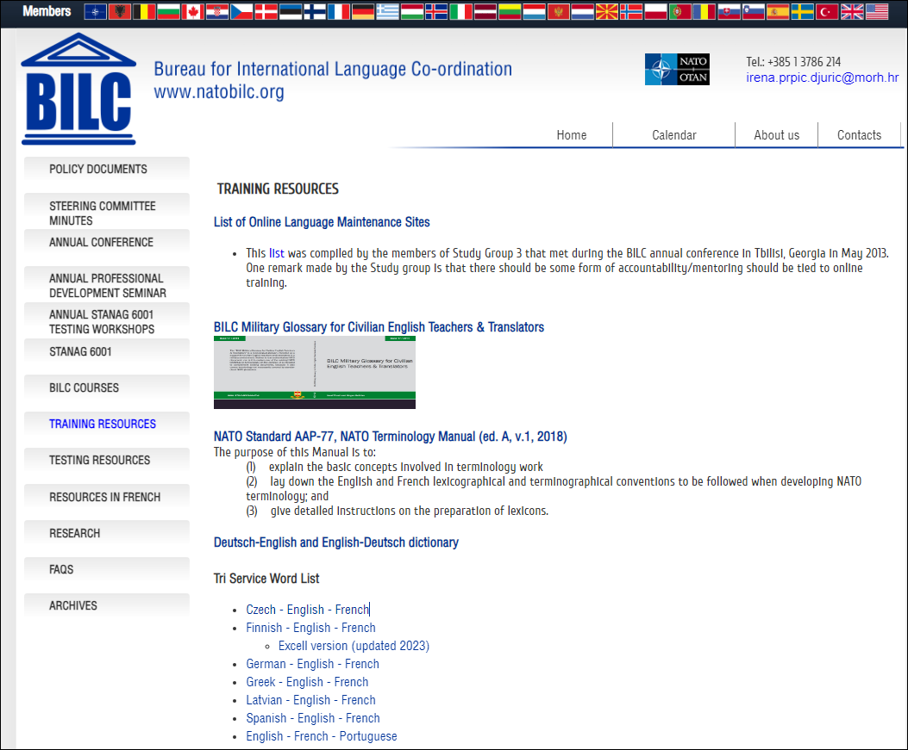

Slide 31
AIMS
Bring together experts dealing with military terminology
Provide insight into terminology management and standardization and use of terminology in various (inter-)national contexts
Exchange experience and good practice
Create opportunities for further cooperation

Slide 32
ISSUES TO BE CONSIDERED
Raise awareness about the importance of terminology in the field of defence
Integrate translators and terminologists in terminology work to meet the specific needs of the military and training
Increase involvement of SMEs
Build a multi-language defence termbase (general, area-specific, mission-relevant)
Create a pool of terminology resources/materials for training purposes
Enable access to authentic materials through exchange programmes
Facilitate research on military terminology
Provide conditions for terminology training
Exchange good practice and lessons learned

Slide 33
“Terminology Management in the 21st Century and the Potentials of New Technology”
1. Applications of new terminology technology
2. Innovation in terminology within military education
3. Terminology management in multilingual settings
4. Understanding and curating emerging terminologies
5. Optimizing civil-military collaboration in terminology development
6. Challenges of defining military terminology

Slide 34
Contacts:
BILC site https://natobilc.org
Email : irena.prpic.djuric@morh.hr
BILCteam.hrv@gmail.com

