Slide 1
ECP TRAINING
DAY ONE
H
ECP A
H
ECP B
H
H
H
H
H
Stand E
HELI
RUN WAY
ECP D
ECP C

Slide 2
ECP TRAINING
Layout
  Belgium has sent 2 A-109 to X-land and FP were deployed for internal security. There is nearly no threat against the troops and Belgium soldiers may not carry weapons.
  Belgian FP man different ECP on base in order to increase Sy.
  Access is granted to other military nations with RAB.
  Vehicles are granted only with correct vehicle pass/vehicle documents.
  All exceptions are mentioned on Entry Authorization Lists
  All incidents have to be reported to chain of command for decision.

Slide 3
ECP TRAINING
ECP A
  Call sign : ECP A
  ECP pedestrians and vehicles
Exercises
  1 : A soldier from another country (Italy) tries to get access with his vehicle but his personal pass has expired. After access denial, the man explains that he has an essential mission to execute and insists on getting access. He says that he will change his pass as soon as possible after his mission.
    Expected: Identify issue, deny access, report and ask for instructions.
  2 : A soldier from another country (Italy) comes on foot and explains that his RAB card was stolen in the morning in the DFAC. He just wants to pass on the information because he is working in a very sensitive area and he fears that someone might use his identity to get access. He also asks to get access to check whether the area is clear and safe.
    Expected: Report situation, deny access and ask for instructions.

Slide 4
ECP TRAINING
ECP B
  Call sign : ECP B
  ECP pedestrians
Exercises
  1 : A soldier from another country (Spain) tries to get access on foot. When asked the man explains that he has no badge but that he is awaited for a very important visit and that he is a high-ranking official in his country. He only shows his national entry card (the COTAG here). He is not on the list.
    Expected: Identify issue, report and ask for instructions.
  2 : A soldier from another country (Spain) comes on foot and is obviously drunk. A wants to get access to the restricted area for his shift.
    Expected: Report situation, deny access and ask for instructions.

Slide 5
ECP TRAINING
ECP C
  Call sign : ECP C
  ECP pedestrians
Exercises
  1 : A soldier from another country (Germany) try to get access but his RAB pass has expired. After access denial, the man explains that he has an essential mission to accomplish and insists on getting access. He says that he will change his pass as soon as possible after his mission.
    Expected: Identify issue, deny access, report and ask for instructions.
  2 : A soldier from another country (Germany) comes on foot and explains that he is responsible for a VIP visit for the next day. He wants to be sure that his guest (DEREK SCHAGGER) is on the EAL. When he figures out that it is not the case he explains that the delay is probably due to his chain of command and asks how he can let his visitor in.
    Expected: Answer questions, check EAL, explain that EAL has to be sent by the national commander to the base security group at least 24 hours in advance.

Slide 6
ECP TRAINING
ECP D
  Call sign : ECP D
  ECP vehicles and pedestrians
Exercises
  1 : A local worker is coming with his vehicle. Basic search of the vehicle is intended for all local workers. Simple procedure. The local worker first refuses because he says that he comes everyday and that it is the first time that he has to do that. He also says that FP may not do that. He says that he will complain about it to his employer. Finally he decides to leave the ECP.
    Expected: execute procedure, control situation, deny access, report to control.
  2 : A local worker is coming with his vehicle. Basic search of the vehicle is intended for all local workers. Simple procedure. The local worker is fully cooperative but when the trunk is open there are some bottles of alcohol inside. The local worker says that it is for a good friend, tries to offer one to the guard and asks if it is possible to bring some alcohol inside (No!).
    Expected: execute procedure, control situation, deny access with alcohol, refuse offer, report to control.

Slide 7
MOBILE PATROLS TRAINING
DAY TWO
Sector A
Sector B
Sector C
Sector D
Stand E

Slide 8
PATROL TRAINING
Layout
  Belgium sent 2 A-109 to X-LAND and FP were deployed for internal security. There is nearly no threat against the troops and Belgium soldiers may not carry weapons.
  Belgian FP execute patrols on base in order to increase Sy.
  Circulation policy
    Access is granted to other military nations with RAB card
    Vehicles are allowed on the base only with correct vehicle pass /documents
      They may not ride faster than 30 Km/hr.
  All incidents have to be reported to the chain of command (control) for decision.

Slide 9
PATROL TRAINING
Sector A
  Call sign : Patrol A
  Sy foot patrol
Situation
  An old UXO is detected in GRID CRASHMAP INDIA 41B. It seems like a very old UXO. There is no tactical issue.
    Trg objective: Train the 10liner on a didactical manner.
    You should not report on the net.

Slide 10
PATROL TRAINING
Sector B
  Call sign : Patrol B
  Sy mounted patrol
Situation 1
  During a routine patrol, someone is seen speeding at least at 50 KM/hr on base. The person is drifting and having fun with his car. When apprehended he explains that he had a bad day and he just wanted to have some fun. No harm to any one.
    Expected : Stop, explain the violation, report to control
    Reporting has to be sent into the net.
Situation 2
  During a routine patrol, someone is seen drunk. He is going to take his car in order to leave the area. When apprehended the person explains that he is drinking in order to forget bad family news that he had today.
    Expected : Stop, explain the violation, report to control and ask for the nation to send someone
    Reporting has to be sent into the net.

Slide 11
PATROL TRAINING
Sector C
  Call sign : Patrol C
  Sy foot patrol
Situation 1
  During a routine patrol, a local worker (ABDULAH) is coming to the patrol to reveal that his friend (AZIZ), also a local worker on base was contacted two hours ago by a very strange man. The man asked him to take and send pictures of the CIS means available on base. ABDULLAH tried to persuade AZIZ not to execute this mission. AZIZ now disappeared and was seen for the last time near building A5.
    Expected : understand, report to control, suggest actions
    Reporting has to be sent into the net.
Situation 2
  During a routine patrol, a local worker (ABDULAH) is taking picture of the vehicles on place. Forbidden. When found he is explaining that he would like to buy the same car since he loves it. He is very cooperative.
    Expected : stop, explain the violation, report to control and ask to delete the pictures.
    Reporting has to be sent into the net.

Slide 12
PATROL TRAINING
Sector D
  Call sign : Patrol D
  Sy foot patrol
Situation 1
  During a routine patrol, a local worker (AMIN) is coming to the patrol to reveal that he lost his badge in the morning around 10 o’clock and doesn’t know what to do. He is very nervous because he’s afraid he is going to be fired for that mistake and ask if the information may not be sent to his employer.
    Expected: understand, report to control, suggest actions
    Reporting has to be sent into the net.
Situation 2
  During a routine patrol, a local worker (AMIN) is coming to the patrol to report that the doorlock of the building where he has to clean seems cracked. Someone has propably stolen something inside.
    Expected : understand, report to control, suggest actions
    Reporting has to be sent into the net.

Slide 13
LAST DAY TRAINING
Layout
  Belgium sent 2 A-109 to X-LAND and FP were deployed for internal security. There is nearly no threat against the troops and Belgium soldiers may not carry weapons.
  Belgian FP carry out patrols and man one ECP on base in order to increase Sy.
  Circulation policy
    Access is granted to other military nations with RAB card.
    Vehicles are allowed on the base only with correct vehicle pass
      They may not ride faster than 30 Km/hr.
  All incidents have to be reported to the chain of command (control) for decision.

Slide 14
LAST DAY TRAINING
Stand A
  Call sign : ECP A
  ECP with pedestrians – No Vehicle
Situation
  You are on ECP A. A Spanish soldier called Ravier PUJOL comes to your position. His RAB badge is correct and you authorize him to come into the base.
    Case 1: Just after he has come on base, he fell on the ground. You go to him and it appears that he fell unconscious.
    Case 2: Just after he came on the base, he broke one of his leg by falling in the stairs.
  Trg objective: Train the 9-liner on a didactical manner.
    Expected : Stop him at the gate, control him and let him inside. Then give him help with the first aid and call for a doctor. Reporting has to be sent into the net.
Personnel:
  2 players for ECP
  1 plastron
Equipment: 1 overall, first aid kit

Slide 15
LAST DAY TRAINING
Stand B
  Call sign : Patrol B
  Sy foot patrol
Situation
  During a routine patrol, two soldiers find an UXO beside a building. They have to take action to ensure security. By doing so, a military man from another country (Spain, ANDRES INIESTA) comes on the spot and asks what is going on. He has a valid RAB card. Then a second guy comes on the spot. He is a local worker (AZIZ) and he says he saw a suspect this morning at 1000 on this place with a bag. It was a civilian but he doesn’t know more about that.
    Expected : Report, ask for support, prepare a 10-liner, ask for evacuation of the building, ask the two guys for more information -reporting of 10-liner has not to been sent into the net but at the Sgt on position.
    Action by Control: send 1 QRF (QB) with two guys (Bulgarians) if requested, ask for EOD/Med,…
Personnel:
  2 players for patrol
  2 players for QRF
  2 plastrons
Equipment: 1 overall, 1 UXO, 1 flak-jacket (smoke-vest)

Slide 16
LAST DAY TRAINING
Stand C
  Call sign : Patrol C
  Sy foot patrol
Situation
  During a routine patrol, two soldiers found a hole in the fence. They have to secure the zone and ask for support. Whilst sweeping the zone, they found a civilian beside the building A12 and he is trying to enter. He has no permission to come into the base. He is cooperative but he has no ID on him.
    Expected : Report, ask for support, deny acces to the zone, be prepared to execute a sweep of the zone with a support team.
    Action by Control: send 1 QRF (QC) with two guys (Bulgarians) if requested, ask for IMP
Personnel:
  2 players for patrol
  2 players for QRF
  1 fictive enemy with overalls

Slide 17
LAST DAY TRAINING
Stand D
  Call sign : Patrol D
  Sy foot patrol
Situation
  During a routine night patrol, the FP personal find a building with light on. After control of the building they find a local worker (ABDULAH) inside the building. He explains he was been working all day and at night he found an open door. He entered inside the building and he found a local worker drinking beers on a sofa. He is drunk but not violent. He asks if he will have trouble because of that. He ‘s afraid to be made redundant and asks not to tell this at his employer.
  Expected : Report, detain the person on position, ask for support if needed, sweep of the whole building, evacuate the worker and wait for IMP, close the building.
  Action by Control: send 1 QRF (QD) with two guys (Bulgarians) if requested, sent IMP to apprehend the drunk man.
Personnel:
  2 players for patrol
  2 players for QRF
  1 plastron in overalls

Slide 18
ON SCENE COORDINATIONS TRAINING
DAY FOUR
Stand B
Stand A
Stand D
Stand C

Slide 19
ON SCENE COORDINATIONS TRAINING
DAY FOUR
Stand B
A
B
Stand A
Stand D
C
D
E
Stand C
1
2
3
4
5
6
7
8

Slide 20
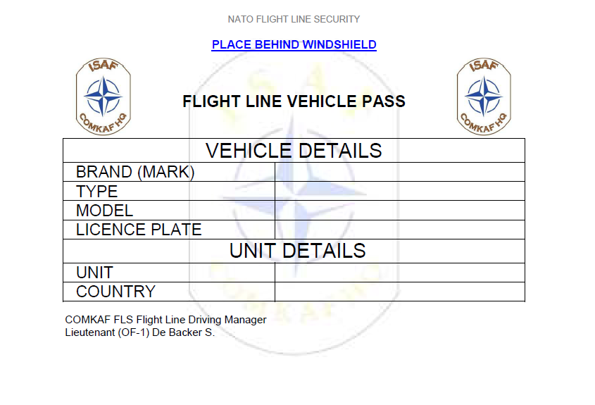
ECP TRAINING
ECP A
  Call sign : ECP D
  ECP pedestrians and vehicles
Exercises
  1 : A local worker try to get access with his vehicle. ECP has to ask to open everything in order to check the car. Simple procedure. The local worker is very slow to understand what is expected.
    Expected: Apply procedure and search the vehicle.
  2 : A local worker try to get access with his vehicle. ECP has to ask to open everything in order to check the car. Simple procedure. During the search alcohol is found in the trunk of the car. Alcohol is strictly forbidden on base.
    Expected: Apply procedure, report, deny access

Slide 21
