Slide 1
CDA / ACD
Navigating Between Pedagogical Theory and Practicable Content Development - Lessons Learned
Jacqueline Asselin
October 2022

Slide 2
PURPOSE
Discuss the Instructional Design process in curriculum development
Focus on the Design phase
Discuss best practices and potential pitfalls in Design
Share with you:
What I wish I knew then, that I know now!

Slide 3
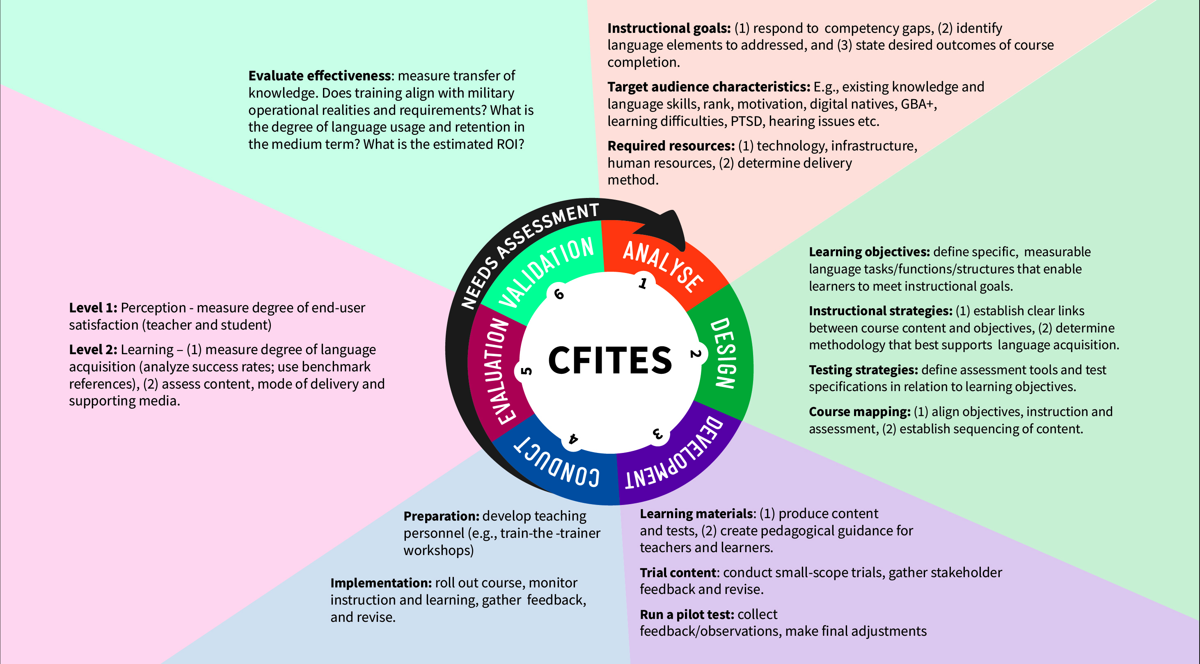
Notes:
The Canadian Forces Individual Training and Education System is a conventional Instructional Design model – it folds in elements of ADDIE and Kirkpatrick Model of Evaluation.
More traditional, waterfall ID approach (vs. SAM for example). The CFITES is engaged when a needs assessment reveals a performance deficiency or opportunity that can only be addressed through formal training and or education. The needs assessment is often handed to you by your organization and acts as a catalyst that sets off the CFITES ID cycle.
Other models for consideration: SAM (Successive Approximation Model) is a rapid design and development model. To be considered for smaller projects. Produce a functional prototype quickly – agile. Small-scope only.
The Kirkpatrick Model
Level 1: Reaction
Level 2: Learning
Level 3: Behavior
Level 4: Results

Slide 4
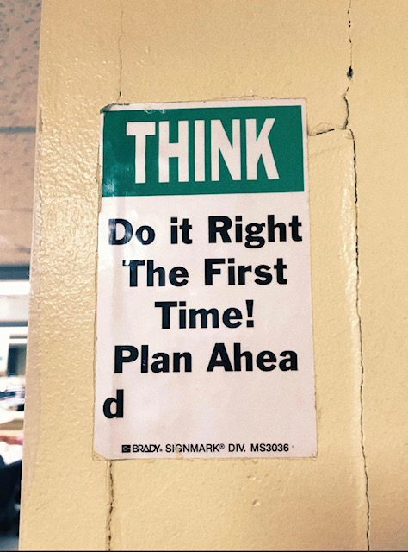

Slide 5
Be Careful of These 4 Design Pitfalls

Slide 6
Pitfall #1: Limited Course Mapping
Objectives
Activities / Components
Assessment
Notes:
Course mapping or curriculum mapping is essential. Process whereby you associate the learning outcomes with your intended activities or course components and cross-reference these with your assessment tools. Allows for identification of unecessary redundancies, misalignments, and GAPS!
But you must go beyond this triangulation and engage in more granular discussions pertaining to micro-content, sequencing and scaffolding.

Slide 7
SEQUENCING & SCAFFOLDING
Notes:
Instructional designers will often stop at the sequencing phase (lack of time) and overlook discussions pertaining to scaffolding.
Sequencing: the linear progression of language functions or structures, from easier to more difficult, from simpler to more complex (Bloom’s taxonomy), and how you chunk the learning content etc.
Scaffolding: strategies for support the learning process. Examples:
Providing explicit modeling through illustrations/videos or writing models, adopting an iterative process (successive degrees of exposure to a language point), providing the audio script with a listening segment, discussing an excerpt of a longer text to discuss its purpose or learn key vocabulary before exposing them to the full text, using elements of native language vs. target language in beginner lessons etc.
There are a million ways in which you can provide scaffolding, but the point is to determine, as a group, what strategies you plan on implementing into your curriculum and why.
The more a team agrees on sequencing and general elements of scaffolding, the more cohesive and coherent the final product will be. If you leave the scaffolding to the development phase, every developer will have their own interpretation of what supporting strategies can look like and you’ll end up with very inconsistent materials.

Slide 8
Go Beyond Course Mapping
Create activity templates (reflect instructional methodology)
Use examples of commercial products to identify likes and dislikes
Discuss standardization in your activity templates
Instructions (teacher/student)
Charts (look, titling)
Images (including representation)
Pre-select content sources and reference manuals
Notes:
Too often, course mapping involves just listing the activity types that you plan on incorporating. I strongly encourage you to build actual templates. For two reasons:
This will enable you to anchor your chosen instructional methodology early on in the process. So whether you’ve adopted a constructivist approach, communicative language theory, or a very task-based approach or a variety of theories, you can make sure that your templates reflect the instructional theory. This will also act as a form of quality control and takes some of the thinking out of the development phase, especially when onboarding developers who may not have partaken in the design phase.
Activity templates create standardization, which reduces cognitive load, performance anxiety, and decreases instruction time as students readily understand what is expected of them as they become more and more familiar with activity types. Students can then focus on performing the language task instead of trying to understand what the task is and what is expected of them.
If you can standardize instructions, charts, and images you can achieve a consistent look and feel, as well as create a more predictable and pleasant language–learning experience.

Slide 9
Pitfall #2: Not Selecting Topics Carefully
Select topics that naturally elicit targeted language points
Select topics with a long shelf-life (avoid perishable data)
Select topics that allow sourcing of authentic, level-appropriate content vs. scripting content?
Avoid hidden curriculum – developer’s footprint
(personal biases, areas of interest vs. balance of ideas, organizational ideals)
Notes:
Select topics/themes that naturally elicit the Grammar, the functions that you are attempting to work with. Be careful: when selecting topics that elicit higher-order tasks (giving and defending an opinion, debating, engaging in dialectical thinking at higher levels of proficiency), try to choose thought-provoking, potentially polarizing topics without setting off a political firestorm in the classroom or exposing students to potentially triggering materials.
Sourcing: Does the topic lend itself to sourcing authentic, level-approriate texts/ audios, or will you have to script content, which is more labour intensive! Try to keep track of that when choosing topics.
Hidden curriculum: refers to the subtext or implicit set of “lessons” or “values” that can appear in your content. Sometimes, it is intentional – you may want to fold in elements that promote military ethos and ethics, for example. But often it’s unintentional: where our personal biases (positive or negative) are folded into the content or there’s a noticeable political slant, which falls beyond the purview of language instruction. Be mindful of individual developer’s footprint by making sure topics aren’t selected based on personal interests, but rather determined by the group whose goal should be to achieve a balance of ideas.

Slide 10
Pitfall #3: Skipping the Prototype
Visual and concrete (working model)
Avoids mission creep (binding agreement, sets boundaries)
Forces you to trial the actual development tools (Desktop Publishing or E-learning)
Notes:
Prototype: it is a visual and concrete working model, instead of a description, or a plan. It will allow you to identify design flaws early on. It marks the shift from a descriptive process to a productive process.
Prototype acts as the binding agreement as to what the final product will look like. It defines. on a smaller-scope basis, what you plan on delivering on a larger scale. Staves off mission creep from stakeholders and the developers themselves.
Allows you to trial development tools: Desktop publishing – InDesign, InCopy, or E-learning tools: Storyline, Brightspace, Moodle. You may detect limitations to the design tools or you may determine a need for upskilling members of your team to use these work tools most optimally.

Slide 11
Pitfall #4: Underestimating Time Required
Calculate approximate time on task for each activity (prototype)
Consider individual learning pace (differentiated learning)
Maintenance - know your limits! You can develop it, but can you maintain it?
Must we create everything in-house vs. commercial products /partnerships?
Notes:
Even this early on in the design phase, it’s important to calculate approximate time required to complete the tasks. It’s very easy to overshoot the runway and create more content than is feasibly achievable for students and teachers. If this is the case, some teachers will dismiss the program as overwhelming and unwieldy.
When calculating time on task, consider different learning paces – work in some wiggle room for a slower learning tempo so that most students can cross the finish line within the course timeframe.
Maintenance: Ask yourself: will you have the time and resources to update and maintain the content in the medium to long term (1 year from now, 3 years from now)? In the absence of an answer, your working assumption should be “no”. This will undoubtedly inform some of your design decisions and temper some of your more grandiose ideas ;) Important to be pragmatic in certain facets of the design phase – proper project management depends on achievable delivery and maintenance.
In light of this last point, it’s responsible to keep various options on the table. Ask yourself, do we have to design everything in-house and from scratch? Given all of the considerations that I’ve discussed, you may want to leverage your subject matter experts where they can have the greatest impact. A hybrid or blended solution is still a solution! Find the combination that works best for your project and your organization.

Slide 12
Conclusion
An instructional design model is key to curriculum development
The DESIGN phase is critical, regardless of the chosen ID model
Pay attention to the 4 design pitfalls:
Engage in Detailed Course Mapping
Select Topics Diligently
Create a Prototype
Consider Time on Task and Maintenance
Notes:
Regardless of the instructional design model that is retained for a project, give the design phase its due time and consideration! It’s your blueprint! Watch out for the 4 pitfalls: detailed course mapping, select topics judiciously, create a prototype, and considering the time factor!
If you do this, you will reap the rewards throughout the development phase and beyond! And you will be eons ahead of most instructional design teams!
Thank you very much for your time! It’s been a pleasure!

Slide 13
Canadian Defence Academy /
Académie canadienne de la Défense

