Slide 1
A Proposed Psychometric Scoring Model
Ray Clifford and Matthew Porter Wilcox
6 September 2022

Slide 2
Theoretical Construct Model
The construct of proficiency is operationalized according to STANAG 6001 criteria
Test Development Model
The author purpose, text type, topical domain, passage length, and item format align with the Theoretical Construct Model
Psychometric Scoring Model
The trialing procedures, item statistical parameters, test assembly, and the scoring process align with both the Theoretical and Test Development Models

Slide 3
Theoretical
Construct
Model
Proficiency
Time

Slide 4
Theoretical
Construct
Model
Level 3
Level 2 Criteria
Level 1 Criteria

Slide 5
Test
Development
Model
Author purpose.
Text type of the language used by the author.
Topical domain of the passage.
Passage Length.
Reader Task.
Required Precision.
Level 3 Criteria
2.
1.
3.
6.
4.
5.
Level 1 Criteria
1.
2.
3.
4.
5.
6.
Level 1 Criteria
1.
2.
3.
4.
5.
6.
Notes:
If they fail, we don’t know why.

Slide 6
Proficiency
Time

Slide 7
A Model vs. The Model for Psychometric Scoring
“All models are approximations. Assumptions, whether implied or clearly stated, are never exactly true. All models are wrong, but some models are useful. So the question you need to ask is not ‘Is the model true?’ (it never is) but ‘Is the model good enough for this particular application?’”
-George Box, Statistical Control By Monitoring and Adjustment, pg 61

Slide 8
Small Medium Large VERY Large
1 2 3 4

Slide 9
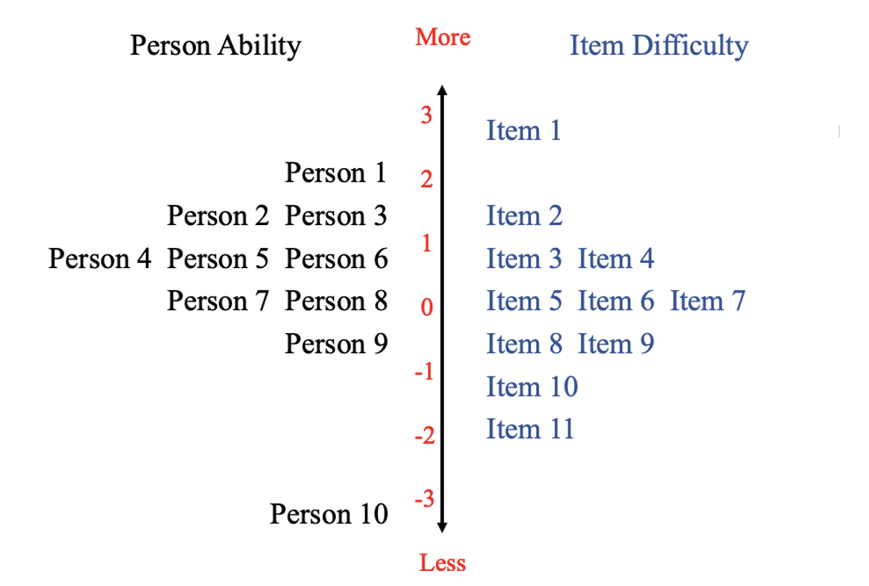
Notes:
Do not confuse Logits with STANAG Levels
Our precision of Measurement is highest when there is an alignment between Person ability and Item difficulty.

Slide 10
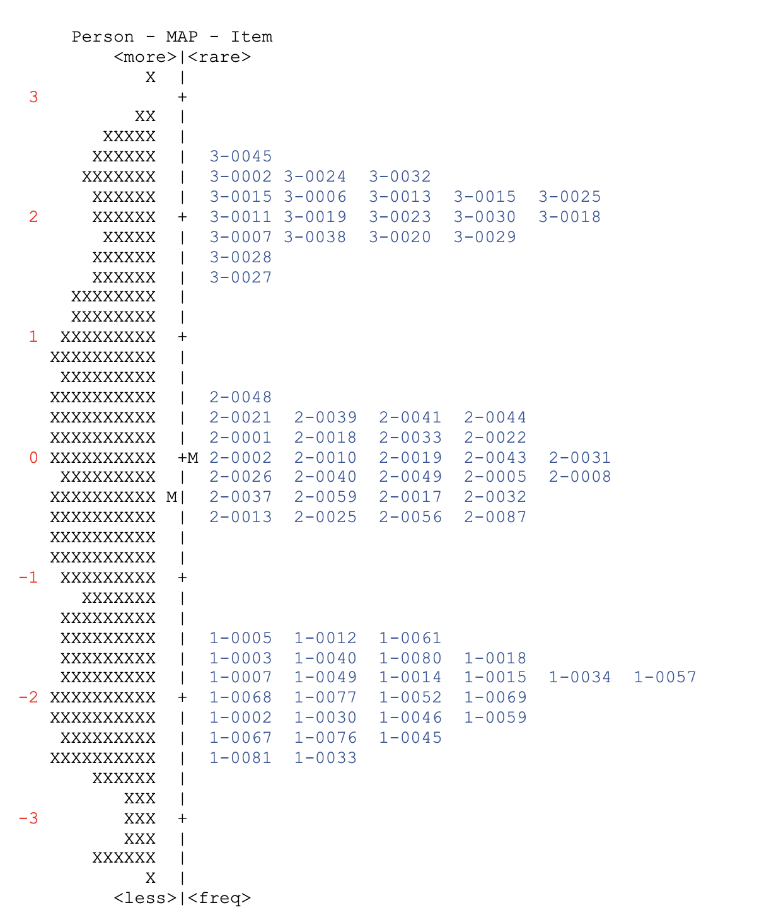
Alignment
of Item
Difficulty
2-9999
Level 3
2.
1.
3.
6.
4.
3-0000
5.
5.
Level 2
1.
1.
2.
3.
4.
5.
6.
Level 1
1.
2.
3.
4.
5.
6.
Notes:
Need to have persons at that level of targeted item. You can link scales together. It is best done when there is a common subset of items or person

Slide 11
Recommendations for item analysis
Trial items with
a sufficient number of individuals (for Rasch analysis 100+)
whose expected ability aligns with the targeted level and at at least one level below.
Who are from the target population, or at least a group who can reasonably be compared to the target population.
If using Rasch, Items should cluster together by level in the expected hierarchy
All items within a given should cluster together (in this example, they are all within 1.0 Logit of one another)
There should be no overlap of items from one level to another
Ideally, there should be a gap between clusters (in this example, there is at least 0.5 logits between each cluster)
Items that are mis-leveled should be reviewed and either re-trialed or removed.
Note: items may also be reviewed, revised, or removed if they do not fit the model.

Slide 12
Alignment of Rating Person Ability
Proficiency ratings are “criterion” ratings, and they require non-compensatory rating judgments at each level.
Total and average scores, even when weighted, are compensatory scores.
“Floor and ceiling” level-specific score comparisons are needed to assign a final rating.
Raters can’t apply “floor and ceiling” rating criteria using a single or composite score.
 | Person A | Person B
Level 2 Correct | 20 | 15
Level 3 Correct | 0 | 5
Total Score | 20 | 20

Slide 13
Floor Ratings
The Rasch Person ability estimate is a single
Weighted compensatory score
While it gives us a better estimate of the Person’s
Ability in general terms, it doesn’t give precise
Information about a student’s ability to sustain
performance from one level to the next.
Sustained ability at a given level is operationalized
by scoring 72% or higher on administered items.
 | Person A | Person B
Level 2 Correct | 20 | 15
Level 3 Correct | 0 | 5
Total Score | 20 | 20
Person Ability | 0.00 | 1.0
 | Person A | Person B
Level 2 Correct | 20 | 14
Level 3 Correct | 0 | 6
Total Score | 20 | 20
Person Ability | 0.00 | 1.0
Notes:
We might look at these scores and say that the A is a 2 and B is a 2+
Remember that the items whose difficulty is rated on the same level as student’s ability means that they have a 50% change or probability of getting that item correct. It doesn’t mean that they got all items below that right, and all above them wrong.
In general terms

Slide 14
Assigning ‘+’ ratings
There are no aligned items at the + levels
There are test takers rated to be + level, but no + level items
We define a + level person as:
A test taker who sustains at a given level and
Gets more than half right at then next
higher level but fails to sustain
REDS
Random
Emerging
Developing
Sustained
Level 3
Level 2 Criteria
Level 1 Criteria

Slide 15
Recommendations for Rating Persons analysis
Is a minimum of 15 items administered per level before assigning floor and ceiling ratings?
Does the scoring model score and rate each proficiency level separately?
Do the final ratings provide dual (floor and ceiling) ratings?
Are the floor ratings representative of sustained performance at a specific STANAG 6001 level?
If a plus level is assigned, is it based on sustained ability at that level with the ‘plus’ denoting a high level of ability that is not sustained at the next higher level?
Are the ceiling scores where performance is not sustained reported using categories such as Random, Emerging, or Developing (RED) ability?

Slide 16
CAT basics
Have a large Bank of calibrated items
Set rules—how to:
start
Select next item
stop
CAT Challenges with CRT
Establishing the floor and probing the ceiling
Balancing topical domains across levels
Assigning ratings

Slide 17
Multi Stage Adaptive Testing
1. Calculate the average item difficulty for each cluster of items Level 3 Average difficulty = 2. 05
Level 2 Average difficulty = -0.01
Level 1 Average difficulty = -2.10
Logit | Domains
0.08 | Arts and Entertainment
0.39 | Current Events and Politics
0.15 | Science and Technology
-0.01 | Business and Economics
-0.40 | Individual and Society Interests
0.036 | Average Difficulty
Step 2: Carefully form individual items into testlets. Testlets should:
Only contain items the same level
Have balanced Content
Have an average item difficulty that is as close to the overall level
Average as possible (for example, withing 0.10 Logits)

Slide 18
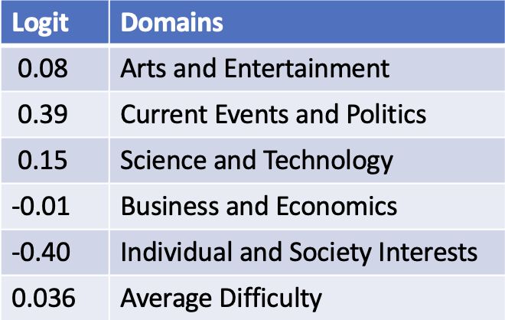
T3-01
T3-02
T-03
T3-04
Logit | Domains
0.08 | Arts and Entertainment
0.39 | Current Events and Politics
0.15 | Science and Technology
-0.01 | Business and Economics
-0.40 | Individual and Society Interests
0.036 | Average Difficulty
T2-01
T2-02
T2-03
T2-04
T1-01
T1-02
T1-03
T2-04

Slide 19
T3-01
T3-02
T-03
T3-04
T2-01
T2-02
T2-03
T2-04
Level 1 + with
Developing Abilities at Level 2
3/5
2/5
3/5
T1-01
T1-02
T1-03
T2-04
5/5
4/5
4/5

Slide 20
T3-01
T3-02
T-03
T3-04
2/5
0/5
T2-01
T2-02
T2-03
T2-04
Solid 2 Reading Ability with
Random Abilities at Level 3
4/5
5/5
4/5
T1-01
T1-02
T1-03
T2-04
5/5

Slide 21
Final Recommendations
Are there enough items at every tested level to accurately assign a rating for each of those levels?
Are there enough items at each level to support multiple test administrations without overexposing the items?
Has the number of test items in the item bank been increased as needed to match the distribution of abilities found in the population to be tested?

