Slide 1
Total Immersion Training for Language and Culture Training Delivery- The Best Option?
Cdr Julia Proffitt RN
Defence Centre for Languages & Culture
(DCLC)
Joint Services Command and Staff College
Notes:
Immersion training is a growing element as part of overall language training.

Slide 2
❝If you talk to a man in a language he understands, that goes to his head. If you talk to him in his own language, that goes to his heart.❞ Nelson Mandela
Joint Services Command and Staff College
Notes:
Immersion training is a growing element as part of overall language training.

Slide 3
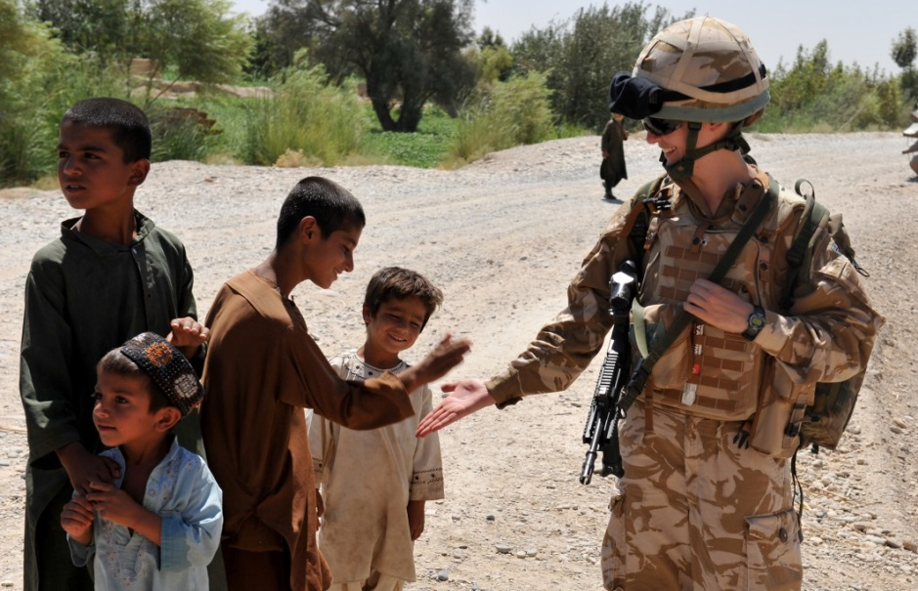
Scope
Immersion Training
The Benefits
Training Structure
Evaluation – what works?
Next Steps
Questions
Joint Services Command and Staff College

Slide 4
Immersion Training
Definition: “In-country language development”
Includes:
Formal teaching at a Language School
Accommodation with host families
Tutoring at military / non-military sites
Cultural excursions
2015/16
>150 students
>15 locations
Joint Services Command and Staff College
Notes:
How we define immersion training at DCLC. People seem to use a number of different definitions -

Slide 5
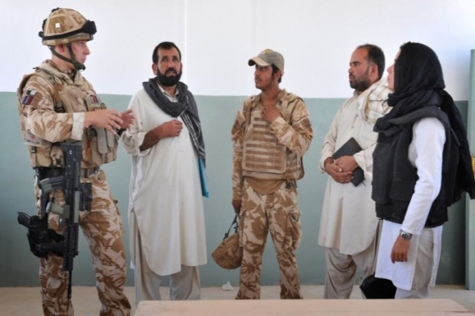
The Benefits
Increased fluency and vocabulary
Confidence
Motivation
Context
Dialect
Variety of voices and accents
Preparation for Multi Level Assessment (MLA)
Cultural exposure and networking
More cost effective???
Joint Services Command and Staff College
Notes:
Normally done in courses, but we are trying to bring a more individual approach where we can. e.g. Flt Cdr Lavender conducting immersion in Beijing ahead of posting as DA there.

Slide 6
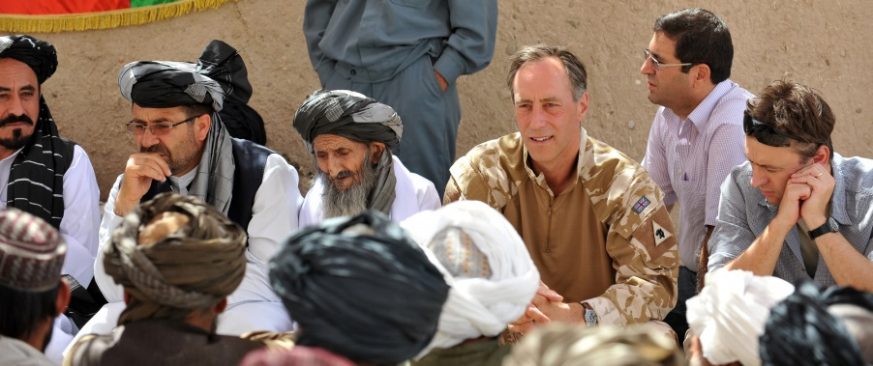
Languages Covered
High volume:
Arabic
French
Spanish
Russian
Farsi
Low volume:
German
Italian
Mandarin
Dutch
Japanese
Brazilian Portuguese
Hebrew
Urdu
Chinese
Norwegian
Dari………..
Joint Services Command and Staff College
Notes:
And many more depending on demand

Slide 7
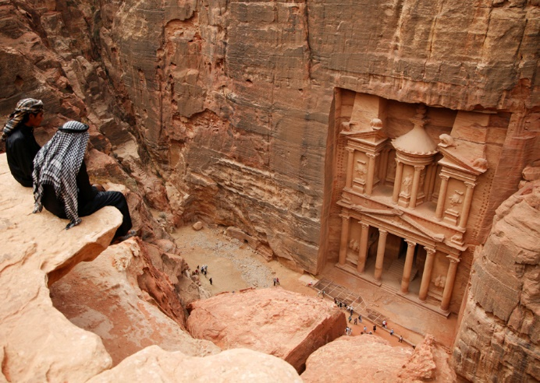
Global Footprint
France
Germany
China
Tajikistan
Brazil
Denmark
Spain
Norway
Oman
Chile
…...
Joint Services Command and Staff College
Notes:
Global reach / footprint, helps to facilitate upstreaming capacity building to forge international partnerships.
Partnerships with other parts of government who do language training.

Slide 8
Current Structure
Groups and Individuals
Up to 12 (including junior students)
Low volume language students alone
All ranks, Tri-Service (Defence)
Occasionally civilians
Timing
4 weeks mid-course – currently post Level 2
Students assessed at L2 prior to departure
Reassessed on return and then sit L3
Teaching
Half day localised teaching/half day culture or self study
Mostly homestays where culturally permissible
Partner military language Schools where possible
Joint Services Command and Staff College

Slide 9
How?
PXR
Country selection
Security, dialects etc
School selection
Market research
Military vocab
Embassy liaison
Defence Engagement
Facilitation
Admin
Flights
Passports etc
Tutor Request
SO3 Immersion
Business Case
Financial Approval
Joint Services Command and Staff College
Notes:
This means that the SBLs are free to concentrate on teaching as the admin burden has been taken away from them. The market research is the crucial part; making sure that a school is fit for purpose e.g. military language, level of teaching etc.

Slide 10
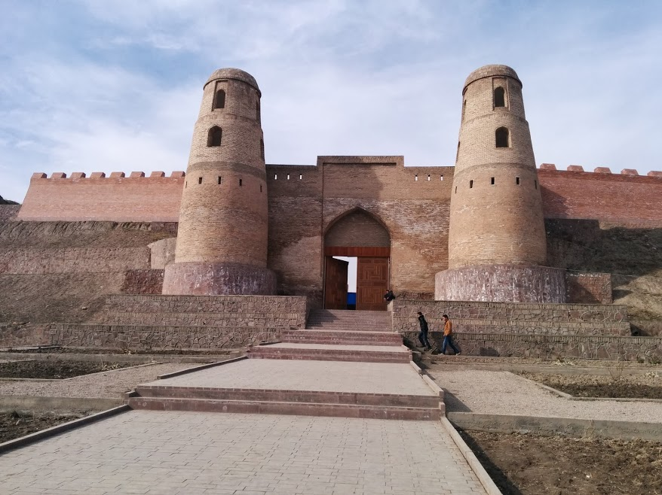
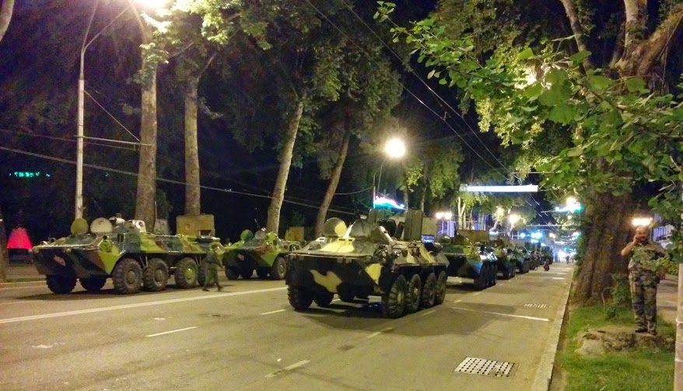
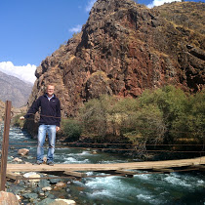
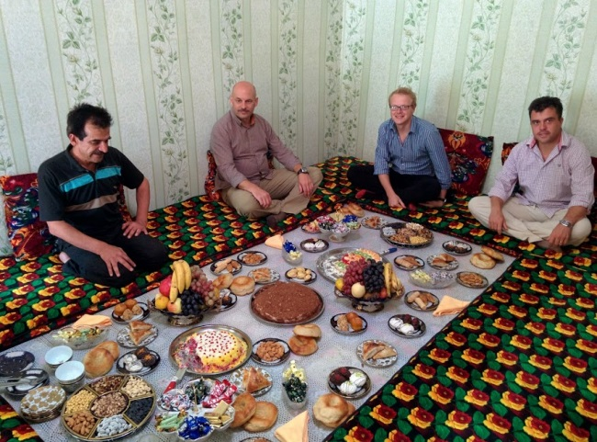
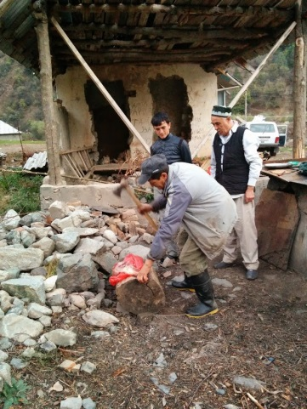
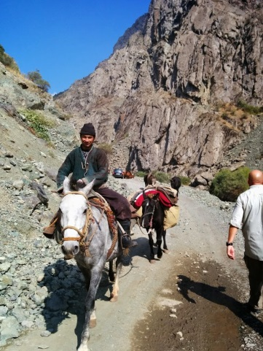
Partnering - Tajikistan (Dari)
Joint Services Command and Staff College
Notes:
Partner Nation support to allow access to languages not accessible otherwise.
Example of Tajikistan Immersion: Permanent staff attend to quality assure for fitness for purpose

Slide 11
Benefits – Increasing proficiency?
Monolingual environment
Variety of tutors / native speakers
Cost effective across Centre
Cultural exposure
Defence capacity building
Joint Services Command and Staff College
Notes:
More than just Language
But does is it a force multiplier?

Slide 12
What works?
Timing ✓
Increased fluency and vocabulary✓
Confidence ✓
Motivation ✓
Context ✓
Dialect ✓
Variety of voices and accents ✓
Cultural exposure and networking ✓
Homestays ✓
More cost effective ?
Reduced training time ?
Military Exposure ✓
Building of partnerships ✓
Joint Services Command and Staff College
Notes:
Normally done in courses, but we are trying to bring a more individual approach where we can. e.g. Flt Cdr Lavender conducting immersion in Beijing ahead of posting as DA there.

Slide 13
What Doesn’t….
Preparation for Multi Level Assessment (MLA) ?
Accommodation in hotels and flats✗
Some mixed teaching groups ✗
Very large student groups ✗
Strong dialect differences ✗
Evaluation of progress….
Control…
Joint Services Command and Staff College
Notes:
Normally done in courses, but we are trying to bring a more individual approach where we can. e.g. Flt Cdr Lavender conducting immersion in Beijing ahead of posting as DA there.

Slide 14
New Initiatives
8 week Arabic Immersion in Oman
Aiming to see greater increase in fluency
Assess reduction of time in training?
Increase cost efficiency
Low Volume training – up to 50% of course length being trialled (Hebrew trial)
Aimed specifically to reduce overall training time for senior officers
Increase cultural exposure
Complete Immersion
Training time limited / student availability curtailed
Joint Services Command and Staff College

Slide 15
Next Steps
Inclusion at STANAG Level 2
Shorter training pipelines with extended immersion
Dedicated Defence Attaché pipeline
Local short term Immersion?
Full Diagnostic Assessments
Pre and Post Immersion
Partnerships across government
Joint Services Command and Staff College
Notes:
Whilst we now offer to all post Level 2,

Slide 16
Future Partnerships?
Links with US Defence Language Institute
Methodologies of learning
University projects, not language schools
USAF Language & Culture Centre
Production of shared immersion database
E.g. School of / not of use
Partnering
Royal Air Force of Oman
Ecole de Guerre
Bundessprachenamt
Australia?
Joint Services Command and Staff College
Notes:
Links with USAF Lang & Cul Center and DLI
DLI have found great success in using university projects rather than language schools as working in small groups towards a goal helps facilitate the language, generating a requirement for the language.
We are now working with USAF L&CC to create a shared database that will highlight positive / negatives schools of choice, countries to use, security issues, checklist proformas etc. This will greatly help sourcing appropriate immersion areas as well as providing further evidence for business cases.

Slide 17
Questions??
Joint Services Command and Staff College

