Slide 1
Defence Requirements Authority for Culture and Language (DRACL)
“The Challenges of Designing an Effective
Multi-Level Assessment from SLP 1-4”
Major David Gibb MA AGC(ETS)
BILC – October 2017

Slide 2
Scope
DRACL overview
The challenge
The solution
Questions and discussion

Slide 3
DRACL – Capability Areas
Foreign Language Capability
Culture Capability
English Language Training

Slide 4
DRACL – Additional Outputs
Governance, strategy, policy
Coordination of the training requirement
Language assessments – MODLAB
Foreign language financial awards
Evaluation (including External Validation)
Assurance
Language data analysis

Slide 5
The Challenge
Build and maintain Defence Culture and Language capability
General language proficiency assessment
35 languages (Training Year 16/17)
70% of candidates are independent candidates
Assessment not exam
Measure any SLP (but targeting 2+)
Resources
Standardisation

Slide 6
The Solution
Specialist contractor
English base paper
Rigorous setting process
Translated into other languages as needed
Assessor training
Detailed assessor reports
Forensic moderation
Quality control

Slide 7
Assessment Overview
Active skills: Speaking/Writing – tasks allowing performance at all levels
Passive skills: Listening/Reading – a multi-part, multiple choice assessment of progressive difficulty
Run over 2 days

Slide 8
Summary
Importance of Culture and Language capability
Challenge of growing and maintaining it
Resource constraints
Testing in 30+ languages
Multi-Level Assessment
English Base Paper

Slide 9
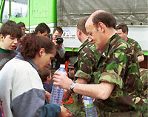
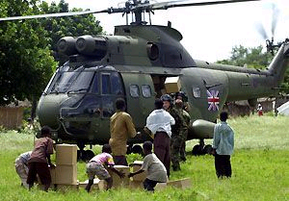
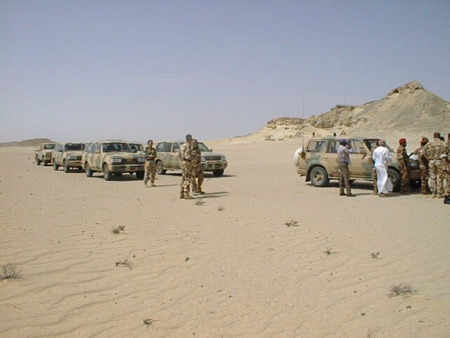
Questions and discussion

Slide 11
Foreign language assessment
UK MOD Language Assessment Board (MODLAB)
In partnership with IoL Educational Trust (IoLET):
  IoLET – the Awarding Organisation of the Chartered Institute of Linguists
The only specialist languages Awarding Organisation in the UK
National recognition and accreditation through Office of Qualifications and Examinations Regulation (Ofqual)
Track record with government and public sector
High level public examinations for professional language skills
Can assess 50+ languages annually

Slide 12
Multi-Level Assessment (MLA)
NATO STANAG 6001 proficiency levels
General language proficiency assessment
Content to include general language and broad military contexts
Single multi-level scheme for all (SLP 1-4):
  Survival
  Functional
  Professional
  Expert
Preparedness for national accreditation (Ofqual)

Slide 13
Assessment Development
Scheme established summer 2016
Reviewed and revised – robust structure for future
Assessment design includes:
  Authoring of tasks at each level
  Tasks reviewed and tested
  IoLET-MoD Setting Board
  Further testing and piloting
  IoLET-MoD Final Setting Board
  Preparation of assessments in different languages

Slide 14
Listening Assessment
Time: approx 50 minutes
4 parts: SLP 1 – SLP 4
Maximum marks = 10 per SLP level
Numerical marking
Pass mark of 70% within each level and across levels to achieve an SLP score

Slide 15
Speaking Assessment
The structure:
  Part 1 – Interaction (10 minutes)
  Part 2 – Task Resolution (15 minutes)
  Part 3 – Presentation (15 minutes: up to 10 to present, 5 for questions)
Module Assessment:
  Criteria marking by SLP level and strength within SLP banding (Interaction – Fluency – Vocabulary – Grammar – Discourse)
  Overall SLP result based on criteria profile
  The assessment is recorded

Slide 16
Reading Assessment
Time: 1 hour 30 minutes
4 parts: SLP 1 – SLP 4
Maximum marks = 10 per SLP level
Numerical marking
Pass mark of 70% within each level and across levels to achieve an SLP score

Slide 17
Writing Assessment
Format:
  60 minutes
  One task, selected from a choice of 5 tasks
  Dictionaries not allowed
Module Assessment:
  Criteria marking by SLP level and strength within SLP banding (Theme – Coherence – Vocabulary – Grammar – Presentation)
  Overall SLP result based on criteria profile

Slide 18
Foreign Language Assessment – General
All marking and grading moderated internally by IoLET and at IoLET-MOD Moderation Board
Final results confirmed at Moderation Board
MLA used where realistic target is SLP 2210 and above for:
  DCLC students
  Independent candidates
Contract for 2 years with options to extend. Currently assessing:
  Some 500 candidates a year
  In 35 languages (Training Year 16/17)
Separate SLP 1111 assessment

