Slide 1
BILC PROFESSIONAL SEMINAR 2018 Zagreb, Croatia
FORÇAS ARMADAS PORTUGUESAS
LtCmdr Marta Gabriel| 18 October 2018

Slide 2
Fostering the learner-centered perspective and autonomous learning
How does this method foster motivation?

Slide 3
Agenda
Definitions and features
- Autonomy
- Learner and teacher - roles
2. A practical case
- Learners
- LNA – Specifications
- Training
- Outcomes
3. Benefits

Slide 4
Definitions and features
“Autonomy is the capacity to control one’s own learning”
Benson (2003), p. 290
Leading Actor

Slide 5
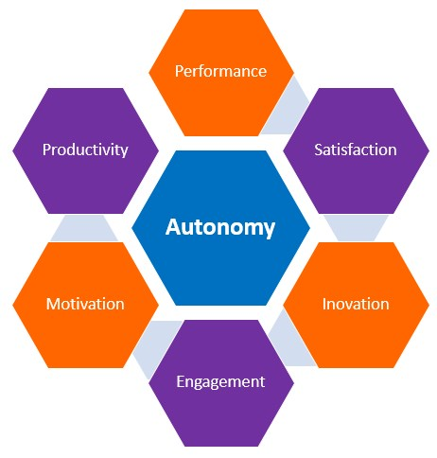
Definitions and features
Learners can achieve autonomy by:
planning their own learning activities
practicing through meaningful and realistic task-based activities
monitoring their progress
evaluating their outcomes

Slide 6
Definitions and features
“Fostering autonomy may simply mean helping students to learn languages in ways that are more relevant to their lives”
Benson (2003), p. 293
Facilitator Counselor Resource

Slide 7
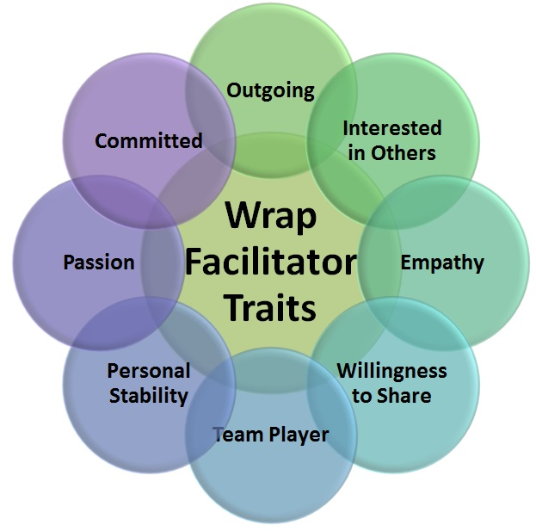
Definitions and features
Teachers can foster autonomy by:
being involved in student’s learning
providing learning options and resources
offering choices and decision opportunities
supporting the learners
encouraging reflection

Slide 8
A practical case
Would you help us prepare for the SLP test?
Sorry, but no! SLP tests are not supposed to be trained!

Slide 9
A practical case
But I am willing to help you improve your English skills!

Slide 10
A practical case - Learners
4 Officers and 1 NCO
Co-workers at the PO CHOD HQ
STANAG 6001 Levels: 2

Slide 11
A practical case: LNA - Specifications
What? End state?
Improve language competence (level 3)
Perform tasks defined in the job descriptions
Briefings
Reports
Staff meetings
Phone calls
….

Slide 12
A practical case: LNA - Specifications
Why? End state?
Compliance with the requirements in future posts abroad next year

Slide 13
A practical case: LNA - Specifications
How?
Self-assessment
90-minute sessions / 2 times/week
All skills
Task-based activities
Various resources
Authentic material

Slide 14
A practical case: Training
Journal writing
some entries focus on level 3 tasks/descriptors
learners’ needs/suggestions/reflection
writing problems
self correction
peer correction

Slide 15
A practical case: Training
Articles – authentic materials
- various sources
students’ own suggestions and organized/prepared by the teacher

Slide 16
A practical case: Training
Group discussions (sometimes recorded and later analysed with students)
Webquests (e.g. Integration of Gender Perspectives in the Operational Planning)

Slide 17
A practical case: Outcomes
In about 6 months, students have:
Increased motivation to study and use the language
Improved autonomy regarding the tasks
Been less afraid to take risks
Behaved more at ease during group discussions
Produced more coherent and focused pieces of writing
Been able to research and collect relevant information
Been less concerned about taking the SLP test!!

Slide 18
Benefits
Learner-centered perspective fosters:
Needs awareness
Objectives definition
Meaningful and realistic training
Progress monitoring
Outcomes assessment
Autonomy
Motivation

Slide 19
Benefits
Meaningful and useful training
Operational and relevant objectives
Task-oriented activities
Individual needs and expectations
Various approaches and techniques
Authentic materials
Trustworthy training
Improvement
Opportunities
AutoNomy

Slide 20
Building Student Autonomy
Reference:
Benson, Phil (2008). Learner autonomy in the classroom, in Practical English Language Teaching, New York: McGraw-Hill.

Slide 21
PORTUGUESE ARMED FORCES - CHIEF OF DEFENSE
“To teach is to learn twice”
Joseph Joubert
Hvala
Thank you
Obrigado
mcgabriel@emgfa.pt

