Slide 1
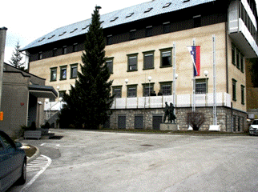
Towards Achieving Standardized Terminology in the Military
Tamara Derman Zadravec
Translation, Interpreting and Proofreading Department
School of Foreign Languages
BILC Military Terminology Conference
10 April 2024, Stockholm, Sweden

Slide 2
Outline
Background and rationale
Elements of terminology standardization
System design incl. standards
Exchange of practical experience
Future challenges

Slide 3
Evolution
1998
2004
2007
2009
2013
2018
Terminology work beginnings
First dictionaries
NATO membership
NATO terminology standardization
MoD Terminology Standardization Board
1st Military Terminology Conference
MOterm terminology database

Slide 4
Initial considerations
Standardization starts at the strategic level
Terminology is to be developed simultaneously with policy and doctrine
Interoperability cannot be applied without standardized terminology
Inconsistent use of terminology may jeopardize security
Notes:
V Natu standardizacijo terminologije kot del uradne politike standardizacije razumejo v smislu razvijanja konceptov, doktrin, postopkov in načrtov za dosego ter zagotavljanje povezljivosti in poenotenja, nujnega za dosego zahtevane ravni interoperabilnosti ali optimizacijo uporabe virov na področju delovanja Standardizacija izrazja predstavlja v Natu bistven sestavni del zagotavljanja varnosti, enotne razlage doktrin in postopkov ter koherentnosti politike, predpisov ter učnih gradiv.

Slide 5
What is terminology standardization?
No single answer…
A process based on rules/norms
Systematic approach
Consensus under authority
Best possible subject-field vocabulary
Notes:
Različna mnenja, ki se v povezavi s tem pojavljajo v literaturi, kažejo, da preprostega in enopomenskega odgovora na to vprašanje ni. Mednarodna organizacija za standarde (ISO) standardizacijo opredeljuje kot proces oblikovanja in uporabe pravil za urejen pristop k značilni aktivnosti v korist in ob sodelovanju vseh udeleženih. Končni rezultat standardizacije je soglasje, ki ga sprejme reprezentativno telo. Standardiziranje terminologije vključuje normiranje izrazja. V ožjem pomenu se lahko nanaša na institucionalno normiranje izrazja, ki ga za svoje potrebe razvija in ureja določena organizacija, v širšem pomenu pa ga izvajajo mednarodni ter nacionalni organi za standardizacijo, kot so na primer tehnični odbor ISO/TC 37 in njegovi štirje pododbori ali na nacionalni ravni

Slide 6
Basic terms & definitions (ISO)
Terminology standardization = unification and harmonization of concepts, concept systems, terms and definitions > normative vocabulary
Standardized terminology = result of terminology standardization, consists of sets of concepts belonging to special (= military) language, established by consensus and approved by a recognized body to achieve optimum order
Consensus = general agreement, takes into account view of all parties and deconflitcs arguments
Standardizing body = administrative entity responsible for standardization; its current items of standardization work are listed in a programme
Notes:
The main objective of the conference is to provide a platform for the exchange of experience and good practices. To this end, we will send you a questionnaire after the conference. Your answers will help us define the exact topics and points of interests as well as give you the opportunity to express your desired level of involvement, i.e. would you like to participate as a lecturer or merely attend the conference. As we are well aware that terminology is not the focal point of the BILC community, we kindly ask you to share this information with all relevant units and services in your respective countries.
Please send your answers to the POC listed on the questionnaire by 15 June.

Slide 7
Why standardize? The case of Slovenia
To resolve:
Inconsistency in translation
Formation of different Slovenian terms for one concept (synonymy)
Different understanding of the same term

Slide 8
Creating the terminology standardization framework
1. Identify terminology, users and their needs
Notes:
The main objective of the conference is to provide a platform for the exchange of experience and good practices. To this end, we will send you a questionnaire after the conference. Your answers will help us define the exact topics and points of interests as well as give you the opportunity to express your desired level of involvement, i.e. would you like to participate as a lecturer or merely attend the conference. As we are well aware that terminology is not the focal point of the BILC community, we kindly ask you to share this information with all relevant units and services in your respective countries.
Please send your answers to the POC listed on the questionnaire by 15 June.

Slide 9
Case of Slovenia
Terminology:
- NATOTerm, focus on AAP-06,
- Terms relevant for the operation of the armed forces and the defence ministry (legislation, operations, education and training, international cooperation)
- Military terminology queries from government agencies, EU bodies & general public.
Users:
- Troops in the field,
- Authors of policy papers & doctrines & strategies etc.,
- International staff,
- Linguistic staff (translators, proofreaders of Slovene).
Needs:
- Online Slovene equivalents of English terms,
- Definitions of Slovene military terms,
- Full dictionary entries for translators.
Discuss: Identify these elements in your military

Slide 10
2. Select staff familiar with the subject field and principles and methods of terminology work

Slide 11
Case of Slovenia
Staff:
- SMEs,
- Language professionals (terminologists, translators, proofreaders),
- Doctrine developers,
- Standardization professionals.
Importance of terminology work competence!
Discuss: What would you consider in selecting the staff? Do you anticipate any challenges?

Slide 12
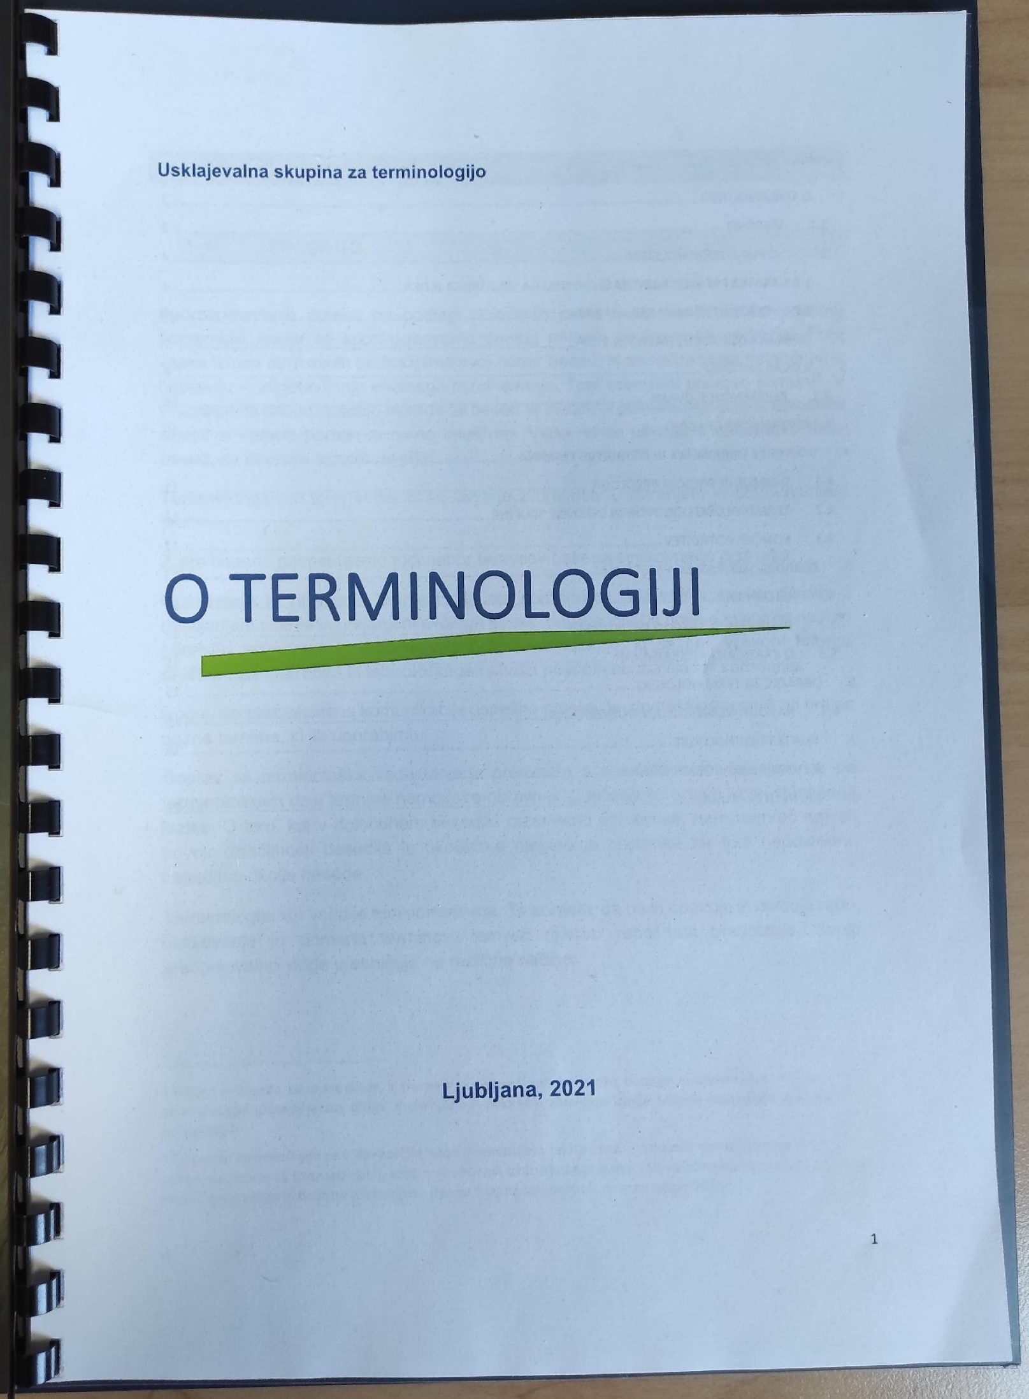
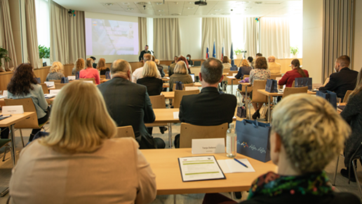
Terminology familiarization
Terminology Manual/ O terminologiji with basic information on terminology work. | E-classroom (https://cei.mors.si/) Familiarization with terminology management in the SAF and the MoD, learning how to do terminology work on specific examples. https://cei.mors.si/ | Terminology conferences and consultations in military units 2013 2018 2022

Slide 13
3. Establish a body or a working group
involving SMEs for validation of standardized terminology who (also) have language knowledge and potential to influence the use of standardized terminology
Slovenia: MoD Terminology Standardization Board, Terminology Coordination Subboard, Working Groups (subject-field specific)

Slide 14
Possible organizational models
Committee work pattern:
Terminologist as consultant outside the body
Terminologist as consultant in the body
Terminology-centered:
3) Terminologist produces terms with specialists
4) Terminologist works with specialists as consultants
Discuss: Which organizational model would suit your military organization, also considering the tasks?

Slide 15
4. Prepare work plan/programme
defining responsibilities, tasks, work methods, work tools, timeframe and deadlines
To consider: realistic planning, records of terminological data/format, terminology database, meeting options & management (in person, e-mail, discussion groups, internet forum, VTC)
Slovenia: Standardization Directive, Terminology Manual, Rules of Procedure of the MoD Terminology Standardization Board, MOterm database SOP
Discuss: How would you get organized?
Notes:
The main objective of the conference is to provide a platform for the exchange of experience and good practices. To this end, we will send you a questionnaire after the conference. Your answers will help us define the exact topics and points of interests as well as give you the opportunity to express your desired level of involvement, i.e. would you like to participate as a lecturer or merely attend the conference. As we are well aware that terminology is not the focal point of the BILC community, we kindly ask you to share this information with all relevant units and services in your respective countries.
Please send your answers to the POC listed on the questionnaire by 15 June.

Slide 16
5. Carry out terminology work
Collect and record terminological data, identify sources of terms, establish term lists, formulate definitions etc.
Normative basis: ISO 10241, 704, 860
Notes:
The main objective of the conference is to provide a platform for the exchange of experience and good practices. To this end, we will send you a questionnaire after the conference. Your answers will help us define the exact topics and points of interests as well as give you the opportunity to express your desired level of involvement, i.e. would you like to participate as a lecturer or merely attend the conference. As we are well aware that terminology is not the focal point of the BILC community, we kindly ask you to share this information with all relevant units and services in your respective countries.
Please send your answers to the POC listed on the questionnaire by 15 June.

Slide 17
6. Evaluate and verify terminology product
Compliance with formal requirements and criteria, accuracy of data, clarity of entries, user response
Discuss: Who would you entrust with quality control/assurance of your terminology product?
Notes:
The main objective of the conference is to provide a platform for the exchange of experience and good practices. To this end, we will send you a questionnaire after the conference. Your answers will help us define the exact topics and points of interests as well as give you the opportunity to express your desired level of involvement, i.e. would you like to participate as a lecturer or merely attend the conference. As we are well aware that terminology is not the focal point of the BILC community, we kindly ask you to share this information with all relevant units and services in your respective countries.
Please send your answers to the POC listed on the questionnaire by 15 June.

Slide 18
7. Publish and use standardized terminology
Final stage of terminology standardization process
Discuss: What options do you have for publishing standardized terminology and promoting its use? What can be the challenges?
Notes:
The main objective of the conference is to provide a platform for the exchange of experience and good practices. To this end, we will send you a questionnaire after the conference. Your answers will help us define the exact topics and points of interests as well as give you the opportunity to express your desired level of involvement, i.e. would you like to participate as a lecturer or merely attend the conference. As we are well aware that terminology is not the focal point of the BILC community, we kindly ask you to share this information with all relevant units and services in your respective countries.
Please send your answers to the POC listed on the questionnaire by 15 June.

Slide 19
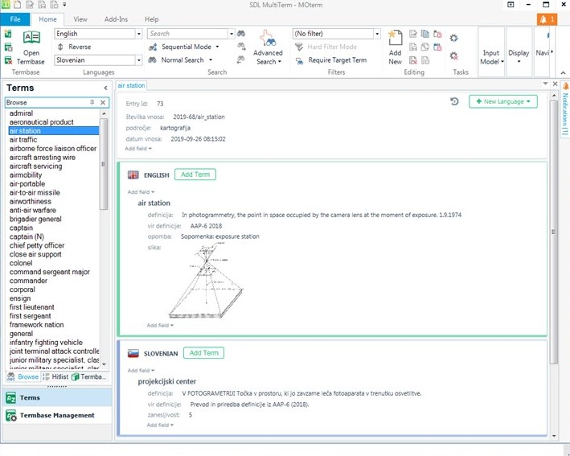
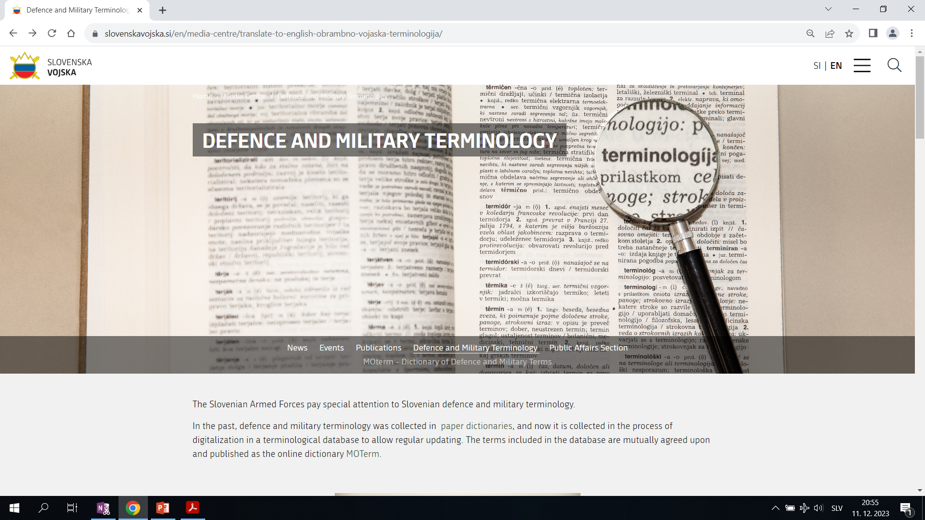
MOterm database/Trados MultiTerm | MOterm dictionary
Notes:
What we did first, was named our dictionary MOterm. MO is the abbreviation of the MoD in Slovenian.
How different sources of therminology dictate different methods of work:
Translations
Dictionary modernization
Term extraction
Individual proposals

Slide 20
ISO standards
Discuss: From the list select standards that would be applicable to individual parts of the system

Slide 21
ISOs applicable to milterm standardization
ISO 704: Principles and methods of terminology work concept, concept relations, terminography
ISO 860: Methodological approach to international harmonization of concepts, concept systems, terms and definitions
ISO/CEI Guide 2:2004: Standardization and related activities – general vocabulary aim, consensus, subject of standardization, normative documents, bodies
ISO 15188:2001(E): Project management guidelines for terminology standardization
ISO 1087-1: Terminology work vocabulary
ISO 10241-2:2013: Part 1 – Presentation requirements and examples,
Part 2 – Adoption of standardized terminological entries relevant for
translation-based terminology development, degrees of
correspondence/deviation
Notes:
The main objective of the conference is to provide a platform for the exchange of experience and good practices. To this end, we will send you a questionnaire after the conference. Your answers will help us define the exact topics and points of interests as well as give you the opportunity to express your desired level of involvement, i.e. would you like to participate as a lecturer or merely attend the conference. As we are well aware that terminology is not the focal point of the BILC community, we kindly ask you to share this information with all relevant units and services in your respective countries.
Please send your answers to the POC listed on the questionnaire by 15 June.

Slide 22
ISOs applicable to digital terminology management
ISO 12620: Computer application in terminology – data categories
ISO/TR 12618:1994: Computational aids in terminology
ISO 26162-1:2021: Management of terminology resources – terminology databases
ISO 30042: Systems to manage terminology, knowledge and content – TermBase exchange (TBX) relevant for translators, CAT, software developers and language specialists, interchange of terminological data between users
Notes:
The main objective of the conference is to provide a platform for the exchange of experience and good practices. To this end, we will send you a questionnaire after the conference. Your answers will help us define the exact topics and points of interests as well as give you the opportunity to express your desired level of involvement, i.e. would you like to participate as a lecturer or merely attend the conference. As we are well aware that terminology is not the focal point of the BILC community, we kindly ask you to share this information with all relevant units and services in your respective countries.
Please send your answers to the POC listed on the questionnaire by 15 June.

Slide 23
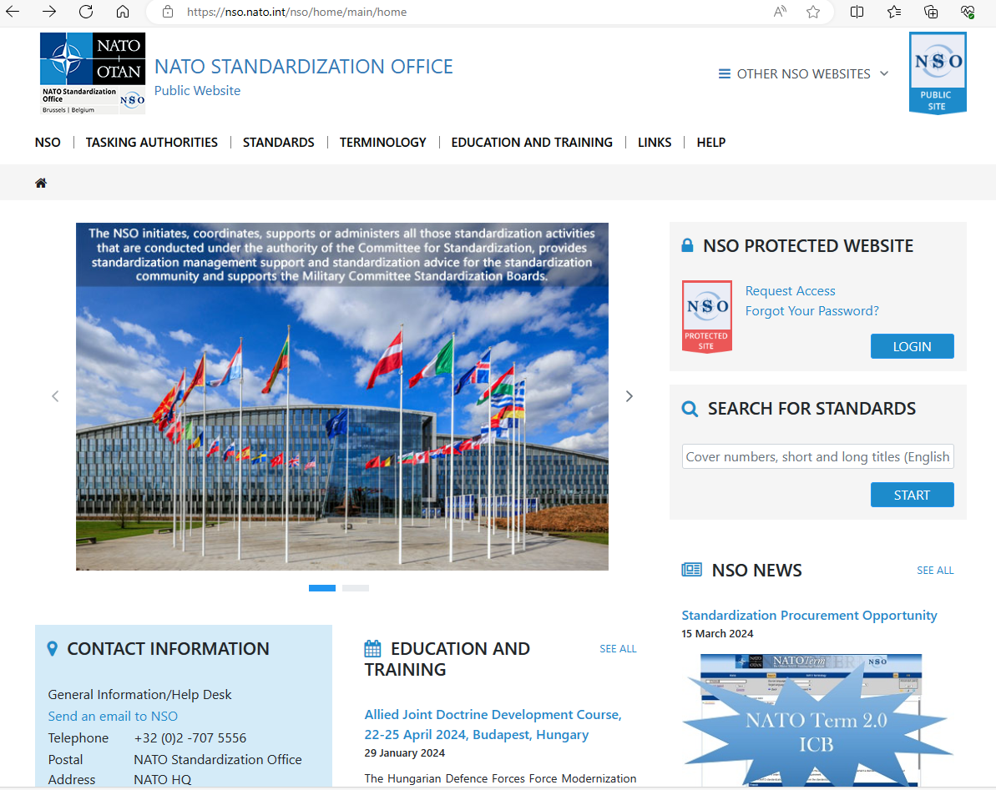
NATO Standardization Office (NSO)

Slide 24
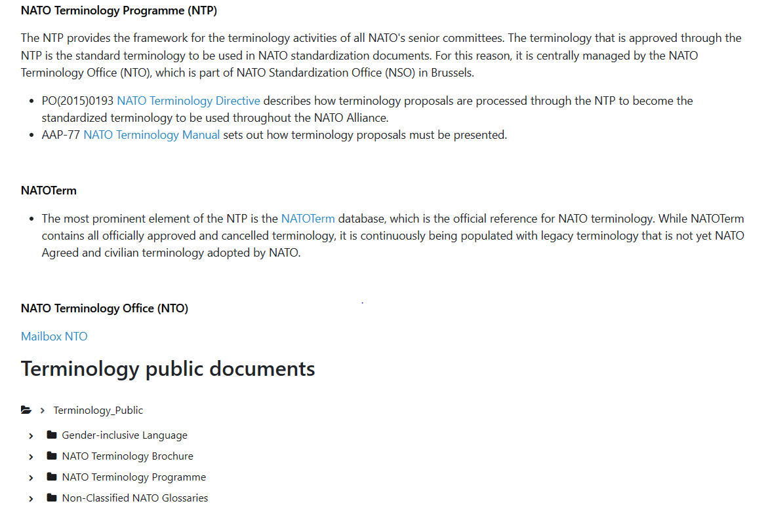
NATO Terminology Office (NTO)

Slide 25
Future challenges (for Slovenia)
Introduce new communication channels (digital platforms, podcast system, thematic portals)
Intensify relationships with SMEs and users
Provide interactive tools for instant validation/updating of terms
Ensure efficient dissemination & visibility of standardized terminology
Enhance quality assurance
Notes:
The main objective of the conference is to provide a platform for the exchange of experience and good practices. To this end, we will send you a questionnaire after the conference. Your answers will help us define the exact topics and points of interests as well as give you the opportunity to express your desired level of involvement, i.e. would you like to participate as a lecturer or merely attend the conference. As we are well aware that terminology is not the focal point of the BILC community, we kindly ask you to share this information with all relevant units and services in your respective countries.
Please send your answers to the POC listed on the questionnaire by 15 June.

Slide 26
Your (future) challenges in military terminology standardization?
Thank you☺
Thank you

Slide 27
Contact: School of Foreign Languages
Translation, Interpreting and Proofreading Department
Poljče 28, 4275 Begunje na Gorenjskem, Slovenia
e-mail: tamara.derman.zadravec@mors.si
T: +386 4 532 3725

