Slide 1
I have 3 Topics to Address
The changing nature of reading and STANAG 6001 testing.
Grading the task rather than the text: to what extent is this true when it comes to a test of reading?
Text length at different levels.

Slide 2
Where to get answers:
You can ask an expert, but remember the meaning of “expert” <exspurt>
Ex = former
Spurt = drip under pressure
Or you can read this detailed document:
Response to Topic 1:
“Close reading” is an increasingly
rare skill, but it is still required in
top management, diplomatic,
and intelligence jobs.

Slide 3
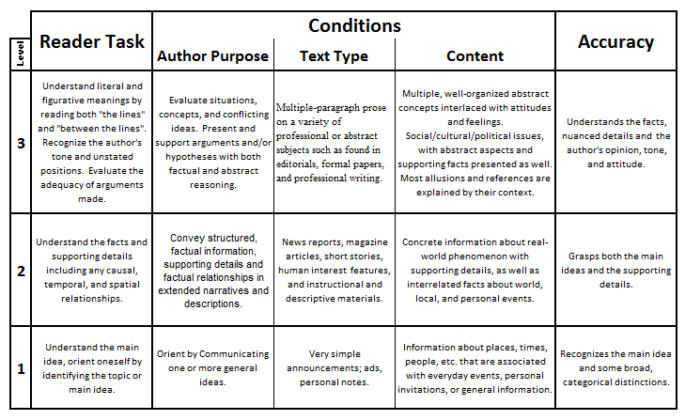
STANAG 6001 – Reading Tasks & Texts

Slide 4
Response to Topic 2:
When teaching, we move incrementally from known to unknown by mixing TCA elements.
When testing, the task, text, and other level-specific elements must be aligned.
If a test item asks the readers to perform a Level 2 task with a Level 3 text, that item is not useful.
If learners GIVE THE RIGHT ANSWER, that doesn’t show that they can read a Level 3 text for the purpose for which it was written.
And if learners GIVE WRONG ANSWERS, they still might have been able to accomplish that Level 2 task with a Level 2 text.

Slide 5
Testing reading proficiency requires satisfying conflicting requirements.
The texts used must be short enough to meet practical item-length and test-length considerations.
The texts used must be long enough to be “authentic”.

Slide 6
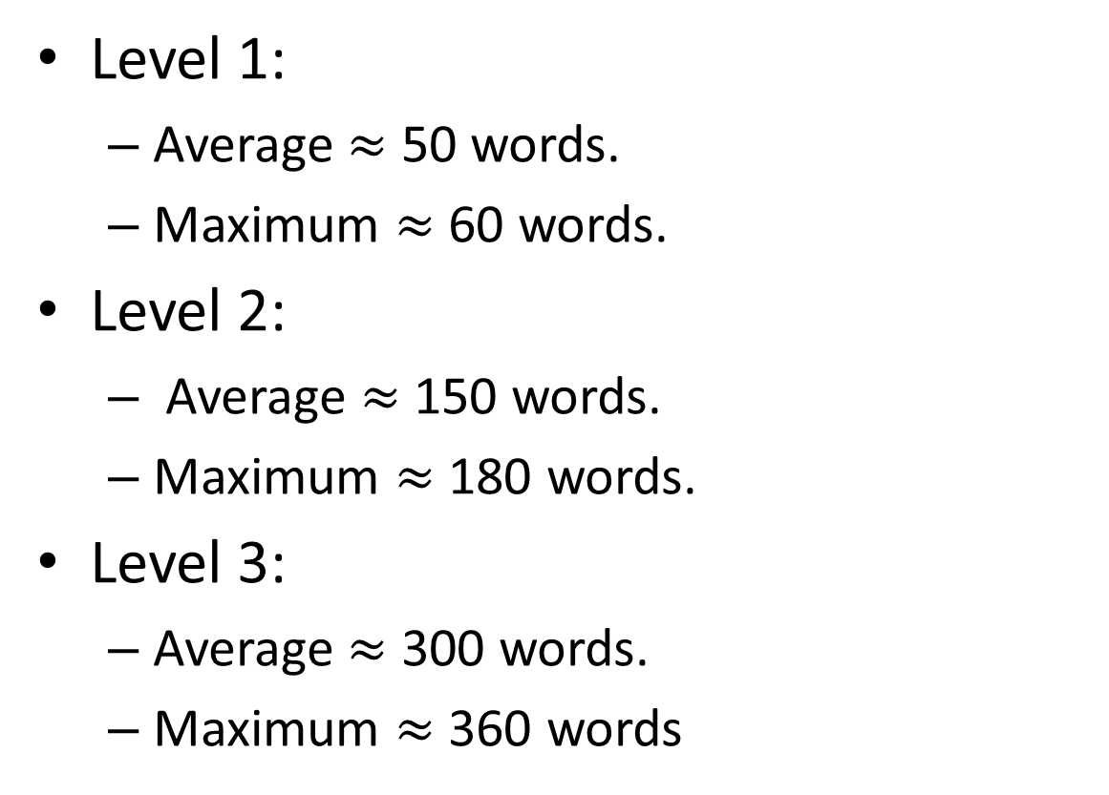
Response to Topic 3:
Level 1:
Average $≈$ 50 words.
Maximum $≈$ 60 words.
Level 2:
Average $≈$ 150 words.
Maximum $≈$ 180 words.
Level 3:
Average $≈$ 300 words.
Maximum $≈$ 360 words

Slide 7
Response to Topic 3: (Continued)
Shortening texts is acceptable if, and only if:
The result is true to the author’s communicative purpose.
The text retains the style, text type, and tone that are typical for the targeted proficiency level.
The passage is still considered authentic by the educated native readers who review the items.
Successful editors use their “Sprachgefühl” to make changes and then run “double blind tests” of the passage’s perceived authenticity.

