Slide 1

Designing and delivering a pre-deployment toolbox for FP and FLS assets of the BEL AF
Sebastien Wesphael, Sen.Capt (OF-3), MA
Belgian Defense Language Center
BEL NCO School

Slide 2
Presentation contents
Identifying the needs for specific language training
History in course design
Developing the toolbox
Delivering the training
  1st attempt
  Encountered problems
  Implementing the changes
  2nd attempt
  Specific training in unit
Current situation
Way ahead

Slide 3
Identifying the needs for specific language training
the knowledge of English for most of FP or FLS personnel is just unacceptable
  Identification of issues for BEL AF troops abroad (mainly Kandahar Airfield)
  AAR Detco on KAF: “ The knowledge of English for most of FP or FLS personnel is just unacceptable”. The cooperation with USAF, RAF and Royal Australian Air Force requires a better mastery of English, especially for FLS personnel. It’s been requested that Belgian FP and FLS personnel are interchangeable in order to obtain experience of working in a international environment. However, this is impossible due to the lack of English knowledge. Shifts on rotational basis is only possible if careful selection of the participating personnel has been made in advance. Therefore, specific English classes and specific scenarios should be designed and delivered in order to give the designated personnel a “go/no-go” to participate in the mission, and prevent untrained personnel to operate, at least as FLS personnel. “
specific English classes and specific scenarios should be designed and delivered
give “go/no-go” to participate in the mission
Notes:
We’ve got an excerpt of an after action report form a Detco based in KAF for a tour of duty with BEL AF troops.
What we can isolate from this passage is the 3 following sentences:
- the knowledge of English for most of FP or FLS personnel is just unacceptable: the word choice is important, and can be found in other ‘End of mission reports’. This is unacceptable.
specific English classes and specific scenarios should be designed and delivered: that was the starting point why we decided to give a specific and tailored training in English. It refers to the title. The Airforce is not the only department in Defence that needs a good knowledge of English. However, FP and FLS personnel have to work in close coordination with personnel of other NATO partners. The airforce tries to establish synergies with other detachments.
The lack of knowledge could be considered as a ‘show stopper’ for some members of the personnel especially members of the FLS taskforce , because besides having to function with other nations in English as a common langauge, also have to talk with the ‘ground control’, i.e. the control tower. It is impossible to achieve the latter without a minimum of English.
give “go/no-go” to participate in the mission : some DetCo demand a more binding preparation and evaluation of the personnel prior to their designation for the mission. Some even ask a particular SLP level for the participation. BDLC can give advice on whether the personnel member is judged able to express himself in the English language but can not take the responsibilty of denying a designation for a personnel member.

Slide 4
History in Course Design
SLP >< American English Course (STANAG 6001 in 2006)
Nautical English (specific Navy vocabulary and procedures)
Technical English for aircraft technicians
Operational English for PfP - in 2005/2006, Mongolian troops also served as part of the Belgian KFOR contingent in Kosovo.
  Classroom training involving:
    Radio procedures and communication
    Cyrillic >< latin alphabet
    Pronunciation
    Standard ops phrases
Notes:
American English Course was specifically designed for AF personnel who often had to attend courses in English for their specific job. This had nothing to do with STANAG 6001 English, because it was meant to be ESP and we had to teach EGP. So, we had to design new courses in accordance with the STANAG 6001 objectives.
- Nautical English : To standardize the language used in commuication , forr navigation at sea, in port approaches, in waterways, harbours, on board vessels with multi lingual crews.
Crews have become ever more international in character. The need for a lingua franca has arisen.
English, being a world language, has filled the gap.
- Technical English: specific vocabulary and grammar needed to comprehend technical manuals and job guides. The grammar is aimed at understanding the structures they come across while reading their technical documentation (e.g. passive voice, compound nouns, word order, imperatives, suffixes and prefixes, linking devices,etc… )
- Operational English for Pfp: problems had been identified regarding some procedures in the field . Some of the procedures were not properly carried out. They had to use standard NATO procedures that somehow differed from their national procedures. Also, the message conveyed needed to be transmitted in English to be understood by the Belgian military (KFOR). Therefore, as mentioned for Nautical English, English was chosen as the working language instead of French or Dutch, for obvious reasons.

Slide 5
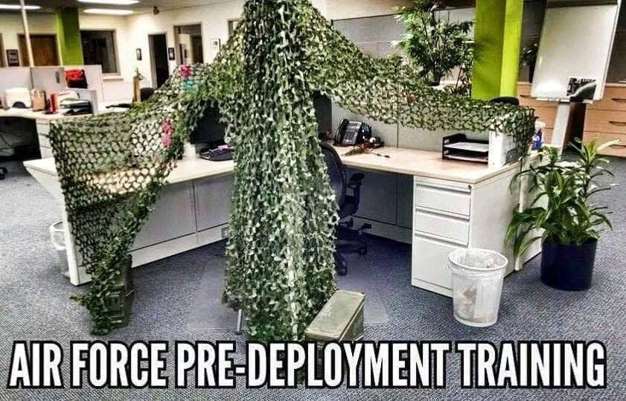
Developing the toolbox
Developing a pre-deployment training for the FP and FLS assets of the Bel AF….
What could that represent?
We first thought of this:
Notes:
When we had contact for the first time with COMOPSAIR to prepare a pre-deployment training package, we had to brainstorm with the colleagues to figure out what they meant with that.
So we looked up the internet to gather some information about what a force protection was supposed to do on mission.
The future DetCo didn’t really know herself what she was supposed to expect as real-life situations on theatre, because it was her first mission.
As we were searching and brainstorming, and the preparation wasn’t really taking off, we first thought of a normal EGP course with a camouflage net above our head… after all, for airforce standards, this would be sufficient to make it operational.

Slide 6
Developing the toolbox
  1st step: course contents proposal (from BDLC –based on conversation with future Detco) :
Alphabet – military alphabet – numbers
Introductions
Filling out forms (personal information)
ECPs (vocabulary – expressions)
Access control (classroom roleplays)
Body and vehicle searches (vocabulary – expressions – classroom roleplays)
Notes:
This also seems quite logical that personnel on the gate has to:
Send message on the radio : spelling names, and giving numbers (military style: e.g. : fower – niner)
Ask some personal information and details and fill out a form.
Perform searches on vehicles and people at the gate, if needed (full search or frisk search)
Indicating a specific location when sending a report about what they had just observed (using grid locations on crashmaps).
Indicate what directions to take if someone reports to the gate and wants to enter the airbase and try to find his way to a particular building or sector in the airfield facilities.
If needed, handle a situation in which a casualty or wounded person has to be evacuated via MEDEVAC / CASEVAC

Slide 7
Developing the toolbox
Radio comms - revision prowords
Indicating location (vocabulary – expressions)
Roleplays Radiocheck – SITREP
First aid CASEVAC (vocab – expressions – classroom roleplays)
Reserve topic
Giving directions (vocab – expressions – classroom roleplays)

Slide 8
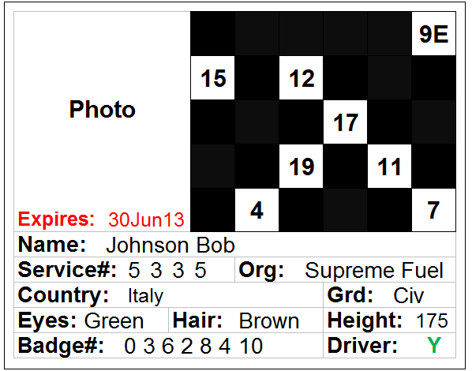
Developing the toolbox
2nd step: gathering info from participating units to missions OGF and ODF – Flight Line Security Officer highlighted communication issues in:
  RAB (Restricted Area Badge) procedures
Notes:
Restricted area badges are some sort of forms in which personal details can be found.
The FP at the gate can see to which sectors the person has access.
The EAL (Entry authorization list) is complementary to the RAB; in order to grant access to the airfield, an individual has to show a valid RAB to enter the sector he wants to go to and to be on the EAL list.
If problems are detected the security officer has to be contacted.
Incidents on the gate can be a problem for personnel with unsufficient knowledge and it is important to know a few key phrases in order to react in a proper way. I will show you one of the incidents that can happen at the gate later on in the presentation.
MEDEVAC / CASEVAC and MIST(AT) reports are templates used to inform the chain of command that medical help is needed in case someone would be wounded. They have to be sent in a standard format and they require the personnel to transmit the information with great accuracy in order to secure a swift and appropriate reaction by the medical corps.
10 liner or UXO reports are to be used when an FP or rather FLS goes on patrol for example along the perimeter fence and finds what he suspects to be an unexploded ordnance.
Finally, SALTA reports are used when observing a suspected enemy movement or incident using grid locations and military time.

Slide 9
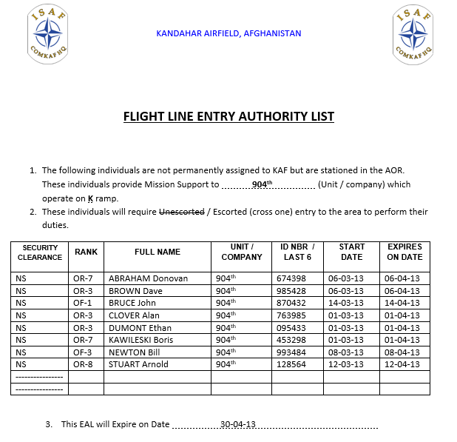
Developing the toolbox
2nd step: Gathering info from participating units to missions OGF and ODF – Flight Line Security Officer highlighted communication issues in:
  RAB (Restricted Area Badge) procedures
  EAL (Entry Authorization List ) checks

Slide 10
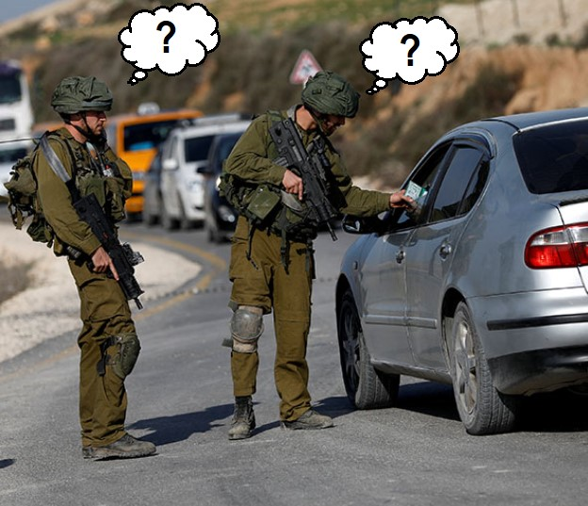
Developing the toolbox
2nd step: Gathering info from participating units to missions OGF and ODF – Flight Line Security Officer highlighted communication issues in:
  RAB (Restricted Area Badge) procedures
  EAL (Restricted Area Badge) procedures
  Responses to incidents at the gate

Slide 11
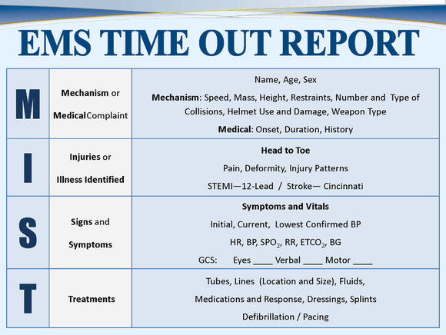
Developing the toolbox
2nd step: Gathering info from participating units to missions OGF and ODF – Flight Line Security Officer highlighted communication issues in:
  RAB (Restricted Area Badge) procedures
  EAL (Restricted Area Badge) procedures
  Responses to incidents at the gate
  9-liner + MIST

Slide 12
Developing the toolbox
2nd step: Gathering info from participating units to missions OGF and ODF – Flight Line Security Officer highlighted communication issues in:
  RAB (Restricted Area Badge) procedures
  EAL : Entry Authorization List
  Incidents at the gate
  9-liner + MIST
  10-liner

Slide 13
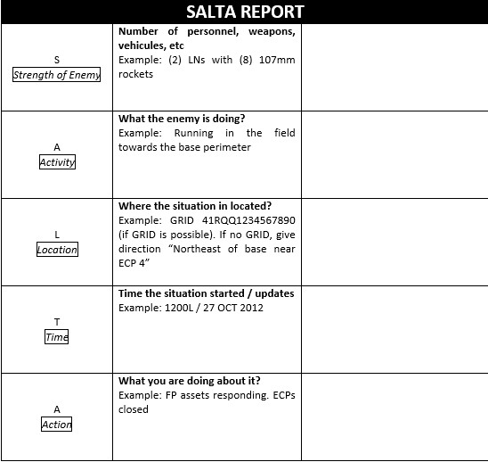
Developing the toolbox
2nd step: Gathering info from participating units to missions OGF and ODF – Flight Line Security Officer highlighted communication issues in:
  RAB (Restricted Area Badge) procedures
  EAL : Entry Authorization List
  Incidents at the gate
  9-liner + MIST
  10-liner
  SALTA report

Slide 14
Developing the toolbox
  3rd step: merging proposal and info gathered on theatre:
Day 1
ECPs (vocabulary – expressions)
Access control (roleplays)
Body and vehicle searches (vocabulary – expressions – classroom roleplays)
Suggested roleplays by Detco
ECPs: Reactions on RAB (Restricted Area Badge)
Possibilities: good RAB/False RAB/no RAB - drunken person - aggressive person
Notes:
Knowing that we went back to our first suggestion and tried to adapt in accordance the information we had gathered from the personnel in operations.

Slide 15
Developing the toolbox
  3rd step: merging proposal and info gathered on theatre:
Day 2
Radio comms - revision radio prowords
Indicating location (vocabulary – expressions)
Radiocheck – SITREP(classroom roleplays)
Proposed roleplays by Detco
Radio conversations:
Rocket attack / “SALTA” (=SITREP)
ON PATROL : Possibilities: hole in the fence - footprints on the ground- a suicide bomber entering the base- find an UXO
(10-liner)

Slide 16
Developing the toolbox
  3rd step: merging proposal and info gathered on theatre:
Day 3
First aid CASEVAC (vocab – expressions – roleplays)
IN KAF: rather MEDEVAC → 9-liner
Proposed roleplays by Detco:
Rocket attack
Ground attack
Possibilities: wounded and dead people → 9-liner/MISTAT

Slide 17
Delivering the training : 1st try
Day 1:
    Military ranks (US Airforce + RAF)
    The alphabet (regular alphabet)
    Introduce yourself
    The Entry Control point: vocabulary
    Types of vehicles on an airport
    Access control vehicle + pedestrian
    Vehicle search / body search
FINAL ROLEPLAY: real-life role play (with vehicles) →
vehicle search and frisk search (on people)
Notes:
You will see that what we delivered the first time compared to what we were expecting to give in the first place has somewhat been shortened and simplified in a way.

Slide 18
Delivering the training : 1st try
Day 2:
    Military alphabet (presentation and exercises)
    Military time (presentation and exercises)
    Radio prowords (vocabulary + application in radio comm)
    Radio check (exercises in pairs)
    UXO (Unexploded Ordnances) report: the 10-liner.
FINAL ROLEPLAY: real-life situation →
UXO found and message transmission on the radio (10-liner report)
ORIGINALLY: 4 DAYS → 3 DAYS → 2 DAYS
Notes:
The major problem we faced in the first place was that the personnel we were training was conbstantly busy during the pre-deployment period.
Originally, we were supposed to give a 5-day training but the personnel usually leaves earlier on Friday, certainly in a period like the pre-deployment phase.
They have to have their medical files ready, attend briefing, bring their luggage to the military airport and other activities of the same kind.
Personnel is willing to participate actively but attendance is hampered by an overload of pre-deployment activities.
People come and go out of the classroom and disturb the group constantly.

Slide 19
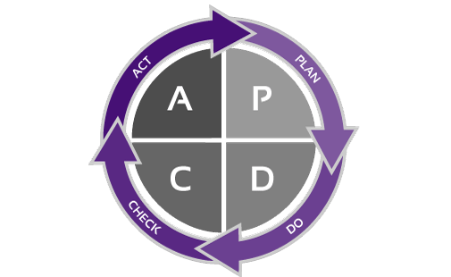
DELIVERING training: encountered problems
Participants have a heterogeneous knowledge of English (young><old, general education><vocational education) → problems in : asking questions, word order,…
→ Role-plays not always feasible
Lack of time in the units: participants come and go.
Training is disturbed by last-minute and unplanned activities (Detco brief, medical file at Mil Hosp, etc… )
Training is high-stakes for chain of command but low-stakes for the unit. (lack of spares anyway)
Little commitment of the staff to help up with the preparation of role-plays (vehicles, equipment, fake UXO’s, etc…)
Intensive training (8 AM to 4 AM everyday): combat units → need to move.
Notes:
We really had to think of the encountered problems and inform the chain of command, so that they react appropriately and apply the necessary changes for upcoming rotations, in order to make the training more efficient, provided that we only had a few days of training.
HETEROGENEOUS GROUP: also people with different native languages, e.g. 1st tactical Wing has French-speaking and Dutch-speaking personnel.
ROLEPLAYS NOT ALWAYS FEASIBLE: part of the personnel have little or no knowledge of English, which means that they barely know how to ask a question for example.
Therefore, bringing them the necessary vocabulary does not always help, as you have they can not use it in a proper and well-structured sentence.
LITTLE COMMITMENT: we mainly have the feeling that the PL commander in the unit doesn't really take it seriously, and that it’s just a tick in the box that they can have on their PDT: mainly reporting to the chain of command that this has been done.
INTENSIVE TRAINING: it includes sitting in the classroom for long hours. And most of them are just not used to it. They have to move and be outdoors. Some of them suffer from an hyperactivity syndrome and that’s the reason why they wanted to join the military.

Slide 20
Implementing changes
More grammar – differentiation in groups
1st stage: basic Functional English at BDLC – 2nd stage: Functional English training in unit
Transmission of remarks to the AF chain of command
Condition for Functional English: the staff in the unit is responsible for the tactical part of the situations – BDLC monitors the use of English only
Functional English week: no other activities planned
Notes:
Condition for Functional English: the staff in the unit is responsible for the tactical part of the situations – BDLC monitors the use of English only : when we first organized real-life situations including vehicle and also body searches, most of the personnel told us that the procedures we were using (coming from handbooks, internet, etc… ) didn’t match the procedures that they had been taught.
Therefore, we have asked the officers in charge and their NCO’s to monitor the tactical part of the the scenarios and that BDLC would focus on the English usage.
no other activities to be planned: it is not always possible to avoid other activities because English is imposed to the unit by the chain of command and even though they are convinced that it is still very convenient to have some English, sometimes an additional language training will not fit in their already quite full programme.

Slide 21
Delivering the training : 2nd try
  Course contents BASIC ENGLISH – TOPICS
Alphabet – military alphabet – numbers – colours
Introductions
Filling out forms (personal information)
Jobs
Nationalities (adjective and noun)
NATO and national ranks
Notes:
We decided then to give a more complete theoretical course (grammar and vocab relevant to the mission) at our facilities – duration 1 week to avoid losing too much time with grammar and vocabulary in the unit.
This course is prerequisite for people attending the Functional Englisg training in unit, needless to say.

Slide 22
Delivering the training : 2nd try
  Course contents BASIC ENGLISH – TOPICS
Asking for help
Military vocabulary: e.g. equipment / vehicles /the barracks / basic training/ uniforms / Mil activities / Mil time / vehicle maintenance
Observation post procedures (SALTA report)
Maps and terrain analysis / grids and coordinates
At the doctor’s (illnesses and first aid)
Giving directions (the route)

Slide 23
Delivering the training : 2nd try
  Course contents BASIC ENGLISH – GRAMMAR
Grammar:
to be / to have (have got)
indefinite and definite articles
there is / there are
short answers
present simple – present progressive
Wh-questions
descriptive adjectives and adverbs
modals (can, must, have to)
giving advice (should)
prepositions
Need – to – have for functional English course
Notes:
All these grammatical notions are taught on a strictly need-to-have basis. All grammar not relevant to the mission is just not treated during the lessons, as they will probably never have to support their opinion or hypothesize when the next rocket attack is about to take place..

Slide 24
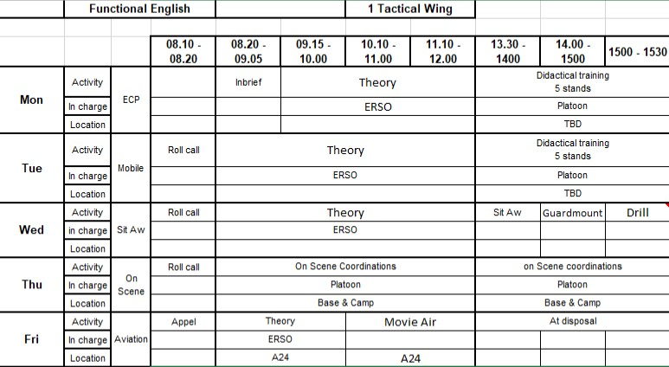
Delivering the training
– in the unit

Slide 25
Delivering the training
– in the unit
DAY 1 (ECP)
Vocabulary:
    The Entry Control point: vocabulary
    Force protection: vocabulary
    Prepositions
    Access control vehicle: vocabulary
    Access control pedestrian: vocabulary
    Vehicle search: vocabulary
    Body search: vocabulary
  Roleplays (afternoon):
    ECP (Entry Control Point)
Notes:
When in the unit, we do not recap any grammar notion but only rehearse or see vocabulary that is needed for the afternoons and the real-life scenarios.

Slide 26
Delivering the training
– in the unit
DAY 2 (THE PATROL)
Vocabulary:
    Radio communications – radio check
    Radio prowords (vocabulary + application in radio comms)
    Medevac – CASEVAC reports (exercises and template): 9-liner
    UXO (Unexploded Ordnances) report: 10-liner
    The observation post – describing a situation: SALTA report
  Roleplays (afternoon):
  Patrolling:
    10-liner report (action cards)
    SALTA report (incident report)

Slide 27
Delivering the training
– in the unit
DAY 3 (MISC)
Vocabulary:
    Giving orders
    American drill
    First aid
    Situational awareness briefing
    Common acronyms used in KANDAHAR
    arts of an aircraft and airfield vocabulary.
- Roleplays (afternoon):
    Situational Awareness Briefing and Guardmount Briefing (by Detco)
    American Drill (KSOO)
Notes:
Sometimes we are asked to add a specific part to the training. As an example, one of the Detco’s asked us to give some US drill procedures, because they had to take part in a parade for a HOTO in the very first days of the rotation.
The situational awareness briefing had been designed by the Detco in order to train his NCO’s to take notes while following a briefing and to rephrase the message conveyed with more simple words to the junior NCO’s.

Slide 28
Delivering the training
– in the unit
DAY 4 (REHEARSAL)
ECP and PATROL scenarios (made by DetCo)
ECP / PATROL / MEDEVAC / SALTA / MISTAT / UXO-REPORT

Slide 29
Current situation
A placement test to assess the level of the participants
A ‘cut-off’ score is implemented on this placement test
  Candidates above this ‘cut-off’ score attend a ‘Functional English Course’
  Candidates below this ‘cut-off’ attend a ‘Basic English Course’ at NCO school:
    !!! Access can be denied to ‘Functional English Course’: training in the unit by language coaches → Force protection personnel only
A ‘Functional English Course’ is held upon request in the respective units for personnel with sufficient knowledge.
The main focus of this training is the situational use of English. The unit makes the needed efforts to prepare possible scenarios relevant to the mission.

Slide 30
Way Ahead
BDLC will advise the DetCo, whether the personnel can be earmarked as FP or FLS.
Final decision though is made by the Detco and his staff.
A full curriculum for personnel below cut-off score (preferably):
  Basic English course (mainly grammar and basic vocabulary) :
    3 weeks (ON HOLD)
  Functional English Course (at NCO school – operational vocabulary and rehearsal of relevant grammar ): 1 week
  Functional English Training (in unit: scenarios by DetCo – held outdoors – equipment provided by unit = vehicles, radios, weapons):
    1 week.
BDLC personnel could guide staff during CERTEX period and provide DetCo with relevant feedback on progression.
Notes:
The 3-week basic English course is placed on hold, because it is time consuming for units and unfortunately, time is already running short with a two-week program.
Nonetheless, a two-week program will always remain insufficient for someone who has had little contact with the language.
The continuous guidance that could take place during certification exercises would definitely help them maintain their level throughout the preparation.

Slide 31


The pre-deployment English team
Notes:
In 1972, a crack commando unit was sent to prison by a military court for a crime they didn't commit. These men promptly escaped from a maximum security stockade to the Los Angeles underground. Today, still wanted by the government they survive as soldiers of fortune. If you have a problem, if no one else can help, and if you can find them....maybe you can hire The A-Team

Slide 32
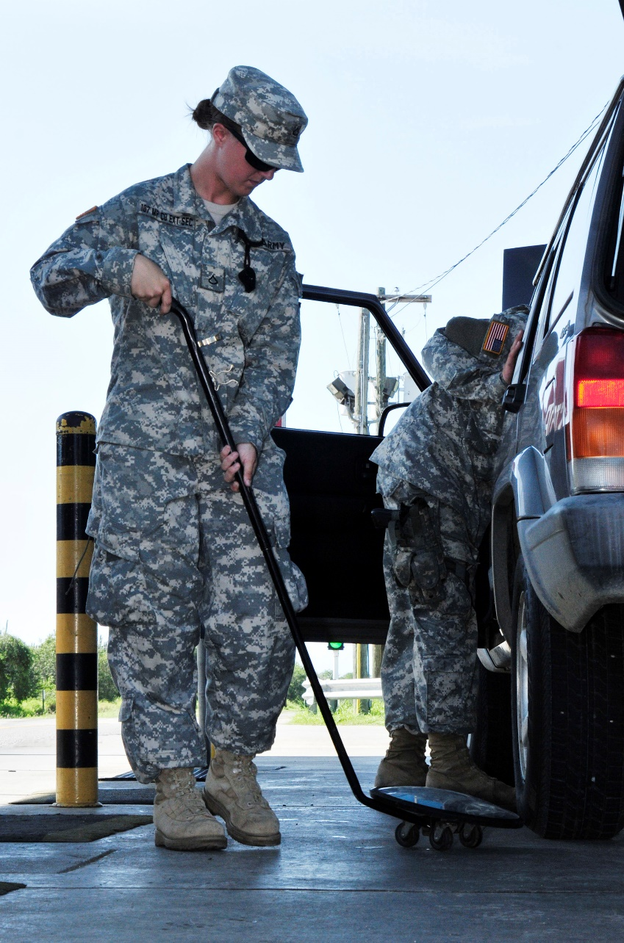
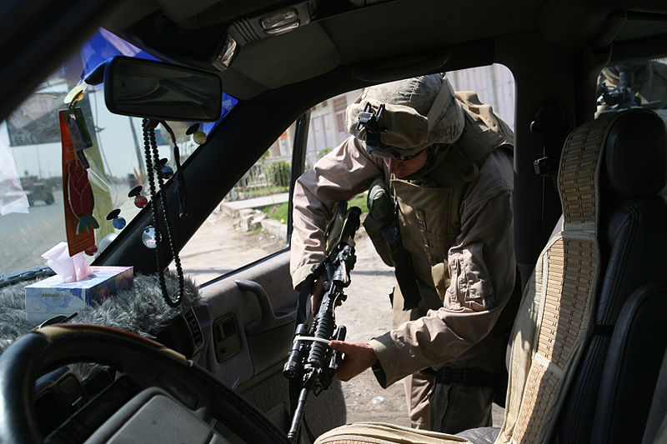
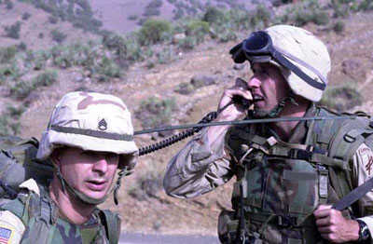
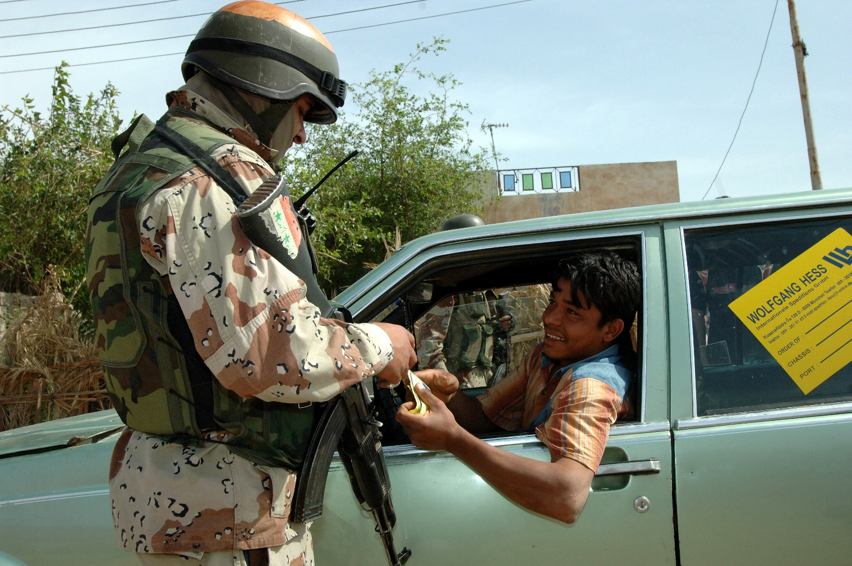
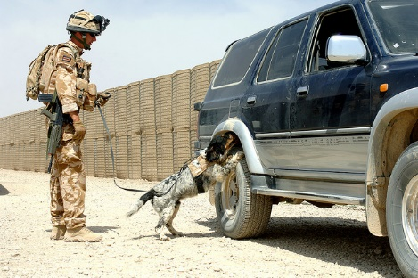
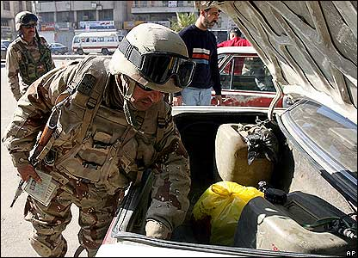
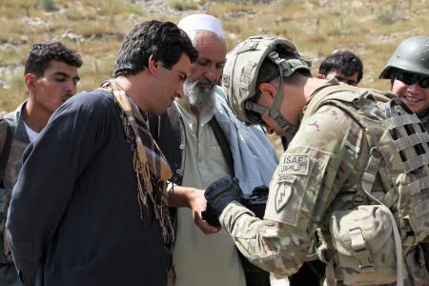
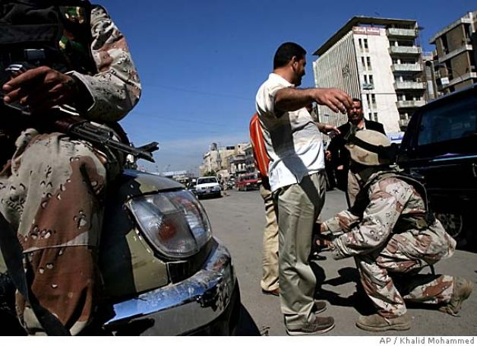
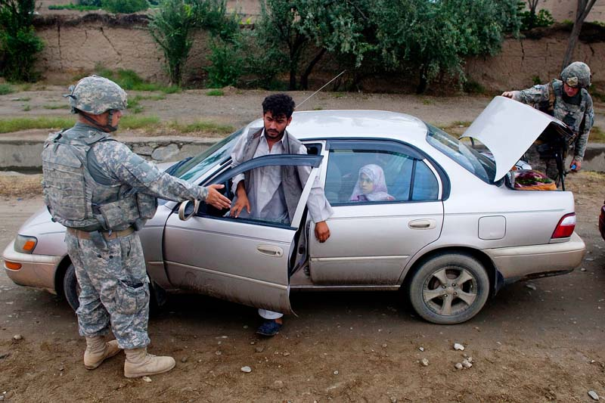
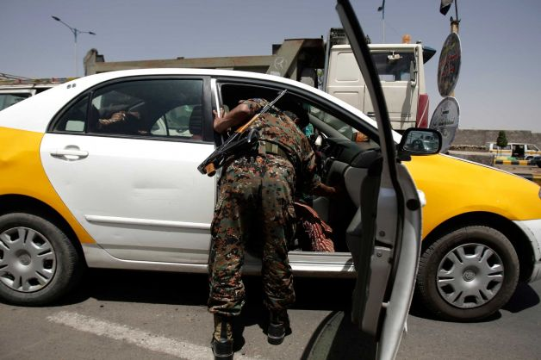
Questions

Slide 33
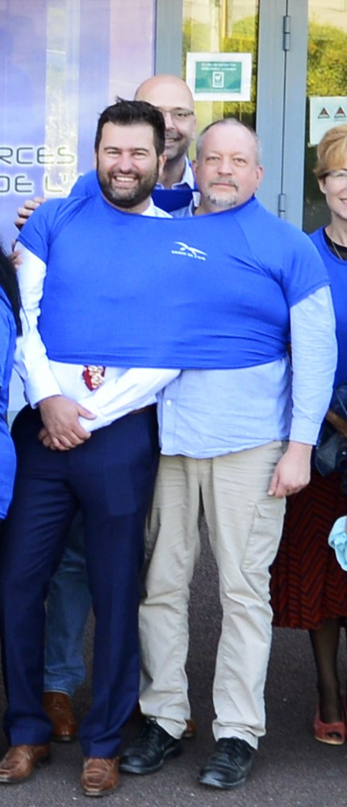
Next presentation
#HOWDAREYOU

