Slide 1
30 Years later: New curriculum and new pedagogical orientation for Canadian Armed Forces FSL program
Danielle Bérubé
Chief of French Curriculum
October 2022

Slide 2
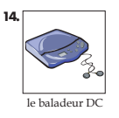
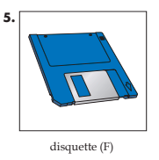
Summary
Introduction
The current curriculum
Operational and theoritical parameters surrounding the development of the new curriculum
New curriculum design, a sample (first level : Level 4)

Slide 3
Introduction
Canadian Armed Forces :
Under the Official Languages Act of Canada
+ 20 learning centers
11 Progress levels (Scale A B C)
My experience with the CAF

Slide 4
The current French curriculum
Outdated (trades, uniformes, images, etc.)
Hard to navigate
Vocabulary issues (selection and quantity)
Lack of technology
Distribution problems (cd sent by mail)
Need for authentic documents (videos, articles, etc.)

Slide 5
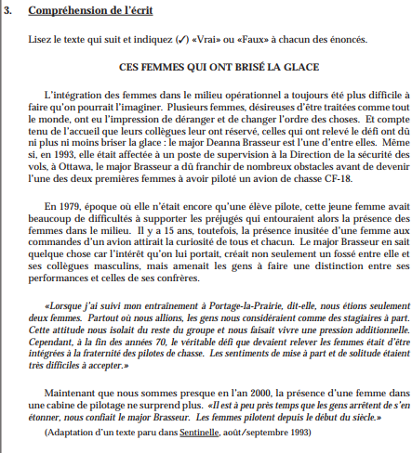
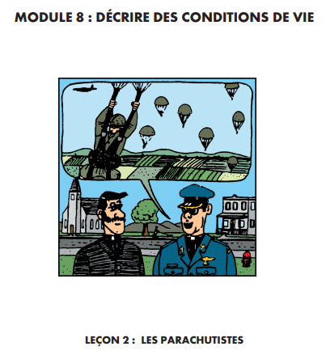

Slide 6
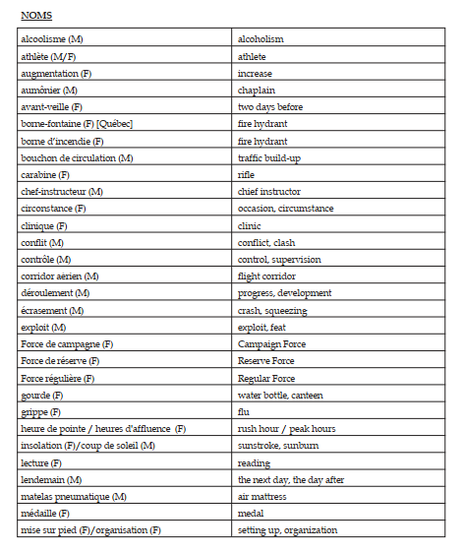
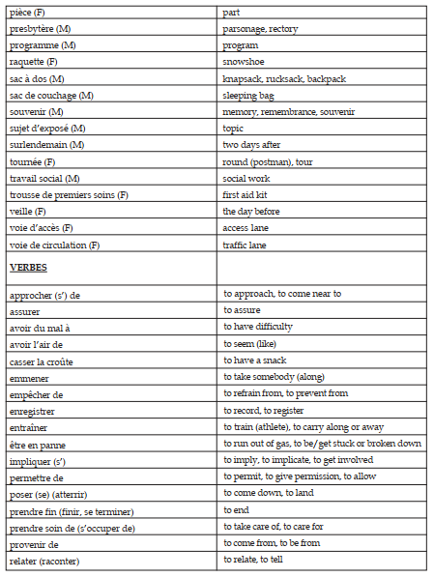
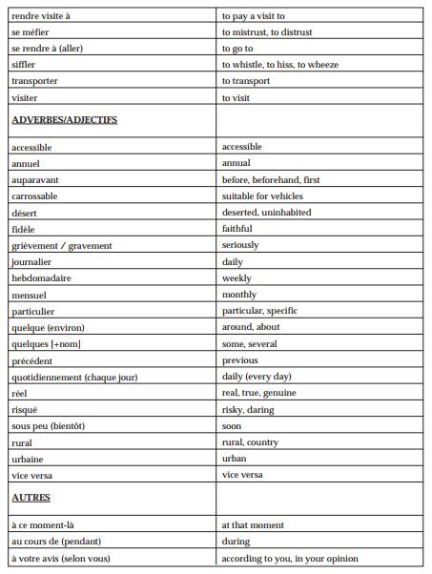
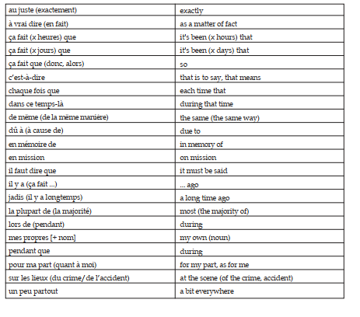

Slide 7
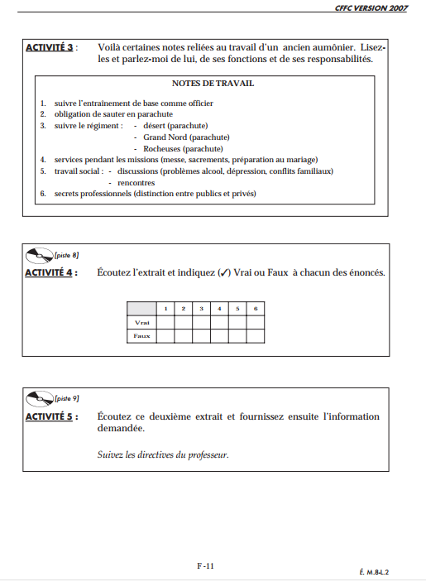
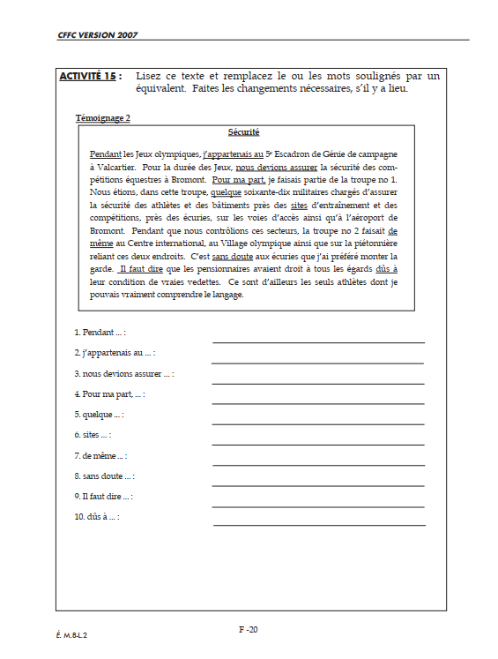
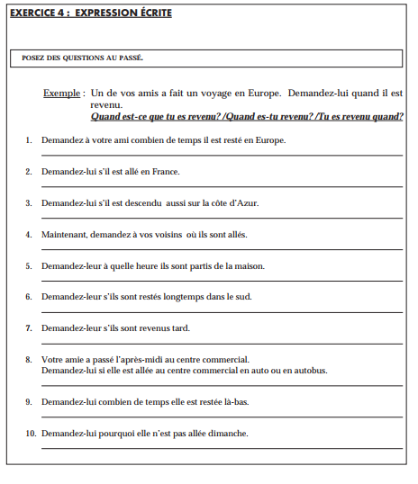

Slide 8
What we’ve kept from the current curriculum
Progression in learning is recognised as efficient
The assessments (correlated and used as a validation of the new curriculum)

Slide 9
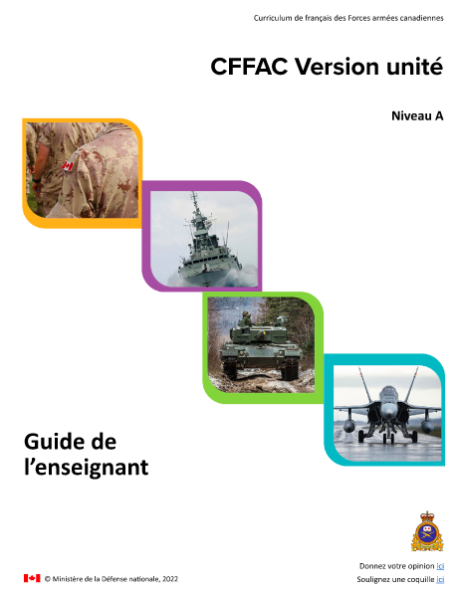
Operational needs
Different types of training
part time / full time,
individual / group class,
access to technology… or not
Document updates and distribution
Train the trainer needs
New teacher support vs flexibility for the experienced teachers

Slide 10
Theoritical and pedagogical orientation
Andragogy
Encourage autonomy
Clear objectives each day (sense of personnal efficacy)
Accountability (vocabulary learning)
Dealing with learning challenges
Exposure to stress / PTSD
Performance anxiety
Learning disabilities
New pedagogical orientation :
Differentiated pedagogy

Slide 11
Differentiated instruction
Differentiated instruction is : providing all students within their diverse classroom community of learners a range of different avenues for understanding new information (…) so that all students within a classroom can learn effectively, regardless of differences in their ability.
Aims to respond to student variety in readiness levels, interests, and learning profiles. It is a classroom that includes and allows all students to be successful.
(Wikipedia, 2022)
*Teachers are provided with a guide presenting the new pedagogical orientation

Slide 12
Approaches and theories in ecucation presented in the teachers’ guide
Communicative approach
Natural approach
Neurolinguistic approach
Behaviorism
Constructivism
Traditionnal approach
Project-based learning
Task-based approach
Structuro-global approach

Slide 13
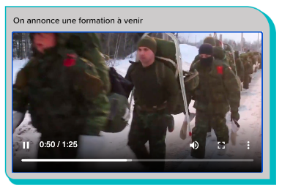
Best Practices in Education: The Teacher’s Guide
Use of talk time in the classroom (70% / 30%)
Flipped classroom
Corrective feedback (oral and written)
Mindmaps
Learning disabilities and learing difficulties
Formative and summative assessment

Slide 14
How does this translate into the curriculum?
The new version of level 4
Task-based units (12 mandatory tasks and a bank of 20 optional tasks)
Each unit (task) = 6 hours of training
4 language skills (S, L, R, W, S) + 1h differentiation
A lot of authentic documents (articles, videos, etc.)

Slide 15
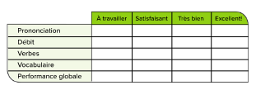
Into the classroom
Teachers are invited to adapt to the students needs or rythm
A larger pedagogical project is proposed
Students are invited to self-assess three times per unit
Students are responsible for selecting a part of the vocabulary to be learned
Students and teachers have the flexibility to select units based on their needs

Slide 16
Class trial : 44 candidates
Confirmed that the new product responds to the needs
Autonomy with vocabulary and grammar will take some ajustment from teachers and students
After trial of level 4, many teachers continued with the new pedagogical orientation (adapting current curriculum)
90% success at level assessment

Slide 17
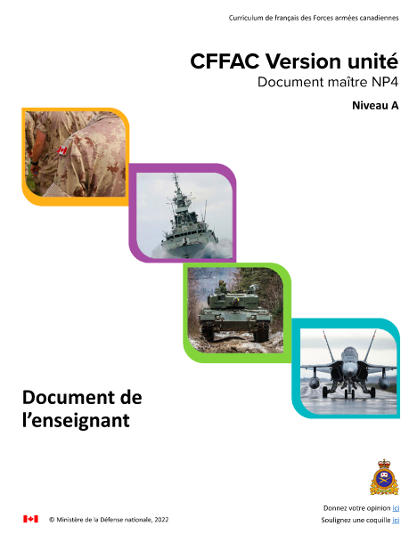
What a unit looks like
CFFAC Modernisé_Liens NP4 (adobe.com)

Slide 18
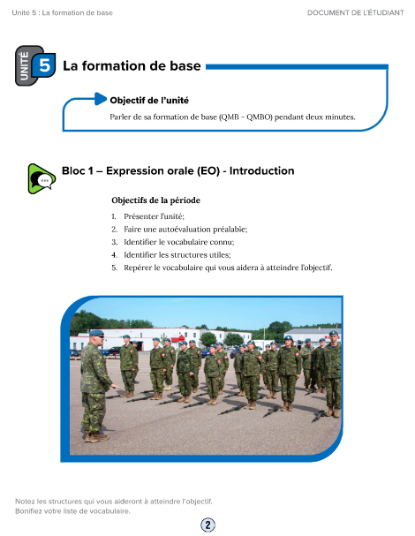
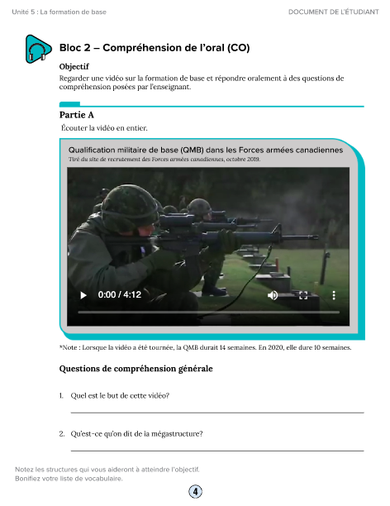

Slide 19
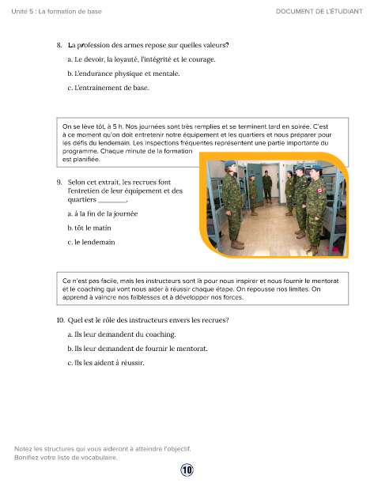

Slide 20
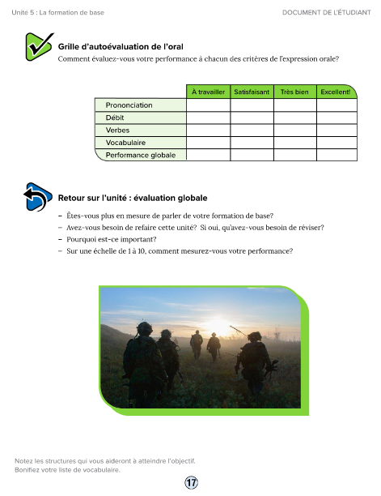
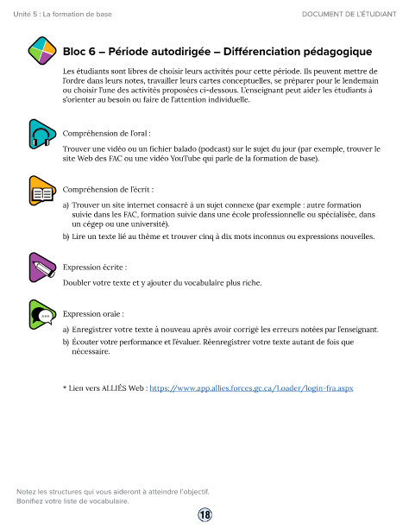

Slide 21
Thank you!
Merci!
Questions?
danielle.berube2@forces.gc.ca

Slide 22
Canadian Defence Academy /
Académie canadienne de la Défense

