Slide 1
Jumanji of English
Maj. Azer Jabrailov

Slide 2
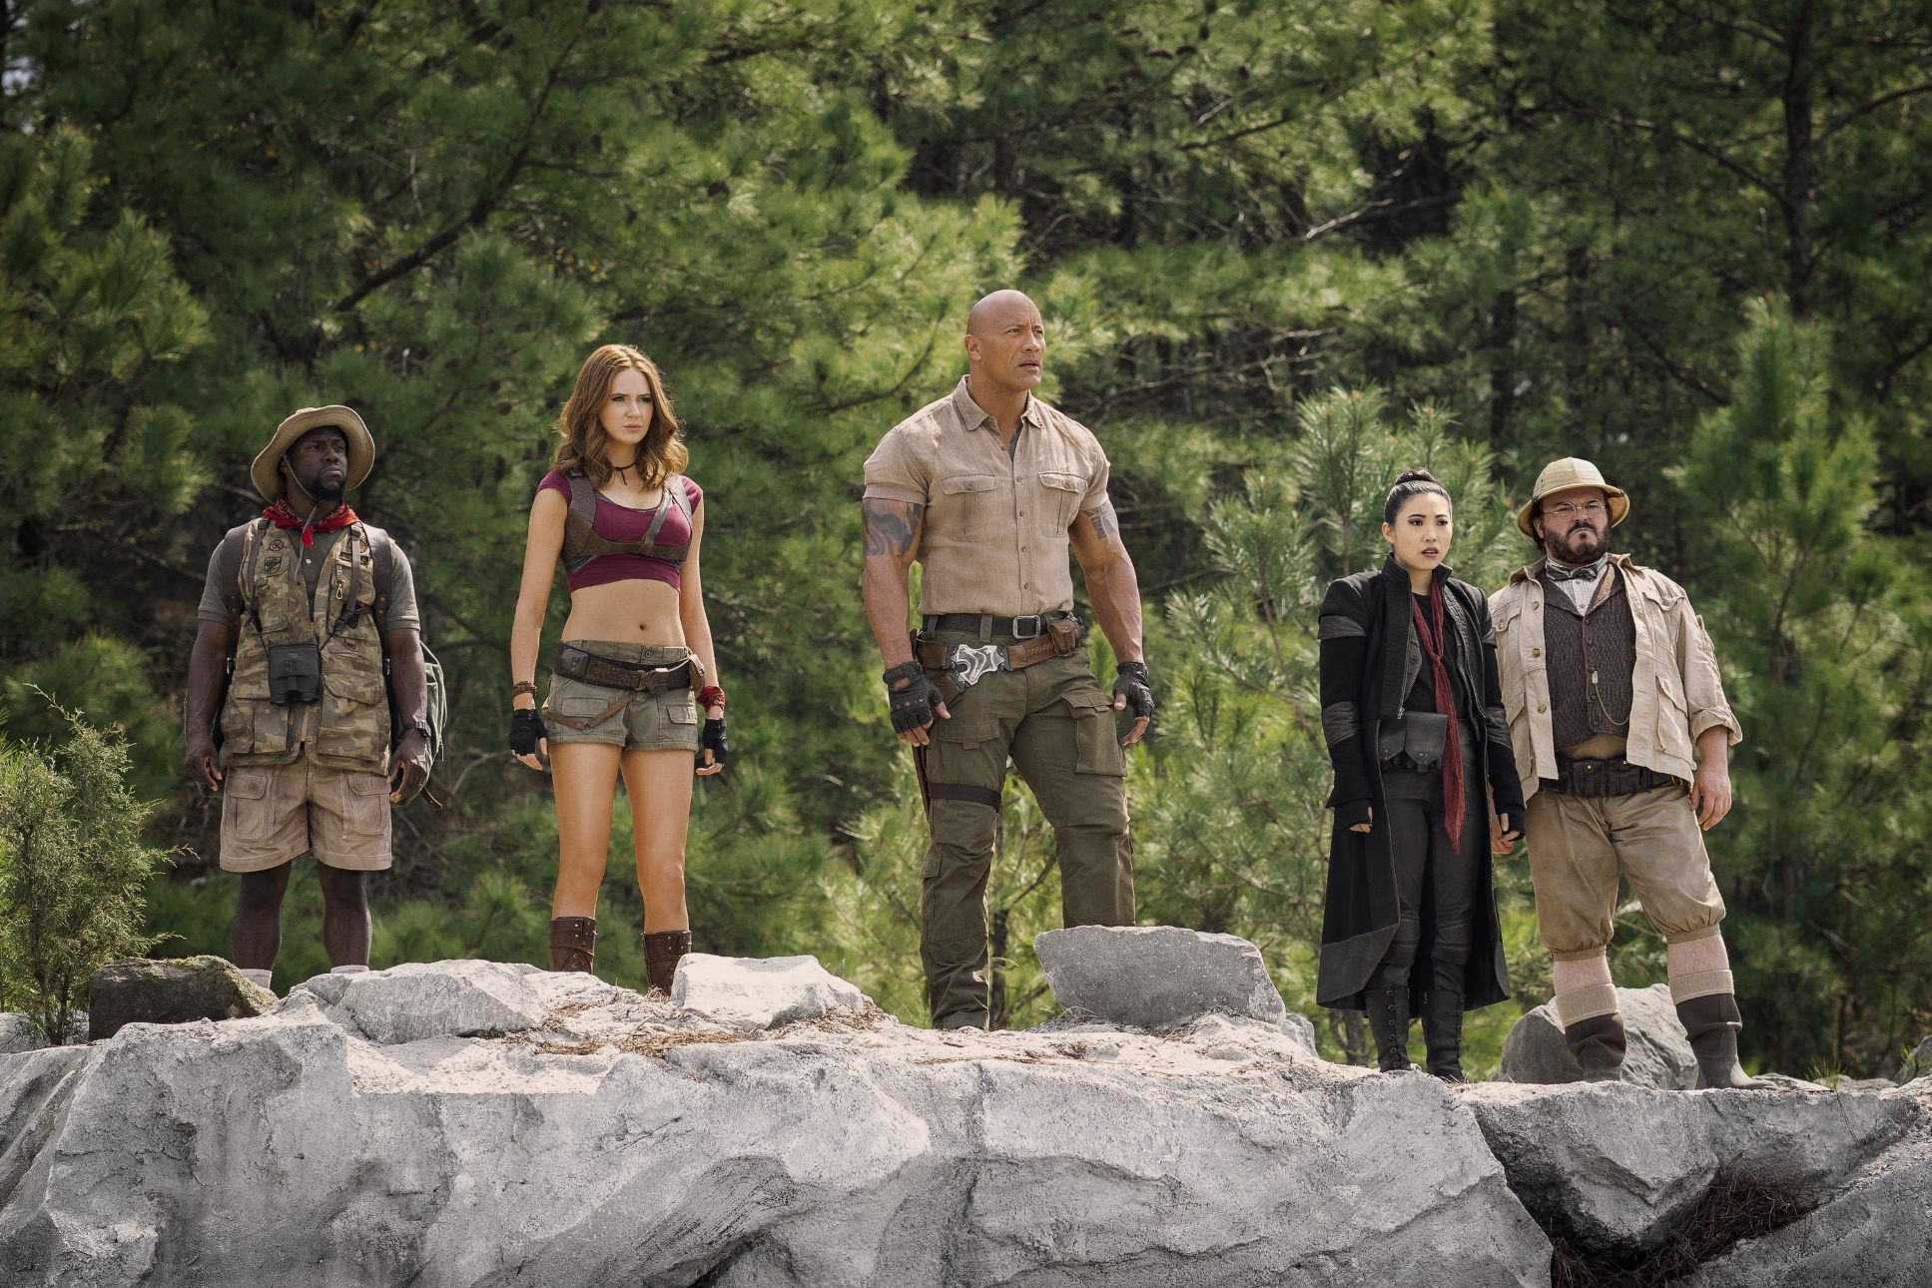
https://youtu.be/3GKsPhIx5KY?si=KdOerng30Hush9n5

Slide 3
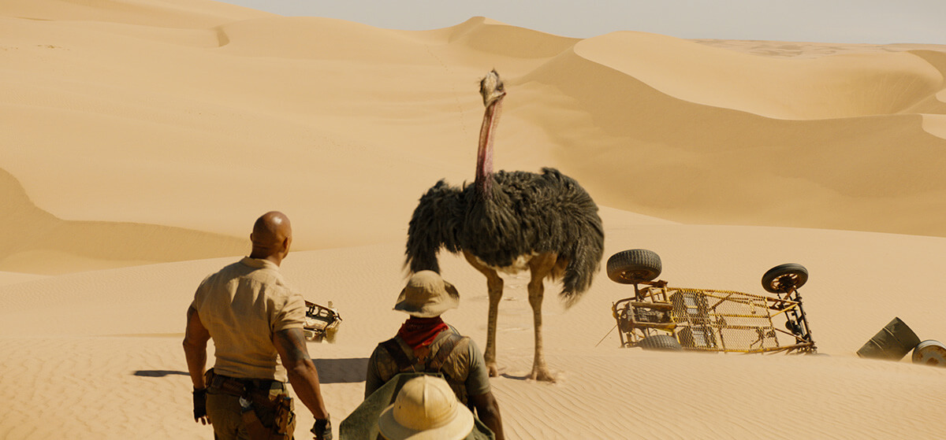

Slide 4
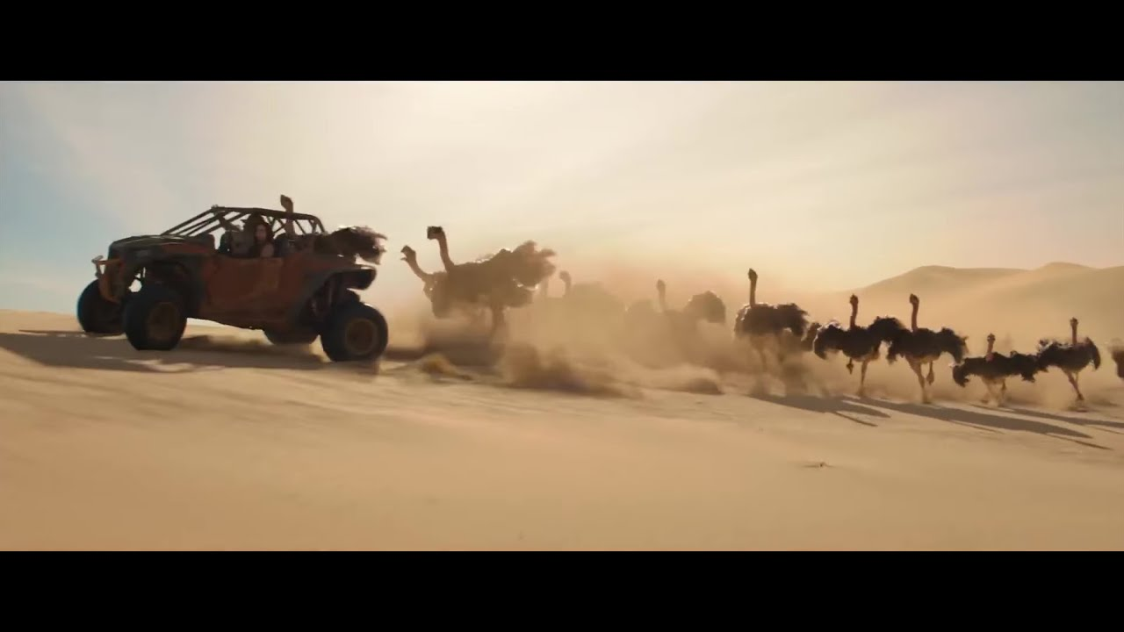

Slide 5
Limited instructions
Trigger imagination and creativity
Leads to communication and group work
Practices problem-solving skills
Gamifies the learning process
Unusual and fun
Promotes independent learning
Forces out of comfort zone

Slide 7
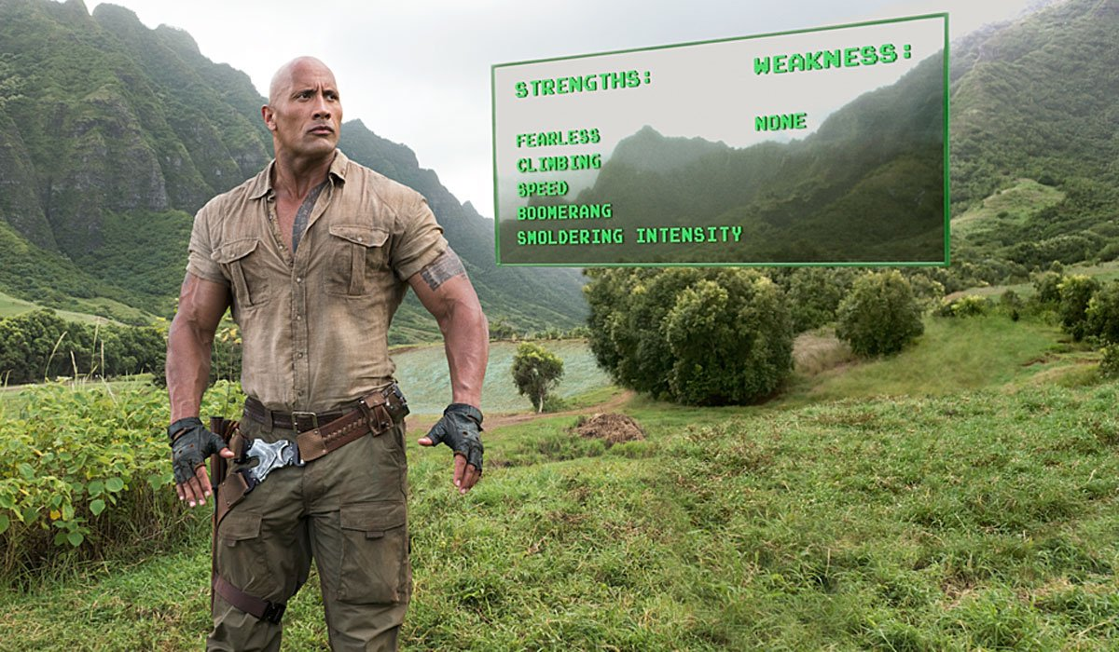
Different sets of strengths and weaknesses

Slide 8
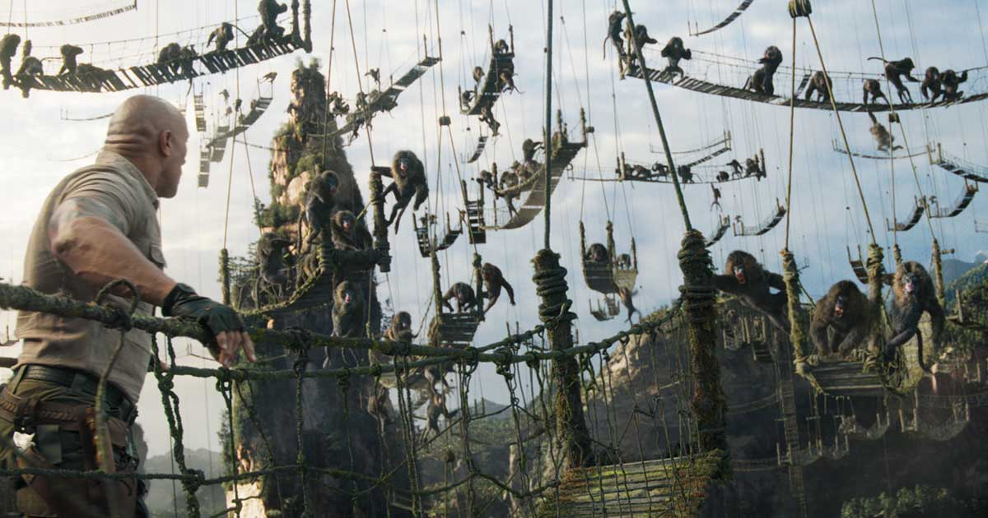
Mission type tasks resemble familiar military environment – cohesion tool?

Slide 9
Advantages
Surprise effect makes it memorable experience
Can be used throughout the course
Act like…
Disadvantages
Time and resource consuming

Slide 10
Characteristics
Visuals are crucial
Need for scenario
Sequencing easy and difficult missions
Time limited tasks
Tips and clues along the game

Slide 11
Possible tasks
Pieces of a puzzle could be hidden in different rooms
The process could involve different media
Could include NPCs
Potential design for online learning course/mobile app

Slide 12
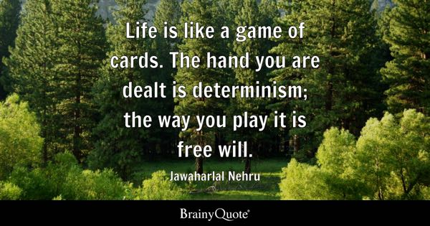

Slide 13
Thank you!

