Slide 1
The Use of AI
in Item Generation and Analysis – the Croatian Experience
NATO BILC STANAG 6001 Testing Workshop
Riga, Latvia 2023
Suzana Horvat
Kristina Serdoz

Slide 3
How it all started…
READING TASK LEVEL 3
PRIVATE EDUCATION IN THE UK
1. According to the author, the elite classes are…
a) now facing discrimination in the high-end workplaces.
b) being unfairly targeted by the political establishment.
c) no longer seen as the elite group they once were.
d) being disproportionately represented in top positions.
2. The author's main argument is that private schools are…
a) necessary for a strong education system.
b) perpetuating a system that favors the wealthy.
c) decreasing in student population diversity.
d) becoming outdated in the modern society.
PRE-TESTING RESULTS:
Item 1:
FV 50
DI 0,71
Item 2:
FV 58
DI 1,00

Slide 4
Objectives:
the use of ChatGPT in analysis of pre-tested items
the prompts and the structure of chats
live creation of a new item
presenting the chats developing speaking and writing prompts

Slide 5
What about you?
In groups, discuss/share:
your experience with any of the AI chat bots
(purpose, process, findings,...)
your views and thoughts on using AI in testing

Slide 6
ITEM ANALYSIS 1
READING L2 MCQ “Fort Moore”
read, briefly moderate (potential problems)
statistics FV 42 / DI 0,86 (behaving as a L3 task)
moderation findings
analysis of the task with Chat GPT (v. 3.5 & 4)

Slide 7
THE STRUCTURE OF THE CHAT
1. SETTING THE FRAMEWORK
1.1.Intro + STANAG 6001 Descriptors
1.2. Test Item CR Alignment Factors
2. TEXT ANALYSIS
3. TASK ANALYSIS
4. ASSUMING THE ROLE OF THE TEST TAKER
4.1. Test taker at Level 2
4.2. Test taker at Level 3
5. ANALYZING PILOTING RESULTS
6. REVISING THE TASK

Slide 8
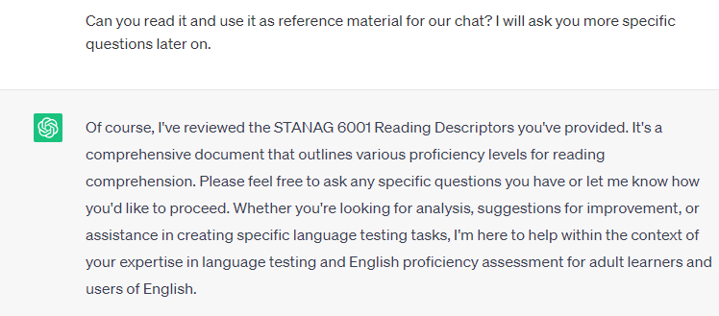
1.1 Intro + STANAG 6001 descriptors

Slide 9
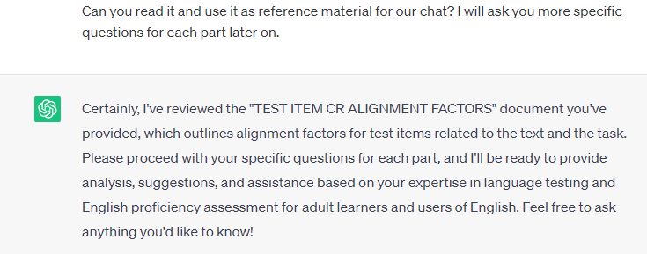
1.2 Test Item CR Alignment Factors

Slide 10
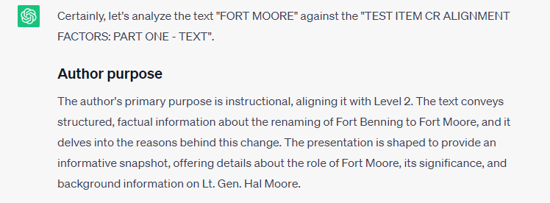
2. TEXT ANALYSIS

Slide 12
3. TASK ANALYSIS

Slide 13
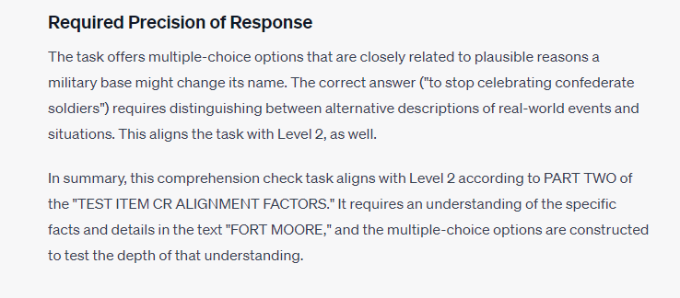

Slide 14
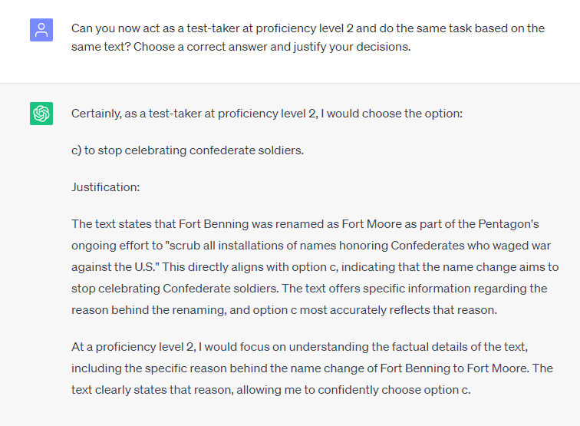
4. ASSUMING THE ROLE OF THE TEST TAKER

Slide 15
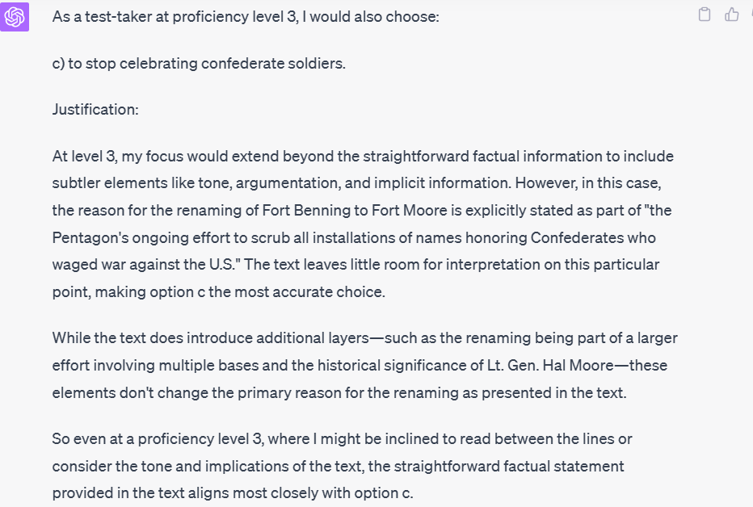

Slide 16
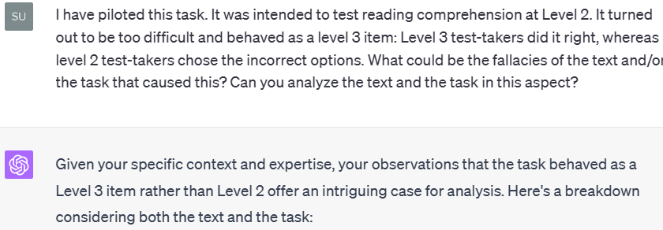
5. ANALYZING THE PILOTING RESULTS

Slide 18
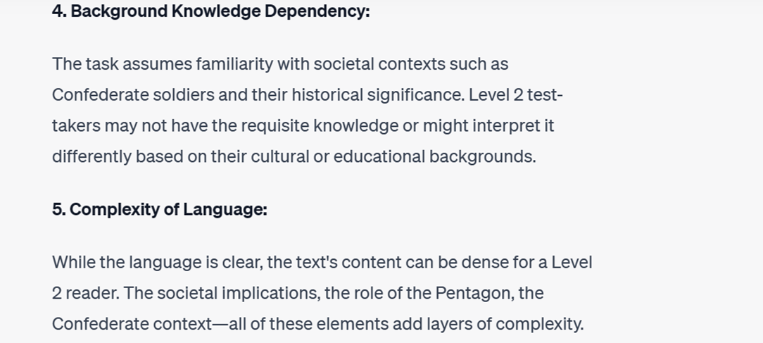

Slide 19
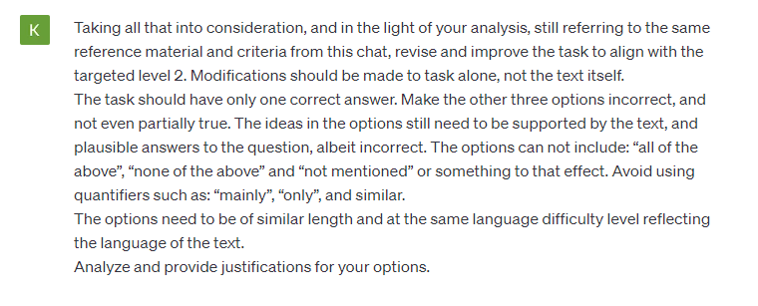
6. REVISING THE TASK

Slide 20
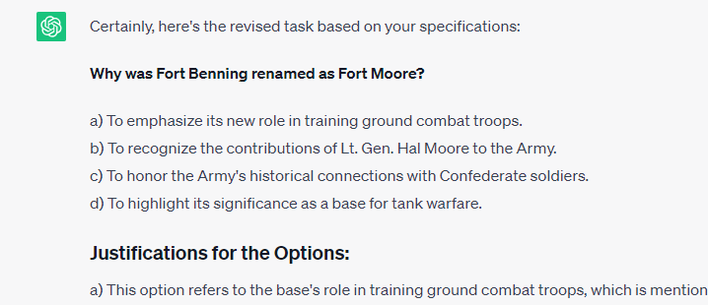

Slide 21
ITEM ANALYSIS 2
LISTENING L3 MCQ “A Speech on Climate Crisis”
listen, briefly moderate (potential problems)
According to the speaker, the situation is worsening because of …
The mismanagement of finances.
The over-exploitation of fossil fuels.
The lack of resolve to deal with the issue.
The high cost of new sustainable technologies.

Slide 22
ITEM ANALYSIS 2
statistics FV 54 / DI 0,00
moderation findings
analysis of the task with Chat GPT (3.5 &4)
alignment IAW STANAG 6001 only (listening!)
defining the text in terms of author’s purpose, text type and topical domain
defining the task in terms of listener’s task and precision of response

Slide 24
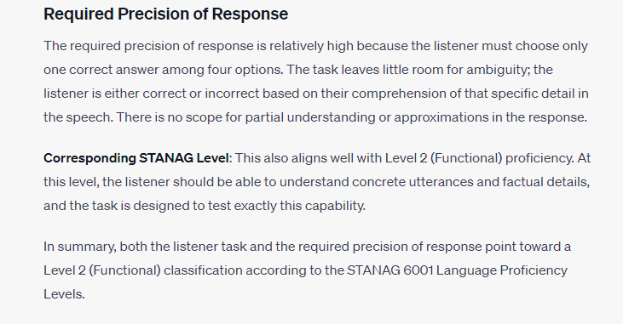

Slide 25
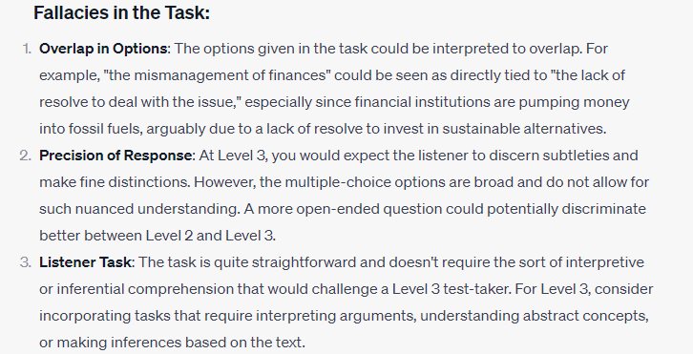

Slide 27
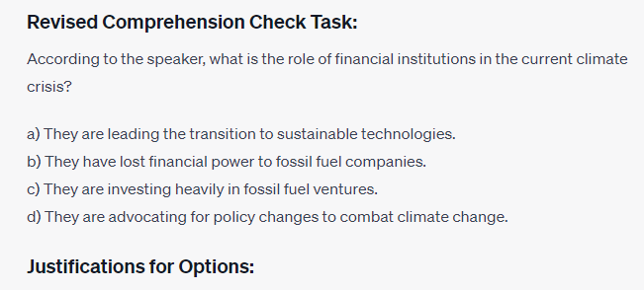
REVISING THE TASK

Slide 28
TASK CREATION
SETTING THE FRAMEWORK
Intro + STANAG 6001 descriptors
CR Alignment Factors
Item Review Checklist
ANALYSIS OF THE TEXT
ITEM GENERATION
ITEM ANALYSIS AGAINST THE CHECKLIST
TASK ANALYSIS AGAINST THE STANAG 6001
ITEM REFINEMENT

Slide 29
WRITING AND SPEAKING PROMPTS
1. SETTING THE FRAMEWORK
Intro + STANAG 6001 descriptors
2. TEST SPECS REQUIREMENTS + MODEL
3. REFINEMENT
chat links for both skills provided in the Shared folder

Slide 30
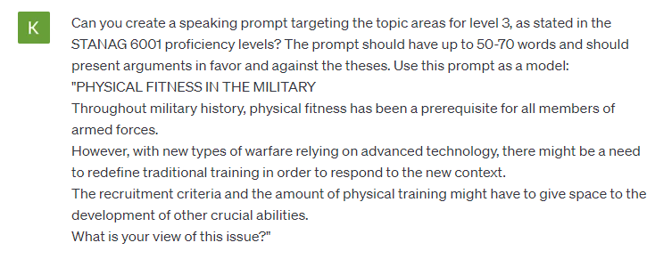

Slide 31
OUR TAKEAWAYS
not a magic wand but a useful new tool
qualities: speed and variability
limitations: step-by-step prompting, inconsistent, needing feedback, separate chats
focus on the process of item development
deeper understanding of standards
new insights in task analysis

Slide 32
Questions?
Thank you!

