Slide 1
Tips For Effective Hybrid Learning Success
Renata Skučienė
Lithuanian Military Academy Foreign Language Teaching Centre

Slide 3
Online Learning Spectrum
Face-to-Face
Web-Enhanced/ Blended
Hybrid
Online
Less Online
More Online

Slide 4
25 respondents
What do students think?

Slide 5
30 respondents
What do teachers think?

Slide 6
Benefits of Hybrid Learning
IMMEDIATE
INTERACTION
INDEPENDANCE
TECHNOLOGY
FLEXIBILITY
CLOSER RELATIONSHIPS
CONTENT MASTERY

Slide 7
Time Management
What Is Important in Hybrid Teaching?
Student Experience

Slide 8
Student Experience

Slide 9
Virtual Class Meetings
Team Work

Slide 10
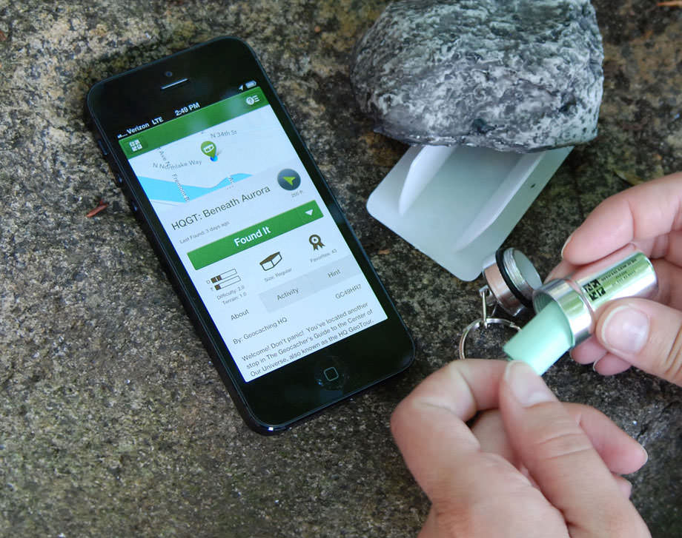
Create the Need to Know
geocaching

Slide 11
Reflect and Set Goals

Slide 12
Differentiate Learning through Online Work
Irregular plural?

Slide 13
Use Tools for Mobile Learning

Slide 14
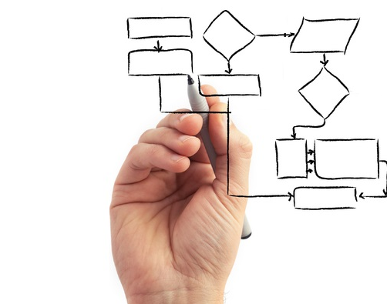
Planning Your Hybrid Course

Slide 16
Take it easy!
Focus on design, not technology.
Use resources already available.
Don’t do it alone.
Manage your students’ expectations.
Prepare for possible problems.
The little things count!

Slide 17
How NOT To Fail in Hybrid Learning

Slide 18
Course-and-a-Half Syndrome

Slide 19
Parallel Universes

Slide 20
Limited Interaction

Slide 21
Underused Assessment

Slide 22
When Hybrid and Blended Learning Outlive Coronavirus

