Slide 1
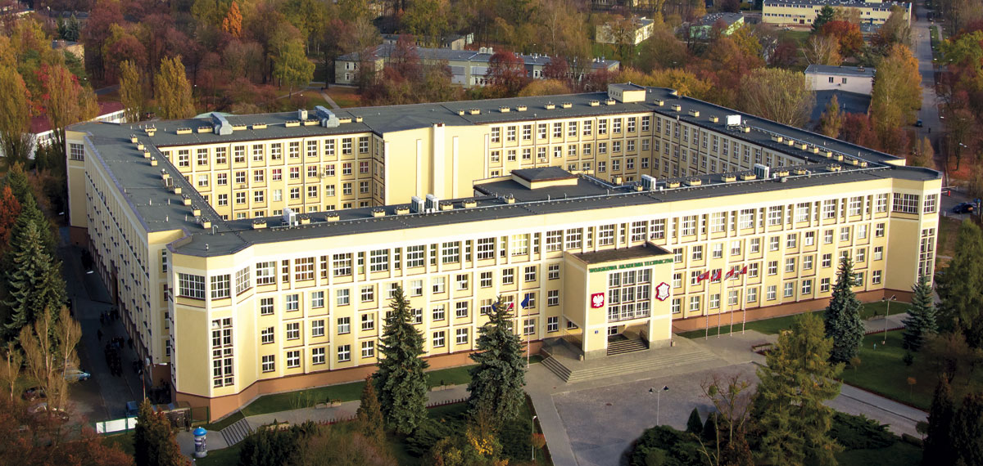

Slide 2
Involve me and I learn
Agata Jagiełło-Tondera, PhD

Slide 3
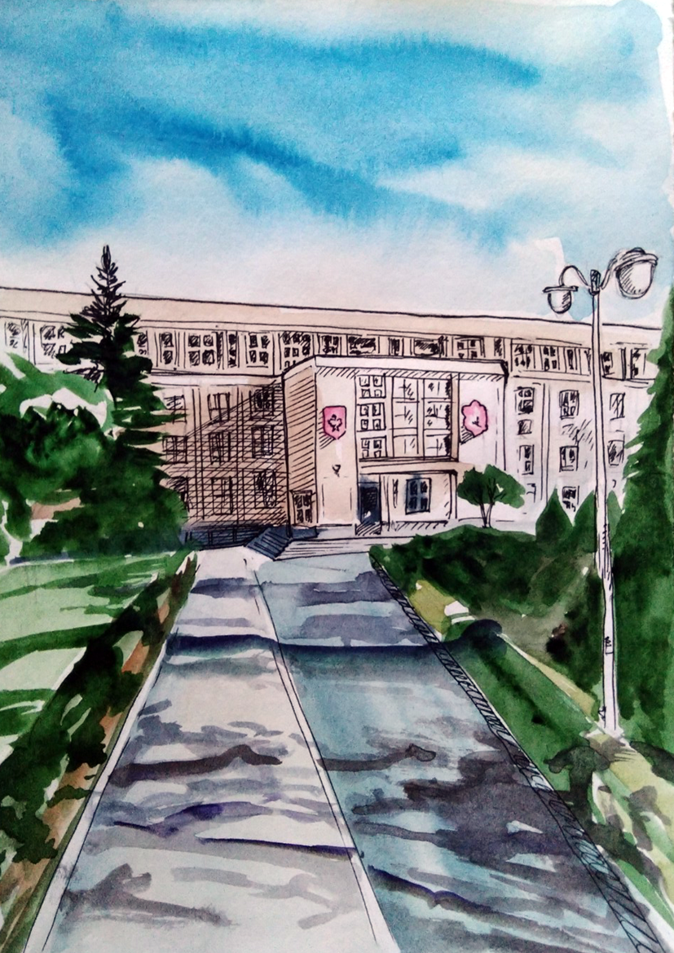
Military University of Technology,
Warsaw, Poland

Slide 4
Language reveals the engine of our souls, our mind. It illuminates us and energizes us. We share it with all we meet. It is the cognitive fire of human life. D. L. Everett, Language, The Cultural Tool

Slide 5
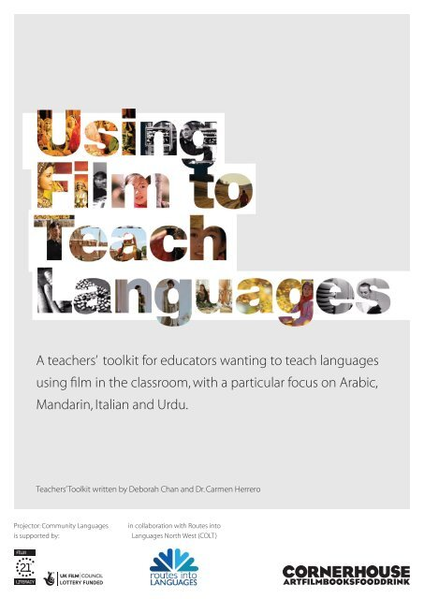
Multimodal pedagogies
Multiliteracies

Slide 6
FILM has the potential
to lift language off the page
and bring it to (technicolour!) life in the classroom.
J.Bottomley 2018

Slide 7
Task-based language teaching (TBLT)
an empirically investigated pedagogy that has garnered attention from language programs across the globe
provides an alternative to traditional grammar translation or present-practice-produce pedagogies by emphasizing interaction during authentic tasks.

Slide 8
Tell me and I forget.
Teach me and I remember.
Involve me and I learn.
B.Franklin

Slide 9
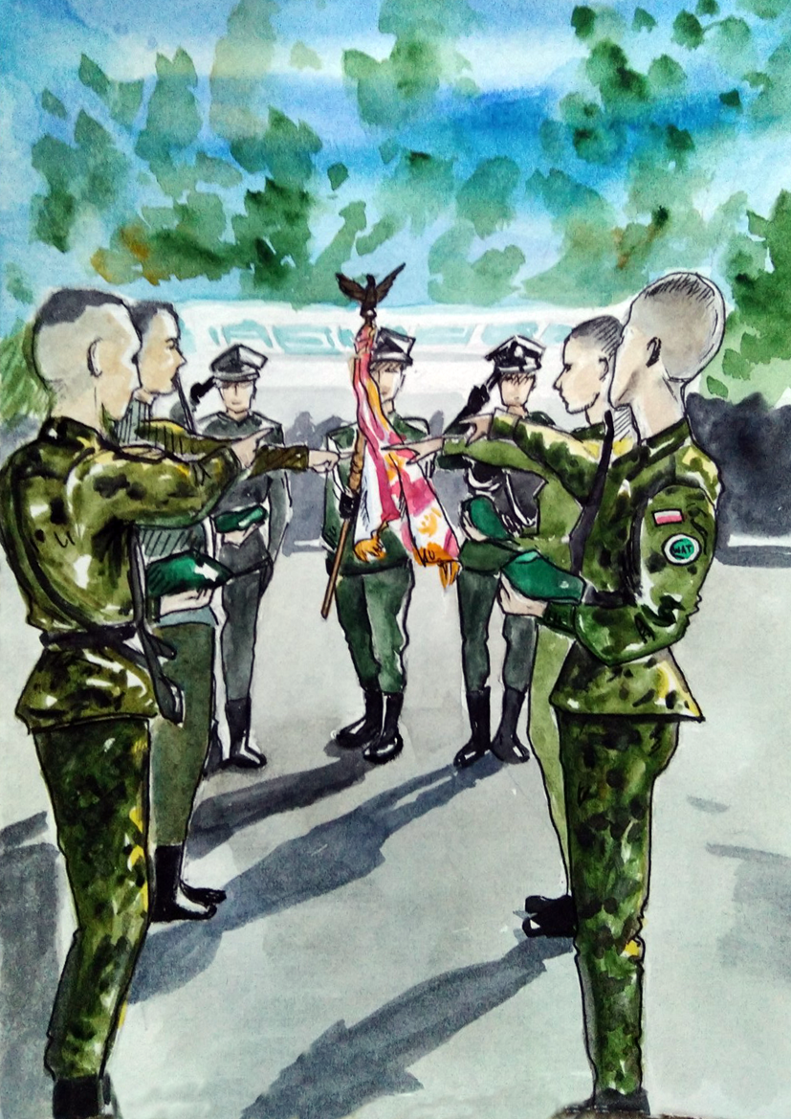
Task-based language teaching (TBLT)
Hi Everyone,
this is Klaudia, Eryk and Franciszek, people who are behind all these emails and letters that you’re reading to prepare for STANAG Level 2. Each one of us is in the second year of studies. We’re from the same company, the same platoon and specialize in the same field of study which is Chemistry. As you should know STANAG stands for Standardization Agreement, which basically means that it looks alike in every NATO country. In our opinion, it’s similar to the Polish school-leaving exam at the basic level but with one difference – you have to know some basic military vocabulary.
We hope our work will help you with passing the exam.
Best wishes,
Your fellow-students

Slide 10
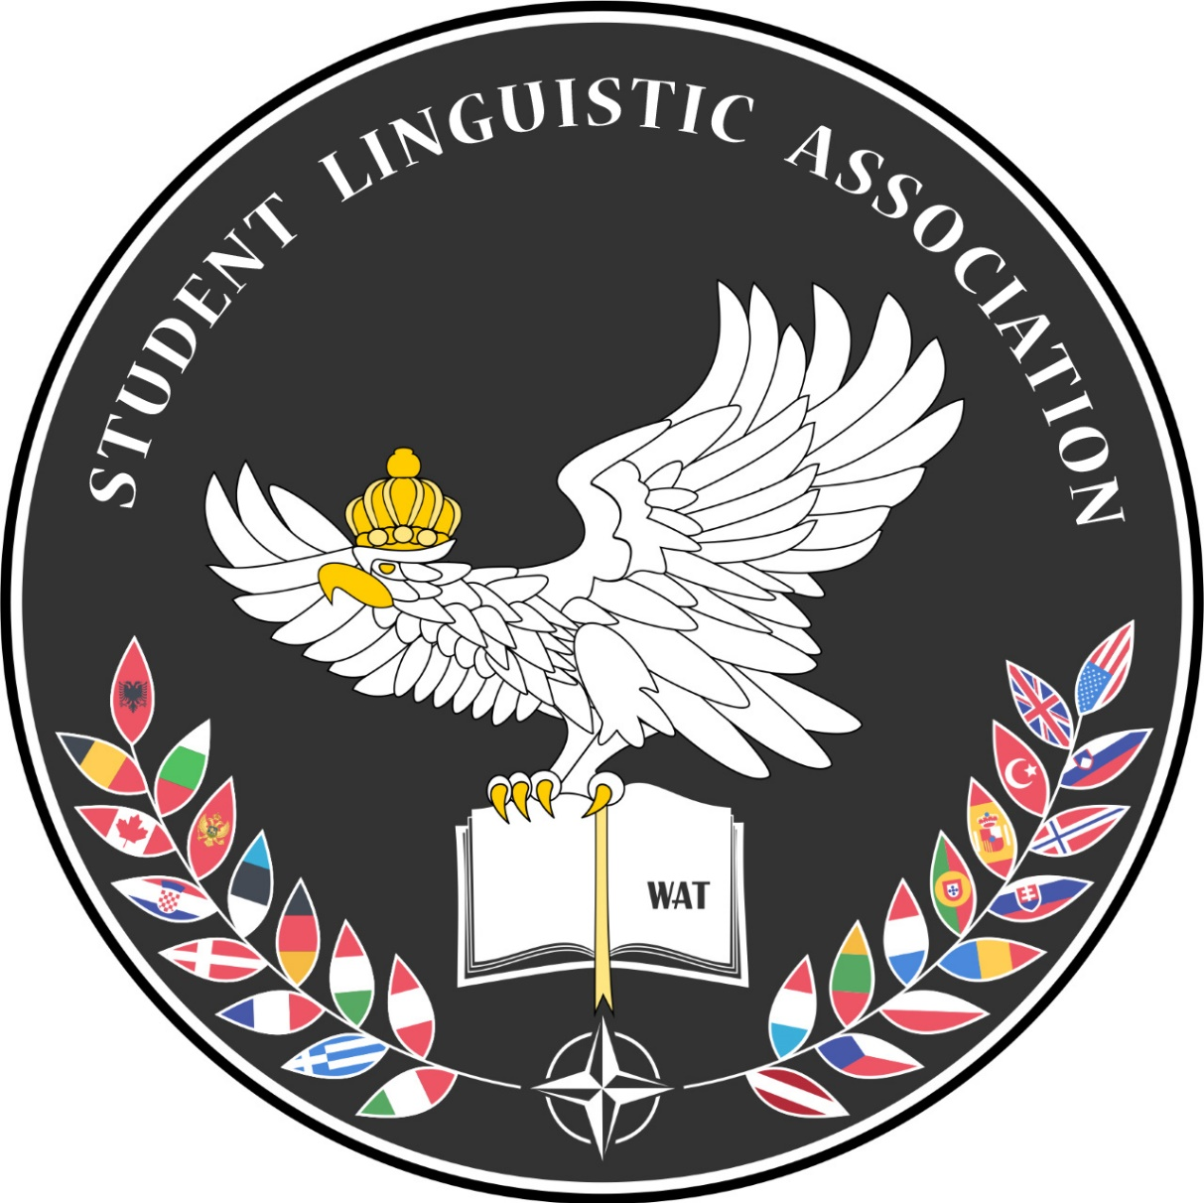

Slide 11
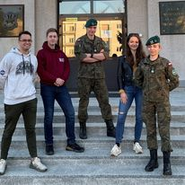
Student Linguistic Association

Slide 12
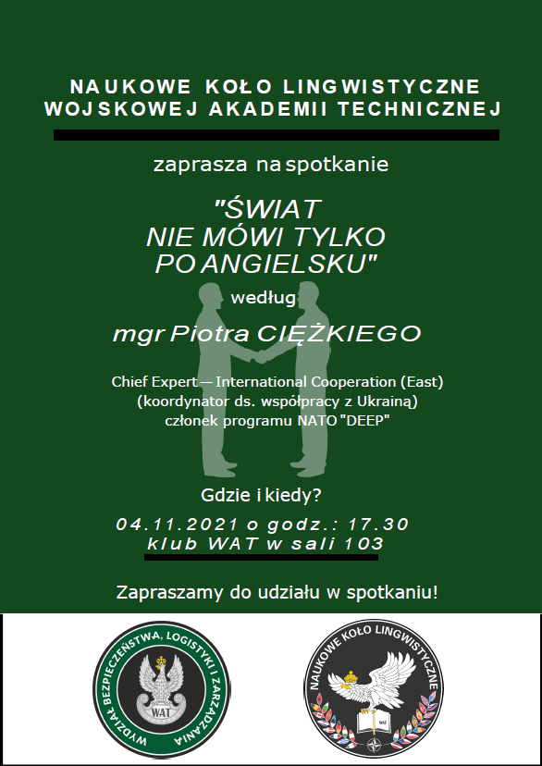
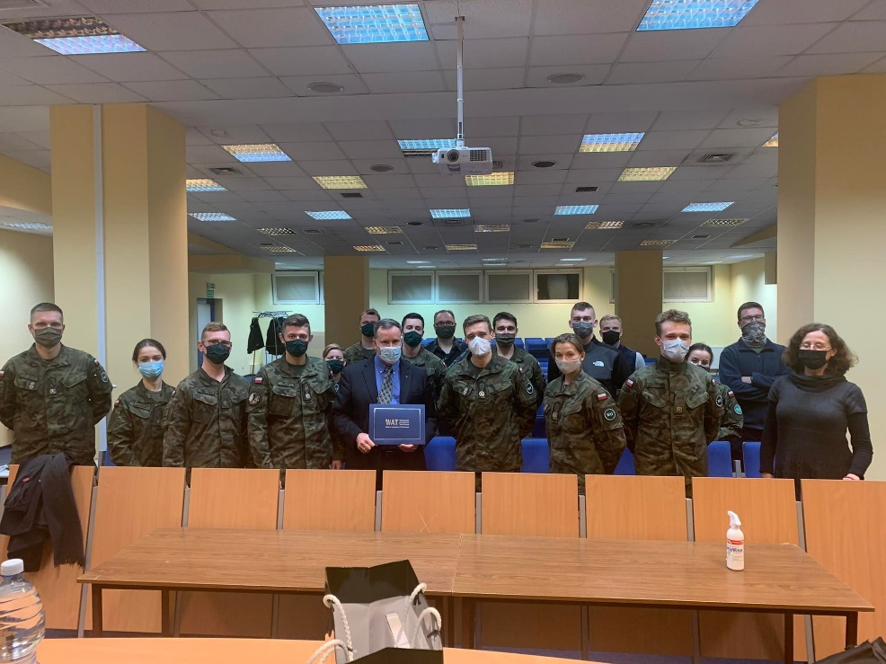
Seminars
The world doesn't speak English only
NATO East Flank Security
WAT and West Point graduate

Slide 13
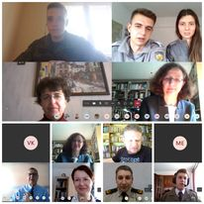
Webinars
Military terminology
Language and security

Slide 14
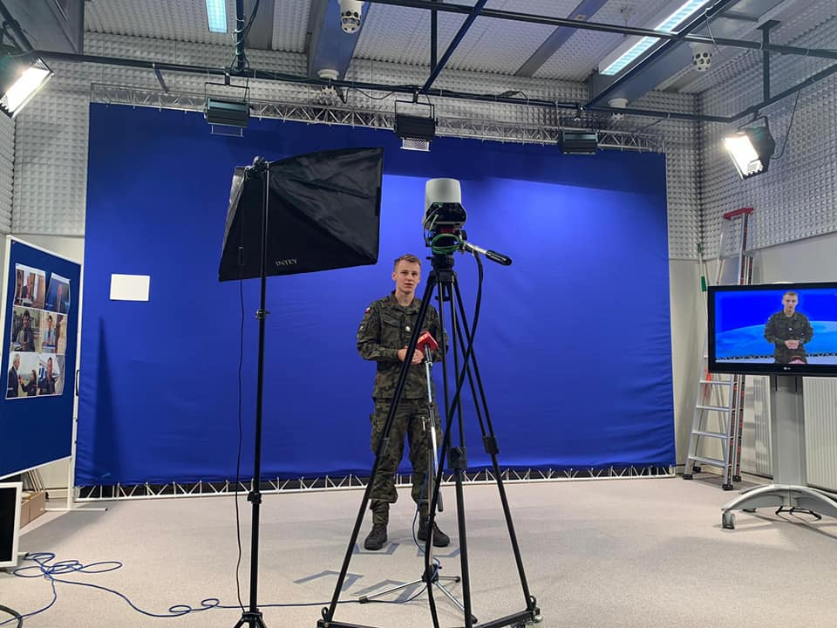
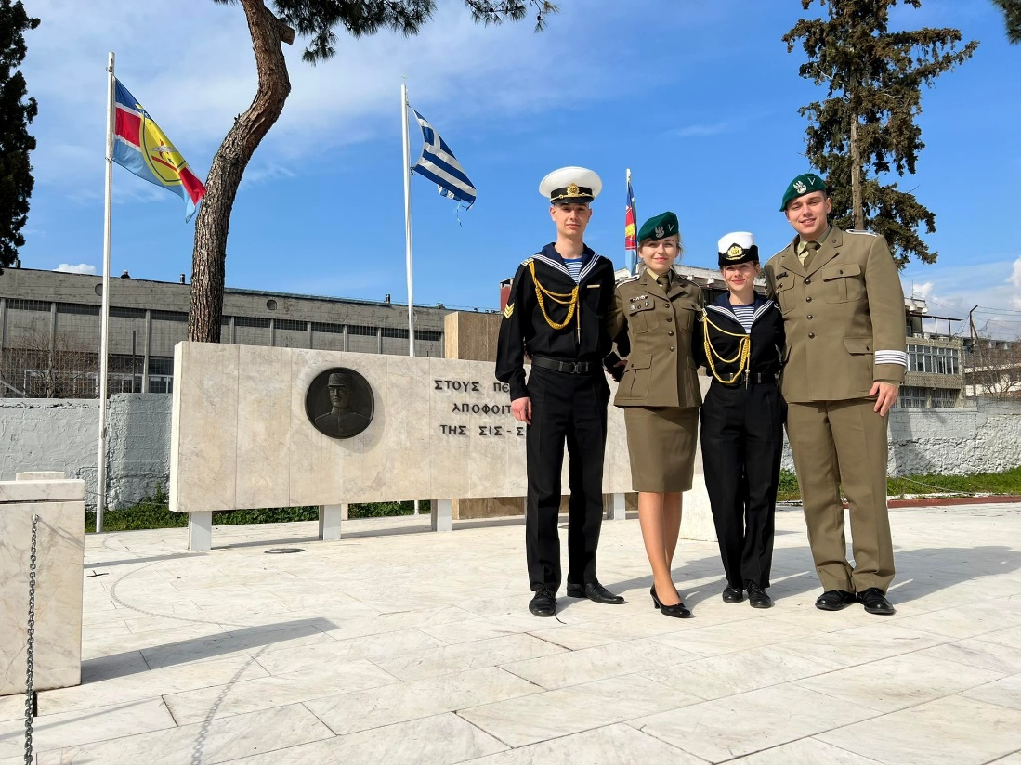
“Military Erasmus”

Slide 16
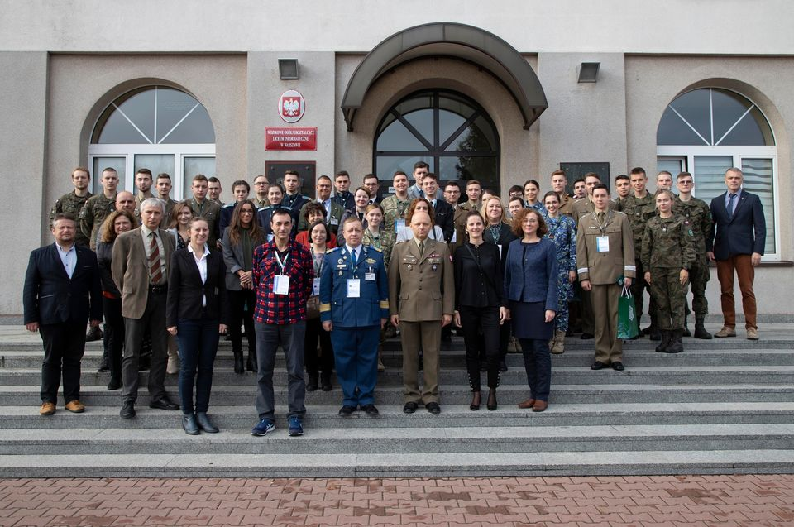

Slide 17
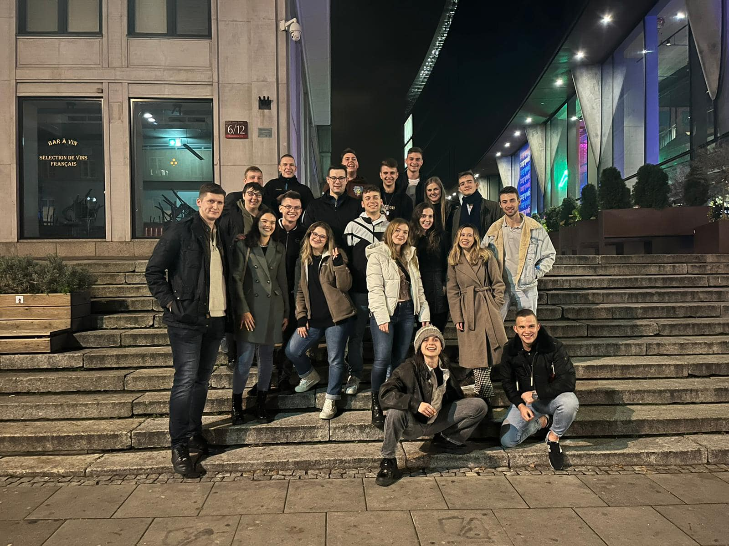
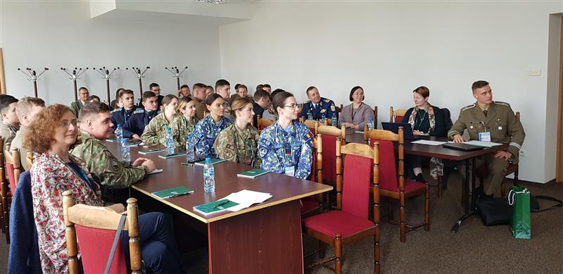
Language and security in the military context

Slide 18
Homo reticulus
“has awareness of operating in the conditions of global social networks and the need to shape them conducive to safe and sustainable development of civilization”
P. Sienkiewicz, 2017.

Slide 19
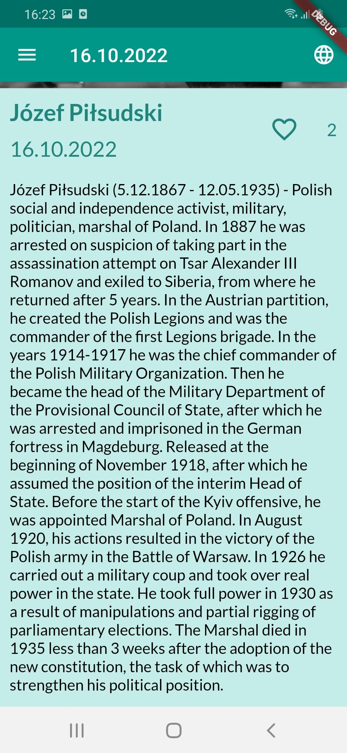
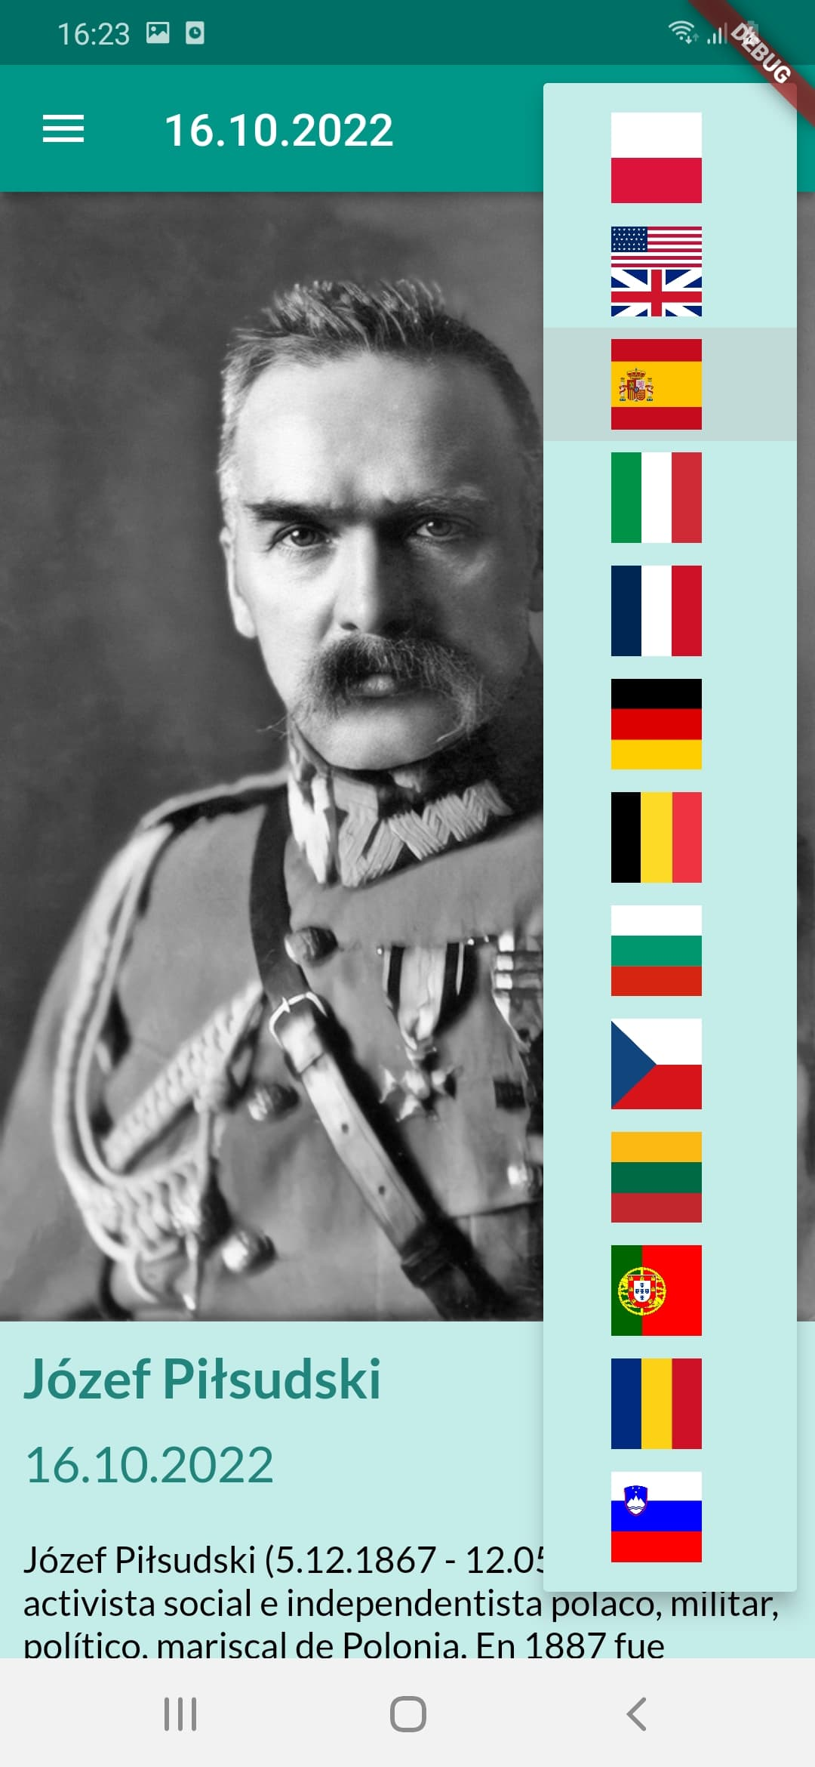
MilVocab app
Student Linguistic Association

Slide 20
Linguistic interoperability is as important to ensuring that countries are able to participate effectively in both NATO missions and wider Alliance activities as any other form of interoperability.
R. Monaghan, 2012.

Slide 21
In an increasingly diverse and interconnected world, language skills are gaining rather than losing their relevance.
https://www.thebritishacademy.ac.uk/publications/lost-words-need-languages-uk-diplomacy-and-security

Slide 22
References: Ellis R., Task-based language learning and teaching, Oxford: Oxford University Press 2003. Everett D. L., Language, The Cultural Tool, Pantheon Books, New York 2012. Footitt H., Kelly M. (eds), Languages and the Military: Alliances, Occupation and Peace Building, Palgrave Macmillan, Hampshire 2012. Jones I.P., Askew L., Meeting the Language Challenges of NATO Operations. Policy, Practice and Professionalization, Palgrave Macmillan, Hampshire 2014. Sienkiewicz P., Homo reticulus w zmieniającym się świecie, „Transformacje”, Z,1-2/2017. https://www.thebritishacademy.ac.uk/publications/lost-words-need-languages-uk-diplomacy-and-security Photographs and pictures: https://www.wojsko-polskie.pl/wat/ https://www.facebook.com/nklWAT?locale=pl_PL https://e-learning.wat.edu.pl/course/index.php?categoryid=83

Slide 23
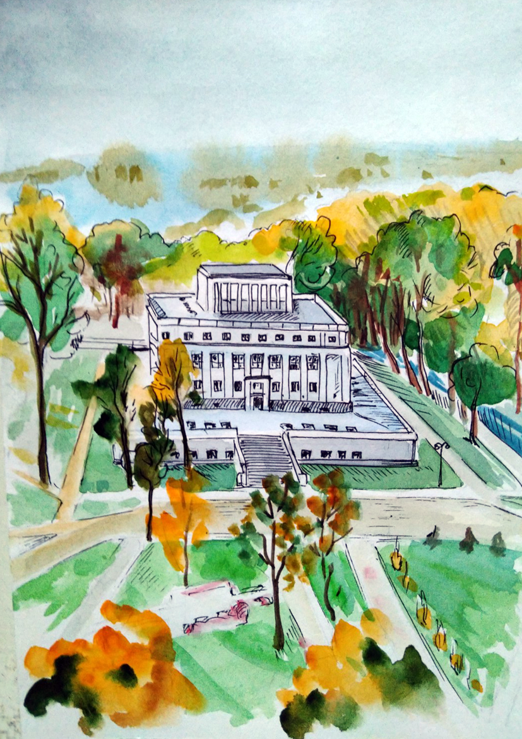
Thank you.

