Slide 1
BILC survey on the use of statistical analyses
BILC Language Testing Workshop 2022, Bonn
Marju Laurits
Estonian Military Academy

Slide 2
Survey design in cooperation with
BILC Item Bank Project members and Branka Petek
Analysis of comments in cooperation with Merit Kompus

Slide 3
Outline
Aim of the survey
Structure of the survey
Results
tinyurl.com/3k5xzu6p

Slide 4
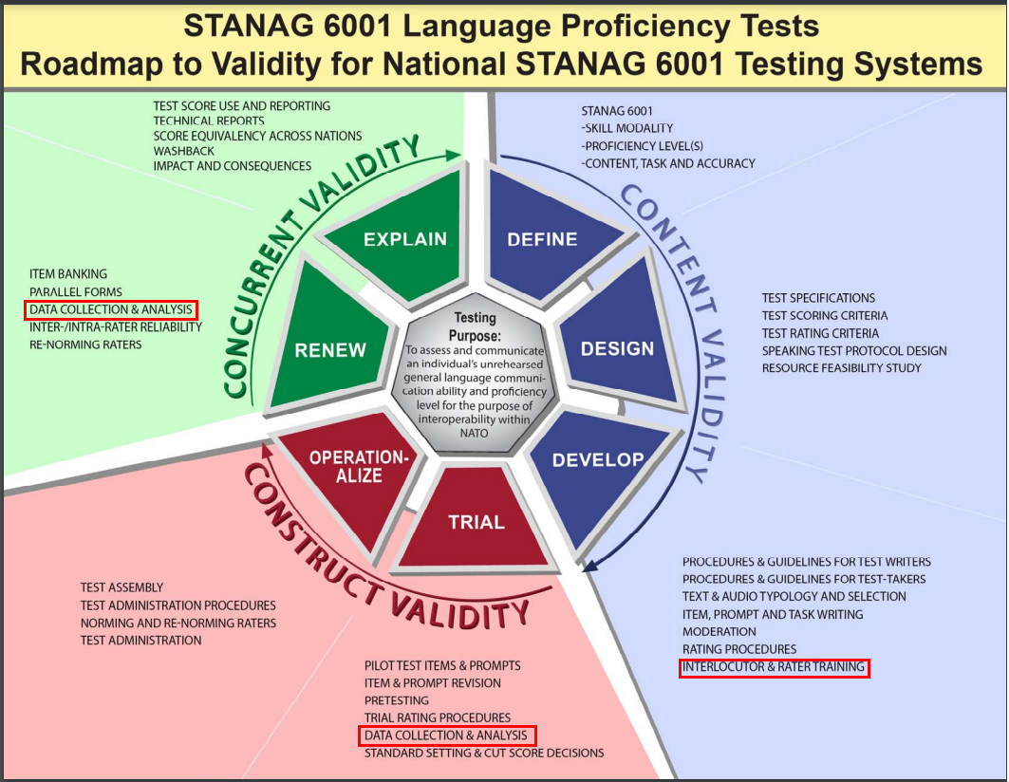
https://www.natobilc.org/documents/LanguageTesting/Roadmap%20to%20Validity.pdf

Slide 5
Participants
25 countries
https://pixabay.com/illustrations/galaxy-world-map-map-of-the-world-2150265/

Slide 6
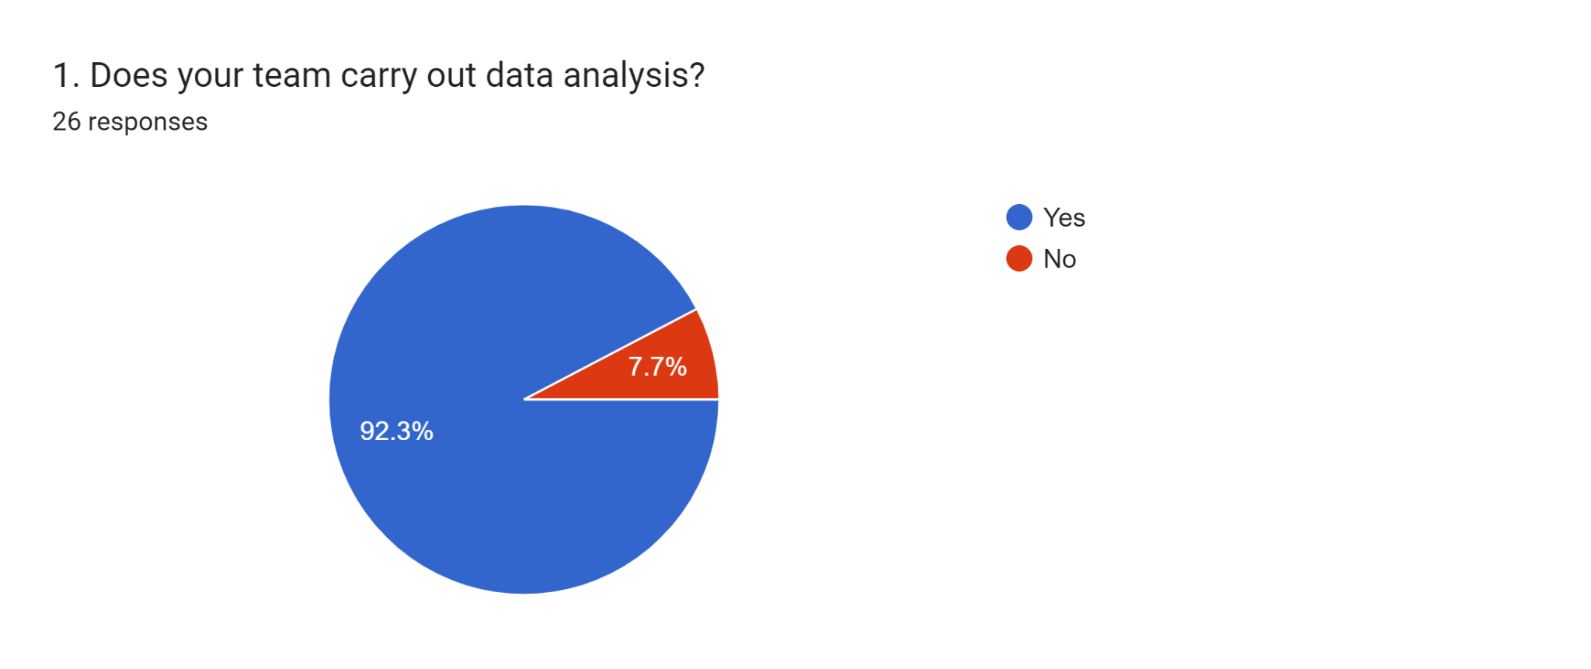

Slide 7
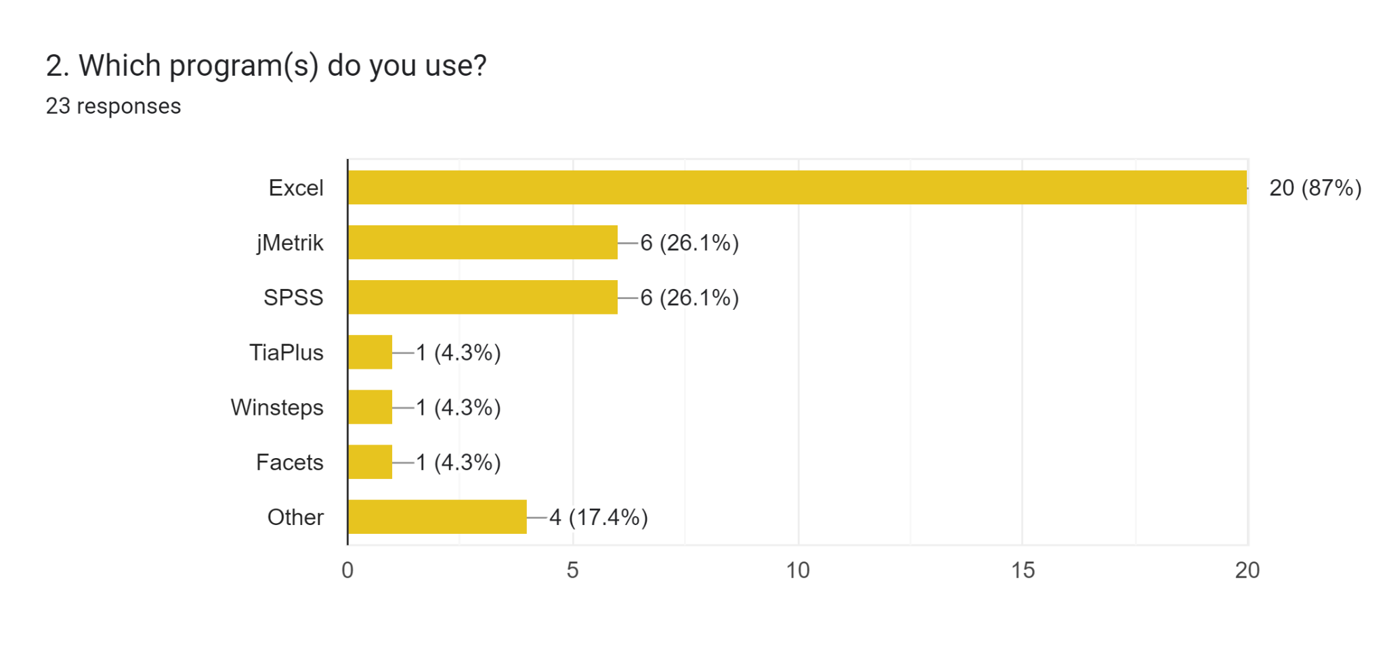

Slide 8
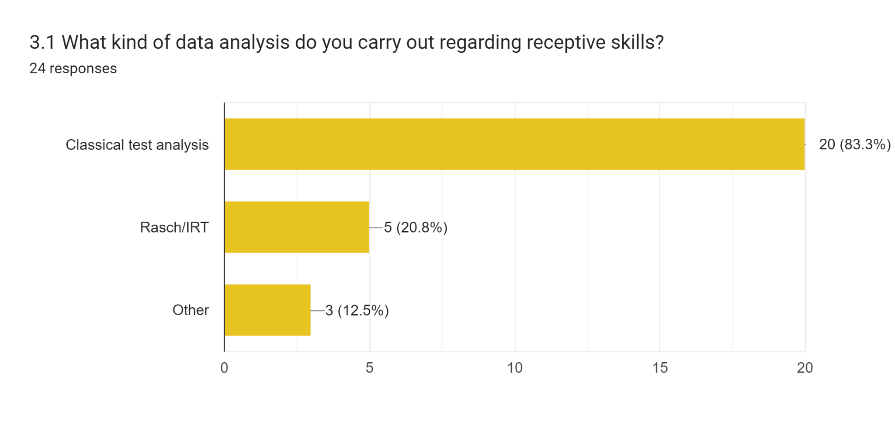

Slide 9
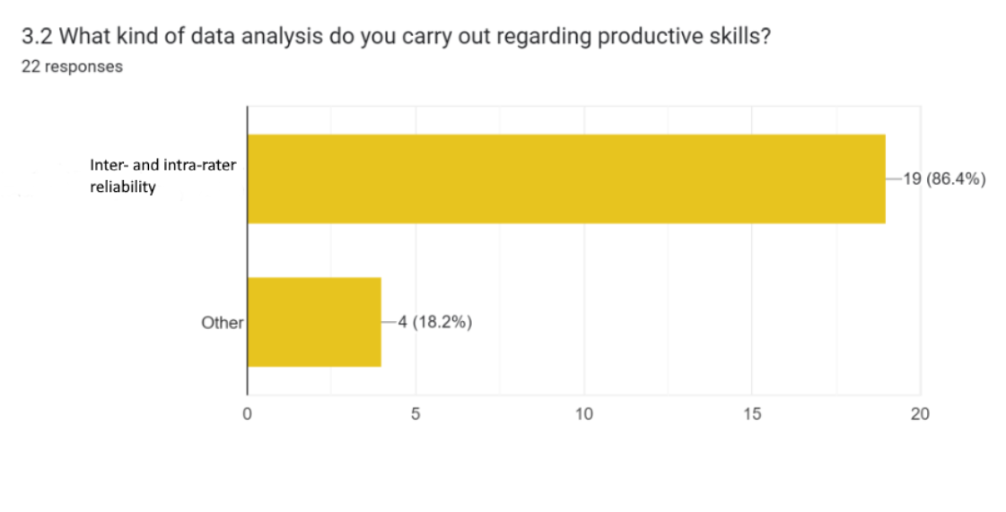

Slide 10
Frequency of data analysis and size of test population
Data analysis is carried out
after pre-testing,
after each test administration,
when there are discrepancies among testers/scores,
during rater norming sessions,
research.
Number of test takers per country ranges from 80 to 20,000.

Slide 11
Training received
LTS - 15 Self study - 7
ALTS - 13 Other courses - 6
BILC testing workshop - 6 Lancaster University - 6
LSAS - 1 No training - 3
In-house training - 2

Slide 12
Thank you!

