Slide 1
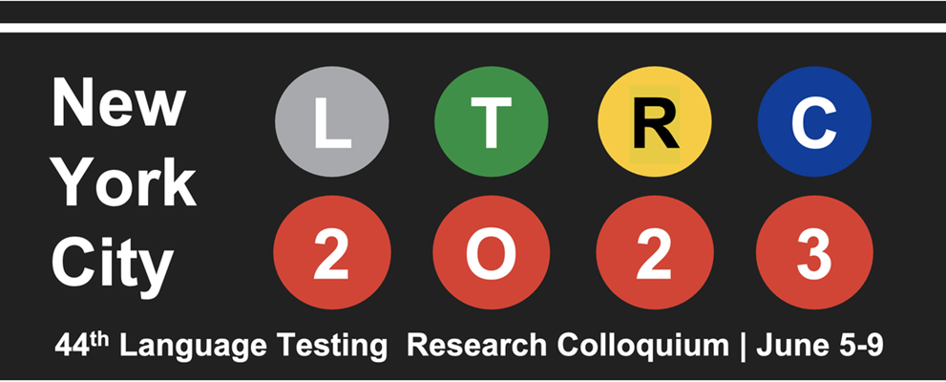
Theme:
Language Assessment for a Global, Digital
and More Equitable Era
Session Formats: plenary, parallel, poster, works-in-progress

Slide 2
Sessions of Interest
Talking to an imagined interlocutor: Interactional and interpersonal features of discourse in computer-mediated speaking assessment
Technology in diagnostic and formative language assessment: Friend or foe?
AI and deep learning applications in language assessment
Automated item generation for language assessment
Linguistic discourse and functional aspects of interactional competence across proficiency levels
Language proficiency test design for a group of military pilots

Slide 3
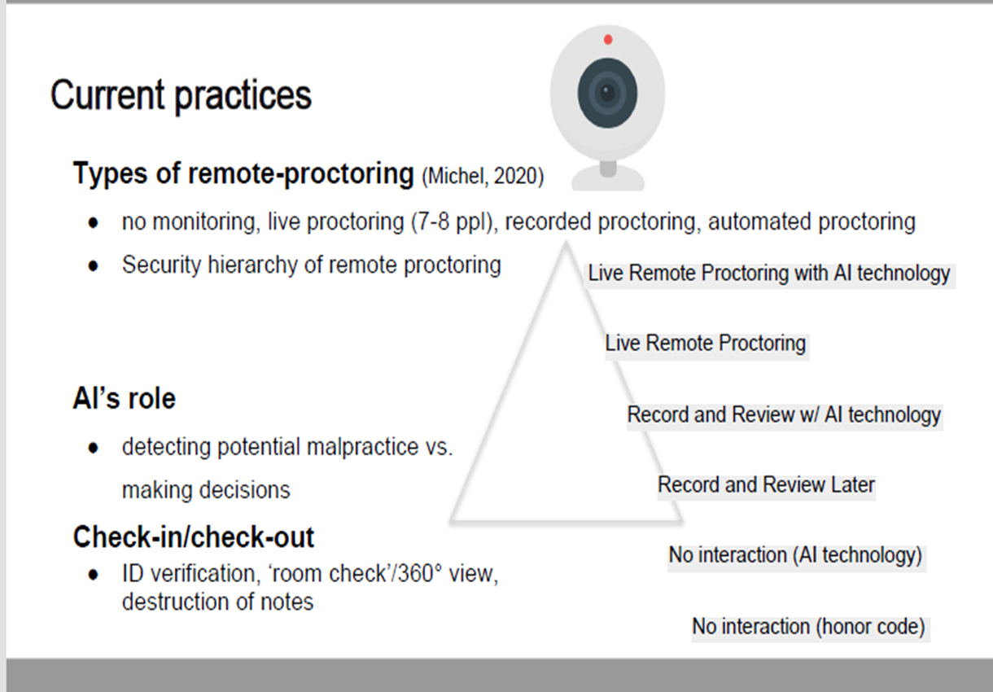
Remote Proctoring
Moving towards minimum standards criteria
for a high-stakes testing capability in an at-home
Setting; Tony Clark, Emma Bruce, Reza Tasviri
(IELTS)
Remote proctoring for at- home language tests;
Issues of validity and fairness; Geoffrey T. LaFlair
(Duolingo English Test)
Remote proctoring for in Language Testing:
Implications for Validity, Fairness and Justice;
Benjamin Kremmel, Dan Isbell & Jieun Kim*
* From Kremmel, Isbell & Kim

Slide 4
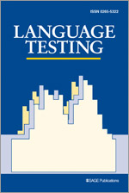
The BILC Testing Community is encouraged to:
Publish
Language Assessment Quarterly, Language Testing, TESOL Quarterly, Studies in Language Assessment
Attend international conferences
2024 LTRC at the University of Innsbruck, 1-5 July
Theme:
Reforming language assessment systems; Reforming language assessment research

