Slide 1
ONLINE MODERATION
Croatian Testing Team
BILC STANAG 6001 Testing Workshop, 2020

Slide 2
SCOPE
Team: Croatian Testing Team
Duration: March 16 - June 1, 2020
Objective: Items design and online moderation
Frequency: 2 times a week ( 2-hour sessions)

Slide 3
OPTIONS
Google Apps vs. Microsoft Teams
Google Docs:
e-mailing back and forth
no specific storage for items designed
Microsoft Teams:
Free collaboration platform combining:
(real-time) collaboration on files
chat and video meetings
file storage

Slide 4
MODERATION PROCESS
Uploading the items onto the platform.
Moderating items individually before online session / adding comments and suggestions into the shared document.
The author’s revision of the item prior to the session (based on comments and suggestions).
Agreeing on the final version during online moderation.
Leaving the item to cool until the next session / trying to devise solutions to the problems in the meantime.

Slide 7
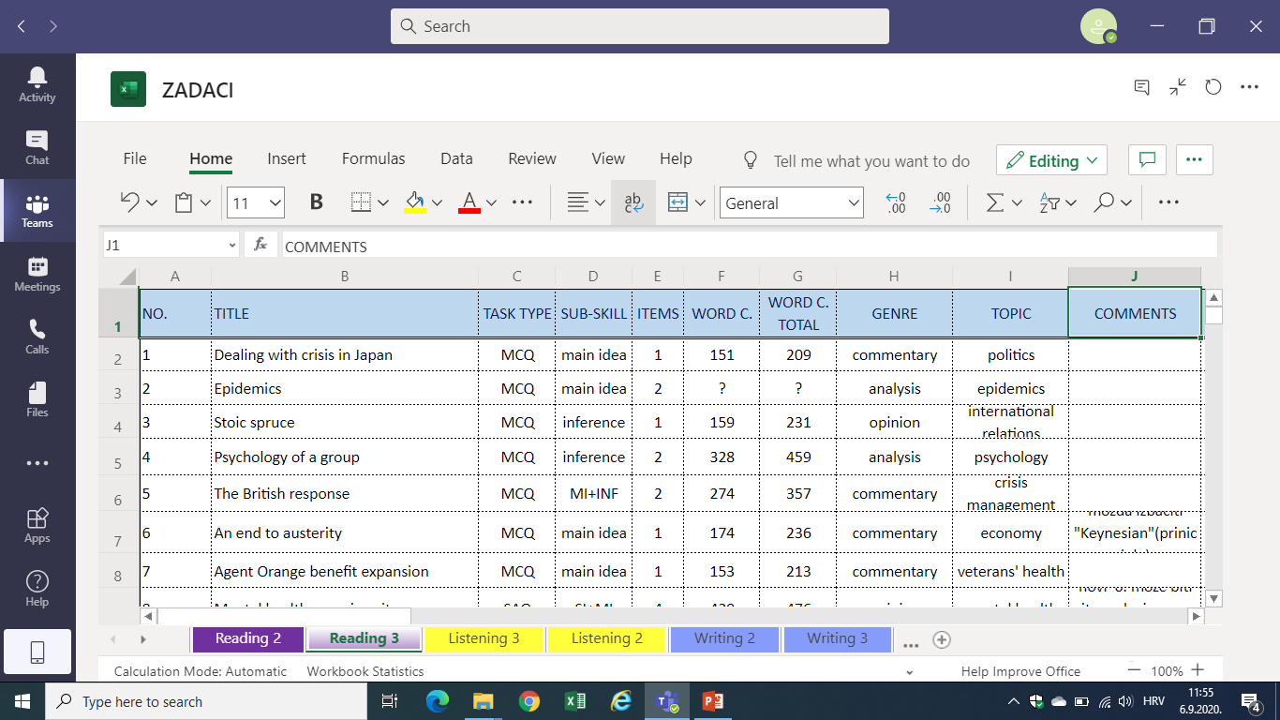

Slide 8
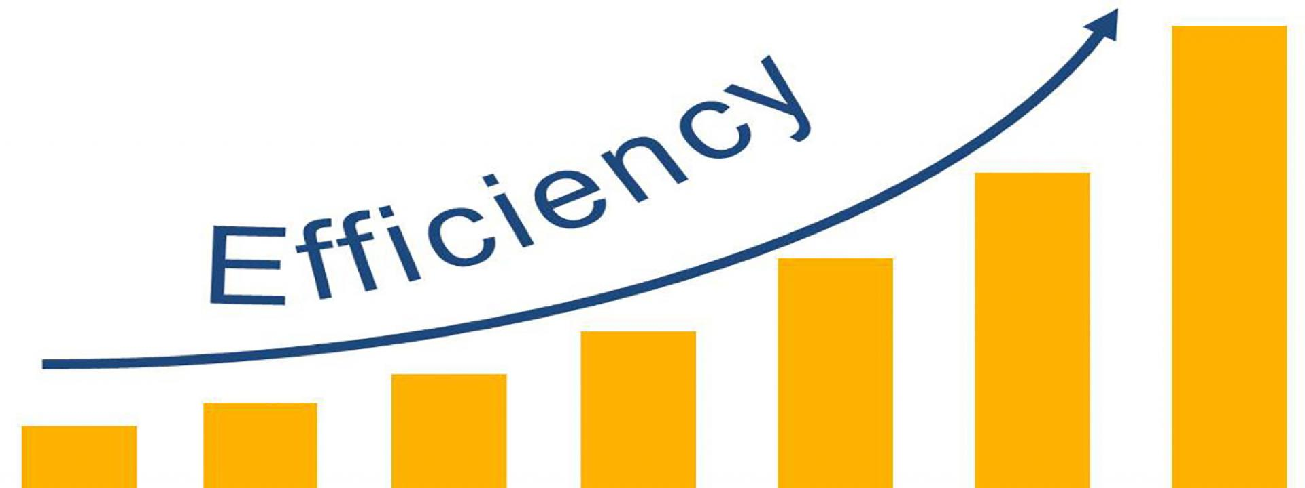
ADVANTAGES OF ONLINE MODERATION
Higher efficiency – more items produced
Working at our own pace and in our own time
Leaving and replying to comments prior to moderation session – more time for in-depth processing
No restrictions on Internet access

Slide 9
Thank you!

