Slide 1
MANAGING EMERGING
MILITARY TERMINOLOGY
AS
SECONDARY TERM-FORMATION
Asst. Prof. Dalibor VRGOČ, PhD
Head of University Department of Humanities and Social Sciences
Dr. Franjo Tuđman Defense and Security University

Slide 2
Words strain, Crack and sometimes break, under the burden, Under the tension, slip, slide, perish, Decay with imprecision, will not stay in place, Will not stay still.
T.S. Eliot Burnt Norton

Slide 3
primary term-formation

Slide 4
unununium

Slide 5
Transfermium wars

Slide 6
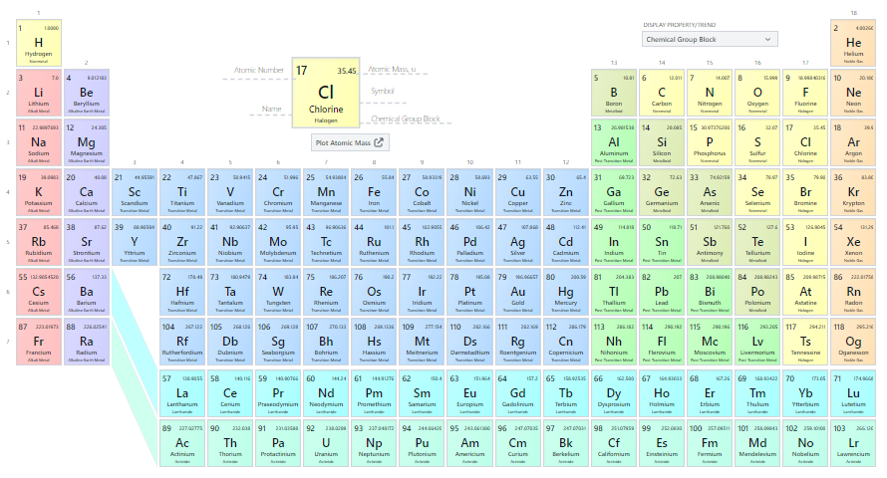

Slide 8
render the enemy incoherent
make the enemy feel distress or chased down
achieve standoff domination of the theatre
create a ‘consciousness of victory’
conscious-burnin’ of the enemy
‘create nitive perception of defeat
utter non-sense!
victory, enemy, objective, invade, conquer...

Slide 9
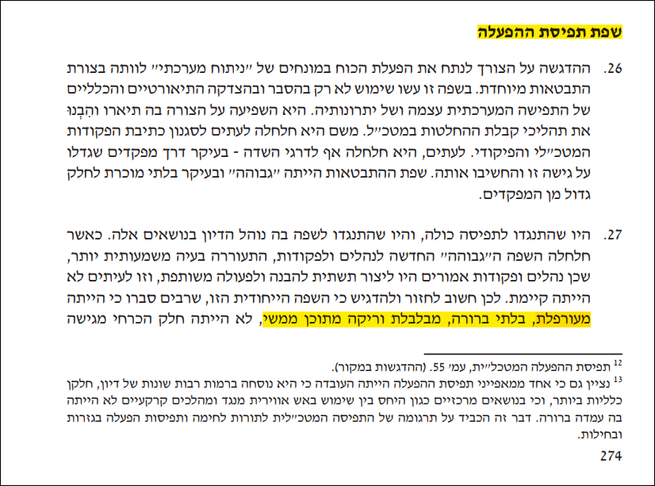
Operational concept language
ambiguous, unclear, confusing, meaningless

Slide 10
precision
and
euphemisms /political correctness

Slide 11
secondary term-formation

Slide 12
kinetic warfare
2011
„There are various ways in which countries can contribute; they don’t necessarily have to be troops, engaged in kinetic action. There are medical facilities, there are other assets that can be deployed, there is intelligence gathering...”
John Kerry, 2015, NATO meeting in Bruxelles

Slide 13
Collateral damage
Friendly fire
Surgical strike
Force projection
theater

Slide 14
World War 2
The First Gulf War
conventional warfare
horse cavalry
hand grenade
pre-dreadnought battleship
acoustic guitar
fixed-line phone
retronyms

Slide 15
EN to upload (v.)
DE – upload
Perfekt?
ich habe upgeloadet(?)
hochladen → ich habe hochgeladen

Slide 16
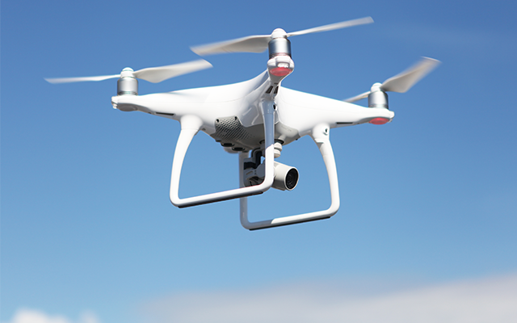
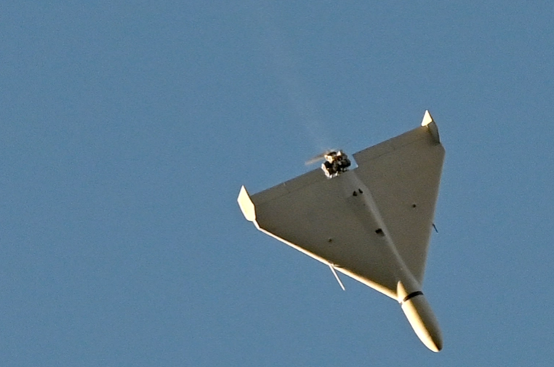
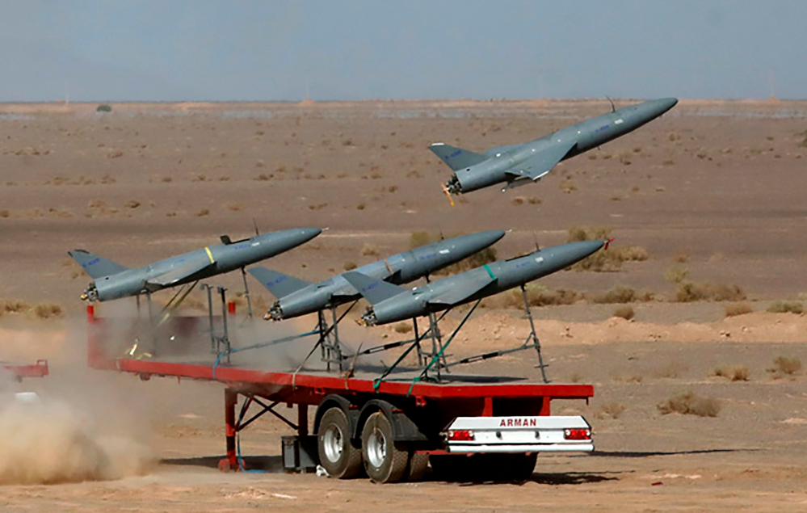

Slide 17
drone
kamikaze drone → croat. dron kamikaza (colloquial term)
loitering munition → croat. lutajuće streljivo* (‘roaming munition’)
* present participle in adjectival role (lutajuće) not to be encouraged in Croatian term formation

Slide 18
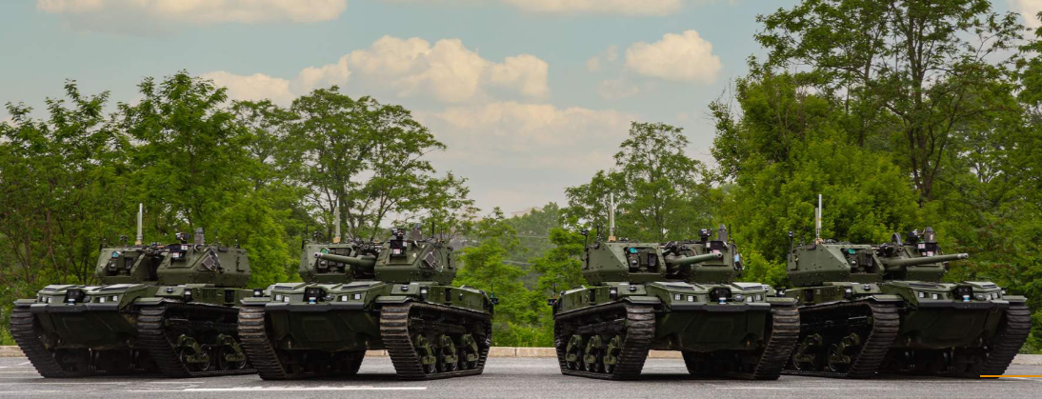
?
tank?
tank drone?
drone tank?
robotic combat vehicle?
unmanned ground combat vehicle?

Slide 19
Autonomous Swarm Tactics
counter-swarm strategies
Cyber Sovereignty
Lethal Autonomous Weapons Systems / Slaughterbots
Cognitive warfare

Slide 20
Croatian terminological principles:
Native terms take precedence over foreign terms;
Terms must be adapted to the Croatian standard language, then such terms take precedence over unadapted terms;
Terms take precedence over other synonymous terms if they correspond to the concept they were assigned to and reflect their place in the conceptual system;
Latin or Greek terms take precedence over terms from a modern foreign language;
More widely used terms and terms more acceptable to users take precedence over less widely used terms;
Shorter terms take precedence over longer ones;
Terms that can more easily be used as bases for derivatives take precedence over those where derivatives are not possible;
It should be avoided that terms within the same terminology system have several meanings;
Terms should not be modified without a valid reason

Slide 21
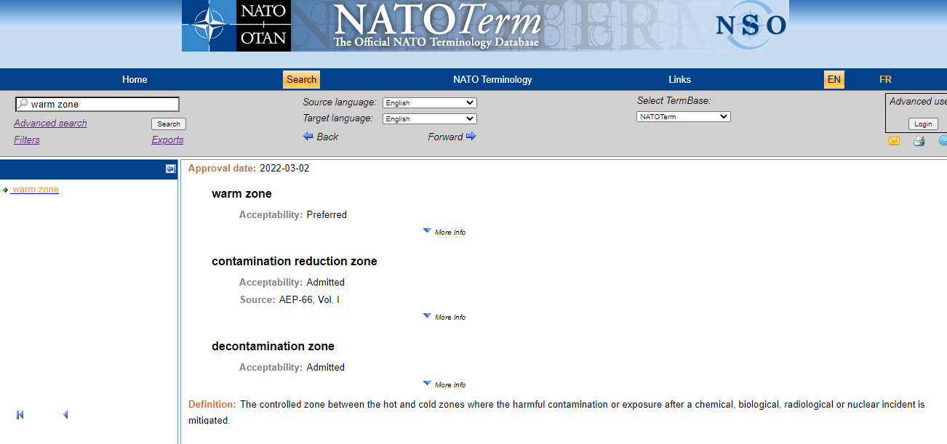
NATOTerm

Slide 22
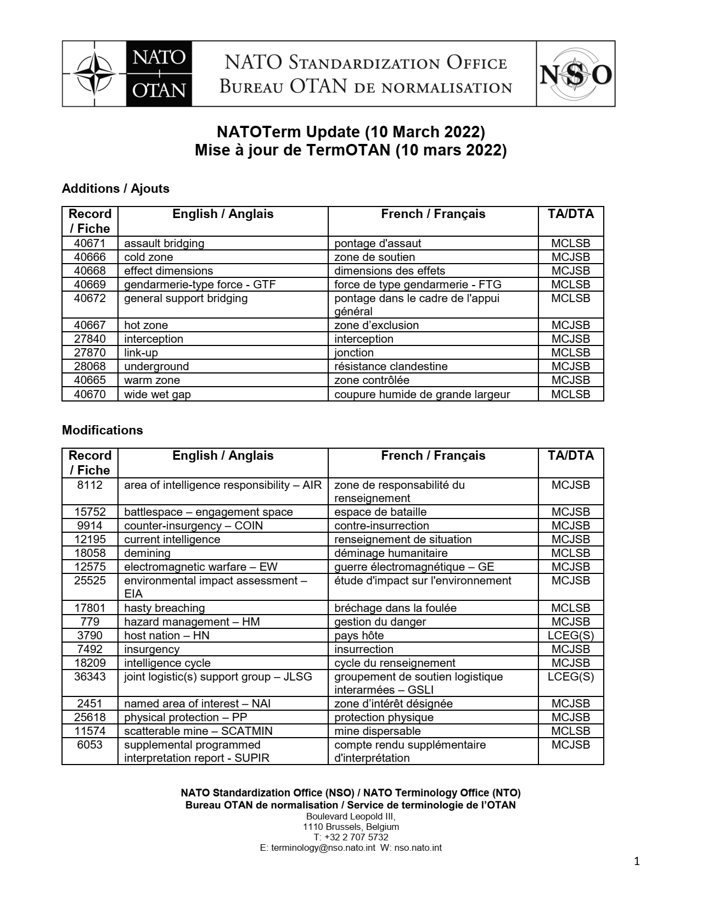

Slide 23
ENGLISH ‘GUEST’ TERMS IN CROATIAN
to the acceptance of English terms in their original form
eng. air policing → air policing
eng. proxy war → proxy rat
eng. table-top exercise → table-top vježba
eng. a walk-in → walk-in
eng. stealth bomber → stealth bombarder
eng. recovery vehicle → recovery vehicle

Slide 24
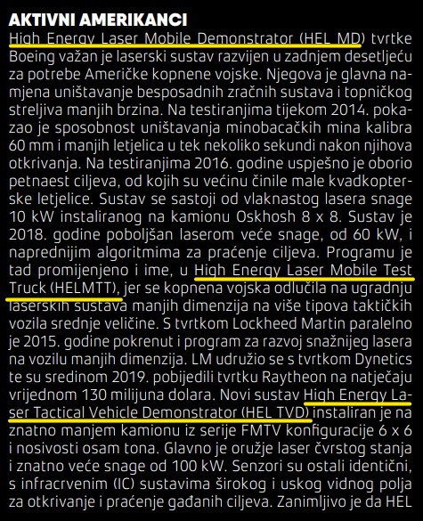
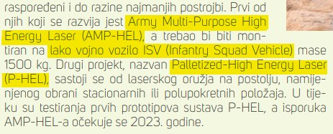
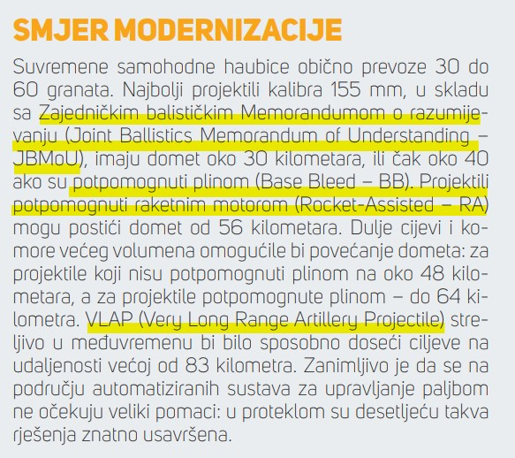
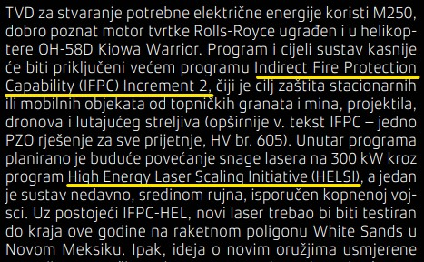

Slide 25
ENGLISH LOAN TERMS IN CROATIAN
English loan words ortographically adjusted to Croatian phonetic system but alien to Croatian standards
eng. kamikaze drone → croat. dron kamikaza
eng. a booster → croat. buster
eng. briefing/debriefing → croat. brifing/debrifing
eng. hovercraft → croat. hoverkraft
eng. quadcopter → croat. kvadkopter
eng. cluster bomb → croat. klaster bomba

Slide 26
LATENT BORROWINGS (Calques)
illusion of creating a domestic word (domestic inventory, foreign content)
all linguistic levels! not only lexical
a widespread problem originating from verbatim and nonchalant translation
profound exposure to English models combined with insufficient knowledge of the recipient language norm
mirroring the English language norm (fashionable)

Slide 27
eng. air cavalry→ croat. zračna konjica
eng. avenue of approach → croat. avenija prilaza
eng. be-prepared mission → croat. biti-spreman misija
eng. carpet bombing → croat. tepih-bombardiranje
eng. enhanced forward presence → croat. ojačana prednja prisutnost
eng. NATO-led operation → croat. NATO vođena operacija
eng. critical infratructure →croat. kritična infrastruktura
eng.vital ground → vitalno zemljište
eng. military operation other than war →
→ vojna operacija različita od rata?!

Slide 28
stealth fighter → stealth lovački zrakoplov
→ lovački zrakoplov niske zamjetljivosti ✓ (‘low-visibilty fighter’)
bodyguard satellite → satelit-tjelohranitelj
→ zaštitni satelit ✓ (‘protective satellite’)
space mine → svemirska mina ?
→ protusatelitska mina ✓ (‘anti-satellite mine’)
space-based laser → svemirski laser? (‘space laser’)
→ orbitalni laser ✓ (‘orbital laser’)
air cavalry → zračna konjica
→ jurišne helikopterske snage ✓ ‘attack helicopter forces’
enhanced forward presence → ojačana prednja prisutnost
→ ojačana rubna prisutnost (‘enhanced edge presence’)

Slide 29
dead time → mrtvo vrijeme
→ vrijeme reakcije ✓ (‘reaction time’)
proxy war → proxy rat
→ posrednički rat✓ (‘war by proxy’)
kamikaze drone → dron kamikaza
→ samouništavajuća bespilotna letjelica✓ (‘self-destroying unmanned aerial vehicle’)
mission creep → puzanje misije
→ prekoračenje misije✓ (‘exceeding/overstepping of mission’)
loitering muntion → lutajuće streljivo
→ vrebačko streljivo✓ (‘munition lying in wait’)
need-to-know principle → „moram-znati” načelo
→ načelo nužnosti pristupa✓ (‘principle of need to access’)

Slide 30
provost marshal
The senior military police officer on the staff – designated as the provost marshal – is responsible for assisting the commander in exercising control over military police forces in the area of operations. Provost marshal is not a rank but a designated duty.
one periphrasis glavni policijski savjetnik zapovjednika snaga pojedine razine (lit. ‘the chief police advisor to the commander of the forces of a particular level’)
Since assistance and advising in military police affairs is provost marshal’s main purview, the following Croatian equivalents could be recommended: glavni vojnopolicijski savjetnik (‘chief military police advisor), stožerni časnik za vojnu policiju (‘military police staff officer)

Slide 31
carrier-based aircraft (carrier-capable aircraft) – def. aircraft that can operate from carriers
one semi-definitional Croatian equivalent (zrakoplov za nosač zrakoplova ‘lit. aircraft for aircraft carrier’) and a definition-like equivalent (avion osposobljen za slijetanje na nosač zrakoplova i polijetanje s njega, ‘lit. aircraft capable of landing and taking off an aircraft carrier’). Both are periphrasis and would only serve as provisional solutions for the lack of a proper term.
However, palubni zrakoplov or palubni avion (‘a deck aircraft’) could be reccomended.

Slide 32
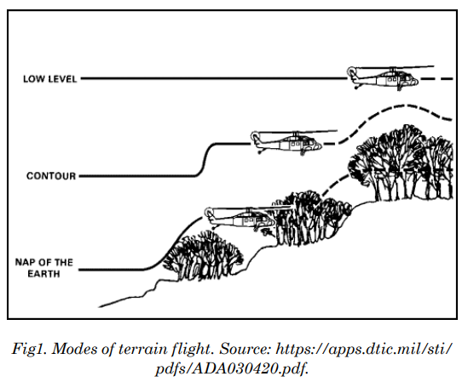
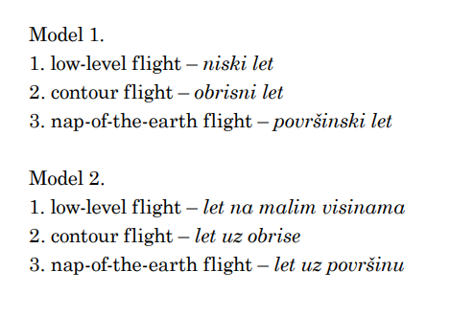

Slide 33
CONCLUSION
Croatian term formation frequently motivated by English patterns
uncritical relying
applicable not only to lexical but all linguistic levels (semantic, syntactic word-formation, stylistic, pragmatic levels)
latent borrowings
giving precedence to English patters under the pretext of its supposed transparency and precision
Croatian term-formation struggling keeping pace with the rapidly growing Angloamerican terminological repertoire

