Slide 1
Action research in foreign language acquisition
NATO BILC 2022
lc.unob.cz
PhDr. Ivana Čechová, Ph.D
University of Defence, Czech Republic, Brno

Slide 2
NATO BILC 2022
OUTLINE
Action research objective and cycle
Study programme 2014
First STANAG results
JAPA
Grounded theory and coding
Final STANAG results
Discussion Club and Online Communication Programme
)
lc.unob.cz
University of Defence, Czech Republic, Brno

Slide 3
NATO BILC 2022
Action research objective
Action research is a form of investigation designed for use by teachers to
attempt to solve problems and improve professional practices in their own
classrooms. It involves systematic observations and data collection which
can be then used by the practitioner-researcher in reflection, decision-making and the development of more effective classroom strategies (Parsons, Brown, 2002).
lc.unob.cz
University of Defence, Czech Republic, Brno

Slide 4
NATO BILC 2022
Action research cycle
Research domain
Designing
Collecting data
Analysing data
Acting
lc.unob.cz
University of Defence, Czech Republic, Brno

Slide 5
NATO BILC 2022
programme 2014 English
In all semesters (from the first to the fifth) students have to achieve credits. In the 5th semester, the pre-requisite for awarding credits is passing NATO STANAG 6001, SLP 2222.
They may take this examination whenever during their English language study.
Number of lessons: 141
lc.unob.cz
University of Defence, Czech Republic, Brno

Slide 6
NATO BILC 2022
First STANAG results
 | 1111 | 2121 | 2221 | 2222 | 3222 | 3232 | 3332 | 3333
FML | 35 | 16 | 7 | 16 | 2 | 6 | 0 | 1
FMT | 12 | 14 | 11 | 17 | 1 | 6 | 0 | 1
Total | 47 | 30 | 18 | 33 | 3 | 12 | 0 | 1
lc.unob.cz
University of Defence, Czech Republic, Brno

Slide 7
NATO BILC 2022
Proposal to help students
Online materials to enhance receptive skills, grammar and vocabulary;
Observing students performance periodically;
Creating homogenous groups (max. 12 students in one group).
lc.unob.cz
University of Defence, Czech Republic, Brno

Slide 8
NATO BILC 2022
JAPA
Languages for the Army _Jazyky Pro Armádu
JAPA is accessible on https://japa.unob.cz (outside the UoD Intranet) - independent server
available 24/7 – according to the needs of the user, anywhere where connected to the Internet
offline – parts of the courses can be printed
lc.unob.cz
University of Defence, Czech Republic, Brno

Slide 9
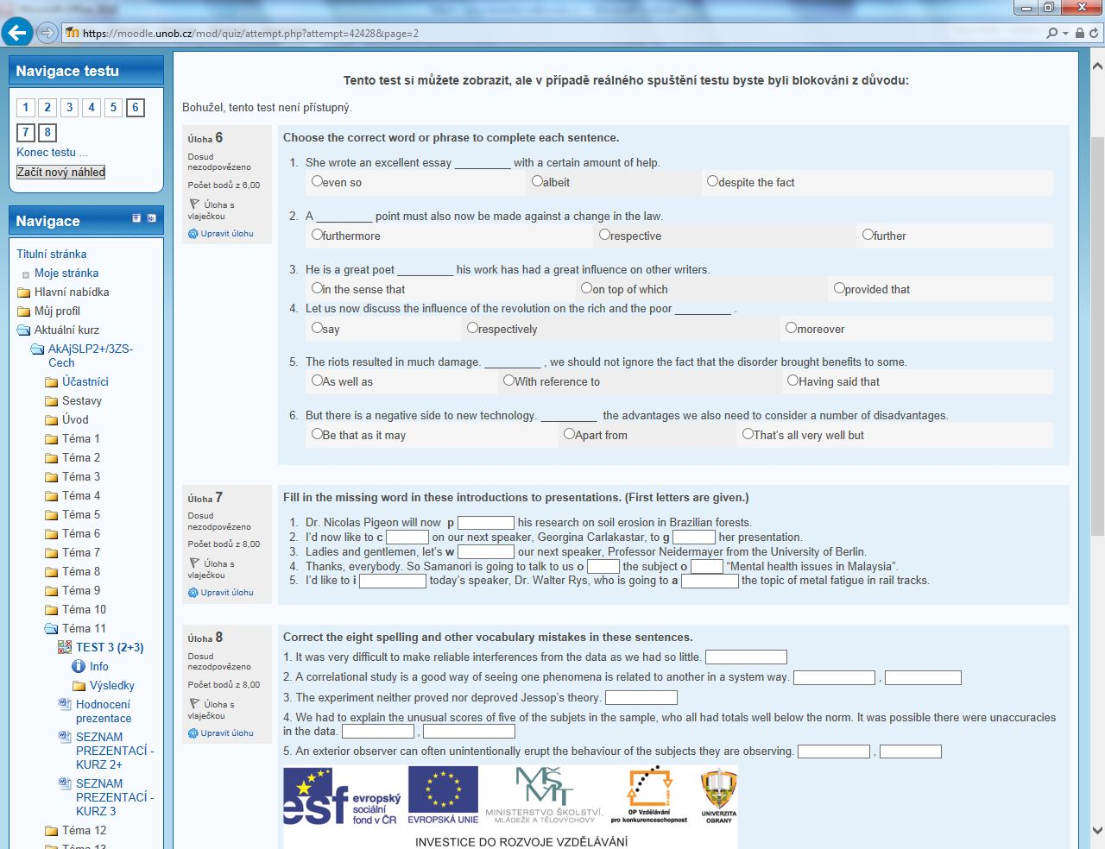
NATO BILC 2022
PhDr. I. Čechová, Ph.D

Slide 10
NATO BILC 2022
Grounded theory
Grounded theory is a research method that will enable you to develop a theory which offers an explanation about the main concern of the population of your substantive area and how that concern is resolved or processed.
Grounded theory assessment: open, axial and selective coding, which helps to build theories in an inductive proces (Strauss, Corbin, 2014).
lc.unob.cz
University of Defence, Czech Republic, Brno

Slide 11
NATO BILC 2022
Open coding – positives
Open coding is an essential methodological tool for qualitative data analysis and is defined as the process of segmenting data into meaningful expressions and then describing them in a single word to a short sequence of words (Punch K. F., 2008).
good for STANAG IIIIII
useful for reading III
many different articles with a lot of phrases
a lot information about STANAG
good for soldiers
best examples of writing
rules how to write e.g.report
can learn new vocabulary
a lot of tests II
get the results of tests quickly
can do it from home
a lot of writing examples III
a lot of topics
you can practise listening and reading III
good for self-learning
access from home, your PC
you are not disturbed by others
it is free
you can do what you need or want II
you can start, stop when you want III
lc.unob.cz
University of Defence, Czech Republic, Brno

Slide 12
NATO BILC 2022
Axial coding - negatives
Axial coding is the second phase of ground theory analysis and is intended to put an axis through data.
Axial coding puts categories back together in order to explore theoretical possibilities, identifies causal relationships, context, intervening conditions to interconnect data. (Punch K. F., 2008).
bad-qualilty recordings
insufficient writing practice
missing speaking and pronunciation fb
lacking variety
difficult orientation in a course
lc.unob.cz
University of Defence, Czech Republic, Brno

Slide 13
NATO BILC 2022
Selective coding - recommendations
Selective coding is the process of choosing one category to be the core category, and relating all other categories to that category. The essential idea is to develop a single storyline around which all everything else is draped (Punch K. F., 2008).
improving quality of recordings |  |  | Better quality listening
more speaking practice |  |  | Need for productive-skills consultations
more samples and feedback to writing
more variety |  |  | Greater variety required
lc.unob.cz
University of Defence, Czech Republic, Brno

Slide 14
NATO BILC 2022
Study Programme 2014 Final Outcomes assessment
 | Number of students | SLP 21+21+ | SLP21+22 | SLP2222
FML | 81 | 3 | 3 | 75
FMT | 57 | 0 | 0 | 57
lc.unob.cz
University of Defence, Czech Republic, Brno

Slide 15
NATO BILC 2022
Discussion Club
The activity in Discussion Club is focused on practicing speaking skills, and the role of lecturers is provided by students.
lc.unob.cz
University of Defence, Czech Republic, Brno

Slide 16
NATO BILC 2022
Online Communication Programme
Objective: to practise oral skills
Countries involved: Czech Republic, Canada, Chile
Supervisors: 2 (Canada and Czech Republic)
Number of UoD students involved: 83
Number of Chilean teachers:15
Length: 1 semester, 14 lessons
lc.unob.cz
University of Defence, Czech Republic, Brno

Slide 17
NATO BILC 2022
Future research
Study Programme 2019
AI project
Military terminology
lc.unob.cz
University of Defence, Czech Republic, Brno

Slide 18
NATO BILC 2022
Thank you for your attention.
Any questions?
contacts: ivana.cechova@unob.cz
lc.unob.cz
University of Defence, Czech Republic, Brno

