Slide 1
BILC Testing Workshop Skopje, Republic of Macedonia September 5-7, 2017 A Practical Guide to Norming and Item Moderation
Nancy Powers
Chief of English Testing, Language Programs
Department of National Defence
Canada

Slide 2
Introduction
Two very important aspects of testing:
Norming
Item Moderation
Three questions:
Where to start?
How do you conduct a norming session?
What do you look for when moderating items?

Slide 3
1. Where to start?
Why do we norm or standardize for speaking and writing?
So that a candidate will get the same rating no matter who tests him/her.
To refine our elicitation techniques/internalize the structure/protocol
It is a matter of reliability, validity and test fairness

Slide 4
Norming – Speaking/Writing
Get informed about the structure/protocol
Listen to a lot of interviews by yourself to learn to recognize the structure of an interview and for elicitation techniques
Read a lot of writing tests to learn how to write a prompt

Slide 5
Remember!
A norming session is not about winning or losing
Rather, it is a chance for the team to objectively discuss a candidate's performance and judge that performance against clearly stated criteria.

Slide 6
2. How to conduct a Norming session – Speaking/Writing
Have a leader/facilitator who understands the STANAG rating scale and the C/T/A statements
Prep: get some benchmarks –must be well structured
Choose some samples (different kinds of samples)
Rate them and be prepared to justify your ratings
Read the level descriptors; have your scoring rubric ready; discuss the structure of the interview
Listen to the benchmark interview
Facilitator explains why it is a benchmark for its particular level

Slide 7
Play an interview that was chosen for the norming session
Each rater takes notes. Everyone rates separately.
In plenary, each rater gives his/her rating and must be prepared to justify why he/she gave that rating
Use some borderline cases later on to allow for discussion and for some guidance on future borderline samples

Slide 8
As a norming session is not a competition, use this discussion as a means to identify and internalize what aspects of the performance warrant the rating
The aim is for consensus on rating
You must decide:
how often to norm
how long the norming sessions will last
specific samples to refer to or fresh samples

Slide 9
Be careful of “drift”
This occurs when the interpretation of the standard changes over time: more lenient or strict
Important to have norming sessions as a team.
Also important to have norming sessions with other teams, if possible
can be normed within the team, but out of step with the outside world

Slide 10
3. What to look for when moderating items
Once the team knows what is expected at each level, they can now go and create listening / reading items and speaking / writing prompts
Moderating these newly created items/prompts is a very important step in test development.
Moderation sessions are a lot of work and can be time consuming. Worth the effort!

Slide 11
Understand that once the moderation session begins, the items are no longer yours – they become the team’s.
Many eyes are needed, because when you work with something closely, you don’t see it.

Slide 12
Item Moderation Guidelines – listening/reading
Before the moderation session begins, there should be a few ground rules that all must abide by:
All must acknowledge that each item writer has worked hard on their items and this must be recognized
The criticisms/comments made on the items must be constructive with the goal of improving the item

Slide 13
To help the moderation session, I have put together a checklist so that new testers will know what to look for.
The following checklist refers to objective multiple-choice items.
There is a shorter checklist for speaking and writing prompts too.

Slide 14
Checklist for reading/listening text
Is it at the appropriate level?
Is the vocabulary appropriate for the level?
Is the language clear?
If editing was done, does the text still make sense?
Is it confusing (too many acronyms)?

Slide 15
Checklist for Multiple Choice Item Review
Item as a whole (Orientation, Stem, Options)
Is it at the appropriate difficulty level?
What does it test?
Is the vocabulary appropriate?
Is the language unnecessarily difficult?
Could the examinee get the right answer on the basis of outside knowledge, without understanding or even reading/listening to the text?

Slide 16
The Orientation
Is the wording concise, clear and non-repetitive?
Is the length appropriate?
The Stem
Is there an overlap between the orientation and the stem?
Does it clearly state the task for the examinee?
Does it contain unnecessary information?
Does it give away the answer?
Is the length appropriate for the level?

Slide 17
The Options
Do they fit logically and grammatically with the stem?
Are they reasonably parallel in structure?
Are they appropriate in length?
Are they tricky?
The Key
Is the key the best answer to the question?
Is it the only correct choice?
Can the key be identified by simply comparing it to the distractors?

Slide 18
The Distractors
Are they all plausible?
Are they of the same generality as the key?
Do any of the distractors draw attention to the key?
Is one of the distractors the direct opposite of the key?
Are they unambiguously false?
Are they partially true?

Slide 19
Example (listening item)
From an interview with author and theoretical physicist, Michio Kaku
Based on what Michio Kaku is saying, which of these statements is true?
Aliens do not exist because they are simply a product of Hollywood imagination.
The portrayal of aliens in popular culture reflects our own dreams and anxieties.
Our image of aliens is based on paradigms borrowed from the animal kingdom.
Aliens resemble us because they are likely a by-product of human evolution.

Slide 20
From an interview with author and theoretical physicist, Michio Kaku
Based on what Michio Kaku is saying, which of these statements is true?
Aliens do not exist because they are simple a product of Hollywood imagination.
Theories on the existence of aliens are merely a figment of Hollywood imagination
b. The portrayal of aliens in popular culture reflects our own dreams and anxieties.
c. Our image of aliens is based on paradigms borrowed from the animal kingdom.
d. Aliens resemble us because they are likely a by-product of human evolution.
Aliens resemble us because they might be a by-product of human evolution.

Slide 21
From an interview with author and theoretical physicist, Michio Kaku
Based on what Michio Kaku is saying, which of these statements is true?
Theories on the existence of aliens are merely a figment of Hollywood imagination
b. The portrayal of aliens in popular culture reflects our own dreams and anxieties.
c. Our image of aliens is based on paradigms borrowed from the animal kingdom.
d. Aliens resemble us because they might be a by-product of human evolution.

Slide 22
From an interview with author and theoretical physicist, Michio Kaku
Based on what Michio Kaku is saying, which of these statements is true?
Based on this video clip, which statement about aliens in popular culture is true?
Theories on the existence of aliens are merely a figment of Hollywood imagination
b. The portrayal of aliens in popular culture reflects our own dreams and anxieties.
c. Our image of aliens is based on paradigms borrowed from the animal kingdom.
Aliens resemble us because they might be a by-product of human evolution.
They are only a figment of Hollywood’s imagination.
Their portrayal reflects our own dreams and anxieties.
They represent the possible evolution of human beings.
They are copies of models within the animal kingdom.

Slide 23
From an interview with author and theoretical physicist, Michio Kaku
Based on this video clip, which statement about aliens in popular culture is true?
They are only a figment of Hollywood’s imagination.
Their portrayal reflects our own dreams and anxieties.
They are a reflection of our own dreams and anxieties.
They represent the possible evolution of human beings.
They are copies of models within the animal kingdom.
Even after this revision, we realized that the key is the only option with a conjunction, so it is different from the other options. After trying to revise the key, we decided to change the last option to have an “and”.

Slide 24
From an interview with author and theoretical physicist, Michio Kaku
Based on this video clip, which statement about aliens in popular culture is true?
A. They are only a figment of Hollywood’s imagination.
B. They reflect human desires and feelings of insecurity.
C. They represent the possible evolution of human beings.
D. They are based on how animals think and behave.
Now the options are balanced and the key is no different from the other options

Slide 25
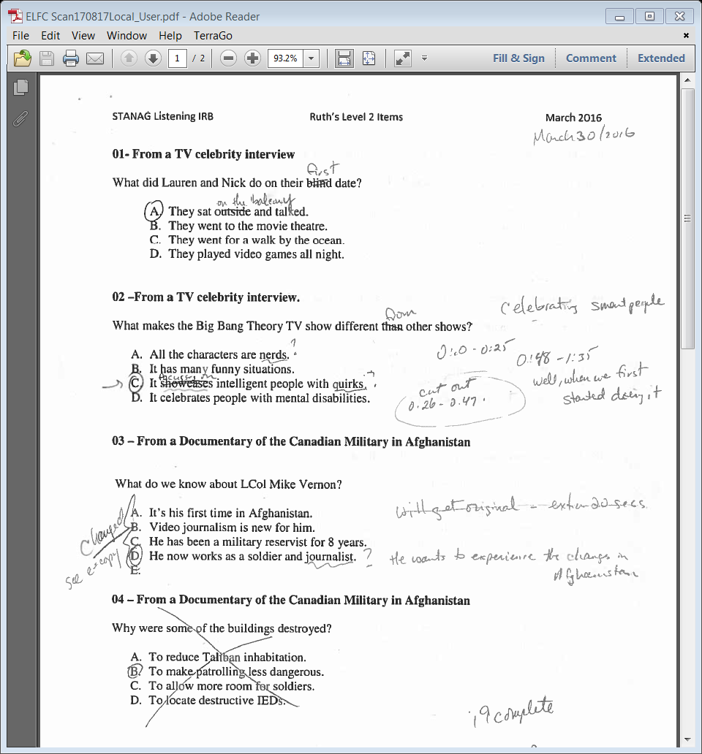

Slide 26
To Keep or not to Keep?
Originally, 205 items spanning levels 1, 2, & 3
approx.10% were kept “as is”.
approx. 70% needed some revision:
minor = maybe one option needed rewording
major = good item, but needed to revise all or almost all options or stem
approx. 20% were discarded after a lot of discussion and attempts to revise

Slide 27
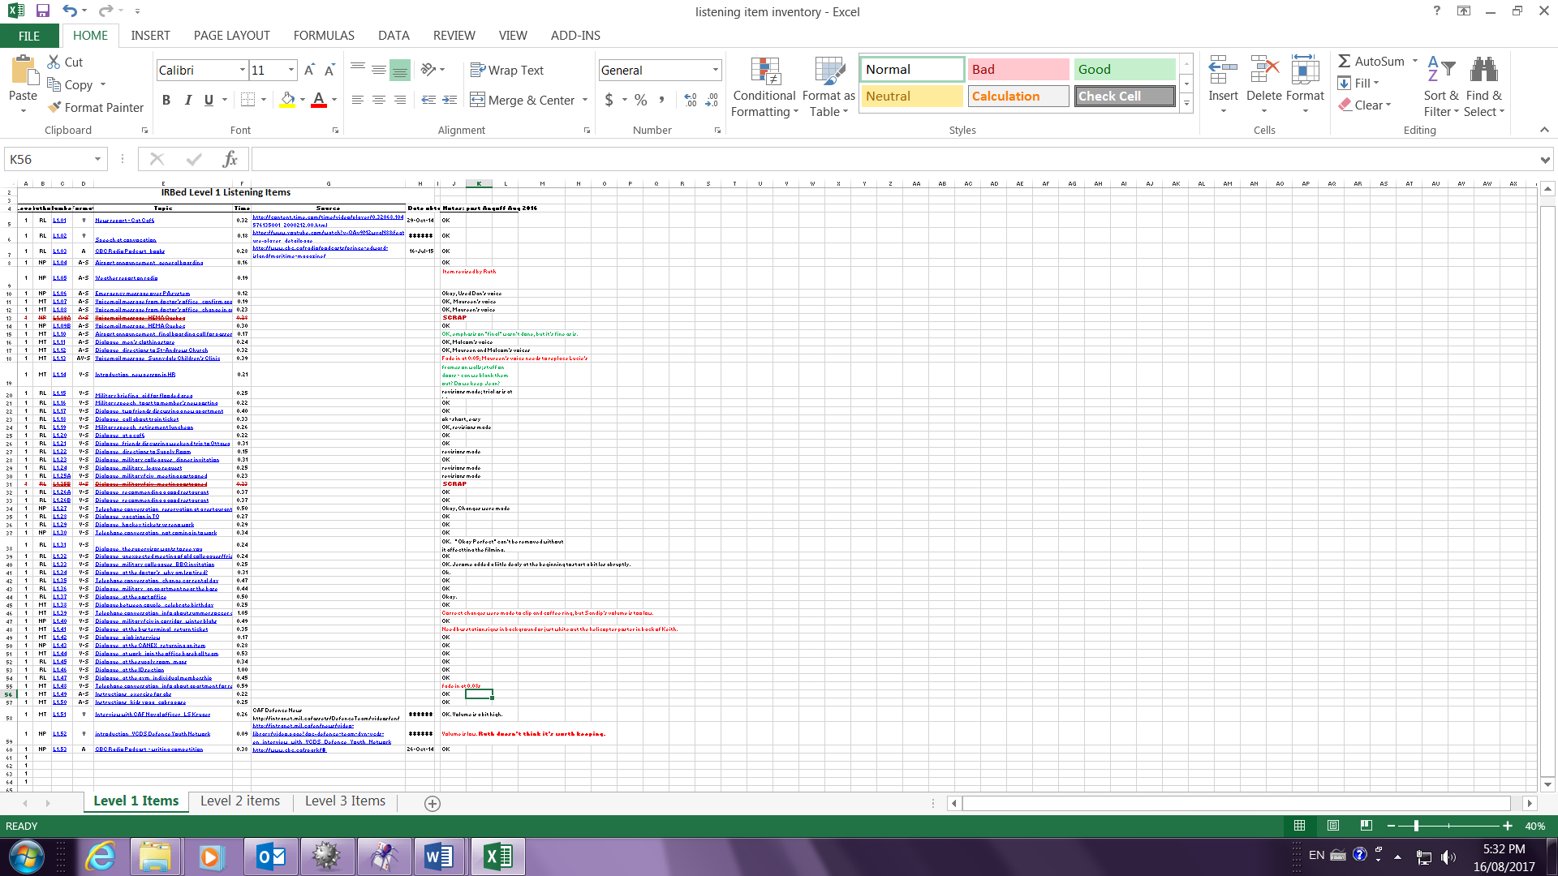
Note: Even after a 2nd moderation session and an Angoffing session, another 15% or so of items were discarded (154 items)

Slide 28
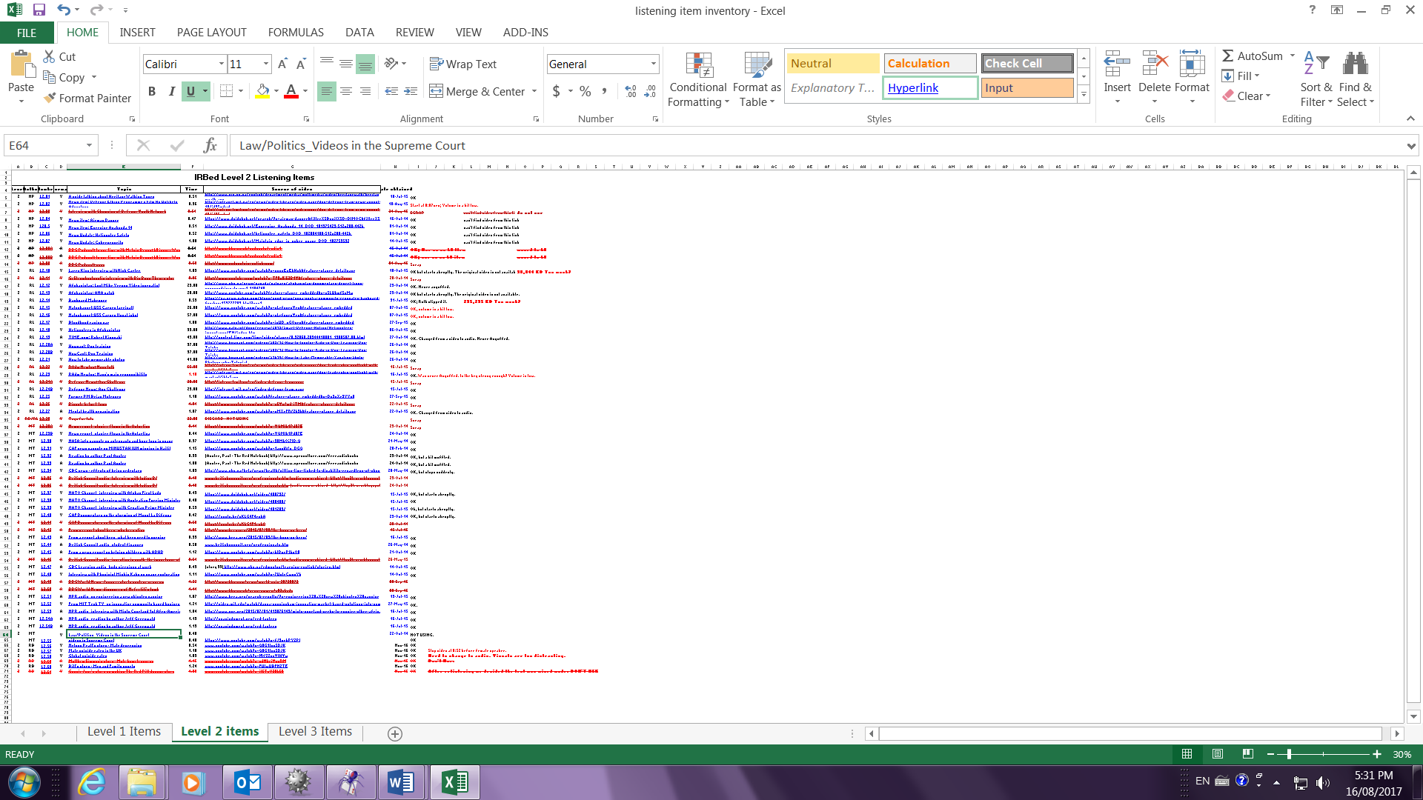
Level 2 items (66 items, 19 discarded)

Slide 29
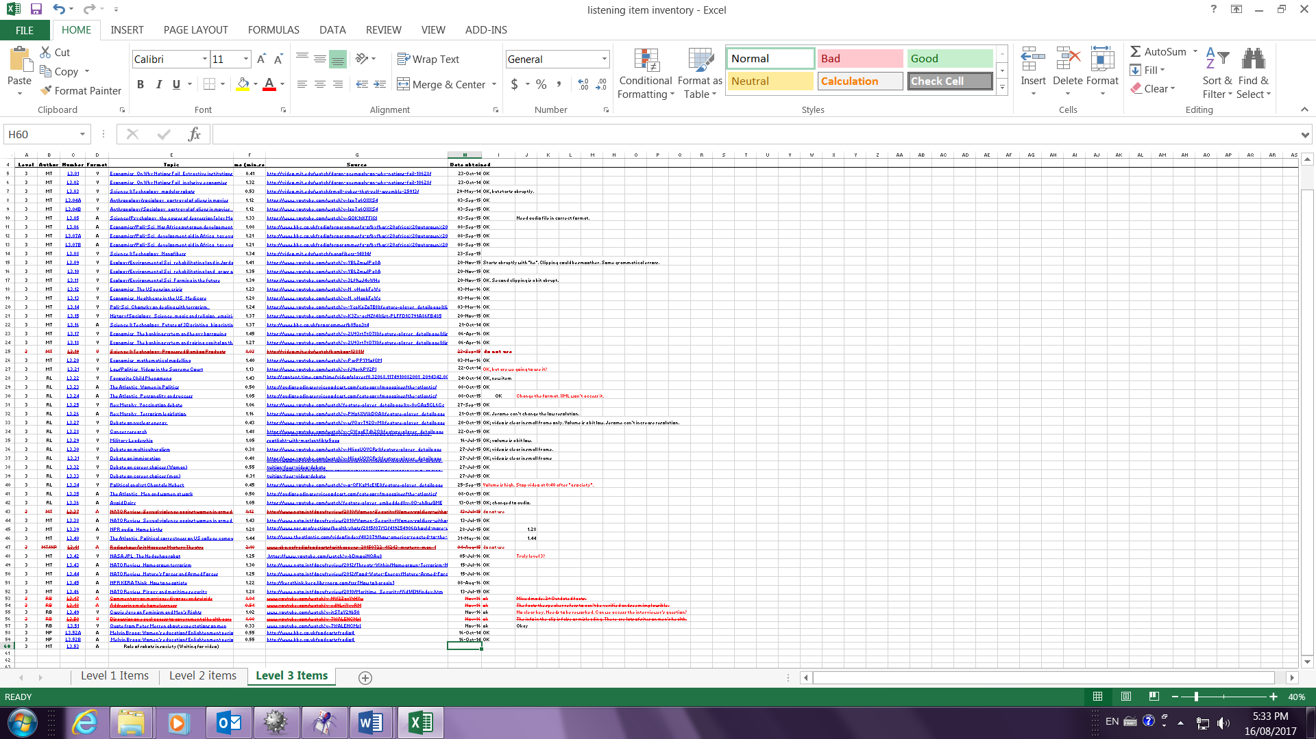
Level 3 (56 items, 6 discarded)

Slide 30
This is even before trialling!
Trialling may also eliminate some items because they are not working as you had expected.
But don’t be discouraged! Create lots of items!!!!!!!
(rule of thumb: create about twice as many items as you will end up with)

Slide 31
Speaking and Writing Prompt checklist
Is the language at the appropriate level?
Is the task at the appropriate level?
Is the task clear?
Is the audience clear?
Will the task elicit the kind of language you are expecting?

Slide 32
Conclusion
Need to be normed before you can moderate items
Moderation is work and a lot of effort must be put into it: reliability and validity.
However there is never the perfect multiple choice item!
But there does come a point when you have to say “enough is enough” and stop revising your items.

Slide 33
Conclusion (cont’d)
Hopefully, these guidelines, when used systematically, will help train testers
to know what to expect in a norming session, and to internalize what they need to look for when moderating items.

Slide 34
Thank you.
Questions?

