Slide 1
Managing Stakeholders Expectations
Michael Adubato
SHAPE Language Testing Centre
ACO/SHAPE, Belgium

Slide 2
Stakeholder?!

Slide 3
What is a stakeholder?

Slide 4
STAKEHOLDER…
A person, group or organization that has interest or concern in an organization.
Stakeholders can affect or be affected by the organization's actions, objectives and policies. Some examples of key stakeholders are creditors, directors, employees, government (and its agencies), owners (shareholders), suppliers, unions, and the community from which the business draws its resources.

Slide 5
STAKEHOLDER…
STAKEHOLDER, ACCORDING TO YOURS TRULY IS:
NATO

Slide 6
SHAPE
ALLIED COMMAND
OPERATIONS

Slide 7
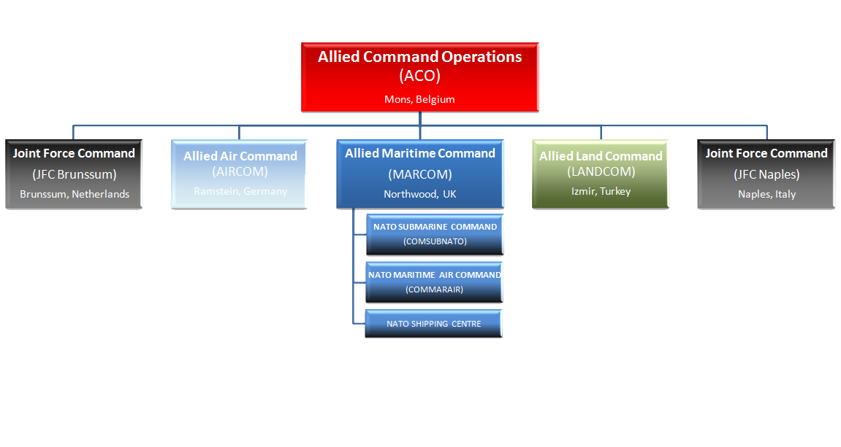
This is ACO

Slide 8
WHERE?
INTRODUCTION
NATO “labor force” comes from 29 nations – only 3 are native speaking
Each ACO PE (Peacetime Establishment) Post is defined with different
requirements – experience, education, security clearance, and
LANGUAGE REQUIREMENT (SLP)
Common need is to understand each other using the official
working language (Everywhere but NATO HQ in Brussels, English is the
official working language)

Slide 9
WHERE?
So why am I covering this topic?
The SHAPE LANGUAGE TESTING CENTRE, my shop, represents
the SHAPE/ACO stakeholders
We are the ONLY entity in the NATO Command Structure that tests
Military personnel

Slide 10
WHERE?
Ideally, all personnel assigned to any NATO post should be tested in
their own country, at their own national testing center. However….
The other option is the SLTC.

Slide 11
WHERE?
WHAT DOES NATO/ACO NEED?
FOR ALL MILITARY PERSONNEL ASSIGNED TO NATO TO MEET ALL
REQUIREMENTS IN THE JD: WE, OF COURSE ARE ONLY FOCUSING
ON LANGUAGE REQUIREMENTS

Slide 12
WHERE?
THE MAIN FOCUS IS ON
LANGUAGE REQUIREMENTS
Initial language prerequisite: JD vs. language certificate
Proper skills to effectively use the language
Professional familiarization in the (new) NATO
Environment – language skills at the required level will
Significantly ease this process
Confirmation of earned language capabilities (national
Language certificate)

Slide 13
WHERE?
EXPECTATIONS
STAKEHOLDERS EXPECT TO RECEIVE MILITARY PERSONNEL FULLY
QUALIFIED TO FILL THE PE POST

Slide 15
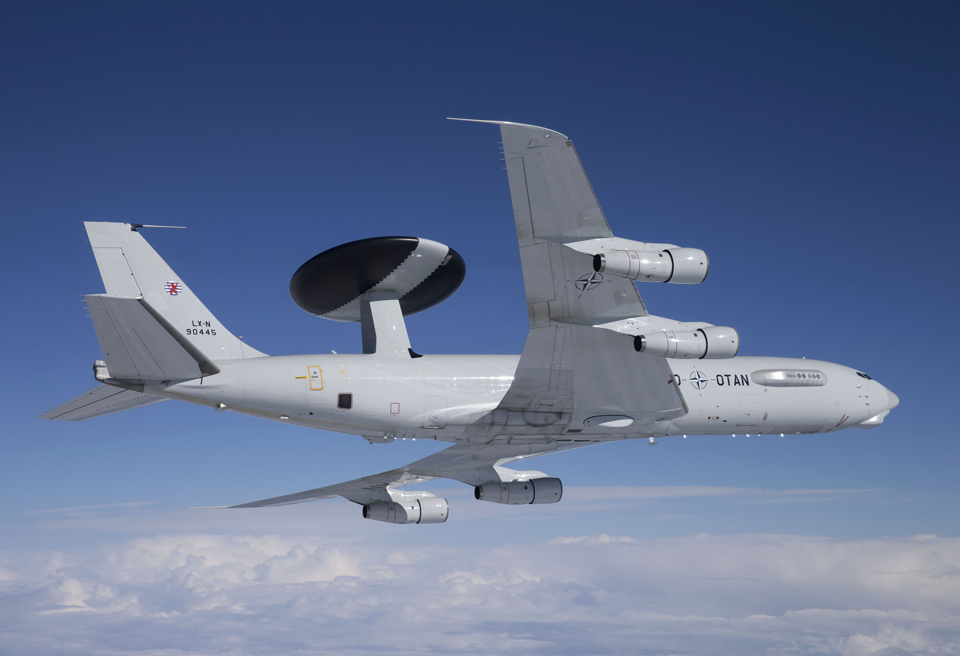
NATO E3A COMPONENT @ GK
You don’t meet your
SLP requirement?
You’re not flying on
This baby!

Slide 16
WHERE?
RECOMMENDATIONS
Based on my experience testing in ACO for 19 years:
CONDUCT THE NATIONAL LANGUAGE TRAINING
AND TESTING AS STRICT AS STANANG 6001
DESCRIPTORS DICTATE
This means that….

Slide 17
WHERE?
THE NATIONAL LANGUAGE CERTIFICATE SHOULD
MATCH THE INDIVIDUAL’S “REAL
KNOWLEDGE”

Slide 18
WHERE?
MORE INTENSIVE TRAINING IN THE USE OF ENGLISH
SUCH AS SPECIALIZED TRAINING PACKAGES AIMED
AT SUCCEEDING IN A NATO OPERATIONAL
ENVIRONMENT

Slide 19
WHERE?
REQUEST FEEDBACK FROM THE
SHAPE LANGUAGE TESTING CENTRE –
ME!

