Slide 1
An international context in higher education – outside the ENL world

Slide 2
Definitions
ELF – English as a lingua franca
A contact language
among users with different L1s
who choose English for communication
Also known as …
English as an international language
English as a world language
English as a global language
EMI – English-medium instruction
Educational instruction via ELF

Slide 3
Motivation
The native speaker as the measure for all Englishes?

Slide 4
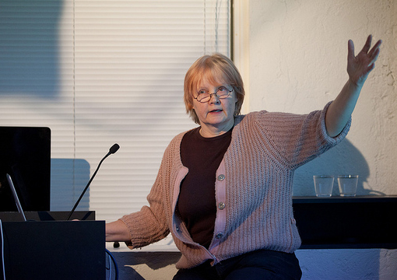
Context
Internationalization of higher education
English-medium instruction (EMI)
Job demands of lecturers changed
Aalto University - EMI / quality control
Pilot-mentoring program
Pilot-certification assessment (optional)

Slide 6
The Problem
Their assessment criteria
General language ability
CEFR scales
Target culture
ENL (NS-NNS)
Homogenous
Monolingual
Integrative motivation
Intended target audience
Specific language ability
EMI lecturers
No target culture
International (NNS-NNS)
Heterogeneous
Plurilingual
Instrumental motivation
A mismatch

Slide 7
The investigation
What criteria might be adequate
for assessing spoken professional
English in an international context (EMI)?
Investigated
Positive & negative self-perceptions
of professional English via language ideologies
Students perceptions of their lecturer’s English

Slide 8
Research Method
Approach
Reflects dialogic aspect of lecturing
Data collection
7 EMI lecturers (QUAL)
36 Paired students (QUAN)
Self-assessed English: 95% at least ’good’
16 First languages represented
Analytics
Discourse Analysis / Language ideologies
Repeated measures ANOVA & correlations
Combined data to present general picture

Slide 9
Importance of the Research
New perspective to language assessment
Assumes language ideologies as relevant
for developing assessment criteria
Research outcome
Could impact future measures
of professional English for an international context
Identifies some assessment criteria
Spoken professional English > international context
A field-specific area > EMI lecturing

Slide 10
Language ideologies
The native speaker as the measure for all Englishes?

Slide 11
Four language ideologies
One nation one culture / Identifying with local national culture
Okay to sound Finnish in Finland (speaking English)
but not necessarily in ENL context
Okay to be Finnish in Finland
respect local sociolinguistic behavior
Speaking according to grammar books = right target
Language is what people speak
not what the books say it is
Because pronunciation can be a problem …
correct grammar is important
Standard language / Correctness > following prescriptive rules

Slide 12
Four language ideologies
Native speaker / Idealized ’perfect’ language in a target culture
If you don’t speak English well enough, you are not accepted
Even NSs deliver slightly incompetent spoken performance
unfinished sentences, doubled up words, hesitations, …
I’m not a NS and anyway I speak better than they do
e.g. to an NNS audience
More than 1 billion NNS of English
so communciation … most of the time with NNS
My internationalized ear guides correctness
No need to hide that I’m not a NS
speak with (L1) background and make myself understood
English-as-a-global language / Using English in ’the world at large’

Slide 13
Main qualitative findings
Lecturer self-perceptions of professional English
Changed in a given context
English-as-a-global language beliefs
Normative or prescriptive beliefs
When guided by …

Slide 14
Main quantitative findings
Do students adjust to their lecturer’s English over time?
Analysis of Variance two-factorial repeated measures
Lecturer English (N = 36) | Time_of_questionnaire | F(1,105) = .742, p = .391
 | Time_of_questionnaire*theme | F(2, 105) = 1.41, p = .249
Where time served as within-subjects factor, and theme as between-subjects factor
Lack of statistical significance suggests …
Rapid or very little adjustment
for proficient EMI students
in comprehending their lecturer’s English

Slide 15
Main quantitative findings
Correlation results
Positive association indicates…
Lecturer’s English
more important at T1 than T2
where difference means adaptation

Slide 16
Main conclusions
EMI lecturers have two basic representations of their English
Own English compared to native-likeness
> faulty English
Own English in work environment
> works rather well
Type A
Type B

Slide 17
Main conclusions
Two representations > induced by certain language ideologies
Type A
(faulty)
Standard language ideologies
Type B
(works)
English-as-a-global-language ideologies
Native speaker language ideologies
Results from student survey support interpretation B

Slide 18
Overall, what does it indicate?
The native speaker as the measure for all Englishes?
A comprehensibility goal over native-likess
Need an alternative measure…
Competent international second language user?

Slide 19
Some relevant criteria …
Accessible NNS fluency
Lecturer credibility
Perceived intelligibility
Accommodation skills
Content accessibility
Engaging the listener
Lecture coherence
Field-specific terminology
(See the handout)
(See the handout)
Lexicogrammatical appropriateness
Plurilingual strategies
International context
Lecturing
Highlight tolerance towards variation in spoken English
See the handout

Slide 20
Implications
Fairness in language assessment practices
Aligning assessment criteria with purpose & context
For EMI: Native-likeness not the central goal
Birthright of nativeness doesn’t ensure adequate skills
Broader and more diverse ways needed …
For assessing spoken professional English
Giving consideration to the context of use
Integrating more with field-specific areas

Slide 21
Thank you!

