Slide 1
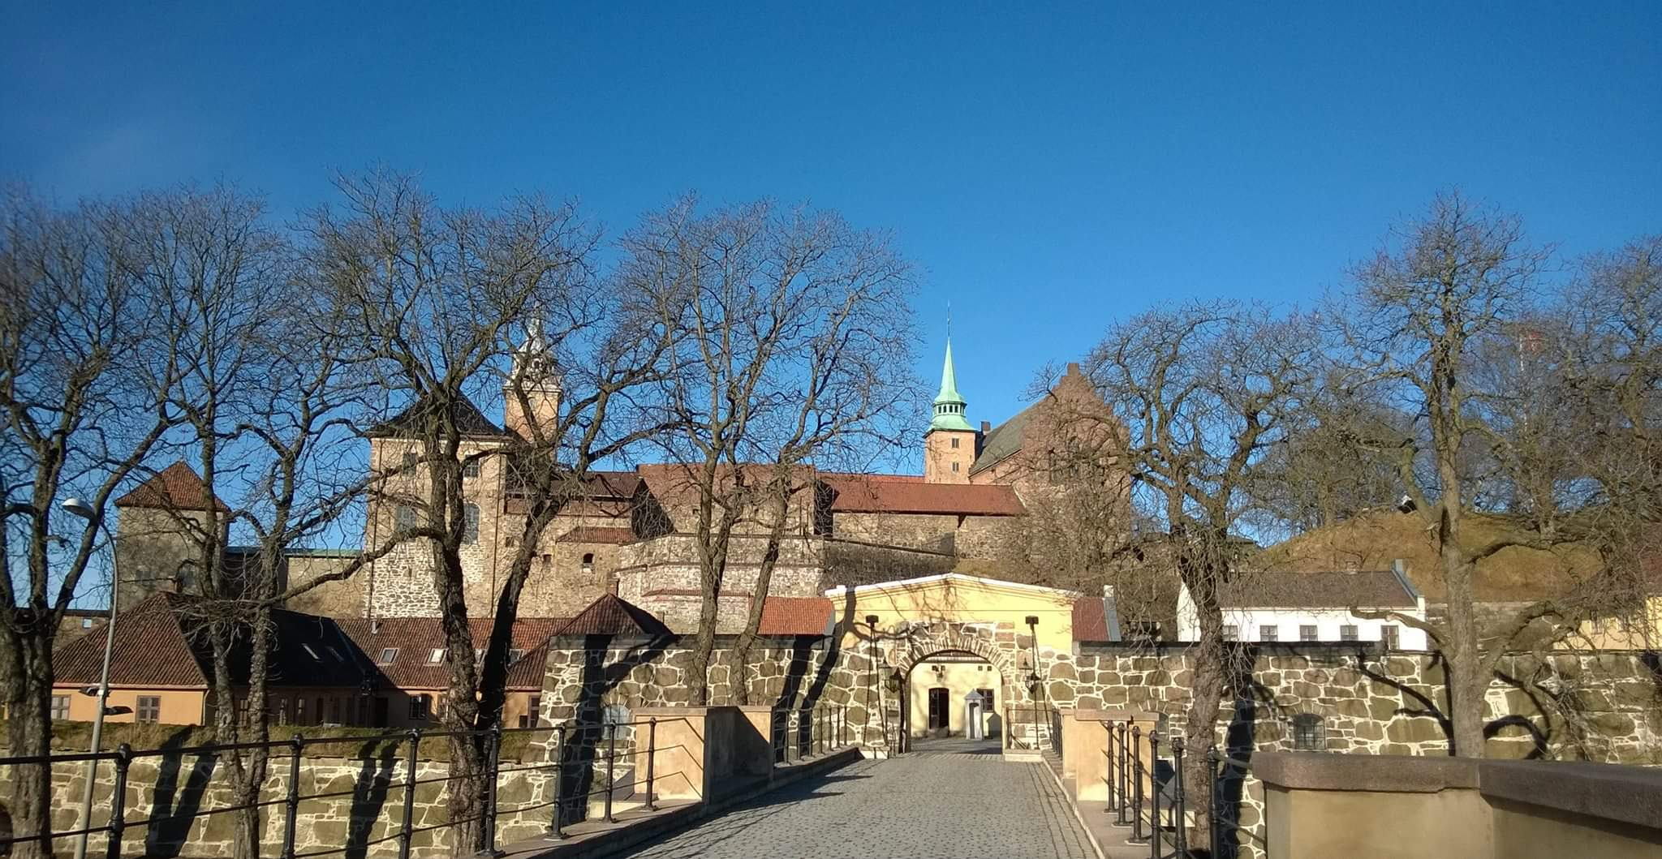
BILC Conference 2020 Oslo, 24-29 May

Slide 2
Working title: Language Use in Military Contexts: Real vs. Classroom World

Slide 3
Conference venue:
Akershus fortress,
Norwegian Defence University College

Slide 4
Conference venue: Norwegian Defence University College

Slide 5
Suggested accommodation
Hotel Citybox, Prinsens gate
Standard single NOK 799,- /night
Standard double NOK 999,- /night
Note: breakfast not included, café on ground floor.
40 rooms pre-booked, until 1 April, 2020
Booking:
Email: therese@citybox.no, booking code 296670

Slide 6
Hotell Scandic Victoria
Standard single room: NOK 1590 per night
Superior single room: NOK 1790 per night
Breakfast included
40 rooms pre-booked until 1 April 2020

Slide 7
Thon Hotel Cecil
Standard room: NOK 1895 per night
Breakfast & light evening meal included
20 rooms pre-booked until 24 March 2020
Link booking:

