Slide 1
Instructor Evaluation Process Improvement
BILC Professional Seminar – 2017
Tbilisi, Georgia
Angel BishopPetty, Defense Language Institute English Language Center

Slide 2
Defense Language Institute
Mission: Provide English language instruction and acculturation to international military and civilian strategic partners and to US military personnel

Slide 3
Defense Language Institute
Total Number of Supervisor: 27
Total number of instructors: 204
Instructors on Mobile Training Team (MTT) 17, or Language Training Detachment (LTD) 4, plus 3 supervisors
Total number of students: 568
52 countries represented at DLI
Instructor/Student ratio: 1:5.2

Slide 4
Background
Update evaluation approach
Reflect upgraded standards
Instructor and supervisor involvement
Formulation of Instructor Working Group – 2016
Information sessions and focus group input
Supervisor validation
Supervisor training and norming

Slide 5
Background
Observe instructors once in 6 month period
Instructors in 3 Sections of DLI – AE, SE, GE
Highly qualified ECL professionals

Slide 6
Rubric Development
Initiated by instructors
Researched best practices
Established Criteria
Obtained feedback (supervisors, instructors)
Conducted supervisor validation

Slide 7
Rubric Development
3 possible ratings
Needs Improvement
Fully Successful
Exemplary

Slide 8
Rubric Development
11 Elements
Planning and preparation
Principles
Explanations and instructions
Monitoring and feedback
Communicative interaction
Flow, pace, and time management
Lesson objectives and language skills
Speech
Professionalism and classroom management
Learning environment

Slide 9
Rubric Development

Slide 10
Validation Process
3-month trial
27 supervisors involved
54 trials
Feedback collected and analyzed
Made changes to rubric

Slide 11
Validation Process
Need for training/norming for supervisor became clear
Concerns with discerning element ratings needed – FS v E
Clarity of examples needed
Change management needed

Slide 12
Revisions to Rubric
Changes were made based on supervisor input
Rewording to provide clarity
Examples revised

Slide 13
Training Needs
Instructor Orientation
2-hour orientation conducted by instructors with supervisor
Supervisor Training
4-day training conducted by chiefs
23 supervisors trained

Slide 14
Supervisor Training Focus
Emphasis on familiarization with rubric
Norming
Buy in by supervisors
Change management
Address questions head on (parking lot)
Recognize that not all supervisors will embrace process equally
On-going process
Be prepared to be flexible and look at problems as they arise
We are all learning together

Slide 15
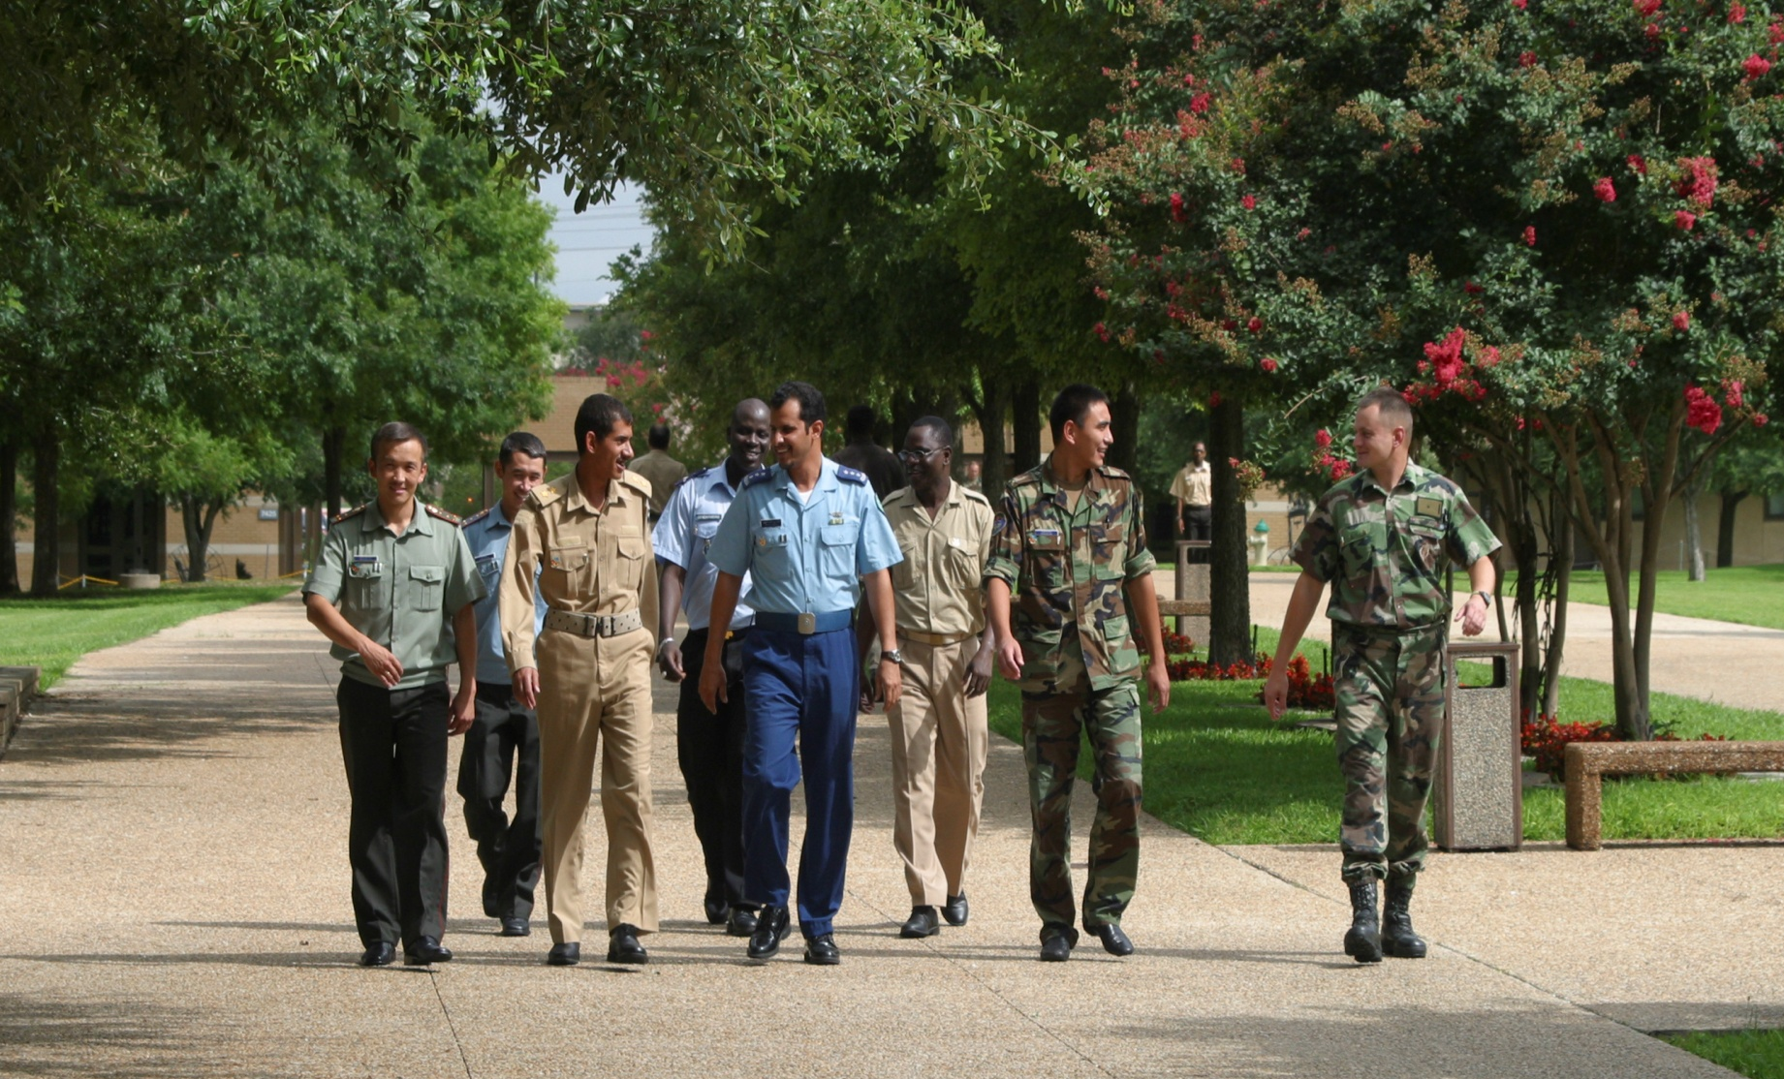
Work In-Progress
Notes:
4

Slide 16
QUESTIONS?

