Slide 1
BILC PROFESSIONAL SEMINAR 2019 Copenhagen, Denmark
PORTUGUESE
ARMED FORCES
Lt Commander Marta Gabriel| 10 october 2019

Slide 2
BILC Professional Seminar 2020, Portugal
Where: Cascais or Estoril (about 30 km from downtown Lisbon)
When: 04-09 October, 2020
Theme: TBD (any suggestions are welcome and appreciated)

Slide 3
BILC Professional Seminar 2020, Portugal
Useful links:
https://www.visitportugal.com/en
https://www.lonelyplanet.com/portugal
https://www.aeroportolisboa.pt/en/lis/home
http://carris.transporteslisboa.pt/en/network-map/

Slide 4
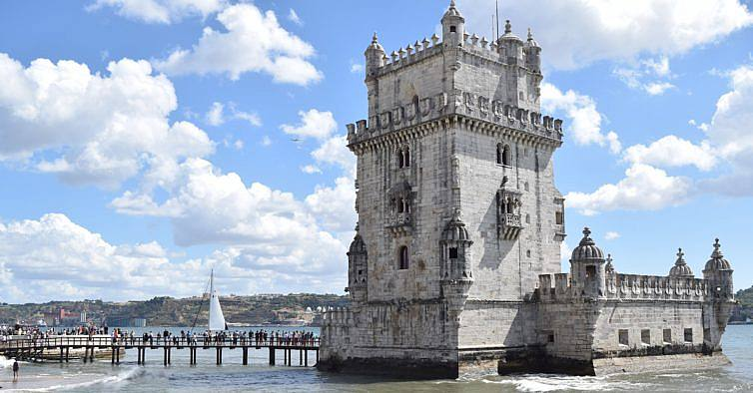
BILC Professional Seminar 2020, Portugal
Bem vindos a Portugal
Welcome to Portugal

Slide 5
LtCmdr Marta Gabriel
BILC National Representative
STANAG 6001 Testing Coordinator
Portuguese Armed Forces Defence Staff
Unclass email: mcgabriel@emgfa.pt

