Slide 1
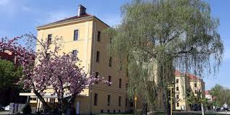
Croatian Defense Academy ”Dr.Franjo Tuđman”
BILC Seminar 2018, Zagreb, Croatia
Foreign Language Center ”Katarina Zrinska”

Slide 2
Croatian Defense Academy ”Dr.Franjo Tuđman”
BILC Seminar 2018, Zagreb, Croatia
Date: 01 – 04 October 2018
Venue: Croatian Defense Academy (CDA), Zagreb
Theme: TBD
Foreign Language Center ”Katarina Zrinska”

Slide 3
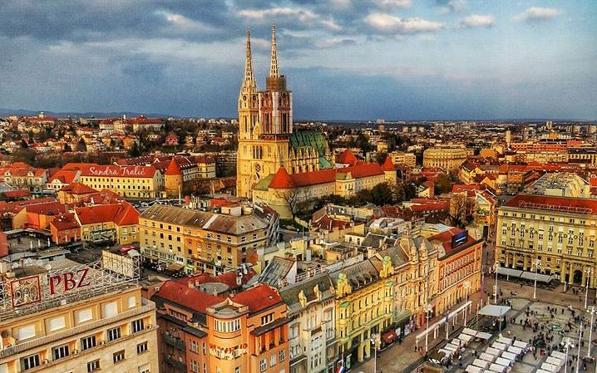
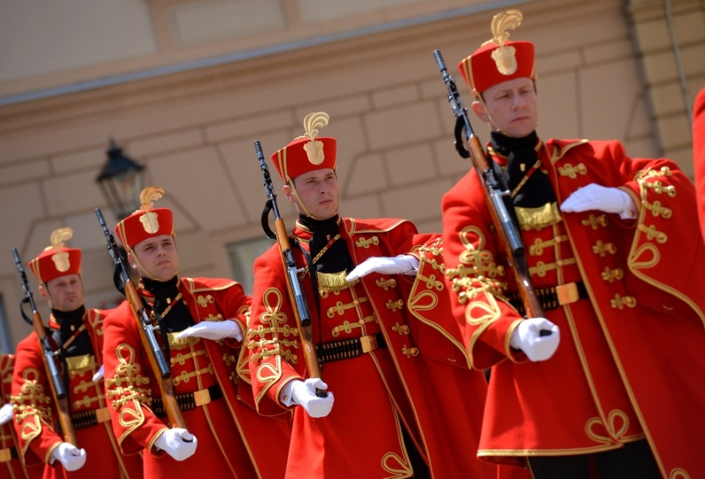
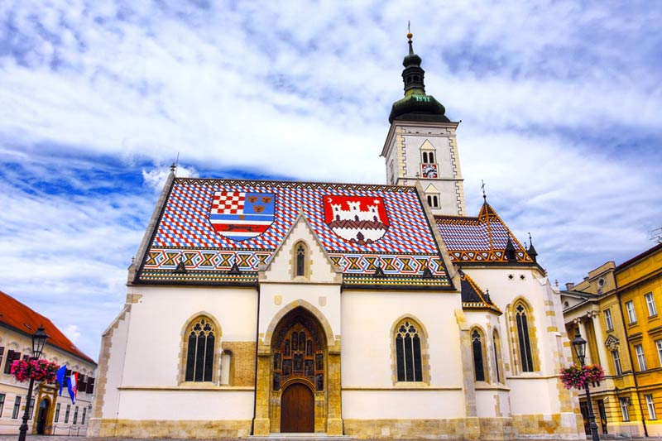
Croatian Defense Academy ”Dr.Franjo Tuđman”
BILC Seminar 2018, Zagreb, Croatia
WELCOME TO ZAGREB, CROATIA!
Foreign Language Center ”Katarina Zrinska”

Slide 4
https://www.youtube.com/watch?v=u4odLj2cDTg

