Slide 1
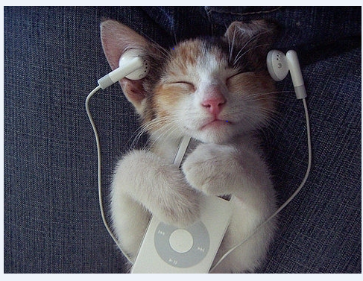
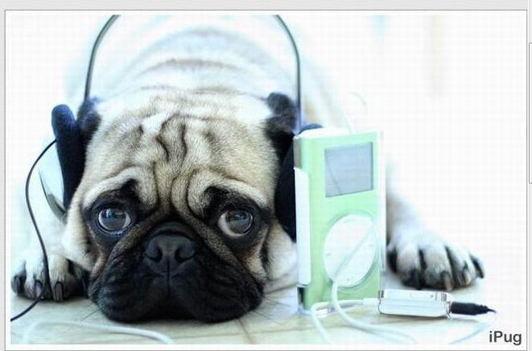
Podcasting Your Way to Listening Success
Robert Engel
Defense Language Institute English Language Center

Slide 2
Military Audio/Video Sources

Slide 3
Authentic

Slide 4
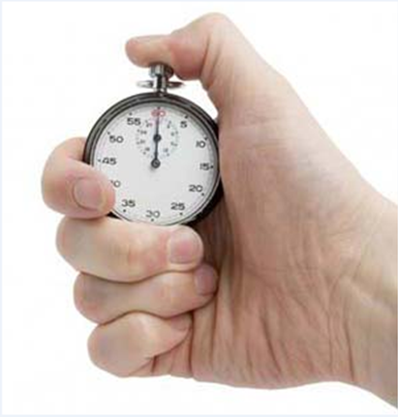
Brief

Slide 5
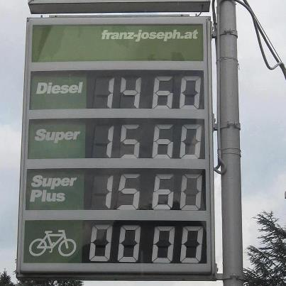
Free

Slide 6
High Interest

Slide 7
Timely

Slide 8
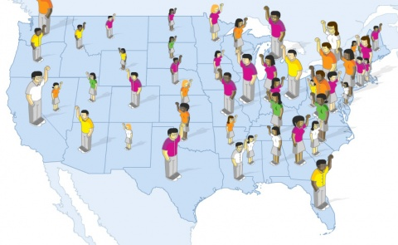
Multiple Speakers
Variety of Accents

Slide 9
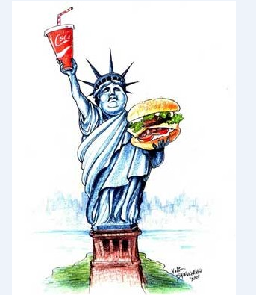
Rich in American Culture

Slide 10
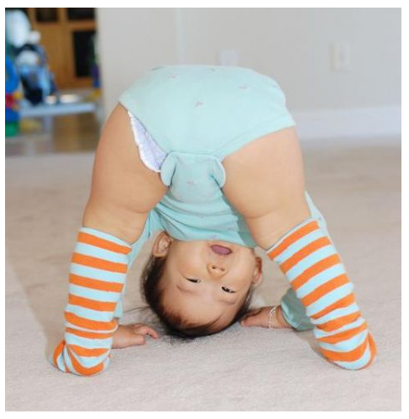
Flexible

Slide 11
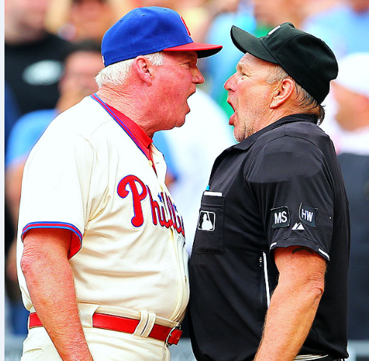
Communicative Interactive

Slide 12
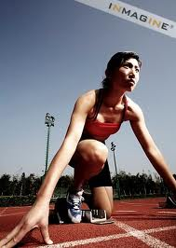
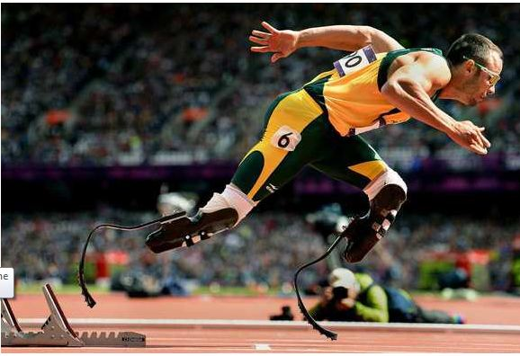
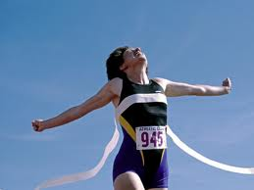
Listening Activity Development
PRE-
WHILE
POST-

Slide 13
Prelistening
Predict
KWL
Discussion Questions
Given details, predict topic
Given topic, predict details
Vocabulary
Activate Schema

Slide 14
While Listening
Check the details heard
Multiple choice
Fill in the blank
Short answer
True/false
Identify sequence

Slide 15
While Listening
Mark discrepancies in a transcript
Predict what comes next
Fill in/make an outline, chart, or table
Take notes
Make a journal entry

Slide 16
Post-listening
Compare answers, discuss problems
Relate to personal experience
Seek input from other sources
Exchange information
Select or write title
Finish KWL

Slide 17
Pre-listening Discussion
Discuss the following in small groups.
What’s the longest period of time you’ve ever had to stay awake? Why?
What can people do to help them stay awake for long periods of time?

Slide 19
Choose the Main Idea
Watch the video “What’s It All About?” Choose the main idea from the choices below.
Energy drinks _________________________.
have special ingredients
aren’t good for your health
are targeted to young people
aren’t as beneficial as water

Slide 20
Write a Title
Watch the video a second time, decide on a good title, and write it in the space below. Then compare your title with a classmate’s title.

Slide 21
Identify the Phrases You Hear
Watch the video again, and check the boxes next to the words and phrases you hear.
1. | ^{passion and freedom} | 11. | ^{active lifestyles} | 21. | ^{right for you}
2. | ^{cans provide fuel} | 12. | ^{improve awareness} | 22. | ^{no set safe amount}
3. | ^{threat to airmen} | 13. | ^{easy way to stay awake} | 23. | ^{start having symptoms}
4. | ^{as popular as ever} | 14. | ^{getting the reverse effect} | 24. | ^{prepped and ready}
5. | ^{bad for us} | 15. | ^{fatigue and nervousness} | 25. | ^{high level of performance}
6. | ^{people love the benefits} | 16. | ^{an energy boost in a can} | 26. | ^{safely drink}
7. | ^{it makes perfect sense} | 17. | ^{bright and intelligent} | 27. | ^{maybe one a week}
8. | ^{energy drinks} | 18. | ^{nutrients and longevity} | 28. | ^{look for an alternative}
9. | ^{also dangerous} | 19. | ^{effect on your heart} | 29. | ^{meets health needs}
10. | ^{young individuals} | 20. | ^{workload on your kidneys} | 30. | ^{good old-fashioned water}

Slide 22
Positive or Negative?
Look again at the list of words and phrases you checked. For each word/phrase you checked, determine whether it sounds positive or negative. Some will be neither. Count the positive and negative words/phrases and put the numbers in the boxes below. Compare your results with a classmate’s.
Positive | Negative

Slide 23
Revise the Title
Read the title you wrote on p. 41 again. Then look at the words/phrases you checked in the table on p. 42. In the space below, write a new title using some of the words/phrases you checked.

Slide 24
Jigsaw
Your instructor will divide you into two groups. Group A will watch Therapist 1, Group B will watch Therapist 2. Once you are in groups, follow the appropriate set of instructions.

Slide 25
Preview and Predict
Worksheet for Group A: Therapist 1
Key Words | therapy therapist mental health stress and anxiety reduce stress
Who is three and a half years old and weighs 185 pounds?
Who does he greet?
Why is this therapist’s temperament suitable for this type of work?
What are the ways he helps during an appointment with the doctor?
5. Who does he help besides patients?

Slide 26
Watch and Take Notes
Group A: Therapist 1 | What’s in common? | Group B: Therapist 2

Slide 28
Preview and Predict
Worksheet for Group B: Therapist 2
Key Words | PTSD symptoms physically and emotionally disabled companion commands
When did Bill Campbell begin to experience PTSD?
What were the effects of PTSD?
What is the name of the program Bill’s psychologist told him about?
What is the companion’s name?
How has Bill’s companion transformed his life?

Slide 29
Watch and Take Notes
Group A: Therapist 1 | What’s in common? | Group B: Therapist 2

Slide 31
Share and Compare
Group A: Therapist 1 | What’s in common? | Group B: Therapist 2

Slide 32
Stress Busters
Answer the following questions. Then discuss your answers with a classmate.
What are three things that cause you to have a lot of stress?
What are three things you do to reduce stress?
What are other ways that dogs are useful to people?

Slide 33
Questions?
Podcasting Your Way to Listening Success
Robert Engel, DLIELC
robert.engel.1@us.af.mil

