Slide 1
Classroom-Based Assessment (CBA) What Works and What Doesn’t
Peggy Garza
BILC Secretary
Chair, English Language Programs Dept.
Partner Language Training Center Europe
George C. Marshall European Center for Security Studies

Slide 2
Definitions of Classroom-Based Assessment
“Assessment internal to the classroom and managed by the teacher.” Glen Fulcher
“Comprises a repertoire of methods and reflective procedures that teachers and students use for evidence to gauge student learning on an ongoing basis.” Carolyn Turner
“ The process of using information about students’ learning in the course of instruction to make decisions to improve learning.” Mary Jo Di Biase

Slide 3
Contrasting Paradigms
Large Scale
Classroom
High stakes
Low stakes
Summative
Formative
Assessment of learning
Assessment for learning
STANAG 6001 (proficiency)
Classroom Based Assessment

Slide 4
Main Principles of CBA
Include a variety of methods to build learner profiles to support language learning in the classroom
Information from CBA should be used as the basis for interaction between the teacher and the student
Teachers need to become aware of assessment methods and procedures

Slide 5
CBA Examples
Self assessments
Diagnostic tests
Peer assessments
Vocabulary
Portfolios
Projects
Dictation
Spelling
Presentations
Debates
Military briefings
Essays
Interviews
Summaries
Achievement tests
Quizzes
Performance tests

Slide 6
Traditional Assessment
Current Practices
Standard exams
Timed, multiple-choice format
Decontextualized test items
Scores suffice for feedback
Focus on discrete answers
Oriented to product
Noninteractive performance
Fosters extrinsic motivation
Continuous long-term assessment
Untimed, open-ended responses
Contexualized communicative tasks
Individualized feedback
Open-ended, creative answers
Oriented to process
Interactive performance
Fosters intrinsic motivation

Slide 7
EALTA Guidelines
European Association for Language Testing and Assessment (EALTA) members involved in classroom testing and assessment will clarify to themselves and appropriate stakeholders
Assessment Purpose(s) and Specification
What is the purpose of the assessment?
How does the assessment purpose relate to the curriculum?
Are there any test specifications?
How well is the curriculum covered?
How are the assessment purposes and specifications made known and discussed?
Assessment Procedures
Who designs the assessment procedures?
How appropriate are the assessment procedures to the learners?
How is information on students´ learning collected?
How is information on students´ learning assessed and stored?
What efforts are made to ensure that the assessment results are accurate and fair?
What efforts are made to promote agreement in marking practices across teachers and schools?
What account is taken of students’ views on the assessment procedures?
Consequences
What use is made of the results?
What action(s) will be taken to improve learning?
What kind of feedback do students get?
What processes are in place for students or their guardians to make complaints or seek re-assessments?
What are the consequences of the assessment procedures for classroom practices?
What are the consequences of the results of the assessment for learners?

Slide 8
EALTA Guidelines
Assessment Purpose(s) and Specification
What is the purpose of the assessment?
How does the assessment purpose relate to the curriculum?
Are there any test specifications?
How well is the curriculum covered?
How are the assessment purposes and specifications made known and discussed?

Slide 9
EALTA Guidelines
B. Assessment Procedures
Who designs the assessment procedures?
How appropriate are the assessment procedures to the learners?
How is information on students´ learning collected?
How is information on students´ learning assessed and stored?
What efforts are made to ensure that the assessment results are accurate and fair?
What efforts are made to promote agreement in marking practices across teachers and schools?
What account is taken of students’ views on the assessment procedures?

Slide 10
EALTA Guidelines
Consequences
What use is made of the results?
What action(s) will be taken to improve learning?
What kind of feedback do students get?
What processes are in place for students or their guardians to make complaints or seek re-assessments?
What are the consequences of the assessment procedures for classroom practices?
What are the consequences of the results of the assessment for learners?

Slide 11
Washback
“Washback is the term that is used when students and teachers do things they would not necessarily otherwise do because of the test.” (Alderson and Wall, 1993)
“In large scale assessment, washback often refers to the effects that tests have on instruction in terms of how learners prepare for the test.” (Brown and Abeywickrama, 2010)

Slide 12
Positive and Negative Washback
STANAG 6001 proficiency testing
Language programs
Positive: improvements in classroom instruction to better align it with STANAG 6001 testing
Negative: establishing test prep courses, such as those focusing on memorized or rehearsed language

Slide 13
CBA Positive Washback
Positively influences what and how teachers teach
Positively influences what and how learners learn
Gives learners feedback that enhances their language development
Is more formative in nature than summative
Provides conditions for peak performance by the learner
(Brown and Abeywickrama, 2010)

Slide 14
CBA’s Role in Proficiency Building
Instructional Goals and Learning Outcomes
Content and Instruction
Assessment
CBA supports proficiency building

Slide 15
Importance of Alignment
“When learning and testing are not aligned, bad things happen.”(Dr Clifford, Madrid, May 2015)
Possible reactions to lack of alignment
Learners, who have mastered the content, fail the test
Learners become frustrated and lose motivation
Teachers change their instruction to prepare learners for the test, not the learning outcomes

Slide 16
More on Alignment
Test method and purpose
Test task and proficiency level

Slide 17
Alignment of Test Method and Test Purpose
 | Methods | Description | Purposes | Advantages | Disadvantages
1 | Tests or quizzes | Provide information on learning outcome | Examine achievement of outcomes Ascertain extent to which program adheres to meet goals Provide feedback to teachers, students | Evidence of learning is generated as part of classes Results are used | Time consuming to create, administer, correct Time taken out of coursework
2 | Performance tests | Classroom activities using an observation checklist, example: give a briefing | Examine student achievement Ascertain performances meet goals Provide feedback to teachers and students | Capture data that is difficult to obtain through written texts and other methods | Can be difficult to interpret Performances influenced by observer Expensive and time consuming
3 | Portfolios | Collection of work such as assignments, reflection, self assessment | Examine achievement over time Understand progress within program Ascertain extent to which program meets goals Provide feedback to students and teachers | Students see growth and reflect on the products in the portfolio Provides a multi- view of student achievement | Resources needed: may be costly and time consuming
(Adapted from DiBiase, 2014)

Slide 18
Alignment of Test Task & Proficiency Level
Interviews and reports
Sentence completion
Panel discussions
Picture-cued
Q & A
Extended
response
Timed paragraph reading
Presentations
Multiple choice
True/ false
Debates
LOW
Essay
Spelling test
Low Proficiency
High Proficiency

Slide 19
What About the Learners?
Learner expectations
They want to be tested on what they learn
They want to succeed
But should also not be afraid to make mistakes and learn from them
Learners appreciate specific feedback
But may need teacher guidance and strategies for language development
Learners require support and coaching
To learn how reflect, become more engaged in the learning process and take greater responsibility for their own learning

Slide 20
Clifford’s Model of Shrinking Learning Expectations (When only Traditional Tests are Used)
Instructional Goals and Learning Outcomes
Textbook
Teaching
Test
Learners do not want to waste their time studying what is not going to be “needed”.
For learners (and often for teachers), it is the tests used and not a course’s stated learning outcomes that define what is “needed.”
(Adapted from Clifford, 2015)

Slide 21
Clifford’s Model of Expanding Learning Expectations
Textbook
Real-world proficiency
Instructional domains
(Clifford, 2015)

Slide 22
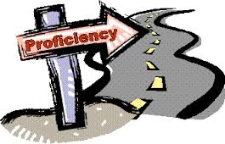
Per Clifford, teaching for proficiency requires
Improved assessment literacy for everyone: teachers, students, and administrators
A tolerance for formative assessment that allows learners and programs to find success from their failures

Slide 23
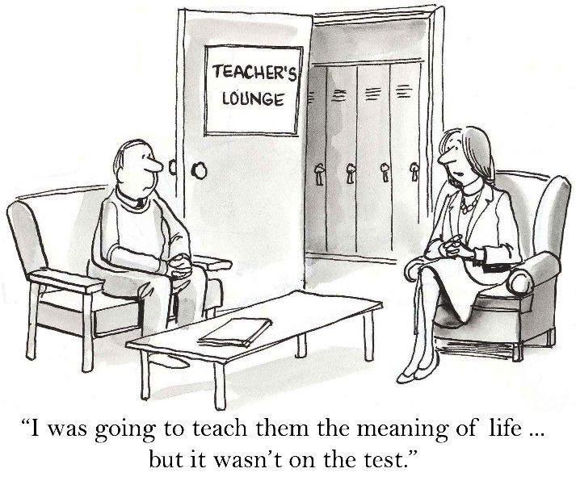
CBA Goes Beyond Traditional Testing
Emphasis on continuous assessment
Real-world communicative tasks
A variety of assessment methods
Learner deficiencies become “windows of insight” (Brown and Abeywickrama, 2010)

Slide 24
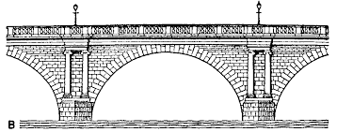
CBA can be described as the assessment bridge or the place where assessment, teaching and learning interweave in the classroom (Turner, 2012)

Slide 25
What Doesn’t Work
Misalignment
Testing learners to find out what they don’t know
Excessive testing
No feedback and untimely feedback
Using poorly designed or rapidly constructed tests, rubrics or scoring criteria

Slide 26
What Works
Providing feedback for improved learning and classroom instruction
Positive washback
Alignment of learning outcomes, content and assessment
Providing a multi-view assessment of a learner’s competence in different domains of language learning
Building responsibility for own learning

Slide 27
Importance of Assessment Literacy
“When teachers and program managers do not have assessment literacy, bad things happen.” (Garza, Helsinki, October 2015)
Possible reactions
They do not understand STANAG 6001 standards and proficiency testing and therefore make bad program design decisions
They blame the STANAG 6001 test, believe it is too difficult, or should test specific grammar, vocabulary or military terms

Slide 28
What Is Assessment Literacy?
“Knowledge, skills, and understanding of assessment principles and practice” (Taylor, 2009)

Slide 29
Why Is Assessment Literacy Important ?
So teachers can provide fair and accurate assessments of their students
To improve alignment between classroom instruction and desired final learning outcomes
To support increasing accountability for classroom instruction
To create coherence across different assessments in a language program and confirm consistency with STANAG 6001 standards

Slide 30
Language Standards & Assessment Seminar
For teachers and language program managers
Objectives
Familiarization with STANAG 6001
Guidelines for aligning instruction to NATO standards
Sound assessment principles and practical activities
Two week-seminar held twice a year

