Slide 1
Basic Statistics for Non-Mathematicians: What do statistics tell us? Why would I want to understand statistics?
Ray Clifford
STANAG 6001 Testing Workshop
Kranjska Gora , Slovenia
4 September 2018

Slide 2
A 10 Question Quiz (for the receptive skills) Which statistic will answer each question?
In general, how well did the test takers do on the exam?
How similar or dissimilar were the test takers’ results?
Which items on the test were the most difficult?
Which items on the test were the easiest?
Were there items that were difficult for the most skilled test takers and easy for the less skilled?

Slide 3
A 10 Question Quiz (for the receptive skills) Which statistic will answer each question?
How do I know if a Norm-Referenced test is reliable?
How do I know if a Criterion-Referenced test is reliable?
How do I know if a Norm-Referenced test is valid?
How do I know if a Criterion-Referenced test is valid?
What Facility Values should STANAG 6001 test items have?

Slide 4
If you were able to confidently answer every question, raise your hand. Congratulations, you have volunteered to help with the break-out activities.

Slide 5
Remember that most statisticians are just “average” people.
They can sit with their head in the oven and their feet in the freezer, and say, “On average, I feel fine.”
They might drown while attempting to wade across a river with an average depth of 1 meter.
They are too busy to explain WHY statistics are useful.

Slide 6
In this workshop, we will focus on WHY statistics are useful!
You won’t need to:
Use a calculator.
Operate a computer.
Know statistical formulas.
You will be introduced to some basic statistical concepts that are useful for:
Summarizing test results. Slides 7 - 11
Describing test items’ characteristics. Slides 12 - 15
Understanding test reliability. Slides 16 - 17
Establishing test validity. Slides 18 - 26

Slide 7
Summarizing general test results, Part 1.
You might be asked questions like these:
In general, how did the test takers do on the exam?
What was the central tendency of the test scores?
What was the test takers’ average score?
There are 3 ways to describe an average result.
The mathematical average – mathematicians MEAN well.
The middle of the road approach – find the MEDIAN.
The fashionable, most popular approach – find the MODE.
When things are normal, the mean, median, and mode are all the same number.
When they are not equal, the scores are “skewed”.

Slide 8
What do these average results tell you:
Example 1:
Mean = 60
Mode = 60
Median = 60
Example 2:
Mean = 60
Mode = 40
Median = 50
Bonus question: Do these numbers tell us how widely the scores were spread out or dispersed?

Slide 9
Summarizing general test results, Part 2.
You might be asked questions like these:
How spread out are the test scores?
How dispersed are the test scores?
How much do the scores deviate from the average score?
There are 2 ways to describe score SPREAD.
The “quick and dirty” way – cowboys feel at home on the RANGE.
The “all inclusive” way – psychologists like a STANDARD DEVIATION.
The range only considers 2 scores – the top and the bottom.
The standard deviation considers the average distance of every score from the mean.

Slide 10
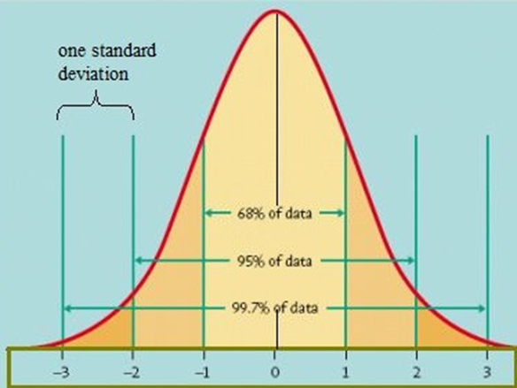
Visualizing “Spread” using standard deviation values. Usually, there are 3 s.d. above and 3 s.d. below the mean score. The smaller the value of the s.d., the smaller the spread and the taller the normal curve.
s.d. = 5
s.d. = 15

Slide 11
What do these “spread” results tell you:
Example 1:
Range = 70
Standard Deviation = 10
Example 2:
Range = 60
Standard Deviation = 5
Bonus question: What is the standard abbreviation for “standard deviation”?

Slide 12
Describing test items’ characteristics, Part 1.
You might be asked questions like these:
Which items on the test were most difficult?
Which items on the test were easiest?
Was item 7 easy or difficult?
There is a way to describe item difficulty.
Item difficulty is measured using the FACILITY VALUE.
The Facility Value (FV) is the ratio [think “percentage”] of the test takers who answered the item correctly.
Facility Values ranges from 0.00 (no one answered correctly) to 1.00 (everyone answered correctly).

Slide 13
What do these Facility Values tell you:
Example 1:
FV = 0.75
Example 2:
FV = 0.50
Example 3:
FV = 0.00
Bonus question: Why is the measure of item difficulty called the “Facility Value” instead of the “Difficulty Value”?

Slide 14
Describing test items’ characteristics, Part 2.
You might be asked questions like these:
How well does this item “separate” Level 3 test takers from Level 2 test takers?
Was this item easy for both high and low ability people?
Was any item difficult for Level 2 people, but easy for Level 1 people?
There is a measure of how well an item separates people by ability.
An items’ ability to separate people by ability is its DISCRIMINATION INDEX.
The Discrimination Index (DI) is a calculated value.
DI = the item’s FV for the high-ability people minus its FV for the low ability people.
For example, the DI might be an item’s FV for Level 3 test takers minus its FV for Level 2 test takers.
Since FV values range from 0 to 1, DI values can range from -1 to +1.
1 – 0 = +1
0 – 1 = -1

Slide 15
What do these DI values tell you:
Example 1:
DI = 1.00
Example 2:
DI = 0.00
Example 3:
DI = 0.50
Bonus question: What would be the ideal DI value for a Level 3 item on a bi-level, Level 2 to Level 3, STANAG 6001 test?

Slide 16
Understanding test reliability.
You might be asked questions like these:
Does a test give the same score to people of equal ability?
Does a Norm-Referenced test reliably spread out people of varying ability levels?
Does a Criterion-Referenced Test dependably classify individuals by category?
There are 2 measures of test reliability / dependability.
The statistical reliability of a Norm-Referenced Test depends on the size of its s.d.
The dependability of a Criterion-Referenced Test is described in terms of agreement.
The larger a Norm-Referenced Test’s s.d, the higher is it statistical reliability.
A Criterion-Referenced Test may have a s.d. of 0.00 and still be 100% accurate and dependable.

Slide 17
What does this information tell you about these two N-R tests? Test 1: s.d. = 20.00, Agreement = 50% Test 2: s.d. = 5.00, Agreement = 90%
What does this information tell you about these two C-R tests?
Test 1: s.d. = 20.00, Agreement = 50% Test 2: s.d. = 5.00, Agreement = 90%
Bonus question: For multi-level, STANAG 6001 tests which is more important high “statistical reliability” or high “classification agreement”?

Slide 18
Establishing test validity.
You might be asked questions like these:
Is this test a valid test of language ability?
Is this test a valid test of STANAG 6001 proficiency levels?
Is this test a valid test of NATO job performance?
As with reliability, N-R and C-R tests have different priorities for demonstrating validity.
N-R tests begin with a focus on establishing construct or concurrent validity using statistical measures.
C-R tests begin with content validation, and then they look for confirming evidence through construct validation and concurrent validation procedures.
Bonus question: For STANAG 6001 tests, which type of validity is an absolute prerequisite for the other two types of validity?

Slide 19
Content Validity This type of validity is a sine qua non for establishing the validity for STANAG 6001 tests.
Some questions you will need to answer when aligning test design and test construction with the Task, Conditions, and Accuracy (TCA) requirements of STANAG 6001:
How many levels of STANAG 6001 will be tested?
Is there a separate (sub)test for each of those levels?
Is every item in each subtest completely aligned with the STANAG 6001 TCA for its targeted level?
Did independent reviewers agree on that alignment?
Will each (sub)test be scored separately?

Slide 20
Construct Validity This type of validity confirms the adequacy of your STANAG 6001 test design and construction.
Questions to answer when confirming that the test is working the way it was designed and constructed to work:
Do the average Facility Values for each level form the expected hierarchy of difficulty?
Does every item’s facility value cluster with the those of other items that are targeting that level?
When grouped by Facility Value, is there a “gap” between the level-specific clusters, so that items from one level do not overlap with items from other levels?

Slide 21
Concurrent Validity This type of validity provides external evidence of the validity of your STANAG 6001 test results.
Do the proficiency levels assigned by your test agree with the levels assigned by a benchmark test?
The following scale may be useful for judging the adequacy of “classification agreement” between two criterion-referenced tests:
0% - 49% Misleading
50% - 74% Unreliable
75% - 84% Marginal
85% - 94% Good
95% - 100% Excellent

Slide 22
Put what you have learned to the test: Level 3
You have already verified the content validity of some Level 3 items and are now trialing them to establish their construct validity before using them in a STANAG 6001 reading test.
What FV would you expect these Level 3 items to generate when administered to people who are Level 3 readers? _______
What FV would you expect these Level 3 items to generate when administered to people who are Level 2 readers? _______
What FV would you expect these Level 3 items to generate when administered to people who are Level 1 readers? _______
Bonus: If the items were administered to a group of language learners (where 1/3 were Level 3 readers, 1/3 were Level 2 readers, and 1/3 were Level 1 readers) what would you expect the overall FV to be for those Level 3 items? The overall Level 3 FV would be = ______

Slide 23
Put what you have learned to the test: Level 2
You have already verified the content validity of some Level 2 items and are now trialing them to establish their construct validity before using them in a STANAG 6001 reading test.
What FV would you expect these Level 2 items to generate when administered to people who are Level 3 readers? _______
What FV would you expect these Level 2 items to generate when administered to people who are Level 2 readers? _______
What FV would you expect these Level 2 items to generate when administered to people who are Level 1 readers? _______
If those items were administered to a group of language learners (where 1/3 were Level 3 readers, 1/3 were Level 2 readers, and 1/3 were Level 1 readers) what would you expect the overall FV to be for those Level 2 items? The overall Level 2 FV would be = ______

Slide 24
Put what you have learned to the test: Level 1
You have already verified the content validity of some Level 1 items and are now trialing them to establish their construct validity before using them in a STANAG 6001 reading test.
What FV would you expect these Level 1 items to generate when administered to people who are Level 3 readers? _______
What FV would you expect these Level 1 items to generate when administered to people who are Level 2 readers? _______
What FV would you expect these Level 1 items to generate when administered to people who are Level 1 readers? _______
If those items were administered to a group of language learners (where 1/3 were Level 3 readers, 1/3 were Level 2 readers, and 1/3 were Level 1 readers) what would you expect the overall FV to be for those Level 1 items? The overall Level 1 FV would be = ______

Slide 25
Enter your estimates from the previous 3 slides into the summary matrix below. How might this information inform your selection of items for the final test?
Item Difficulty | Level 3 People | Level 2 People | Level 1 People | Average Overall FV
Level 3 Items | ? | ? | ? | ≈ ?
Level 2 Items | ? | ? | ? | ≈ ?
Level 1 Items | ? | ? | ? | ≈ ?

Slide 26
1. Are your estimates close to the estimates in the summary matrix below? 2. Is there a pattern in the cells where ability and difficulty are aligned? 3. Are there patterns where ability and difficulty are not aligned?
Item Difficulty | Level 3 People | Level 2 People | Level 1 People | Average Overall FV
Level 3 Items | 0.80 | 0.45 | 0.25 | ≈ 50
Level 2 Items | 0.90 | 0.80 | 0.45 | ≈ 70
Level 1 Items | 1.00 | 0.90 | 0.80 | ≈ 90

Slide 27
Now try the 10-Question Quiz a second time.

Slide 28
A 10 Question Quiz (for the receptive skills) Which statistic(s) will answer each question?
Agreement
Discrimination Index (DI)
Facility Value (FV)
Mean
Median
Mode
Range
Standard Deviation (s.d.)
Reliability
Validity (content, construct, concurrent)
In general, how well did the test takers do on the exam?
How similar or dissimilar were the test takers’ results?
Which items on the test were the most difficult?

Slide 29
A 10 Question Quiz (for the receptive skills) Which statistic(s) will answer each question?
Agreement
Discrimination Index (DI)
Facility Value (FV)
Mean
Median
Mode
Range
Standard Deviation (s.d.)
Reliability
Validity (content, construct, concurrent)
Which items on the test were the easiest?
Were there items that were difficult for the most skilled test takers and easy for the less skilled?
How do I know if a Norm-Referenced test is reliable?

Slide 30
A 10 Question Quiz (for the receptive skills) Which statistic(s) will answer each question?
Agreement
Discrimination Index (DI)
Facility Value (FV)
Mean
Median
Mode
Range
Standard Deviation (s.d.)
Reliability
Validity (content, construct, concurrent)
How do I know if a Criterion-Referenced test is dependable?
How do I know if a Norm-Referenced test is valid?
How do I know if a Criterion-Referenced test is valid?

Slide 31
A 10 Question Quiz (for the receptive skills) 10. What Facility Values should STANAG 6001 test items have?
What do you absolutely need to know BEFORE you can fill in the expected values…
a.) in the light blue cells?
b.) in the “Weighted Overall FV”
column?

Slide 32
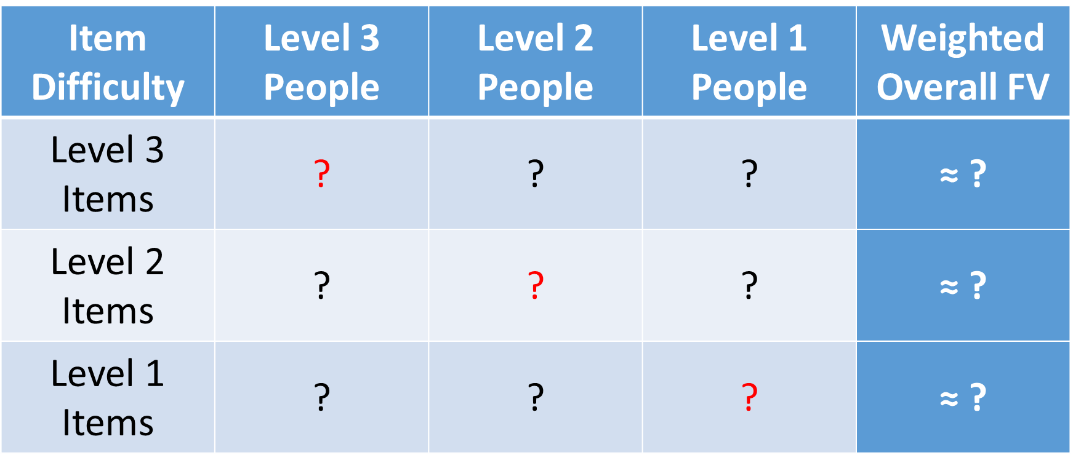
A 10 Question Quiz (for the receptive skills) 10. What Facility Values should STANAG 6001 test items have?
What do you absolutely need to know BEFORE you can fill in the expected values…
a.) in the light blue cells?
Which test takers had a known ability level of 3, of 2, and of 1 .
b.) in the “Weighted Overall FV”
column?
The number of test takers used to calculate the FV at each ability level. (The overall FV is a weighted average of the row values, not a simple average of row values. Note that the example above had an equal number of test takers at each level.)

Slide 33
Enter notes about your new insights here.

