Slide 1
Closing Remarks
Peggy Garza
Associate BILC Secretary

Slide 2
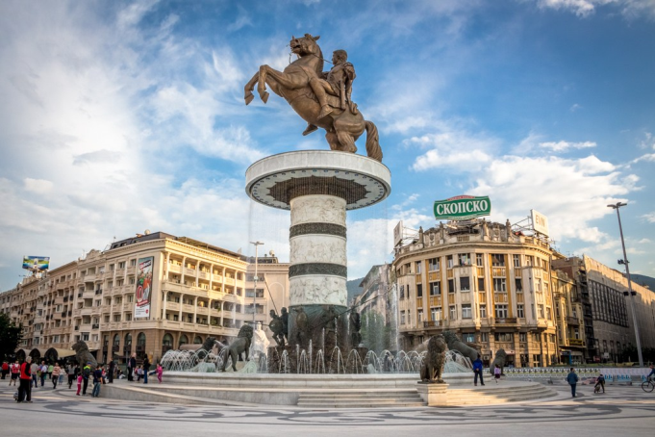
Testing Workshop
Dates: 5-7 September 2017
Location: Skopje, Macedonia
Topic: Setting the Stage for Tester Success
Activities:
Host nation events
Tour of Skopje, museum
Dinner

Slide 3
26 Nations + 1 NATO HQ Represented
Albania
Austria
Azerbaijan
Bosnia-Herzegovina
Bulgaria
Canada
Croatia
Denmark
Estonia
France
Georgia
Germany
Kosovo
Latvia
Lithuania
Macedonia
Mongolia
Netherlands
Poland
Portugal
SHAPE
Slovakia
Slovenia
Spain
Sweden
Ukraine
USA

Slide 4
Accomplishments
8 presentations + host nation presentation
Workshop activities
Job descriptions for testers
Training plans for new testers
Norming and renorming testers
Best practices in STANAG 6001 testing
3 panels with national representatives
Hot Topic Discussions

Slide 5
Special Thanks to the Hosts
ви благодарам

