Slide 1
Lessons Learnt from Designing and Delivering a Technical Engineering Course.

Slide 2

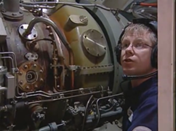
Need to design a Maritime Engineering Course
Royal Navy requested a English Language Course for UK/ French Engineering exchange programme
Military language; Jargon, abbreviations, acronyms…
Jackspeak – sailor slang
The maritime engineering environment

Slide 3

What doesn’t work? – Ferris Bueller

Slide 4
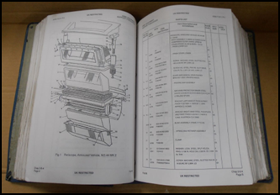
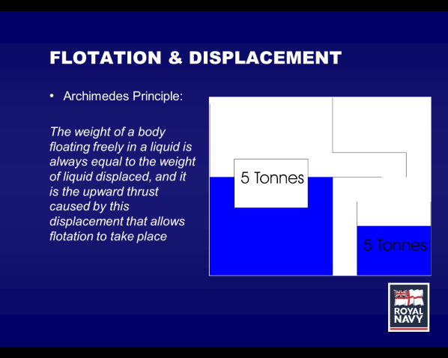
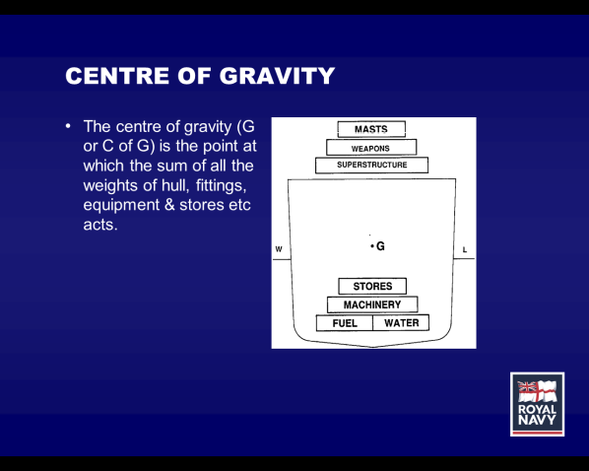
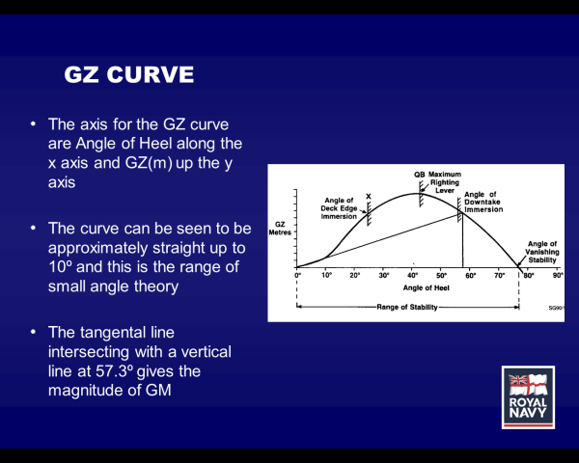
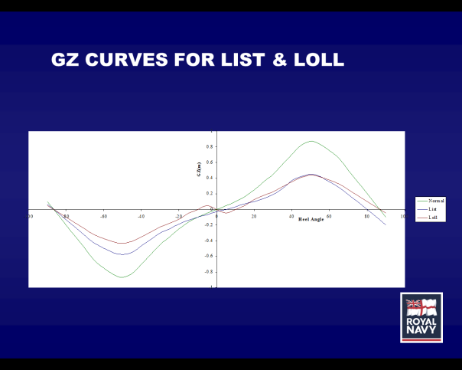
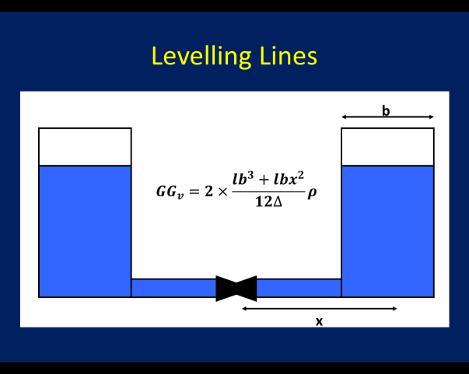
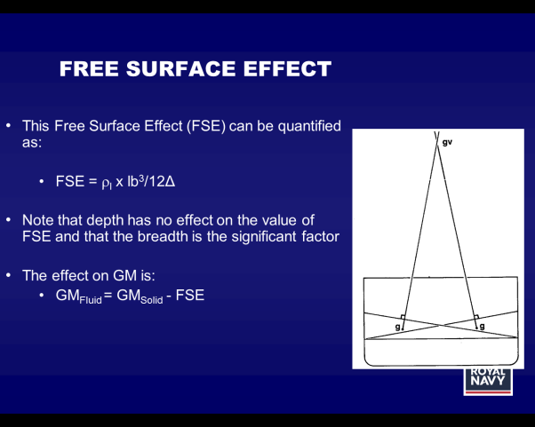
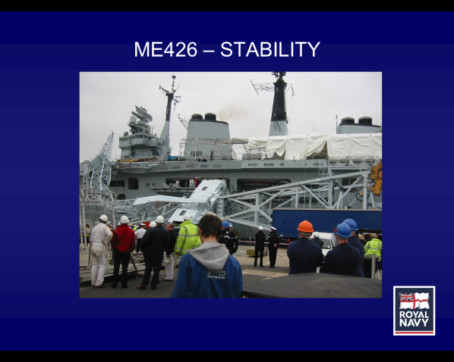
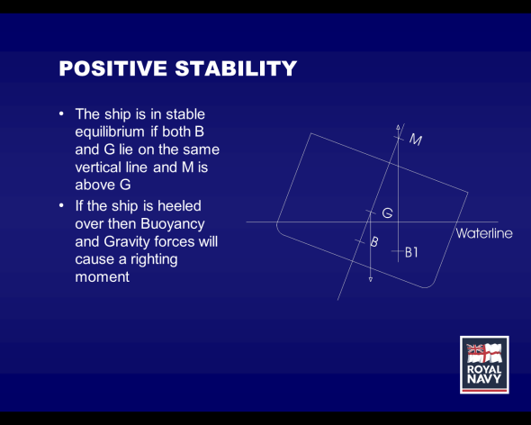
We would never do that… or would we?
Here is a technical manual –
teach them this…
They need to know every engineering term in the RN + every possible variation
Course materials challenging to native speakers

Slide 6
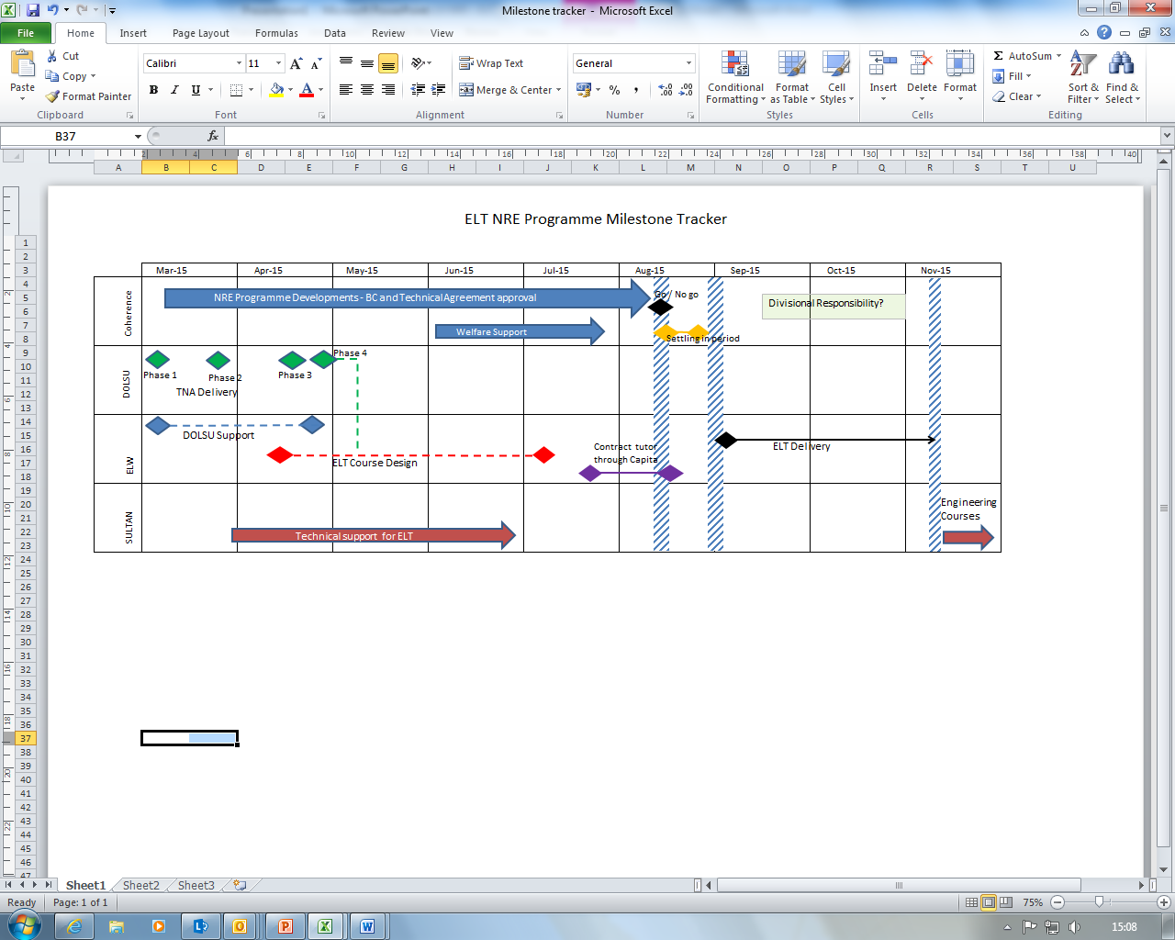
Milestone Tracker

Slide 7
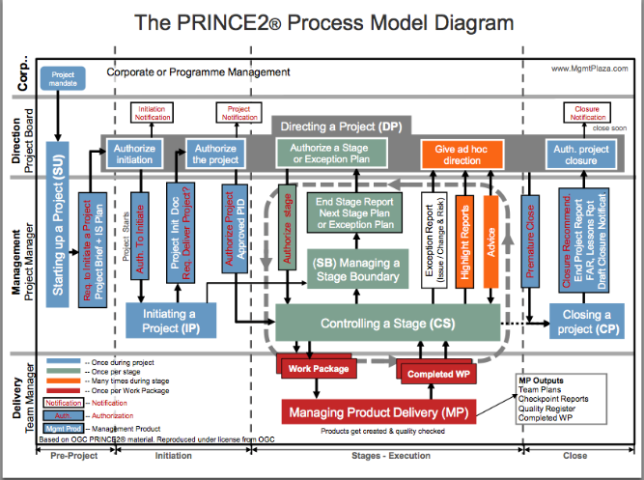


A bit of trial and error
tasting and testing
Budget for the cake
Workout what you have in stock and what you have to buy
My mum’s 60th Birthday
Plan to bake a cake
Deliver the cake
sing Happy Birthday
Buy ingredients
Bake the cake

Slide 8
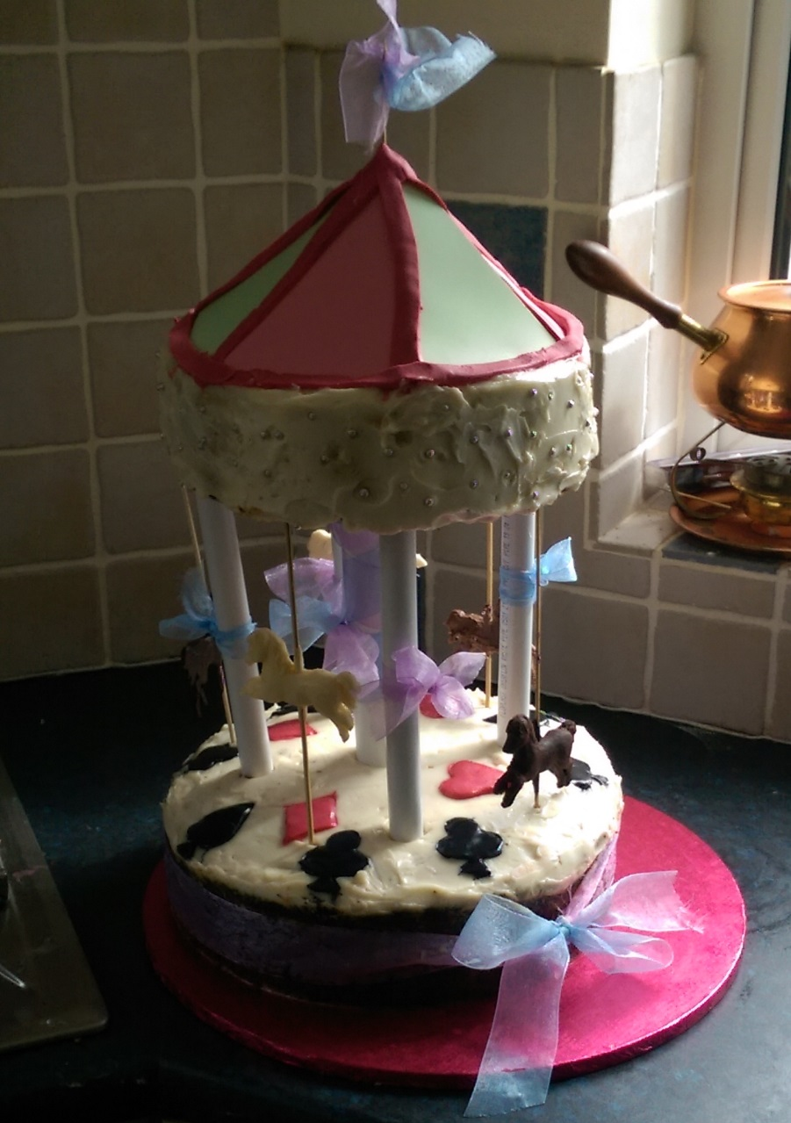
Project Management
The end product

Slide 9
Training Needs Analysis (TNA)
Language Course
Linguistic and cultural knowledge
Engineering Knowledge
The Engineer
The TNA has taken the end product of the engineer and reversed the process to develop the language requirements of the course.

Slide 10
Course Requirements
Engineering / technical language
Abbreviations and acronyms
RN terminology
CBRNDC
Jackspeak

Slide 11

Remember Ferris Bueller
Collaboration military / civilian
Immersion in English
Memorable materials
Realistic Examples
Variety of tasks
Clearly relevant to real life
Employ good teachers

Slide 12
Developing course materials
Buying in off the shelf materials
Existing materials
Develop new materials
New Bespoke Course

Slide 14
Jackspeak
The most gash thing about deploying with the Andrew is scrubbing out for the Old Man’s rounds. The dabbers ended up scrubbing the heads and bathrooms which was gash. The problem with scrubbing out the bathrooms is all the stokers kept coming in for a dhobey. The stokers properly flashed up our killick which was a fair one. Our PO told him that was just life in a Blue One.

Slide 15
Abbreviations and acronyms
The MEOOW has asked you to look at the OPDEF in the MMS. It is next to the LPAC, which is near the DG in the MMS. The OOW has informed the MEO on behalf of the CO that the ship needs VA due to the noise coming from either the HPAC or the STP; you should be able to lookup the defect in the BR and IPC. You will need to make an OPDEF Cat.
The MEO believes it may be a LP LO issue, which must be investigated to avoid MARPOL. SOAP needs to be commenced as well as a LPE. OC could be at risk.
You must follow SOPs and wear PPE. Ensure that you use NDE and NDT. Be careful of the COSHH requirements. Treat this scenario as an OMDRM with the ETs.

Slide 16
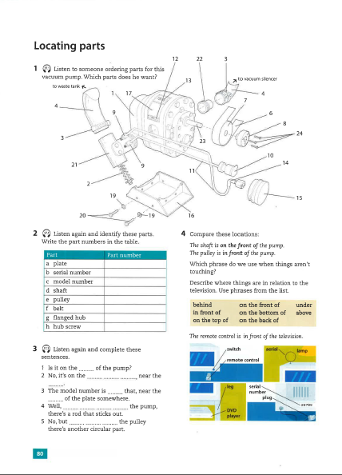
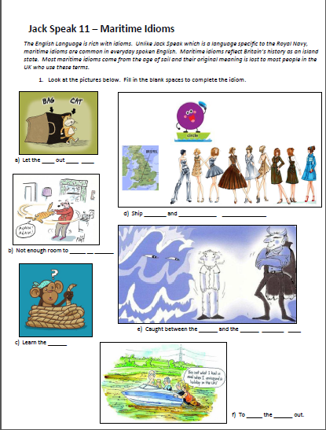
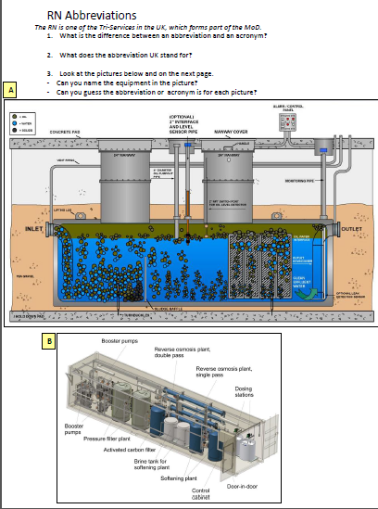
Examples of course material

Slide 17
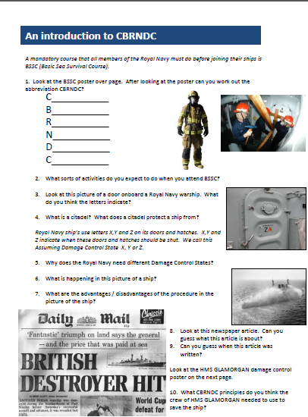
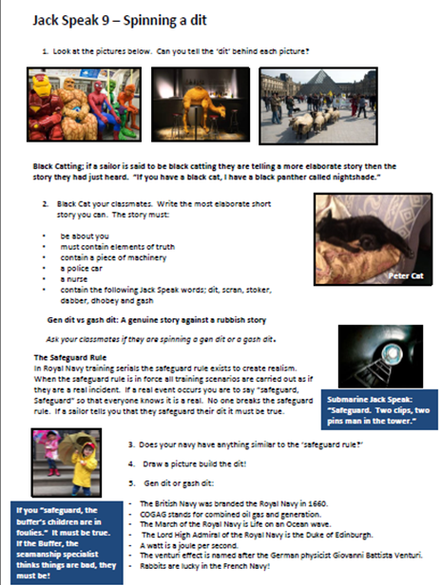
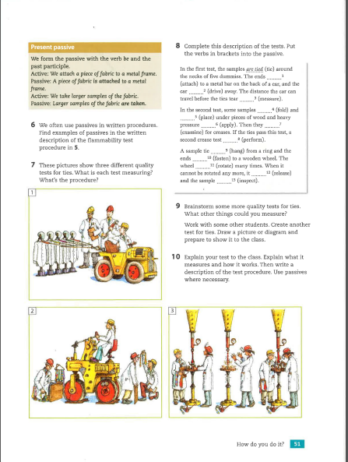
Examples of Course Materials

Slide 18
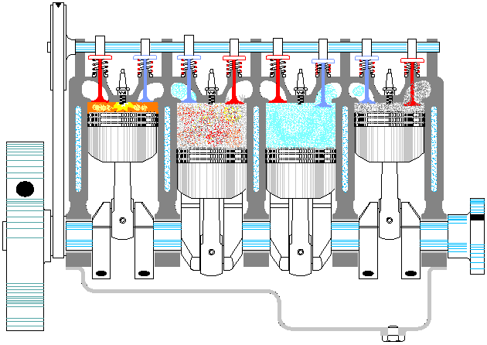
The Internal Combustion Engine

Slide 19
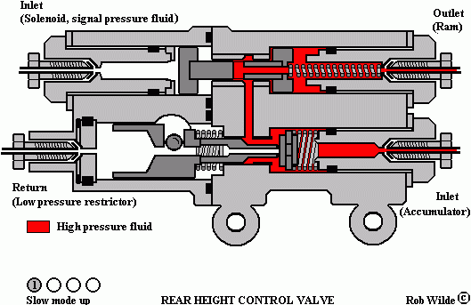
Hydraulic values

Slide 20

X
X
X
X

Slide 21
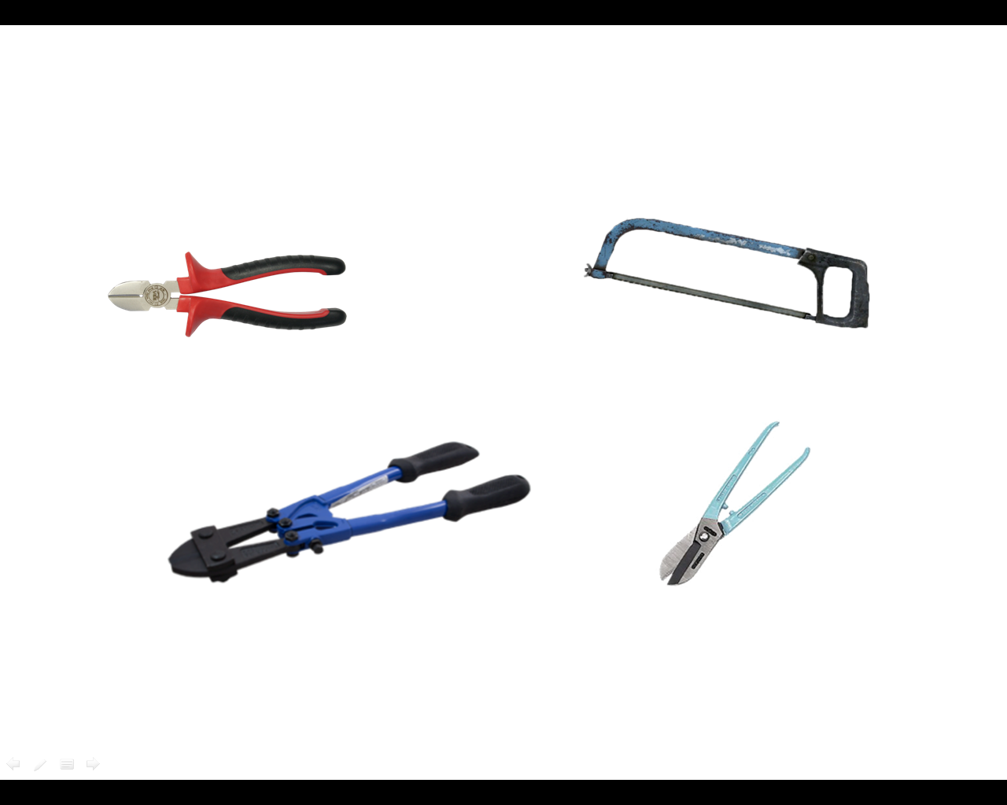
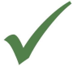

Smart Board Technology
Bolt Cutters
Wire Cutters
Pillars
Hack Saw

Slide 22

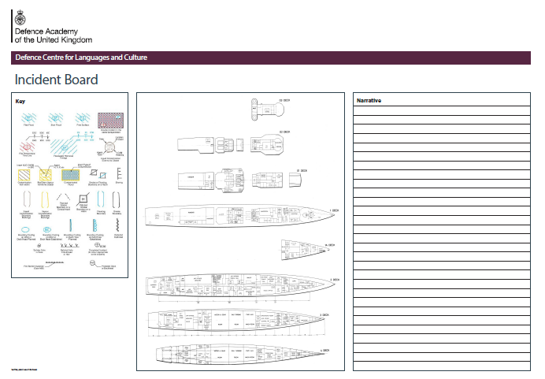
Realistic linguistic usage - Incident Board

Slide 23

Quality assurance
STANAG 6001 Examinations
Bespoke Examination
InVal / ExVal

Slide 24
Requirements for course design
Clear end state ‘concept’
Resources – time, money, expertise, contractor support?…
Project Manager
Research
Evaluation and reflection

Slide 25
Any questions

Slide 26
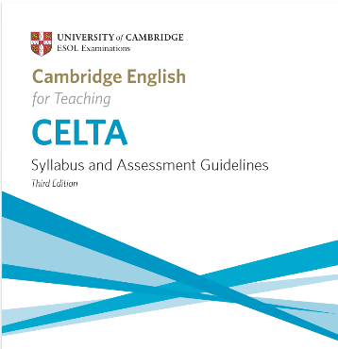
Teacher Training
Train the Trainer (TTT)
CELTA
IELTS 7+
Pre-course material / assessment
Courses 2016 – February, June and November

