Slide 1
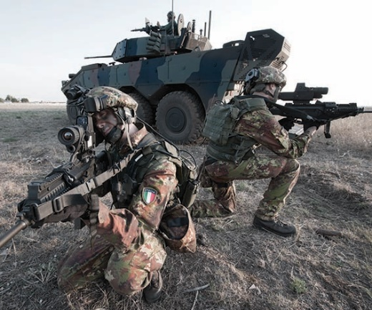
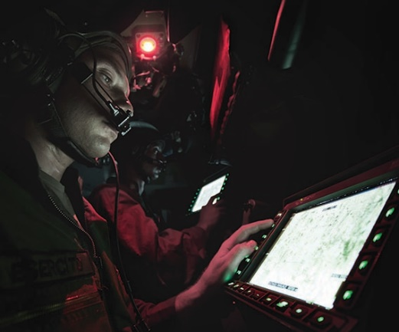
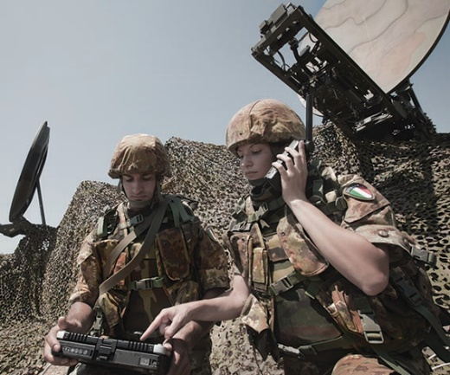
ITALIAN ARMY LANGUAGE SCHOOL
Language Testing Office
LANGUAGE REQUIREMENTS AND TESTING
FOR JTACs
Budapest , october 2016

Slide 2
AGENDA
What is a JTAC
2. What are JTAC requirements / language requirements
JTAC / FAC Training Sequence
JTAC Language Requirements
JTAC/FAC Language Training and Test
Training for the Job
2

Slide 3
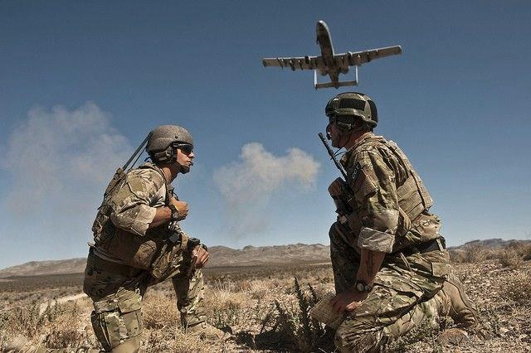
What is a FAC / JTAC ?
Joint Terminal Attack Controller (ATP 3.3.2.2)
A certified/qualified individual who directs the action of aircraft engaged in close air support IAW CAS TTPs and provides terminal attack control.
Joint Terminal Attack Controller (JP 3-09.3)
A qualified (certified) Service member who, from a forward position, directs the action of combat aircraft engaged in close air support and other offensive air operations. A qualified and current joint terminal attack controller will be recognized across the Department of Defense as capable and authorized to perform terminal attack control. Also called JTAC. See also terminal attack control.
Mission Statement : a soldier who from a forward position can deliver joint indirect fires and direct the actions of joint combat aircraft engaged in operations in close proximity to friendly fires
Notes:
What is CAForward Air Controllers
Forward Air Controllers (FAC) are highly trained specialists who provide a vital link between air and ground forces. Their primary role is to communicate with attack aircraft and call in attack runs on targets on the ground. An FAC, or Joint Terminal Attack Controller (JTAC), as they are known is U.S. and NATO circles are trained to call in air support from jets, helicopter gunships and armed drones.
When air power is used to support friendly ground units in contact with the enemy it is known as close air support (CAS). The nature of CAS is such that blue-on-blue or so-called 'friendly fire' incidents are always a risk, as is causing civilian casualties. FACs help to lower those risks by carefully selecting targets to ensure that the right ones are hit. In fact, it was standard operating procedure in Afghanistan that no CAS missions were to be carried out without a FAC on the ground, authorising every step of an engagement.
In 2009, an SBS FAC called in an Apache gunship to take out a Taliban leader travelling by motorcycle.^{[2}

Slide 4
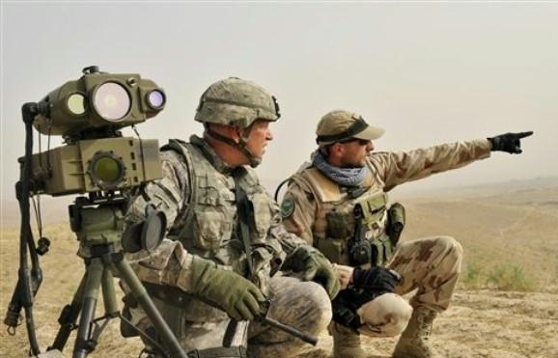
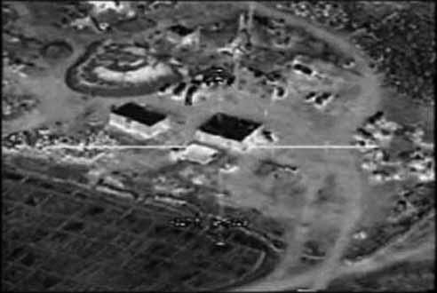
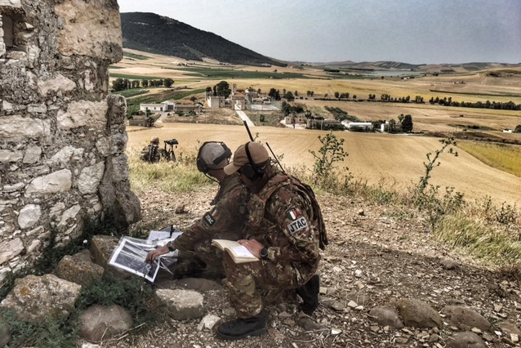
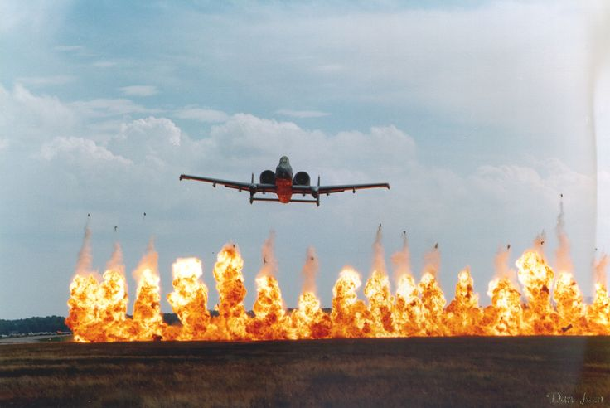
What is a FAC / JTAC ?

Slide 5
Video JTAC in combat

Slide 6
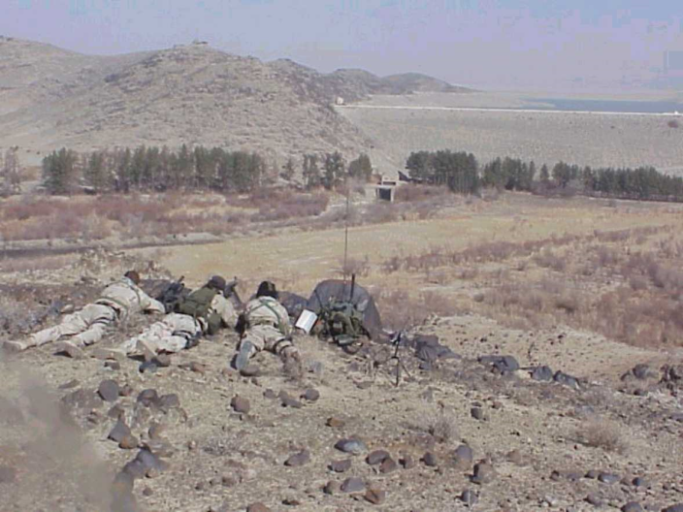
So, just to be inequivocal
So, in sum
THIS is a JTAC
THIS is an ATC
AND

Slide 7
JTAC Requirements /Language requirements - 1
ATP-3.3.2.2 Edition A Version 1
FEBRUARY 2014
English is the language to be used when controlling NATO aircraft. Therefore,
FACs need adequate knowledge of and proficiency in the English language to the
equivalent of NATO STANAG 6001 Level 3. The competency examination should be biased towards military, particularly FAC, terminology.2 LASER Operators (LOs)3 who are required to speak to aircrew will also adhere to this standard.
1 The term “Forward Air Controller” is taken in this document to be synonymous to the USA terms “Terminal Attack Controller” and “Joint Terminal Attack Controller.”
2 The implementation of a national specific “FAC specialized language course,” based on the STANAG 6001 descriptors and requirements (but specifically focused on operational English for FACs), is highly recommended
.
3 The term “Laser Operator” is taken in this document to only pertain to ground based LOs in support of a FAC.
4 National FAC pre-deployment training should be biased towards specific training, theatre oriented academics with particularemphasis on current theatre Special Instructions (SPINS), Rules of Engagement (ROEs), Tactical Directives, SOPs, examples of current operation orders, etc. and practical exercises for all the Tactical Air Control Party (TACP) members. Close coordination with the ground forces and Ground Commander is also recommended.

Slide 8
JTAC Requirements /Language requirements
STANAG 3797 - ATP-3.3.2.2 Edition B Version 1
SEPTEMBER 2016
Qualification requirements are:
a. Successful completion of all qualification METLs as listed in Annex A.
b. Successful completion of all controls, including category and number, per Table
4.3.
c. Possession of a documented English SLP - LSRW of 3.3.3.2 IAW STANAG
6001 when the individual is not a native English speaker.
d. Successful completion of the JTAC evaluation conducted by a JTAC-E IAW para
4.3.4.
Notes:
Nations will certify JTACs in accordance with NATO publications and national
regulations. The instruction must be based on the principles for CAS IAW ATP-3.3.2.1.
Certification requirements are:
a. Successful completion of a nationally approved JTAC training course
b. Successful completion of all METLs per Annex A.
c. Successful completion of all controls IAW Table 4.2. under the instruction of JTAC-Is.
d. Satisfactory completion of the initial JTAC evaluation conducted by a JTAC-E IAW NATO and national requirements. This includes an evaluation against all criteria corresponding to the certification being evaluated as shown in Annex D.
Qualification requirements are:
a. Successful completion of all qualification METLs as listed in Annex A.
b. Successful completion of all controls, including category and number, per Table 4.3.
c. Possession of a documented English SLP - LSRW of 3.3.3.2 IAW STANAG 6001 when the individual is not a native English speaker.1
d. Successful completion of the JTAC evaluation conducted by a JTAC-E IAW para 4.3.4.
In order for the JTAC to retain qualification, all controls (category and number) and METLs per Annex A must remain current. The expiration of
any controls or METL will result in the loss of qualification. The control (category and number) and METLs have a one year (365 days) currency
period. After the first year of qualification the JTAC must remain current for the controls (category and number) and METL in order to be qualified.
The period between controls will not exceed 6 months (180 days) in order to retain qualification.

Slide 9
FAC – JTAC TRAINING SEQUENCE
1. Selection of potential personnel (Army Units)
2. Pre FAC/JTAC Training course at Schools for joint Fires (8 Weeks)
3. Language Course at Army Language School (5 Weeks)
4. FAC/JTAC Training Course at School for Aerial Cooperation (8 Weeks)
Notes:
1 The Selection of potential personnel is carried out within the operational Units of the Army with the assistance of a Certified and Qualified Forward Air Controller
The criteria for the selection are:
Employment in operational Combat / Combat Support Unit
Qualified to be employed abroad (disciplinary)
Language: Ability to achieve SLP 3/3/3/2 at the end of the course (the candidate must have an SLP of 2/2/2/2 or higher)
Physical fitness (Stress). This criterion is important because a JTAC must be able to perform his duty in stressful conditions (heat/cold/phisical exertion etc)
OF / NCO / Enlisted (preferred are NCOs and Enlisted since they guarantee continuity whereas officers are generally posted every few years . For OFs maximum Rank is !st LT)
Security Clearance (NS or higher)
2. Personnel is then sent to the Pre-FAC/JTAC
This pre-course lasts 8 weeks and comprises some 110 Periods of Language Training with teachers provided by the Army Language School (1 Period = 50 minutes)

Slide 10
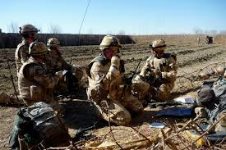
JTAC Requirements /Language requirements
relies mostly on listening comprehension and speaking
prepared primarily to:
· identify and describe targets
· plan, brief, study and describe ingress and egress routes
· orient, direct and guide aircraft as it delivers its ordnance onto the enemy
· describe weather, terrain, vegetation, altitude, enemy/friendly positions, buildings and
other structures, aircraft, obstacles, casualties, injuries, etc.
· confirm and clarify information
· adjust plan and execution of tasks to suit emerging circumstances
· advise when scenarios change as actions unfold.

Slide 11
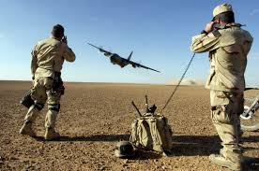
JTAC Requirements /Language requirements
The language he uses must be designed to negate any ambiguity regarding:
· what the target is
· where it is (location/map reading)
· how it will be reached
· what obstacles need to be overcome (weather, visibility, enemy activity, smoke, dust, etc.)
· what changes may have to be put in place as the operation unfolds; and,
most importantly,
· where friendly forces are located and how they are marked.

Slide 12
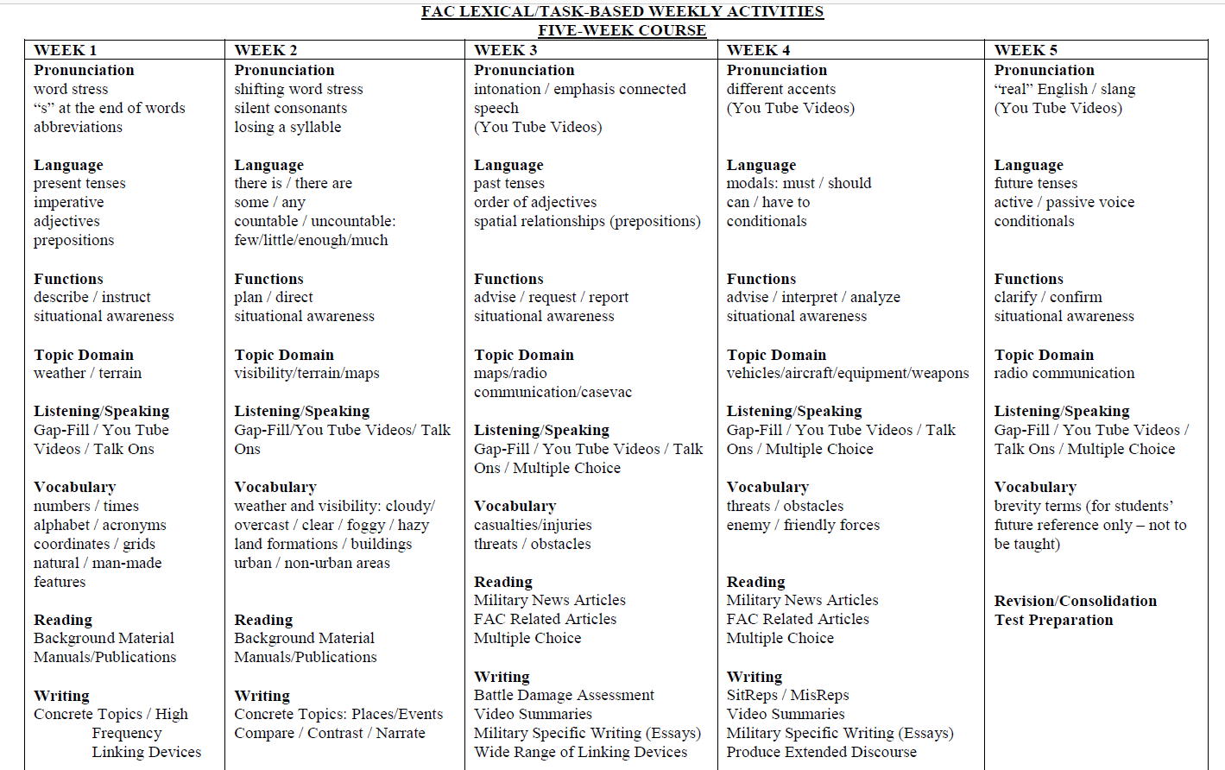
JTAC / FAC Language training and Test

Slide 13
JTAC / FAC Language training and Test
1. Prepared on the basis of a SLP but NOT an SLP
2. Test on 4 abilities L/S/R/W
a. Listening 20 multiple choice questions 10 level 2 and 10 level 3 (30 minutes)
b. speaking 2 X «Talk on» , 15 minutes each
c. Reading 20 multiple choice questions 10 level 2 and 10 level 3 (50 minutes)
d. Writing «Video Summary» (40 minutes)
3. Administered over 2 days (speaking on day 2)
4. Test Supervisors
a. FAC/JTAC Supervisor
b. Language Expert
c. Member of the School
Notes:
a. prova listening
Questa prova è costituita da 20 attivazioni (dieci attivazioni di livello 2 e dieci di livello 3). Ogni domanda è seguita da riposte a scelta multipla con 3 / 4
Opzioni.
▪ Numero di domande: 20
▪ Punteggio: 30 punti (1,5 punti a domanda)
▪ Tempi di somministrazione: 30 minuti circa
. Idoneità: uguale o superiore a 18 punti (12 risposte corrette).
b. prova speaking (“task interattivo”)
In questa prova, che si svolge come una simulazione, vengono utilizzate immagini pre-selezionate (tramite Google Earth o strumento analogo) che
riproducono luoghi autentici e che permettano al candidato di interagire come FAC con un assetto aereo simulato da un pilota CAS / FAC Istruttore o
Supervisore.
Il candidato conduce 2 Talk-On nei quali fornisce una descrizione dettagliata di caratteristiche del terreno, punti cardinali, distanze, unità di misura, oggetti,
colori, dimensioni, forme, movimenti, estensioni verticali, condizioni meteorologiche, ecc. “con prontezza, attendibilità, accuratezza, efficacia e in
Modo comprensibile.”
▪ Numero di prove: 2 (due talk-on)
▪ Punteggio totale: 40 punti (20 punti per ogni talk-on)
▪ Tempi di somministrazione: 30 minuti circa (15’per ogni talk-on)
▪ Idoneità: uguale o superiore a 24 punti (con un minimo di 12 punti per ognitalk-on).
c. prova reading
Questa prova è costituita da 20 attivazioni (dieci attivazioni di livello 2 e dieci di livello 3)
le attivazioni riflettono anche la capacità di comprendere descrizioni, istruzioni, narrazioni e termini specifici relativi, in questo caso, ai contesti operativi di un FAC.
▪ Numero di domande: 20
▪ Punteggio: 20 punti
▪ Tempi di somministrazione: 50 minuti circa
▪ Idoneità: uguale o superiore a 12 punti (12 risposte corrette).
d. prova writing – (Video Summary)
Ai candidati viene chiesto di scrivere un componimento di 150 / 200 parole che riassuma/descriva in modo sequenziale gli eventi/azioni visualizzati in un
video di una durata di circa 3 minuti tratto da una missione/addestramento/esercitazione FAC in un teatro operativo.
▪ Numero di prove: 1
▪ Punteggio: 10 punti
▪ Tempi di somministrazione: 40 minuti
▪ Idoneità: uguale o superiore a 6 punti.

Slide 14
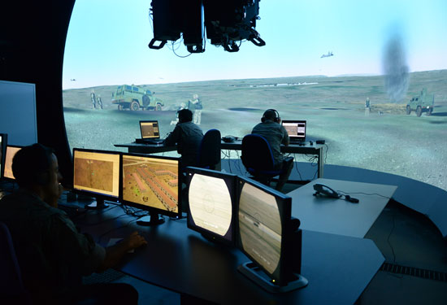
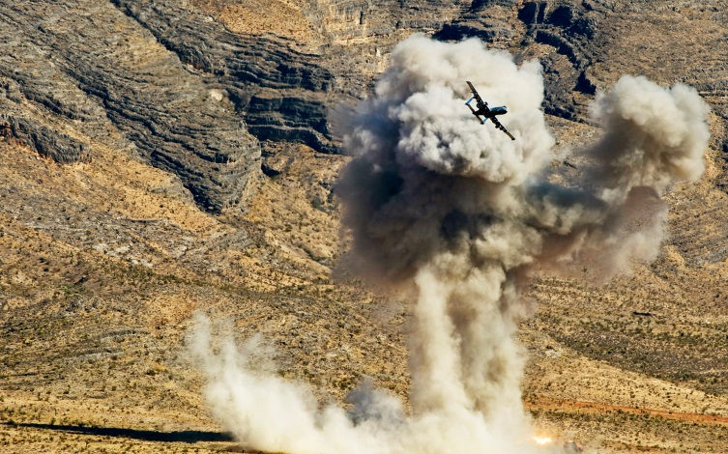
Training for the Job at Joint Air Operations School
10 Week Course at JAOS
Course is in English
75 hours of Lectures and Tests
3 ½ hours of simulator time
17 hours of Live initial /intermediate/final
CAS training
25 minutes of final «Checkride»

Slide 15
Close Air Support
VIDEO CAS

Slide 16
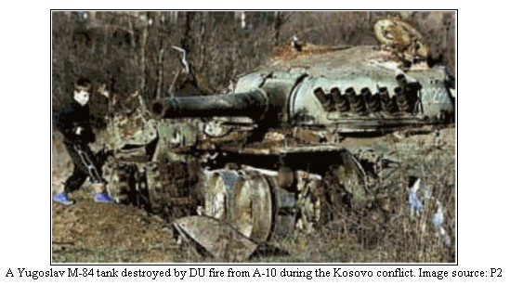
Questions?

