Slide 1
Snap & Spark: Authenticity in the Military Language Classroom
Hege Kristine Skilleås,
Royal Norwegian Naval Academy
Birgitte Grande,
Norwegian Defence University College

Slide 2
«Language is the most complex of human behaviours.»
Clifford (2003)

Slide 3
Authenticity and TLU
The concepts of authenticity and target language use range paramount within specific-purpose language teaching and testing, both in which the language production and assessment will be located within exceedingly particular professional domains.
See, for instance, O’Sullivan (2012)

Slide 4
The classroom dilemma
General Language Proficiency (GLP)/
NATO STANAG 6001
OR
English for Specific Purposes/ English for Military Purposes
… or both?
How can TLU be trained authentically in the military language classroom?

Slide 5
Authenticity is important, because
If the teaching elicits authentic language use, this will allow for inferences to be made, from candidates’ performances to their future performances in real life target language use situations.
See, for instance, Bachmann & Palmer, 1996
Young & Weiyun He, 1998
Lewkowicz, 2000
Hughes, 2003
Fulcher & Davidson, 2007
Notes:
Or the test.
Grave implications for validity argument, should language programmes and tests be perceived as inauthentic by stakeholders.

Slide 6
MA Study, Lancaster University, 2015
Explored teachers’ perceptions about authenticity and target language use; about the balance between GLP and ESP in the military language classroom; and about the role played by subject-matter experts (SMEs)
Triangulated data (survey, questionnaire, interviews)
Sample: 20 instructors, teaching English to armed forces personnel in a Scandinavian country (Denmark, Norway, Sweden)

Slide 7
“I use authentic tasks in order to assess military language production in class.” Blue = I agree Red = I disagree
Notes:
Similarly, 70% of respondents reported that when assessing a student’s language performance in class, they would often imagine that student to be in a hypothetical TLU situation.
70% also agreed that language teachers in the military must know real military TLU situations and what would happen in them in order to create authentic teaching materials and tasks, and in order to be good teachers for this group. 25% of respondents disagreed on this point, however.

Slide 8
What are «authentic tasks»?
Map work
Mission analysis discussion
Briefings, delivery of orders
Describing their job, their unit, their equipment
Debating, convincing somebody of their viewpoint
Presentations
Notes:
* Mentioned by all interviewees

Slide 9
“Assessing military language production is more difficult than assessing general English.” Blue = I agree Red = I’m not sure Green = I disagree

Slide 10
Assessment criteria of authentic military language performance?
Can they master the discrete features (do they use the right words for the right things, and the correct acronyms and abbreviations?
Students’ professional attitude when delivering an oral language performance – «snap & spark» (in the military context not considered construct-irrelevant skills)
«We are looking for two different types of language, two different registers.»

Slide 11
“A GLP course will provide officers with the language skills needed in order to function well in their future postings.” Blue = I agree Red = I’m not sure Green = I disagree

Slide 12
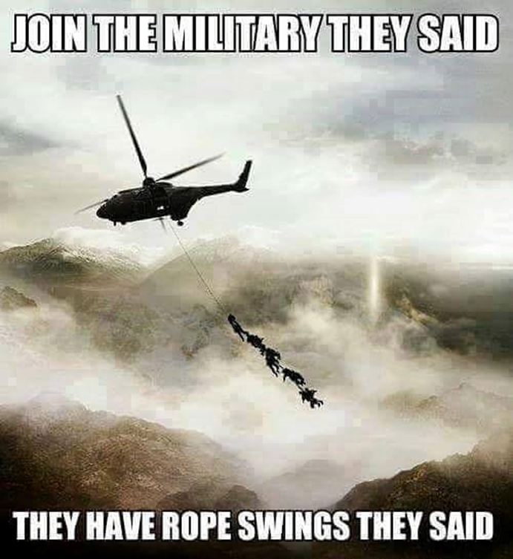

Slide 13
Why is authenticity desirable?
Teachers: authentic tasks provide TLU
Cadets: Relevant tasks fuel motivation
Stakeholders: want «plug-and-play» officers

Slide 14
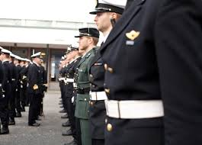
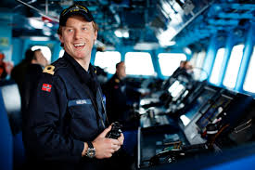
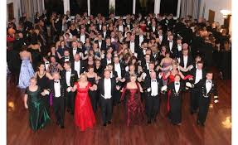
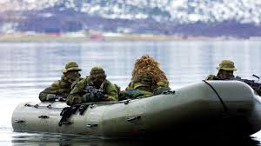
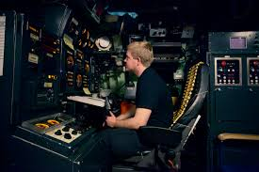
The officer: role flexibility

Slide 15
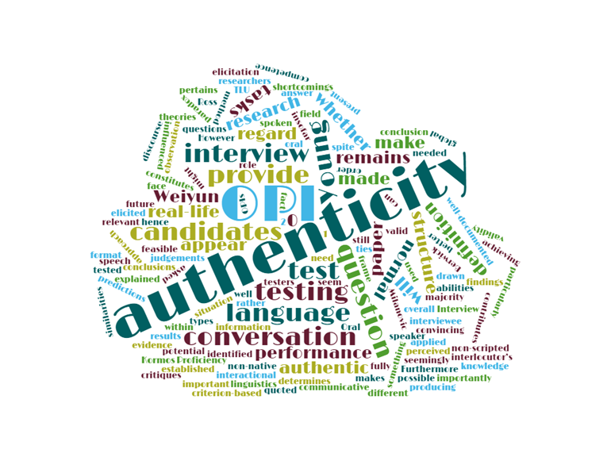
«Operation Harvest»
Changing scenarios:
Anti-piracy in Somalia / Guinea-Bissau UN escort operation / WW2 Battle of Narvik ​/ Northern areas mobilisation
Standard elements, TLU situations:​
Scenario, RoE, available forces​
Mission analysis​ brief
Develop Courses of Action, Decision brief​
Wargaming​
Final plan, 5-para order​
​
Learning outcomes:
L3 language​
Extensive input/output​
Confidence​
Vocabulary – need to use new words immediately​
Knowledge of military terms, procedures, conventions (abbreviations ☺) ​

Slide 17
Navigation simulator: SMCP and problem-solving
Simulator: DataBridge / SeaMap 10 ECDIS (SM10) / Radar (DB10) / Cruise consol / Map desk / Standard bridge equipment such as GPS, log, VHF, binoculars (exact copy of corvette bridge).
Preparation: P.C. van Kluijven’s videos on practical use of VHF + some Standard Maritime Communication Phrases (NATO alphabet, standard phrases).
Scenario: crossing the English Channel (added elements: traffic, nighttime, visibility, currents, accidents, sea states).
Communication: from harbour masters, pilots, agents, and other vessels (roles played by merchant navy captain and navy commander).

Slide 18
Outcome: TLU, decision-making, leadership
“We were astonished at the speed by which students would pick up the correct (initial) VHF phraseology by just listening in on the others, and retaining this information/knowledge throughout every simulator exercise”.
SMCP help control situations, securing and safeguarding ship-to-ship communication. However, the complexity and unexpectedness inherent in seafaring and naval combat means that students will at all times need to deal with chaotic situations.
(Løhre, 2009).

Slide 19
Thank you for your kind attention

